Slide 1
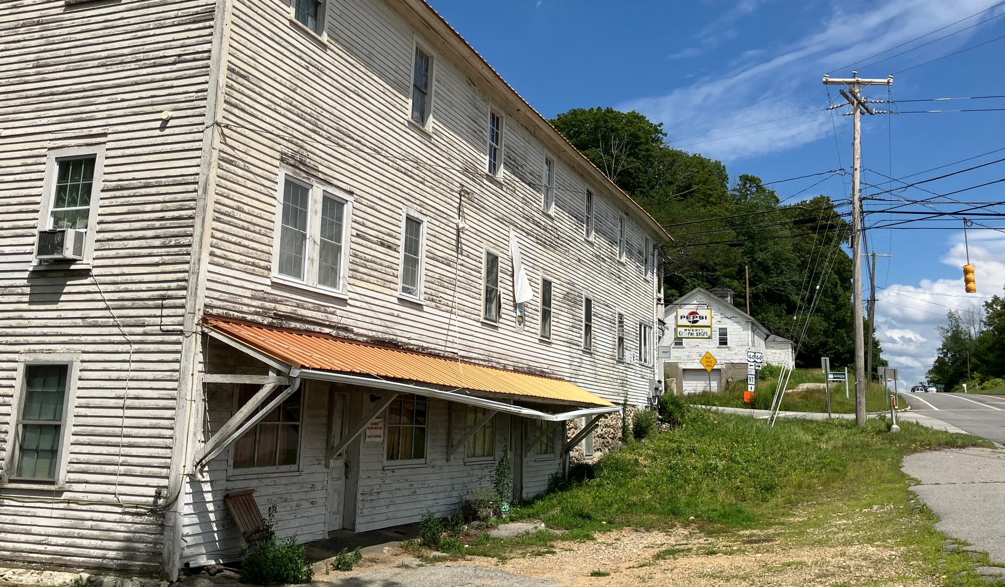

Regulating Nonconforming Buildings, Structure, Uses & Land
A Training Program on Zoning Practices, Legislative & Case Law Requirements
December 15, 2025
A one Hour Couse for Planning Commissions and Zoning Boards of Appeal
Notes:
My Name is Charles Vidich, and I am the senior project manager at the Western Connecticut Council of Governments, and I am joined by Tucker Becket, Senior Planner at WestCOG. Today we will review how nonconformities are regulated by municipalities in Connecticut. This training course reviews the range of approaches taken to protect nonconformities in Connecticut. The training includes the first ever analysis of all nonconforming use regulations in Connecticut. We also review legislative and case law authority for its use. The goal of this presentation is to familiarize you with the legal requirements for regulating nonconforming buildings, structures, use and lots. We will discuss how zoning regulations have taken widely different approaches to the goal of achieving the goal of increasing the conformity of nonconforming uses. As a planning and zoning commission member or member of a zoning board of appeals, you are required to understand how nonconforming buildings and uses are regulated and the legal responsibilities that apply to your decision making.
This one-hour training session fulfills your requirement to receive at least one of the four hours of training relevant to your role as a planning and zoning commission or zoning board of appeals member every four years. If your term is longer than four years, then you must receive the required training during the term of your service on the commission.
The image on this first slide is of a nonconforming commercial building in Putnam built in 1800. It is an important cultural relic in eastern Connecticut.

Slide 2
Overview of Training
Definitions, Case Law & History
Approving Changes to Nonconformities
Scope of Nonconformities in Connecticut
Criteria for Change of Nonconformities
Nonconformities: Exceptions and Expansions
Conformity versus Intent of Property Owner
Notes:
This course provides an overview of the relevant definitions, case law and history of nonconforming uses and buildings in Connecticut. We then review statewide procedures for approving changes to nonconformities. Based on a recent WestCOG study we will review the scope of nonconformities across Connecticut and the criteria use to determine if other uses can substitute for an existing nonconforming use. Then we will review the exceptions to nonconformities and under what circumstances they may be expanded.
We conclude with a review of the rights of the property owners to determine when a nonconformity has been surrendered including relevant case law and state enabling act legislation.

Slide 3

Definitions, Case Law & History
Notes:
Let’s start with examples of definitions used for nonconforming uses, buildings, lots and structures.

Slide 4
Definitions from Weston Zoning Regulations
Nonconforming Buildings: A building that fails to meet one or more dimensional requirements for the required height, setbacks, lot cover, impervious cover or floor area ratio for the zone in which it is located.
Nonconforming Use: A use of a building or of land which does not conform with the use regulations of the district in which it is situated, but which use existed at the time of the adoption, or amendment substantively affecting such use, of these regulations and complied with the Zoning Regulations at the time it was established.
Notes:
Let’s start by reviewing some good examples for definitions of nonconforming buildings and uses from the municipality of Weston. A definition for a nonconforming building is relatively common in Connecticut. A nonconforming building is one that fails to meet one or more of the dimensional requirements of the zoning regulations. It is important to also review the exceptions to dimensional requirements when assessing whether a building is conforming or nonconforming. We will touch on that issue later on.
Nonconforming uses are quite common in Connecticut since we have had more than 300 years of development before the state established zoning as a municipal responsibility in 1925. A gas station in a residential zone or an industrial building in a residential or commercial zone, both of which existed before the enactment of zoning are considered nonconforming uses. However, from a practical perspective, proving when a building or use was first established can be a burden on property owners who may not have sufficient records to document the prior existence of the building or use before zoning was enacted or before subsequent revisions to the regulations.

Slide 5
Definitions from Bethel Zoning Regulations
Nonconforming Related Terms
Nonconforming – A situation or circumstance that does not conform to the applicable sections of these Regulations.
Nonconforming Building – A building that does not conform to these Regulations with respect to size, area, height, setback or other requirement for the zone in which it is situated.
Nonconforming Lot – A lot that does not conform to these Regulations with respect to area, width or other requirement for the zone in which it is situated.
Nonconforming, Pre-existing – A nonconforming situation that predated the adoption of these Regulations or the applicable provision which resulted in the non-conformity.
Nonconforming Use – A use of land or of a building that does not conform to these Regulations for the zone in which it is situated
Notes:
In contrast to Weston, Bethel also provides definitions for nonconforming lots, and pre-existing nonconformities that predate the zoning regulations. Definitions are quite important yet often overlooked in many zoning regulations. Courts rely on definitions to determine the intent behind the regulations on nonconformities. If your commission has not established specific definitions for nonconforming lots, buildings, structures, use and other dimensional requirements, now would be a good time to do so.

Slide 6
Definitions from New Milford Zoning Regulations
Nonconforming Building or Structure: A building or structure legally existing on the effective date of these regulations, which met all requirements of the zoning regulations then in force but does not meet the current requirements of these regulations; or a building or structure legally existing on the effective date of any amendment hereto which caused such building or structure to cease to meet the requirements of these regulations. (Effective: November 1, 2007)
Nonconforming Lot: A parcel of land separately recorded by deed or depicted on a subdivision map approved by the Planning Commission and duly filed in the office of the Town Clerk prior to the effective date of these regulations or any amendments thereto, or any zoning change which fails to meet the area, shape, frontage or any other applicable requirements of these regulations pertaining to lots. (Effective: November 1, 2007)
Nonconforming Use: A use of land, which does not conform to the regulations of the use district in which it is, located and which was a lawful use at the time these regulations or any amendments thereto became effective.
Notes:
Unlike the previous definitions found in Weston and Bethel. New Milford addresses nonconforming structures. This is an important addition to definitions since the Connecticut Zoning enabling Act specifies the types of structures that are considered eligible for nonconforming status unless a municipality established its own definitions.

Slide 7
Definitions on Changes to Nonconforming Use
Intensification generally refers to an increase in the degree or volume of an existing nonconforming use, as long as it remains consistent with the original nature and purpose of the use. This could involve doing "more of the same," such as handling more customers or operating for longer hours within the same established season. .
Expansion involves a qualitative change in the nature or purpose of the nonconforming use, or an increase in area or time devoted to the use. This is generally disallowed under Connecticut law. Examples of expansion include adding winter operations to a historically seasonal business, constructing new buildings beyond the original footprint, or converting a seasonal use into a year-round operation. .
Notes:
Few if an municipalities have adopted definitions for the intensification or expansion of a nonconforming use. The difference between intensification and expansion of a nonconforming use is case specific and is determined by how any given zoning regulation decides to establish boundaries on the extent to which a nonconforming use may be physically enlarged, or expanded in terms of work hours, employment, seasonal versus year-round operation and many other factors. What is conforming in one town may be nonconforming in another. The Connecticut legislature has left a great deal of discretion to zoning commissions to determine what is conforming versus nonconforming – as we shall discuss in this training session.

Slide 8
Examples of Expanding Nonconforming Use
Enlarging building or footprint where the nonconforming use is housed.
Extending use to additional buildings or land on the property that were not previously part of the nonconforming use.
Increasing the site area or floor area occupied by nonconforming use.
Increasing the number of structures or size of any structure housing the nonconforming use.
Increasing amount, volume, or intensity of a nonconforming business use.
Notes:
Here are five examples of expanded nonconforming uses. Increasing the building footprint, the number or size of the nonconforming structures are potential examples of inappropriate expansion of nonconforming uses. The Connecticut Supreme Court has ruled on several expansions of nonconforming uses. There are no hard and fast rules for determining if an expansion exists since zoning regulations across Connecticut vary widely in their definitions and constraints on nonconforming uses and buildings.

Slide 9
Examples of Intensified Nonconforming Use
A manufacturing plant that predates zoning changes allows it to continue operating in a residential zone. If the plant increases its production volume or operates more hours per day within the existing building, it's considered an intensification.
An increase in the volume of business or number of customers or longer operating hours within the same season.
Notes:
Generally speaking, a nonconforming use can intensify its activities, such as increasing the number of its customers or volume of business without resulting in an expansion of the nonconformity. However, the Supreme court has ruled that expanding a business from a seasonal to a year-round operation constitutes an expansion – not an intensification of the use. While Connecticut’s zoning regulations do not define expansion or intensification these terms should be included in the definition section of the regulations. The advantage of this approach is that it provides transparent standards that property owners can use to better understand their property rights.

Slide 10

Case Law on Changing Nonconforming Uses
In Zachs v. Zoning Board of Appeals (1991), the CT Supreme Court outlined a three-part test to determine permissible changes to nonconforming uses, considering:
The extent to which the current use reflects the nature and purpose of the original use.
Any differences in the character, nature, and kind of use involved.
Any substantial difference in the effect upon the neighborhood resulting from differences in the activities conducted on the property.
Notes:
While the goal of zoning is to eliminate nonconformities to the greatest extent possible, from a practical matter, most zoning commissions have recognized the need for more nuanced approaches to regulating changes of one nonconforming use to another nonconforming use that is of equal or less neighborhood impact than the existing use.
The Connecticut Supreme Court has established a three-fold test determine whether a change one nonconforming use to another is acceptable. We would encourage you to read the decision in Zachs v. Zoning Board of Appeals and apply its principles to customized special permit review procedures for nonconforming uses.

Slide 11

Case Law on Changing Nonconforming Uses
In High Watch Recovery Center, Inc. v. Planning & Zoning Commission (2025), the Connecticut Supreme Court concluded that extending a seasonal nonconforming use into a year-round operation constituted an impermissible expansion, even if the new structure was otherwise permitted in the zone.
The central question is whether the proposed change alters the fundamental nature, character, and kind of the original nonconforming use, or significantly impacts the surrounding neighborhood.
Notes:
As mentioned earlier, the Connecticut Supreme Court recently ruled that extending seasonal uses to year-round uses constitutes an impermissible expansion of a nonconforming use. The court suggested that the fundamental nature of the use was changed from the original nonconforming use and would have greater impacts on the neighborhood. While the court’s decision was fact based and specific to a proposed development in Kent, Connecticut, it reveals that dramatic changes in activities – seasonal to year-round use – are not consistent with the limitations imposed on nonconforming uses in Connecticut.

Slide 12
Connecticut Case Law & Laws Bearing on Nonconforming Uses & Buildings
1925
Legislature establishes Zoning Enabling Act
CT Supreme Court holds owner’s property rights not lost by NC registration
PA 91-199 expands 3- year violation without enforcement on lot line violation
1991
CT Supreme Court upholds uniformity rule in Mackenzie v. Monroe PZC
2013
PA 13-9 Property owner bears burden of proving non-conformity exists
2017
PA 17-39 declares property owner determines when Bldg. is discontinued
PA 61-569 eliminates rule that nonconform building can’t be rebuilt
1991
2025
WestCOG releases analysis of zoning practices impacting NC Uses.
1971
PA 71-388 Declares 3- year violation without enforcement becomes a non-conform
PA 77-509 requires conformity with zoning to get a building permit
1967
PA 67-896 Declares 5 year violation without enforcement become a non-conform
1989
PA 89-277 ensures NC use not terminated without property owner intent
1997
Public Act 97-296 exempts industries with years of operation as valid NC
2024
CT Supreme Court rules 4 types of NC uses must evaluated on its own merits
1961
1981
1977
CT Supreme Court identifies criteria for NC use expansion v. intensified
2013
Notes:
The Connecticut legislature authorized the use of zoning since 1925. In 1961 the state legislature eliminated requirements that prevented nonconforming building from being rebuilt. Yet despite that important legislation, many zoning commissions have continued to adopt regulations that directly or indirectly aim to eliminate their reconstruction. In 1967 the legislature declared that if a building was in violation of zoning for 5 years without enforcement it was defacto a nonconforming use. Four years later, in 1971 the law was changed so that it would take only three years before non-enforcement of existing violation created a “get out of jail” card to make the use nonconforming. In 1977 the legislature required building permits to be issued only after determining the development conforms with the zoning regulations. In 1981, the CT Supreme Court upheld the rights of property owner over what was overly ambitious program for registering nonconforming properties in the Noank Fire District.
In 1989, the state legislature made it clear that only the property owner can determine if their property should be terminated. In 1991, the CT Supreme Court has established its test of whether a change to a nonconforming use is an intensification or expansion of the existing use. In 2013 the Court once again established an important rule in the Mackenzie decision that requires uniformity of regulations within any given zoning district. In that same year, the legislature placed the burden on the property owner to determine the nonconformity status of their property. In 2017 the legislature, expanded the property rights of nonconforming uses and buildings by declaring only they can voluntarily surrender that right.

Slide 13
Approving Changes to Nonconformities
Notes:
Many may believe that nonconforming buildings cannot be altered. Well, that is a myth. In Connecticut, nonconforming buildings and uses are to be protected but not necessarily expanded – except as we will now discuss.

Slide 14
Approving a Change of Nonconforming Use to Another Nonconforming Use: 2025
Permit Procedure | No Zoning | Allow Change of Nonconforming Use to Other Similar Nonconforming Use |  | Grand Total
 |  | No | Yes
Special Permit |  |  | 56 | 56
By Applicable Permit Procedure |  |  | 25 | 25
Variance |  |  | 16 | 16
Special Exception |  |  | 15 | 15
Site Plan |  |  | 3 | 3
Zoning Permit |  |  | 2 | 2
Site Plan & Special Permit |  |  | 1 | 1
Site Plan & Special Exception |  |  | 1 | 1
Not Allowed | 2 | 48 |  | 50
Grand Total | 2 | 48 | 119 | 169
Source: WestCOG staff analysis of municipal zoning regulations, June 2025. This analysis excludes eight political subdivisions in Litchfield (Bantam), Killingly (Danielson), Old Saybrook (Fenwick), Groton (Gorton City, Groton Long Point & Noank Fire District), Griswold (Jewett City), Newtown (Borough of Newtown), and Stonington (Borough of Stonington)
Notes:
What is surprising from our analysis of Connecticut’s nonconforming use and building regulations is that 48 municipalities do not allow a change of a nonconforming use to another one. In contrast 119 municipalities allow for a change of one nonconforming use to another one of same or lesser impact. The overwhelming majority (73) allow for this approach through the special permit procedure, also called special exception. In addition, 25 municipalities do not specify the permit procedure, leaving it to the commission to decide on a case- by-case basis what type of permit is most appropriate. The wide range of approaches taken, clearly reveals the lack of statewide standards for managing nonconforming uses in Connecticut.

Slide 15
Scope of Nonconformities in Connecticut: 100 Years of Zoning Revisions
Permutations for the 4 Basic Nonconformity Types
Building
Lot
Use
Structure
Building & Lot
Lot & Use
Building & Use
Building & Structure
Building, Lot, Use & Structure
Use & Building
Lot & Structure
Lot, Structure and Use
Building, Lot and Use
Lot Structure and Building
Building, Structure and Use
Notes:
According to the law of combinations, the greater the number of items that are considered nonconformities, the greater the number of potential combinations that may exist. For example, almost of Connecticut’s municipalities have explicitly established four basic nonconforming types: Buildings, lots, uses and structures. This table reveals the number of different ways multiple nonconformities can exist simultaneously – making the work of the zoning commission or zoning boards of appeal more challenging in navigating the distinct restrictions each type of nonconformity creates. There are 15 potential scenarios for these four types of nonconformities. In municipalities that have included signage, parking spaces or performance standards as additional areas for regulating nonconformities, the number of potential permutations expand rapidly. For example, if your commission has five different nonconformities then the potential combination is 31; with 6 nonconformities there 63 combinations and with 7 types of nonconformities there are 127 potential combinations. Each must be evaluated separately according to CT case law.

Slide 16
World of Accessory Structures: The Challenge of Managing Potential Nonconformities
Mobile Accessories | Recreational Accessories | Entertainment Accessories | Functional Accessories | Pet Accessories
Recreation vehicle | Playhouses | Covered Deck | Handicapped ramps | Dog houses
Tractor Trailers | Badminton | Fire pit | Utility sheds | Chicken Coops
Motorcycles | Tennis Courts | Porches | Propane Tanks | Rabbit cages
Four wheelers | Basketball Hoop | Gazebo | Emergency Generator | Bird Feeders
Farm Tractors | Bocce Courts | Pagoda | Ground based solar | Aviaries
Lawn mowers | Storage Bins | Terraces | Wind Energy Devices | Animal barn
Bicycles | Swimming pools | Gardens | Drone Landing site | Horse stable
Notes:
Connecticut’s zoning enabling act lists specific accessory strictures when a municipality has not identified their own list. The number of accessory structures that exist across Connecticut is vast. This table provides a short list of the most common ones found in the nonconforming structure regulations across Connecticut. The advantage of identifying your own accessory structure regulations is that Connecticut courts rely on municipal definitions as their first line of inquiry in determining if an accessory structure is exempted from setback standards, has its own unique setback standards or is subject to generic setbacks applicable to the buildings on the lot. Managing accessory structures and their siting on any given lot takes planning and consideration of the rights of property owners and their neighbors.

Slide 17
Criteria for Change of Nonconformities
Notes:
The goal of the state’s zoning regulations is to allow those who own nonconforming buildings or nonconforming uses to continue as long as they do not expand their nonconformity. How that is done has consumed zoning commissions for the last fifty years. We will now review the criteria that have been developed over time through practice and case law to achieve that objective.

Slide 18
Nonconforming Use Regulations: Flexibility versus Conformity
Zoning Approaches for Regulating Nonconforming Uses | Number
No Change allowed to Nonconforming Use | 48
Change Nonconforming Use: 1 Factor | 67
Change Nonconforming Use: Multi-Factor | 52
Total Municipalities | 167
Notes:
As we discussed, earlier 119 municipalities allow a change of one nonconforming use to another one that is the same or less impactful that the current use. What is interesting is that 67 municipalities make that decision on one variable – whether the proposed new use is less objectionable or less impactful than the existing use. This approach lacks specificity or criteria for the evaluation of how impacts will affect the neighborhood or the environment. Those using this approach are operating with criteria that are not only inconsistent with Connecticut case law but with insufficient factors for determining the acceptability of the proposed new use.
In contrast, 52 municipalities use two or more evaluation criteria to determine whether a proposed new nonconforming use that replaces the existing one will achieve the goals of ensuring the current use reflects the nature and purpose of the original use. Multifactor analysis also allows for a more nuanced review of any differences in the character, nature, and kind of use involved compared to the original use and any substantial difference in the effect upon the neighborhood resulting from differences in the activities conducted on the property

Slide 19
Flexible Approaches to Nonconforming Uses
Today 71% of Connecticut’s Zoning Regulations Allow for a change of one nonconforming use to another less nonconforming use.
Yet there is room for improvement: decision making criteria range from primitive to sophisticated.
A 1979 Connecticut Supreme Court decision allowed a change of one nonconforming use to another. Avoids inadvertent takings of property without compensation.
(Point O’Woods Association, Inc. v Old Lyme Zoning Board of Appeals. 178 Conn 364 (1979)
Notes:
In 1979 the Connecticut Supreme Court allowed for a change of one nonconforming use to another. In part, that decision aimed to avoid the inadvertent taking of property without compensation. Zoning commission must be mindful of the property rights of those owning nonconforming uses or buildings to avoid unconstitutional takings of property without compensation. The Point O’Woods case is the seminal example of how Connecticut Courts have gradually focused on the rights of the property owners.

Slide 20
Evaluation Criteria if a Proposed Nonconforming Use Replaces an Existing Nonconforming Use When only one Decision-making Criteria Exists
Criteria to compare a proposed to existing nonconforming use | Municipalities
No more Objectionable | 17
Less Nonconforming | 13
Proposed use equally or more appropriate | 12
Substantially the same in Nature in Purpose | 8
Special Permit conditions apply | 6
New Use is less Intense or less Impacting | 4
No greater neighborhood impact | 3
Building designed for such use | 1
Use Can't be Prohibited | 1
Proposed use limited to a use permitted in district | 1
No criteria listed | 1
Grand Total | 67
Notes:
Now let’s look the one factor criteria used by 67 municipalities that rely on one phrase to determine the fate of a property owner wishing to sell his or her property to another nonconforming use that has the same or less impacts as the current use. The phrases, “no more objectionable” or “less nonconforming” or “proposed use equally or more appropriate” account for 63% of the terms used to determine if a change of use is appropriate.
The disadvantage of this one factor approach is the lack of transparency in the decision-making process for property owners and the lack of substantive guidance to commissions and/or ZBAs when deciding on an application.

Slide 21
Evaluation Criteria: Nonconforming Use Replaces an Existing Nonconforming Use When Multi Factor Decision-making Criteria Exist: 52 Municipalities
Comparison Criteria | Frequency | Comparison Criteria | Frequency
Is the use suitable for the neighborhood? | 29 | Consistent with uses in zone or other zone? | 5
Are there no greater traffic impacts? | 22 | Is there a change in the intensity of use? | 5
No greater parking or loading requirements? | 20 | Is the building designed for the use? | 4
What are impacts on property & property values? | 17 | Consistent with ones excluded from zone? | 3
What are the proposed hours of operation? | 16 | Is it a less objectionable use? | 3
Protects public health, safety & general welfare? | 13 | Are there noise & lighting impacts? | 3
Is it a less nonconforming use? | 12 | Must the applicant abandon prior use? | 2
Is exterior appearance of the building changed? | 11 | Are there noise impacts? | 2
Is the proposed use equally or more appropriate? | 8 | Is use subject to special permit conditions? | 2
Does proposal involve no greater building size? | 8 | Is the use subject to site plan approval? | 2
Consistent with nature & purpose of existing use? | 8 | Are there noise and vibration impacts? | 2
Environmental impacts (floods, pollution, buffer)? | 6 | Proposed use involves outside activities? | 1
Consistent with orderly neighborhood development? | 6 | How many proposed uses are permitted? | 1
Impacts from more employees, residents or customers? | 5 | Consistent with Plan of Conservation & Development? | 1
 |  | Total (28 decision making criteria) | 217
Notes:
In contrast to the one factor approach, 52 municipalities have developed a range of evaluation criteria to determine if it makes sense to change one nonconforming use to another less impactful. On average municipalities that have adopted a more thorough review procedure have adopted 4 decision criteria. The top five on the list across Connecticut are 1) the suitability of the new use in the neighborhood, 2) the traffic impacts that it might generate – especially if they are greater, 3) the parking and loading requirements – especially if they are greater, 4) impacts on property values in the immediate area and 5) the hours of operation. These five criteria account for 48% of all multi-factor decision making criteria in Connecticut.

Slide 22

Nonconforming Uses May be Changed
Approving a change to a new Nonconforming Use
New Use must not enlarge or extend nonconforming use.
Zoning Regulations must provide for this liberal approach to maintaining a nonconforming use in lieu of requiring abandonment.
Point O’Woods Association, Inc. v Old Lyme Zoning Board of Appeals. 178 Conn 364 (1979), CT Supreme Court
Case involved conversion of a two unit building with a general store on the first floor and a 900 square foot apartment on second floor to a two-apartment building.
Notes:
The ability to change one nonconforming use to another was upheld in the case of Point O’Woods, Inc. v. Old Lyme Zoning Board of Appeals. This seminal case allows changing one nonconforming use to another provided the new use was less impactful than the original use. This case also underscored the importance of protecting the property rights of nonconforming properties and uses.

Slide 23
Nonconformities: Exceptions & Expansions
Notes:
It is not possible to discuss nonconformities without also addressing the range of exceptions and expansions to these uses across Connecticut.

Slide 24
Dangers of Excessive Focus on Ceasing Operations, Abandonment, or Discontinuance
Dealing with Widespread Existence of Nonconforming uses, buildings
327,771 dwelling units in Connecticut built before 1940
Most built before Zoning was adopted
Zoning as a tool to Maintain Culturally Important Urban & Suburban Development –even if nonconforming
Small lot developments in Lake Districts
Nonconforming yards in Village Districts
Pre-World War II non-sewered small lot subdivisions
Industrial uses in residence zones
Gas stations in public water supply watersheds
Nonconforming buildings integral to town character predating zoning
Nonconforming parking spaces in town center
Notes:
In the las twenty years there has been an increased focus on protecting nonconforming uses and properties. Connecticut has one of the oldest housing stock in the nation – representing about 22% of all the state’s housing in 2020. The state’s older housing, in many cases may also be some of its most affordable housing and for this reason, protecting nonconforming buildings from discontinuance has important impacts on the availability of low-cost housing.
There are dozens of lake districts in Connecticut where small lots preceded the adoption of zoning. Similarly, there are dozens of small lot zones across Connecticut that have been upzoned so that property owners no longer have the freedom to add on to their house either horizontally or vertically due to overly restrictive rules on the expansion of these lots.
Similar challenges exists for industrial or commercial developments located in public water supply watersheds or for businesses located in cramped village centers with inadequate parking.
In all these cases, numerous municipalities have come to realize that nonconforming uses are not necessarily liabilities for the community but may be essential elements of their character and culture,

Slide 25
26 Municipalities Address Need for Flexible Approaches to Nonconforming Lots
Flexible Approaches for Nonconforming Lots | Municipalities
Nonconforming lot exception for all setbacks | 6
Nonconforming lot setback exceptions by lot size | 6
Nonconforming lot exception for rear/side setbacks | 3
Nonconforming lot frontage setback exceptions | 3
Nonconforming lot setback exceptions by Zone | 3
Nonconforming lot setback exceptions by lot width | 2
Nonconforming lot Buildable Area exception | 1
Nonconforming lot exception for side yard setbacks | 1
Nonconforming lot reduced groundcover | 1
Grand Total | 26
Notes:
Flexibility is needed with nonconforming uses and twenty- six municipalities have recognized that need by creating exceptions to dimensional standards that are unique to nonconforming uses. This remarkable approach is attracting attention as homeowners seek to expand smaller homes to meet the needs of a growing family or to add a necessary accessory structure integral to their lifestyle.

Slide 26
Columbia CT Exceptions for Primary or Accessory Structure or Addition of an Accessory Structure for Nonconforming Lots
Residential Structures on Nonconforming Lots in a Residential District with lots that don’t contain at least 30,000 sq. ft. with a minimum width of 100 ft. in any direction free of waterbodies, wetlands, & slopes exceeding 20% over more than 10% of contiguous area
Frontage Lot Area in sq. ft): | Minimum Front/ Rear Setback | Minimum Side Setback | Maximum Height | Maximum Lot Coverage
Lot of record less than 18,500 | 30’ | 15’ | 35’ except the portion of structure closer than 25’ from side property lines or closer than 50’ from front or rear property lines, shall be 25’ in height | 15%
Lot of record between 18,501 to 25,000 | 30’ | 15’ |  | The greater of 2,775 sq. ft. or 13.5%
Lot of record between 25,001 to 37,500 | 40’ | 20’ |  | The greater of 3,375 sq. ft. or 12.0%
Lot of record between 37,501 to 49,999 | 40’ | 20’ |  | The greater of 4,500 sq. ft. or 10.0%
Rear Lots of record | 30’ | 30’ | Same as above | 10%
Notes:
Let’s look at one of the most sophisticated approaches for expanding housing in small lot zones constrained by upzoning over the years. Columbia has created uniform setback standards for nonconforming lots that vary with the size of the lot.

Slide 27
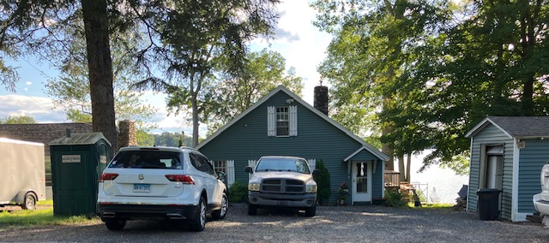
An Example of an Undersized Lot on Columbia Lake
Notes:
This house is less than the minimum lot size for the zone in which it is located but would be eligible for some side yard exceptions as shown in the previous table.

Slide 28
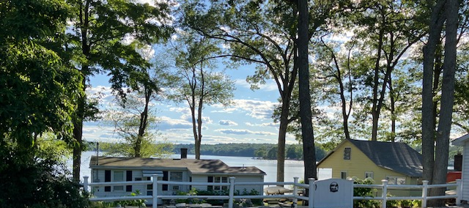
Another example of an undersized Lot on Columbia Lake
Notes:
This is also a dwelling unit next to Columbia Lake. It is eligible for the side yard exceptions we just discussed.

Slide 29
Uniformity Rule Applied to Nonconforming Buildings
The Connecticut Zoning Enabling Act States:
“…such regulations shall be uniform for each class or kind of buildings, structures or use of land throughout each district..”
Applying the uniformity rule to nonconforming buildings means that the regulations must be uniform throughout each district.
The approach taken in Columbia is an example of the uniformity rule applied to qualifying nonconforming lots and buildings
Notes:
The Columbia approach does not violate the uniformity rule because the uses for which these exceptions apply are all governed by the same rules since they all are part of one class of buildings. This approach is consistent Section 8-2 of the CGS that states: “All such regulations shall be uniform for each class or kind of buildings, structures or use of land throughout each district…”
In this case the class of building are those that are nonconforming with respect to lot size.

Slide 30
Exceptions to Dimensional Requirements in 167 Zoning Regulations: 2025
Types of Height, Setback, & Lot Cover Exceptions | Frequency od Use
Setback exceptions for all yards | 85
Height Restriction exceptions | 62
Side & Rear Yard Setback exceptions | 59
Front yard setback exceptions | 51
Accessory building setback exceptions | 40
Non-conforming use exceptions | 26
Environmental setback exceptions | 25
Animal related setback exceptions | 22
Miscellaneous exceptions | 8
Building /Lot cover exceptions | 2
Grand Total | 380
Notes:
With the proliferation of hundreds of different variations on house designs, roof penetrations, accessory structures and exceptions to setback standards, it is difficult to discuss nonconforming buildings without also understanding the range of exceptions that exist to setback standards for buildings, structures, architectural features and plumbing, electrical and energy needs.
Based on a WestCOG review of the 167 municipalities, we have identified at least 380 different exceptions to setback and height requirements that may often have a bearing on whether any given use is a nonconforming use or building or simply subject to its own setback or height restrictions.

Slide 31
Expanding Nonconforming Buildings: An Analysis of the Approaches Adopted by Connecticut’s 167 Zoning Regulations
Approaches to Expanding Nonconforming Buildings | Number of Municipalities | Percent of Total
Allow Conforming Expansions | 97 | 58.0%
Allow Nonconforming Expansion with Conditions | 14 | 8.4%
Allow Conforming Expansions with Conditions | 12 | 7.2%
Allow Conforming Expansions with size or value limits | 12 | 7.2%
Allow Nonconforming Expansions without Conditions | 3 | 1.8%
Total Municipalities that allow Expansions | 138 | 82.6%
Fail to address Nonconforming Expansions | 3 | 1.8%
Prohibit Expansion of Nonconforming buildings | 27 | 16.2%
Total Municipalities with Zoning Regulations | 167 | 100.0%
Notes:
It is instructive to note that 83% of all zoning commissions allow building expansions in Connecticut – whether those expansions are conforming or nonconforming expansions with stipulated conditions for the expansion. As you may recall, earlier we mentioned that 119 municipalities allow for a change of use from one nonconforming use to another that is less impactful. This table makes it clear that there is a greater degree of flexibility in expanding buildings than there is in changing land uses in Connecticut. The twenty-seven municipalities that prohibit the expansion of nonconforming buildings are an outlier from what most zoning commissions in Connecticut consider acceptable.

Slide 32
Three Cases for Expansion of Nonconforming Buildings
Proposed addition
Proposed addition
Proposed addition
Case 1
Case 2
Case 3
What factors determine conformity?
Front yard setback
Lot line boundary
Nonconforming building exceeds side and front yards setbacks
Side yard setback
Rear yard setback
Notes:
This chart provides a visual explanation of what is conforming versus a nonconforming expansion of a building. Case 1 identifies a proposed addition in the rear of the lot that falls within the rear lot line (the yellow shaded area represents the area of the building that complies with setback standards. In Case 1, the proposed addition does not conform to side yard setbacks but is no more nonconforming in width than the existing building. This approach has been adopted by 14 Connecticut zoning commission.
In contrast, Case 2 involves an expansion in the back of a building that exceeds the front yard setback but would not violate the side or yard setbacks. This approach has been adopted by 12 zoning commissions in Connecticut.
Case 3, the third example, involves a building that conforms to the zoning setback standards but any addition in the side yard would violate setback standards – unless the zoning regulations provide for flexible setback standards . This third approach is much like that established in Columbia, to reduce the development constraints imposed by small lots provided the septic system and well water standards are met.

Slide 33
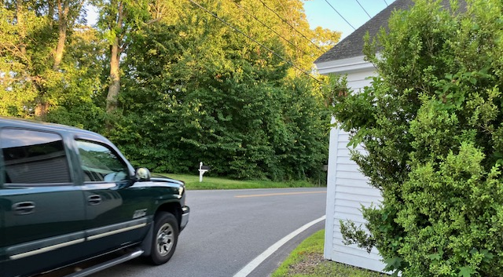
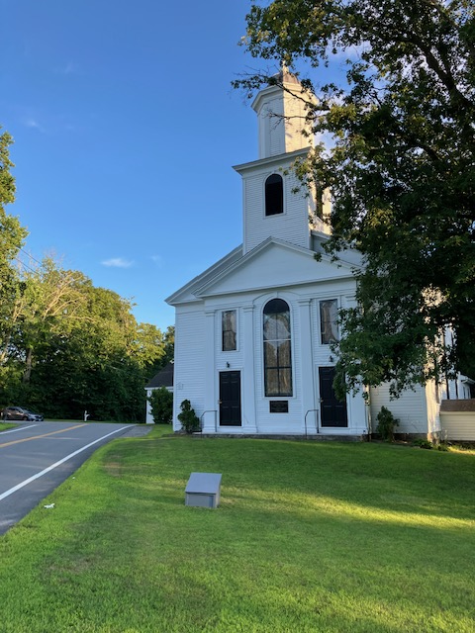
This 1829 Baptist Church, doesn’t qualify for a Side yard Exception
Notes:
This 1829 Baptist church should not be eliminated regardless of how close it is to the road. It would be far easier to move the road away from the church than to declare the church abandoned just because no one happens to attend church for several weeks or months. The two photos you see underscore the safety issues that may emerge when cars drive by the church at inappropriate speeds. In the 19th century, horse and buggy carriages were the means of travel and at the speeds of horse travel there were no safety consideration to speak of.

Slide 34
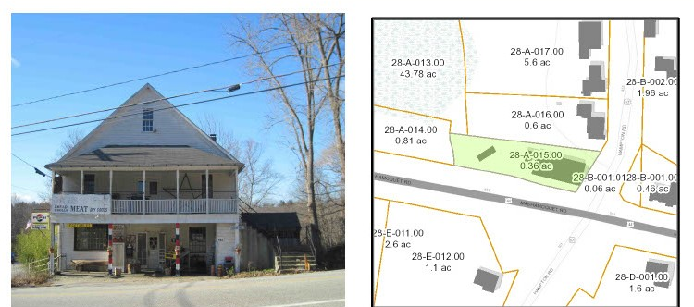
This Commercial building lacks adequate front yard and lot size
Notes:
Built in 1800, this building does not conform with setbacks or with the minimum lot size of 37,500 square feet. It only has 15,682 square feet most of which is consumed by the large building. It is currently vacant and owned by a real estate company.
Fortunately, Pomfret’s zoning regulations allow for its continued existence as follows: “Non-conforming buildings and structures may be expanded or enlarged provided no increased encroachment, including any vertical or horizontal expansion within a setback area…”

Slide 35
Conformity versus Intent of Property Owner
Notes:
Perhaps the most important regulatory concern that has emerged over the last forty years in the right of the property owner to decide the fate of his or her nonconforming property.

Slide 36
Reasons for Nonconforming Structures, Uses & Land to Conform to Zoning
Reasons for Discontinued Nonconformity (multiple factor approaches) | 167 Municipalities
When Changed to a Conforming Use | 107
Nonconforming bldg. destroyed: If 50%+ value Lost or not timely restored | 97
Abandoned Bldg., Land or Use ceases for a Specified Time | 47
Nonconforming Building is Moved | 43
Nonconforming Structure ceases | 34
Nonconforming Building Ceases for specified Time | 29
Owner Voluntarily Discontinues Use | 25
Land Ceases Nonconforming Use | 14
Owner Fails to notify nonconformity was eliminated | 6
Danger to Public Health & Safety | 6
Conformity occurs with voluntary demolition | 5
Failure to meet time limits on building repair | 3
Demolition of a building is not evidence of intent | 2
Grand Total | 418
Notes:
This table presents the reasons zoning commissions have established for forcing nonconforming uses to conform to zoning. The most common approach is when a property owner simply changes a conforming use or building to one that is conforming. The second most common approach to forcing conformity is through a stipulation forbidding reconstruction of a building when 50% or more it has been destroyed or if the former building cannot be restored within a specified time. A smaller number of municipalities have established criteria for when a building has been abandoned which in turn forces its conformity with the regulation. Similarly, 43 municipalities require any building that is moved must comply with zoning once it has been moved.
All these “forced approaches” to conformity are legally suspect based on the Connecticut legislature’s ongoing affirmation of the property owner’s right to voluntarily decide whether the use is discontinued. This is an area where zoning commissions will need to revise their regulations for consistency with Connecticut’s zoning enabling act and recent Connecticut Supreme Court decisions. Keep in mind that the decision to voluntarily discontinue a nonconforming use or building is exclusively that of the homeowner. Yet only 25 municipalities have explicitly adopted this plain English reading of Connecticut’s zoning enabling act.

Slide 37
Urban Girls, Inc. v. Zoning Board of Appeals of Bridgeport (2012)
Two Appellate Court decisions in the 1980s allowed cessation of use to extinguish a nonconforming use. The goal was abolishing nonconforming uses. Those decisions created a problem of non-constitutional taking of property rights.
Public Act 89–277 held that a failure to use a nonconforming use for a period is not enough to abandon it. In addition to mere non-use of property, there must be the owner’s intent to permanently cease the use to establish abandonment.
To establish abandonment of a nonconforming use it must be proven that: (1) there was a voluntary discontinuance of the use, and (2) the voluntary discontinuance was accompanied by an intent not to reestablish that use.”
Notes:
The non-constitutional taking of private property without compensation by forcing property owners to give up the right to their property has been upheld in the case of Urban Girls Inc. v. Zoning Board of Appeals of Bridgeport. Voluntary discontinuance is the foundation for any municipal nonconforming use regulation.
What we have determined from this training program on nonconformities is that many zoning commissions have redefined the word “voluntary” to accelerate the elimination of nonconformities. This perspective, represents a misrepresentation of Connecticut’s commitment to maintaining nonconformities as long as they are not expanded. However, as we have seen, there is a great deal of mission creep occurring in the administration of nonconforming building and use regulations – in part reflecting the lack of statewide oversight of the degree to which zoning regulations properly implement the state’s zoning enabling act.

Slide 38
Checklist for Compliance with Nonconformity Laws & Case Law
Item# | Requirements for Effective Management of Nonconformities | Sources: Case Law, Laws and WestCOG
1 | Include definitions for the 4 basic types of nonconformities. | Munroe v. ZBA, 2003
2 | Allow property owner’s right to voluntarily discontinue nonconforming use, building, or structure. | PA 17-139; PA 89-277
3 | Include a chronology of zoning amendments since zoning adopted and include in regulations. | WestCOG report.
4 | Address distinction between expansion v. intensification of nonconforming uses. | High Watch v. PZC 2025
5 | Distinguish between nonconforming buildings, uses, lots and structures in regulations. | Zachs v. ZBA 1991
6 | Consider health code based uniform exceptions to dimensional rules for nonconforming lots | Columbia zoning regs.
7 | Establish list of accessory structures subject to “structure specific” dimensional standards. | WestCOG report.
8 | Adopt parking space exceptions for lots/uses with insufficient space n transit or village districts. | PA 21-29
9 | Eliminate rules to abandon or cease nonconforming uses or buildings w/o owner’s consent. | PA 17-39
10 | Allow for change of one nonconforming use to another of equal or less impact. | Pt O’ Woods v. ZBA, 1979
11 | Adopt multi-factor special permit criteria for changes from one nonconforming use to another. | WestCOG report.
12 | Require cessation of nonconforming uses, buildings or structures if public safety concern exist. | Police powers
13 | Consider non-punitive registration of nonconforming uses once Item#3 is completed. | WestCOG report.
14 | Allow exception for nonconforming buildings to meet codes (e.g., ADA ramp, Bldg. Code, FEMA rules) | Prevailing Practice
15 | Ensure commission members receive training on nonconformity laws & case law | PA 21-29
Notes:
This checklist can be found in the WestCOG report that was released last month. It provides a summary of most items discussed in today’s training session. It may also be useful in evaluating any updates that you may be considering to your town’s nonconformities regulations. One item that we have not discussed but is included on the checklist is the registration of nonconformities. Vert few municipalities have taken this approach. Any attempt to take that approach should rest on a non-punitive registration of nonconformities after the commission creates a chronology of zoning amendments. See items 3 and 13 on the checklist. These issues are discussed in the WestCOG report as well as in a Supreme Court case involving the Noank Fire District’s unconstitutional approach to NC registrations.

Slide 39
Summary of Key Takeaways
Maintaining Nonconforming Uses and Buildings is Important
Four Reasons to allow Nonconforming Uses to be Replaced:
Consistent with CT Supreme Court Cases that allow continuation of nonconforming uses or for other less impactful uses
Avoids unconstitutional taking of private property without compensation
Maintains culturally important architecture and business ventures
Property owner has right to voluntarily decide fate of property
Three Reasons for Flexible Regulation of Nonconforming Lots
Flexible setback requirements enable continued use of properties
Nonconforming buildings are a class or kind of building & can be regulated uniformly
Nonconforming buildings provide affordable housing in Connecticut
Notes:
Maintaining nonconforming uses and building is important. With over 22% of the state’s housing stock built before 1940, maintaining, and in some cases expanding these uses is in the interest of property owners and those seeking to protect affordable housing.
There are three reasons for flexible regulations for nonconforming lots.
1) First the goal should be to maintain the important affordable housing role provided by older housing;
2) Second nonconforming buildings are a class or kind of building and be regulated uniformly as is being done by twenty-six municipalities and
3) Third providing flexibility allows for a wide range of accessory structures that are part of life in the 21st century but are over-regulated by some nonconforming lot regulations. Many zoning regulations fail to provide sufficient exceptions for many common homeowner needs such as ADA compatible ramps for older people, space for electric generators, solar panels, propane tanks and dozens of other modern amenities that were never considered when the state’s zoning enabling act was adopted in 1925.

Slide 40
Summary of Key Takeaways
Lack of Uniformity in the Regulation of Nonconformities
A Model Zoning Regulation is needed consistent with Case Law, Numerous Revisions to the Zoning Enabling Act & Zoning Practice
Excessive Focus on Abandonment, Discontinuance and Ceasing Nonconforming Buildings or Uses
Need for Increased municipal and regional level Planning to determine strategies to distinguish between “tear down” approaches and those aimed at protecting important cultural, economic and housing resources.
Notes:
We have also learned of the lack of uniformity in how nonconformities are regulated in Connecticut – suggesting the importance of ongoing training. This course has cited several important CT Supreme Court cases on nonconforming uses that have not yet been addressed by most zoning commissions in Connecticut.
Finally, most zoning regulations in Connecticut have been overly focused on the abandonment of nonconforming uses. The emphasis on tear down approaches runs counter to recent developments to restore and protect the state’s cultural assets. For example, Washington township has cited the important role that many of its nonconforming buildings and uses play in the culture and character of their community. Rather than eliminating Connecticut’s long pre-zoning era, many municipalities are recognizing the need to protect important housing, commercial and industrial uses that pre-date zoning or subsequent revisions to zoning over the last 100 years.

Slide 41
Relevant Case Law
Connecticut Case Law
Superior Court of Connecticut. “Urban Girls, Inc. v. Zoning Board of Appeals of Bridgeport” (2012).
Connecticut Court of Appeals. "Munroe v. Zoning Board of Town of Branford." In 818 A.2d 72, 75 Conn. App. 796 (Conn. App. 2003).
———. "Parker v. Zoning Commission of the Town of Washington." In 209 Conn.App, 631, 269 A.3d 157 (Conn. App, 2022). Hartford, CT, (2022).
———. "Verrillo v. Zoning Board of Appeals of Branford." In 155 Conn.App. 657, 111 A3d 473 (Conn. App. 2015). Hartford, CT, (2015).
Connecticut Supreme Court. "Helbig v. Zoning Commission of the Noank Fire District." In 185. Conn. 294, 306, 440 A.2d 940 (1981).
———. "High Watch Recovery Center v. Planning and Zoning Commission." Hartford, CT, (2025).
———. “Point O’Woods Association Inc, v. Zoning Board of Appeals of the Town of Old Lyme”, 178 Conn. 364 (1979).
———. "Zachs v. Zoning Board of Appeals of Town of Avon." In 589 A.2d 351, 218 Conn. 324 (Conn. 1991). Hartford, CT, 1991.
Notes:
The list of relevant case law represents an important source of guidance on how nonconforming uses are to be regulated in Connecticut. These cases are available from the Connecticut Judiciary website or from Google Scholar’s listing of Connecticut court decisions.

Slide 42
Relevant Law Journal Articles
Maltbie, William M. "Legal Background of Zoning." Connecticut Bar Journal 22, no. 1 (1948): 2–9.
Strauss, Eric J., and Mary M. Geise. "Elimination of Nonconformities: The Case of Voluntary Discontinuance." Urban Lawyer 25, no. 1 (Winter 1993 1993): 159–78.
Sullivan, Peter B. "Powers of the Zoning Commission." Connecticut Bar Journal 52, no. 5 (1978): 356–64.
Sussna, Stephen. "Abatement of Non-Conforming Uses and Structures." Connecticut Bar Journal 44, no. 4 (1970): 589–98.
Tondro, Terry. Connecticut Land Use Regulation: Second Edition with Amendments through 2002. Wethersfield, CT: The Atlantic Law Book Company, 1992.
Walshe, John. "Zoning and the Nonconforming Use in Connecticut." Connecticut Bar Journal 45, no. 3 (1971): 427–50.
Dennis, Thomas G., Walter J. Gorski, Philip F. Karpel, and Joseph C. Lee. "Connecticut Law of Zoning (Part B)." Connecticut Bar Journal 41, no. 3 (1967): 453–527.
Infranca, John J., and M. Farr Ronnie. "Variances: A Canary in the Coal Mine for Zoning Reform?". Pepperdine Law Review 50, no. 3 (March 2023): 443–504.
Notes:
While there is a limited amount of law journal articles on nonconforming issues in Connecticut, the ones listed here are the most relevant to this training.

Slide 43
WestCOG Study That Enabled this Training
WestCOG, Zoning Nonconformities: Where Rules and Reality Diverge, (November 18, 2025)
For more information: Contact
Tucker Beckett at tbeckett@westcog.org
Charles Vidich at cvidich@westcog.org
Notes:
We encourage you to access our recent publication on “Zoning Nonconformities” for an in-depth review of the issues we have discussed today.

