Slide 1
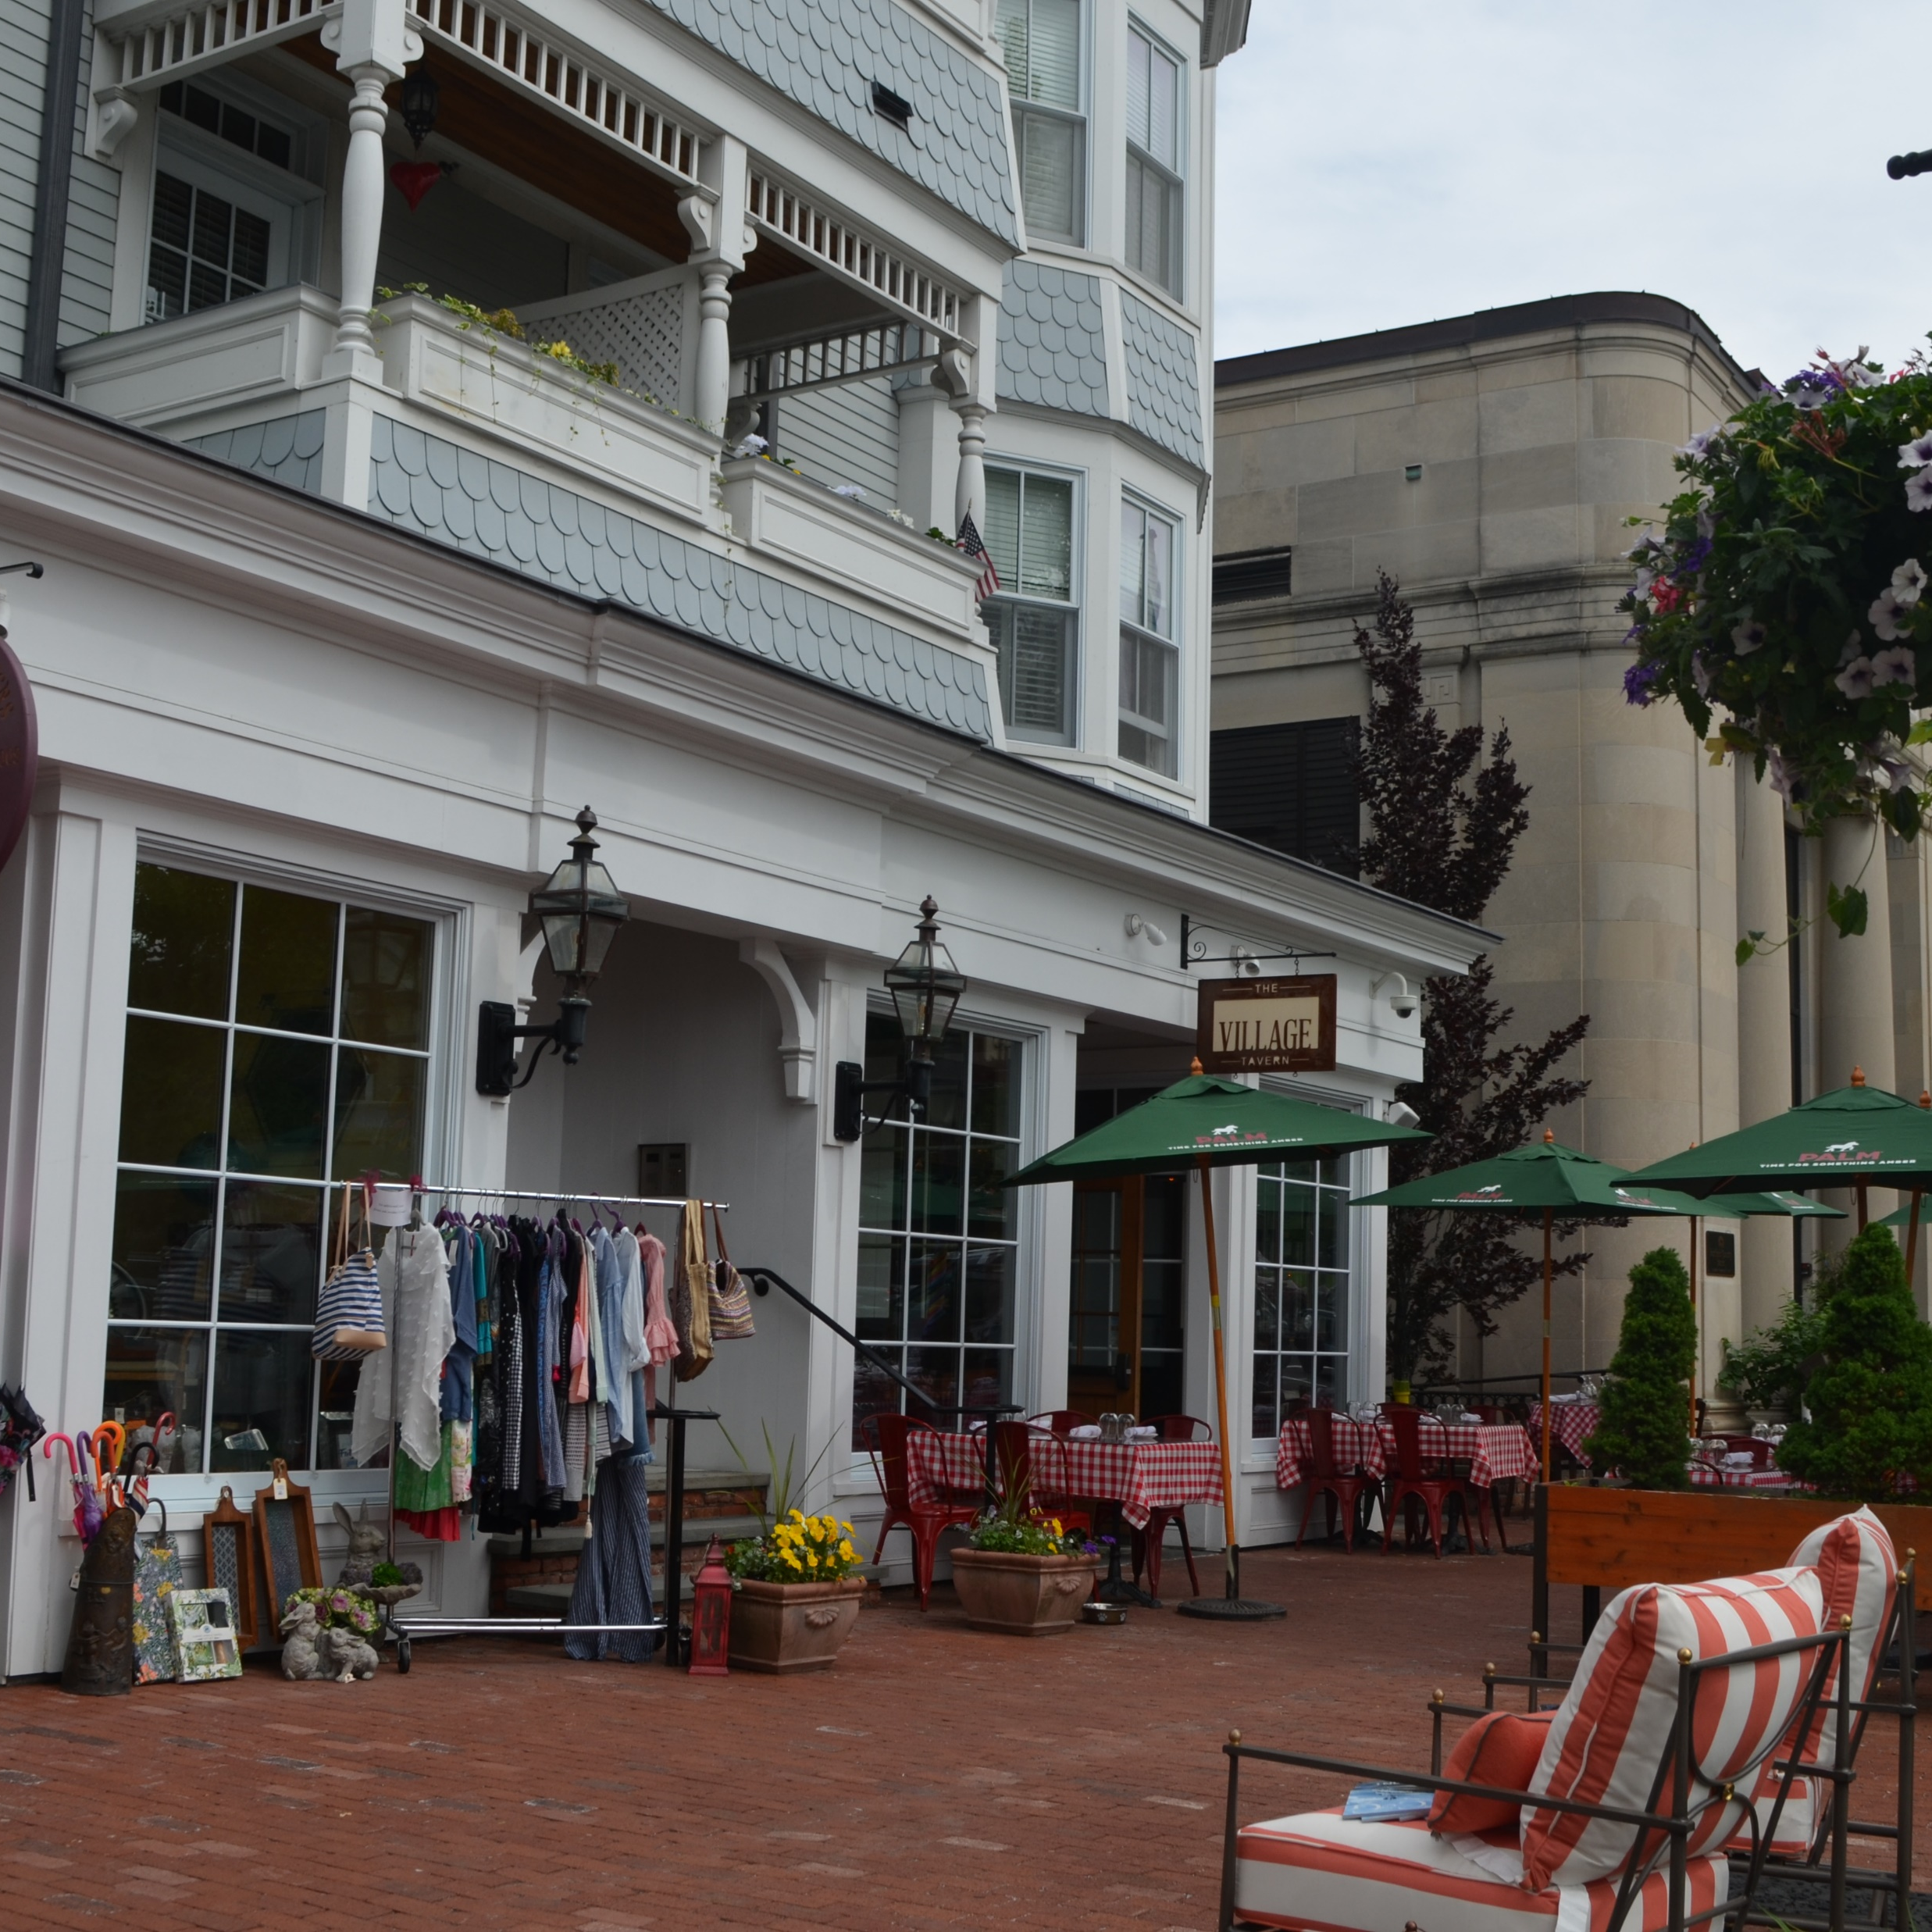

Special Zoning Districts
Floating Zones
Overlay Zones
Planned Developments
Village Districts
June 23, 2025
One Credit Hour Training for Planning and Zoning Commissioners
Notes:
My Name is Charles Vidich and I am the senior project manager at the Western Connecticut Council of Governments. I am joined by my colleague Tucker Beckett, Senior Planner at WestCOG. Today we will review special development zones and their role in addressing a range of land management needs faced by municipalities in Connecticut. This training course reviews the types f special development zones used , their common applications, the legislative and case law authority for their use and their strengths and weaknesses. The goal of this presentation is to familiarize you with innovative zoning approaches to addressing a wide range of economic development, housing, village design and environmental responsibilities you have as a planning and zoning commission member or member of a zoning board of appeals in Connecticut.
This one-hour training session fulfills your requirement to receive at least one of the four hours of training relevant to your role as a planning and zoning commission or zoning board of appeals member every four years. If your term is longer than four years, then you must receive the required training during the term of your service on the commission.
This training is the first to provide a statewide analysis of current special zoning district practices based on a very comprehensive study completed by WestCOG.

Slide 2
Overview of Special Development Zones
Definitions
Legal Basis for Special Development Zones
Floating Zones
Planned Developments
Overlay Zones
Village Districts
Summary: Special Development Zone Applications
Notes:
As you can see from our agenda, this training session will address the purpose and application of four special development techniques; floating zones, overlay zones, planned developments and village districts. We start with a review of basic definitions for these zoning techniques and their legislative history in Connecticut.

Slide 3
Definitions
Floating Zone: A zoning district that does not apply to any specific property until an application is made to apply the new district to an eligible parcel. Parcel eligibility is identified in the district text with specific tethering factors determining what parcels meet the landing criteria.
Tethering: Eligibility factors that determine where a floating zone can land. Examples include access to arterial highways, sewer and water service, minimum parcel size & consistent with Plan of Conservation and Development.
Notes:
Floating zones are a special development zone that do not apply to any given property until an application is made to land the zone in one or more locations for parcels that meet the eligibility criteria. The key eligibility criteria are called tethers since they determine where a floating zone can land. For example, specific zones, specific highways or specific parcels greater than a certain size are examples of commonly used tethers in Connecticut

Slide 4
Definitions
Overlay Zoning: A zone in which a common set of standards is applied to a designated area that may apply to one of more zoning districts and impose additional or alternative regulations than required by the underlying districts.
Planned Development Zones: A zone created within an existing district comprised of a large parcel of land that could not be developed through an existing or new zoning district and is under single ownership. The PD may include uses, regulations, and other requirements that vary from traditional zoning districts.
Notes:
In contrast to a floating zone, overlay zones supplement and generally do not replace the regulations found in the underlying zone. Overlay zones are often used to address unique environmental or watershed protection concerns that do not align with the base zoning districts. They may exist within one base zone or cover multiple underlying zoning districts within a municipality.
Planned Development zones are created to meet unique housing or economic development needs that are not properly met by the underlying Euclidean zones. Planned Developments create new districts with their own height, bulk, setback and development standards independent of the underlying zone which they replace.

Slide 5
Definitions
Village Districts: A district established under Connecticut General Statutes Section 8-2J that enables zoning commissions to require 1) landscaping guidelines, 2) seven building and village compatibility standards, 3) maintenance of public views, and 4) architectural review procedures for designated areas of a community. A village district may be established as a new zoning district or be an overlay zone to one or more existing underlying zoning districts.
Notes:
Village districts is the fourth special development zone we will discuss today. Unlike the other special development zones, village districts created under Section 8-2J of the Connecticut General Statutes are subject to landscaping, building design and architectural review standards. They may be adopted as overlay zones or as a replacement for existing zoning districts where village character or special architectural or landscape design are desirable features to be protected.

Slide 6
Connecticut Case Law & Laws Bearing on Special Development Zones
1959
Special Permits authorized by Public Act 614
Connecticut Supreme Court upholds floating zones
Design rules for Village Districts authorized by PA 98-16
2006
CT Supreme Court upholds uniformity rule in Mackenzie v. Monroe PZC
2021
Floating zones explicitly authorized by Public Act 21-29
2024
421 overlay zones exist in 139 CT municipalities
Municipalities must adopt floodplain management regulations
1998
2024
106 village districts exist in 71 CT municipalities
1985
Overlay zones and special use zones authorized by PA 85-409
An Act Concerning Aquifer Protection Areas
1979
Overlay zones authorized by an Act Concerning Coastal Zone Management
1990
CT Superior Court declares PDD zones must have explicit tethers
2007
Public Act 07-04 authorizes Incentive Housing overlay Zones
2024
88 floating zones exist in 55 CT municipalities
1968
1969
1989
Public Act 06-128 enables New Haven to use floating, overlay,& flexible zone
2013
Notes:
The Connecticut legislature authorized the use of zoning in 1925. In 1959 when Euclidean zoning was modified to allow for special permit uses within any given zoning district. The zoning enabling act of 1925 did not provide for any incompatible uses but it soon became apparent that some uses might be compatible if they were managed under special permit standards. Soon other innovations emerged with the National Flood Insurance Program in 1968 creating floodplain zones. In 1969 the CT Supreme Court upheld the use of floating zones in Stamford and then in 1985 the legislature enabled the use of overlay zones to expand its use beyond that limited to the coastal zone management program.
In 1998 the legislature added village districts as a new zoning tool to expand architectural protections from the exclusive domain of historic districts to be a tool for innovative village and urban design. Nine years later incentive housing overlay zones were added to the list of special development techniques. In 2013 the CT Supreme Court put guard rails on some special development practices in the Mackenzie case to ensure the principles of uniformity – otherwise known as the equal protection act – were complied with.
In 2021 the legislature codified the CT Supreme Court’s holding that floating zones are a valid zoning tool. We will go into more detail on a number of these important laws during this training sessions.

Slide 7
A Short History of the Evolution of Special Development Practices in Connecticut
Before 1925
No Zoning
1925 to 1959
Permitted
Prohibited
1959 to Present
Permitted
Prohibited
Conditional
1969 To Present
Permitted
Prohibited
Conditional
Negotiated
2006 To Present
Permitted
Prohibited
Conditional
Negotiated
Master Plan
Notes:
This diagram provides a bird’s eye view of how zoning has evolved over the last 100 years. When the zoning enabling act was adopted in Connecticut there were only two types of land uses – those that were permitted and those that were prohibited in any given district. Because the world is not black and white and has shades of gray, in 1959 the legislature authorized the use of special permits to address uses that could be compatible within any given zone and meet the uniformity rule, provided they meet more exacting conditions of compatibility.
As we discussed a few minutes ago, by 1969 the floating zone emerged as a flexible zoning tool that enabled a more negotiated approach to large scale development. Since then, we have seen the use of master plans used to design specific districts using the flexibility of floating zone techniques.
The point to be emphasized here is that the uniformity rule – the principle that like uses are treated equally – has lost much of its historic meaning. Planned zoning districts, like floating zones, have landed and created new independent zones that are not judged for consistency with the zones they replace – merely for consistency within the ones they have now created.

Slide 8
Five Special Development Regulations: What’s in Common?
106 Village Districts
421 Overlay Zones
Special Permits
102 Floating Zones
70 Planned Development
Notes:
Today, Connecticut’s zoning commissions have five key special development tools to address proposals that have inter-district and/or intra-district impacts not effectively addressed by traditional Euclidean zoning. These five special development zones are not equally well used across Connecticut. The most common tool is the special permit which is near universally used by all zoning commissions. This slide shows the number of zones that exist in Connecticut for each type of special development district – not the number of municipalities that use them. There are 61 municipalities with 102 floating zones; 51 municipalities with 70 PDDs; 73 municipalities with 106 village districts and139 municipalities with 421 overlay zones.
While each of these five tools has distinct regulatory and legal applications many of them bleed into each other based on the specific way in which tool is applied. The important point to understand is that there are many examples where these tools are used jointly to achieve specific objectives. For example, there are thirty-two municipalities that have adopted a village district regulation as an overlay zone rather than as a separate base zone. Similarly, one municipality provides planned developments through an overlay zone. We will discuss some of the strengths and limitations of these zoning tools in our discussions of each special development approach. It is important to remember that with the exception of special permit driven development strategies, all of the four zoning tools require changes to the zoning regulations and the zoning map.

Slide 9
All Five – Overcome the Uniformity Rule
Section 8-2 a (2) All zoning regulations shall be uniform for each class or kind of buildings, structures or use of land throughout each district, but the regulations in one district may differ from those in another district.
Section 8-2 a (3) Such zoning regulations may provide that certain classes or kinds of buildings, structures or use of land are permitted only after obtaining a special permit or special exception from a zoning commission, planning commission, combined planning and zoning commission or zoning board of appeals, whichever commission or board the regulations may, notwithstanding any special act to the contrary, designate, subject to standards set forth in the regulations and to conditions necessary to protect the public health, safety, convenience and property values.
Notes:
Now for the answer to the question raised on the previous slide. All five zoning strategies overcome the requirement of the uniformity rule. As you can see from Section 8-2 of the Connecticut General Statutes the uniformity rule requires each class of buildings, structures or use of the land throughout the district to be uniform. The only exception to that rule is the special permit process.
Since the four special development techniques constitute a change of zoning district, the creation of a new district or a modification of the underlying base zoning district, they have been held to be consistent with the uniformity rule as long as these districts are created in the public interest.

Slide 10

Zoning Has Evolved: Reflects Need for Flexibility
Shift in Focus over 75 years:
Urban Scale v. Individual Building Approvals
Master Planning for Complex Developments
Integrated Neighborhood Scale Development
Transportation Management
Mixed Use Development
Environmental Protection
Notes:
Zoning has evolved to address the rapid pace of development and the need for large scale approaches to development at the neighborhood and urban levels.
Environmental protection, transit supporting development and mixed-use development are some of the most prominent zoning concepts to emerge in the last 75 years. These ideas were poorly addressed in the standard zoning enabling act of 1925. Innovative zoning has occurred in three different levels of government: the state legislature, the court system and municipal zoning itself.
Euclidean zoning is often misunderstood to be based on the famous Greek named Euclid who developed a system of geometry primarily addressing flat two- dimensional planes. In reality, Euclidean zoning refers to the U.S. Supreme Court case that established the constitutional basis for zoning in America. The case, decided in 1926, is called Village of Euclid et. al. v. Ambler Realty Company.

Slide 11

Floating Zones
Notes:
Let’s start with a review of floating zones.

Slide 12
The Purpose of Floating Zones
To create flexibility balanced by control in the development of land relying on legislative authority to create customized development.
Tethering: applied anywhere based on specific standards
Mixed use: Alternative to Euclidean zoning
Diversity of Uses: Development options include;
Representative Examples of Commonly Used Floating Zones in Connecticut
Housing and Recreation | Planned Residential Development
Transit Oriented Development | Planned Industrial Development
Main Street Design | Planned Development District
Assisted Living Facilities | Planned Recreational Development
Housing Opportunity Zones | Waterfront Redevelopment District
Hospital Complex Design | Highway Interchange Zone
Notes:
Floating zones offer flexible development approaches that are not possible within Euclidean zoning. Except for Bethlehem and Eastford every Connecticut municipality has wall to wall zones that pigeon-hole every type of development into either a permitted or prohibited category. Floating zones are used to address a wide range of mixed-use development needs, higher density housing, transit supporting density strategies or even special land uses that require long range planning such as assisted living facilities for an aging population.
While a commission could enable these uses through a special permit process, as many municipalities have historically done, a floating zone enables the commission to tether controversial or less compatible uses to specific locations within a community best suited to handle traffic, and other infrastructure requirements. When and where a floating zones lands, within the authorized tether sites, is determined by the marketplace not by the wishes of the zoning commission.

Slide 13
Activating Floating Zones: 2 Steps
Create Floating Zone
Tethering Rules
Design Rules
Map Floating Zone
Qualify Parcel
Special Permit
Notes:
There is a two-step process to create a floating zone. First a text change is made to the zoning regulations that establishes the tethering standards, design and development rules. Second an application is made to land the floating zone on a qualifying parcel using special permit or master plan review procedures. Once adopted the zone is added to the town zoning map. There are public hearings for the first and second steps in the process.

Slide 14

Two Key Features of Floating Zones
Hard Tethers:
Ex. Links to arterial roads, tied to specific zones, minimum parcel size
Benefits: Provides explicit landing standards for floating zones
Soft Tethers:
Ex. Links to broad policy objectives such as neighborhood compatibility, historic preservation
Benefits: Provides wide discretion for landing floating zones
Notes:
Like any process that has developed over time, tethers have evolved to address hard and soft-landing techniques for a floating zone. A hard landing is one associated with precise factors that link the floating zone to specific roadways, specific parcel sizes, specific road frontage requirements, access to public water and sewers, or even specific zones. The advantage of the hard tether is that it provides “bread-crumbs” that tell the developer and the public where the zone is likely to land. To the extent that tethers are created to address long-term development needs of the community, they operate in the public interest.
In contrast soft tethers are based on broad policy objective such as protecting historic buildings, ensuring neighborhood compatibility or protection of groundwater resources. These soft tethers rarely provide a clue to the possible landing sites for the floating zone. They are most useful after an applicant makes a request to land the floating zone – not beforehand.
It is useful to conceptualize soft and hard tether as a two-step review process where soft tethers (step 2) are used to refine the locational factors identified by the hard tethers (step 1).

Slide 15
There are 102 floating zones in Connecticut. This chart
presents the top 20 most common uses. Only 9%
of floating zones focus on environmental purposes.
Notes:
This slide summarizes the uses of floating zones in Connecticut. Based on a complete inventory of all floating zones that exist in Connecticut as of 2024 we find that mixed use development including planned development as well as age restricted housing are by far the most popular uses for floating zones. Yet it is important to note that floating zones are also used for a range of housing, medical research, golf courses and even agricultural preservation strategies.
Floating zones can be used for strategic land planning for those municipalities that use their plan of conservation and development to forecast future development needs. For example, aging communities may wish to “bake” a floating zone concept for elderly housing or assisted living into their zoning regulations and then promote its simplified approval process in the marketplace. The types of services needed in any given community change with time. To the extent a planning and zoning commission can anticipate these future needs the better it can serve its community.
To be useful, a floating zone needs to be flexible, easily implemented and transparent in its tethering standards. This trifecta goal is not always achieved in practice- especially the need for transparency and public awareness of the purpose, scope and potential landing locations.

Slide 16
Without specific standards for landing a
floating zone, the public has no basis for
determining future community impacts.
Key Siting factors for Floating Zones
Notes:
Now let’s look at tethering practices. The most common tethers are 1) requiring minimum acreage for the floating zone, 2) ensuring consistency with the POCD, 3) linking the landing site to specific zones, 4) requiring public sewer and water and 5) linking the zone to specific highways or highway classes.
In many cases the POCD may already identify areas suitable for future development and can serve as a guide for landing a floating zone.
Not all municipalities have understood the need for regulatory transparency. As you can see five municipalities have no hard tether standards. This creates public concerns when a floating zone lands and no advanced warning exists of the zone change.

Slide 17
Using the Master Plan process results in a negotiated set of standards not predetermined by the zoning commission.
Notes:
Now let’s look at the soft tethers used in Connecticut. By far the most common soft tethers are requiring a Master Plan to guide development and requiring the landing zone to meet compatibility standards – whatever that might mean in practice. Soft tethers are, by definition, more subjective approaches to ensuring the floating zone works where it lands. Since a zoning commission is unlikely to know where a floating zone will land, the soft tethers may sometime operate as “feel good” or subjective factors with little technical or scientific foundation in specific facts or studies about any given location. When supported by evidence- based land use practice they carry more clout. Nonetheless, soft tethers tend to be points of negotiation with developers.
Neighborhood compatibility represents the critical soft tether and is often addressed through stringent buffer and setback standards along the perimeter of the selected site – sometimes referred to as the landing site for the floating zone.

Slide 18
Floating Zones: Strengths v. Weaknesses
# | Strengths | Weaknesses
1 | Design Flexibility | Conflicts with Public Expectations
2 | Greater Legislative Discretion | Less Accountable to the Public
3 | Parcel Level Performance Standards | May affect abutter’s property value
4 | Limited Public Involvement | Limited Public Involvement
5 | Customized Development Plans | Lack of Uniformity with Underlying Zones
6 | Abutter Notices not Triggered in Float State | Landing Factors are Opaque to Public
7 | One Parcel Can Qualify for Landing Sites | Poses Danger of Contract Zoning
8 | Can be Created on lots as small as 2 acres | Floating zone often benefits single landowner
9 | Anticipates Future Development | Market Forces are Unpredictable
Notes:
There are advantages and disadvantages to the use of floating zones. Design flexibility is one of the key benefits. However, in the land of steady habits public expectations may perceive any change as a bad one. For this reason, one of the most important paths to success must rely on transparent and well communicated notices to the community about the creation as well as the landing of floating zones.
Landing factors are almost always opaque to the public and this is often a cause for community backlash when the landing site is identified. The solution to this challenge rests on the use of hard tethers that make the location or locations more transparent as to where the floating zone will likely land.
It is important to recognize that a floating zone can not be tied to one parcel. Such an approach is akin to contract zoning and violates the legal foundation of a floating zone – it must float – meaning there must be more than one landing site.

Slide 19
Wide Range of Geographic Applications for Floating Zones
Designated Streets, Parcel Sizes or Access Factors
Examples: Elderly Housing, Planned Commercial, Mixed-Use Development
Intra-District Zones
Examples: Village Districts, Main Street Design
Multi-District Zones
Examples: Planned Residential Development
Notes:
Floating zones may land on sites that are as small as a few acres or hover over multiple zones with large parcel requirements. The tethering standards are strongly influenced by the type and intensity of anticipated development. For example, a regional shopping mall will generally require far more land for development than a floating zone used to develop an elderly housing complex. A floating zone has even been created for potential village districts in Trumbull. The floating village district could land in multiple village locations in that community.

Slide 20
Floating Zones are Litigation Resistant
“The discretion of a legislative body because of its constituted role as formulator of public policy, is much broader than that of an administrative board, which serves a quasi-judicial function. This legislative discretion is wide and liberal and must not be disturbed by the courts unless the party aggrieved by that decision establishes that the commission acted arbitrarily or illegally…”
Connecticut Supreme Court
220 Conn. 527, 543-44, 600 A.2d 757 (1991)
Notes:
One of the strongest motivations for using floating zones is that they are an exercise of the legislative powers of the zoning commission and therefore are subject to far less scrutiny by the Connecticut judicial system.

Slide 21
Authority for Floating Zones
Public Act 21-29, An Act Concerning the Zoning Enabling Act
Authorized use of floating zones
Connecticut Supreme Court Upheld Validity of Floating Zones
Sheridan v. Stamford Planning Board (1969)
Connecticut Supreme Court holds floating zones not for one property
River Bend v Simsbury Zoning Commission (2004)
Notes:
Floating zones, as we have discussed, have been valid zoning techniques since 1969 in the case of Sheridan versus the Stamford Planning Board. It is important to recognize that a floating zone is not designed for one property, there must be multiple locations where the zone can land to be consistent with the Supreme Court’s 2004 decision in River Bend v. Simsbury Zoning Commission.

Slide 22
Planned Development Districts
Notes:
Now we will review the use of planned developments - how they are created and what they share in common with floating zones.

Slide 23
Planned Development Districts (PDD)
Like Floating Zones:
PDDs provide flexible design & development options.
Unlike Floating Zones:
PDDs can be created without tethers
One Step Activation Process:
PDDs are created and mapped in a one step process like any Euclidean zone.
Once Established:
PDDs are generally managed by special permit & site plan review processes
Notes:
Like floating zones, planned development districts provide much needed flexibility for a wide range of housing, commercial and industrial applications. Unlike floating zones, PDDs do not need to be created using tether concepts even though that is often one of its applications. A key distinction, according to the CT Supreme Court is that PDDs are established through a one step activation process whereas floating zones require a two-step process.
While, this may sound like a a useful distinction, in reality PDDs often are created using phased development approvals where the change to the text of the zoning regulation is approved before the change to the zoning map is approved. In effect, some municipalities, in order to comply with the Supreme Court’s interpretation of what constitutes a PDD, will approve the text and map change but not place it on the map until the special permit and site plan approval process has been successfully completed. While this may be a small distinction, it reveals the practical subtleties faced by zoning commissions that may decide to deny a PDD proposal at the administrative level – whether that be the special permit or site plan review phase.

Slide 24
Options for PDD Development
Planned Developments can be created three ways:
Special Permit Approval Process
Administrative approval based on consistency with special permit standards
Simultaneously Changing Zoning Regulations
1) Zoning Text 2) Zoning Map and 3) Special Permit/Site Plan
Legislative and Administrative Approvals aligned into one process
Phasing the Regulatory Changes
1) Zoning Text Change separated from 2) Zoning Map & 3) Special Permit/Site Plan
Legislative and Administrative Approvals become a two step Process
Notes:
As we have discussed, PDDs can be created through various approaches. The three basic ways are through a special permit process, through simultaneous changes to the zoning text, zoning map and administrative review procedures or by phasing the approval process to approve the zoning text change and making the final approval contingent on the special permit review process before mapping the zone.

Slide 25
Notes:
Planned Development districts are primarily used to address multi-family and inclusionary housing needs. They are also used for economic development and transportation management purposes as well. The uses of PDDs are remarkably similar to the uses found for floating zones. There is very little difference in the uses served by PDDs and floating zones. The real differences are the procedures used to adopt these zoning techniques. Indeed, in many cases, it is hard to distinguish the two special development zone concepts until an analysis is made of how the two types are placed on the ground. The tether concept being a key distinction between the two types.

Slide 26

Overlay Zones
Notes:
The third special development concept we will now review is overlay zoning. It is the most popular special development technique in Connecticut. We will now review its applications.

Slide 27
The Purpose for Overlay Zones
Overlay zones provide flexibility to address unique environmental, design, and housing issues not well aligned with traditional Euclidean zoning boundaries.
Unique Boundary Lines: Floodplains, Watersheds, Aquifers, Ridgelines
Unique Neighborhood Design: Village Districts, Preservation Zones, Neighborhood Transition Zones, Adaptive Reuse Zones
Unique Development or Housing Issues: Professional Offices, Planned Commercial Development
Unique Traffic Issues: Transit Oriented Development, Highway Interchanges, Highway Access Management
Notes:
Like floating zones, overlay zones provide flexibility in addressing unique environmental, design and housing issues that do not align with Euclidean zoning boundaries. For example, the boundaries of floodplains, watersheds, aquifer protection areas and ridgeline protection areas never coincide with the underlying zoning boundaries in any given town. Overlay zones are especially useful for environmental protection purposes but also are used to address housing, traffic and neighborhood design issues.

Slide 28
Two Types of Overlay Zones in Connecticut
Mandatory: Regulate new development or redevelopment impacting an affected environmental resource.
Examples: Watershed Protection, Special Flood Hazard Area
Discretionary: Establish housing incentives for development.
Example: Incentive Housing Overlay Zones
Notes:
There are two type of overlay zones in Connecticut; the first are those that are mandatory and establish supplemental regulations to those found in the underlying zone. The best examples are flood hazard overlay zones, watershed management zones, and aquifer protection area zones.
In other cases, overlay zones create discretionary standards that do not change the underlying zoning unless a developer decides to adopt the discretionary standards. The incentive housing overlay regulations established by the State legislature in 2004 are an excellent example; these zones actually replace many of the underlying zoning requirements once a developer chooses to apply for them. In this sense, incentive housing overlays operate much like a floating zone except that there is not a two-step legislative approval process. The zoning commission simply creates the housing incentive overlay zone in their legislative role, and then a developer applies to use the existing overlay zone for a specific property.

Slide 29
There are 421 different overlay zones in 139 Connecticut municipalities. Environmental
overlay zones account for 53% of the overlay zones.
Notes:
Overlay zones are by far the most popular and most widely used of all the special development techniques. As you can see more than 50% of all overlay zones are dedicated to environmental protections addressing a wide range of concerns. Overlay zones are also commonly used for neighborhood design and inclusionary housing. More recently, overlay zones have been used to address traffic management and transit supporting density strategies.
There are 421 distinct overlay zones in Connecticut within the 139 municipalities that use them. The 28 municipalities that do not use overlay zones are primarily located in the most rural parts of Connecticut.

Slide 30
Commonly Used Overlay Zones in Connecticut: 2024
Category | Name of Overlay | Code | Number of Zones
Environment | Flood Hazard Zones | FHZ | 64
Environment | Aquifer Protection Zones | APA | 55
Environment | River Protection Zones | RP | 34
Design | Village District Zones | VD | 32
Design | Design District Zones | DD | 27
Housing | Incentive Housing Zones | IHZ | 18
Environment | Coastal Zone Mgt Zones | CZM | 15
Design | Historic Preservation Zones | HP | 12
Environment | Watershed Protection Zones | WP | 12
Development | Highway Revitalization Zones | HRZ | 10
Environment | Lake District Conservation Zones | LDC | 9
Development | Mixed Use Development | MUD | 9
Traffic | Transit Oriented Development Zones | TOD | 7
Design | Neighborhood Transition Zones | NTZ | 7
Environment | Tidal Marsh Zones | TMZ | 7
Development | Adaptive Reuse Zones | ARZ | 7
Housing | Affordable Housing Overlay Zones | AHO | 6
Environment | Ridgeline Protection Zones | RGP | 5
201 of the 309
overlay zones in this top
20 list are designed
to address various
environmental issues.
Notes:
Here are the most frequently used overlay zones. It is important to note that river protection zones, while not specifically authorized by federal or state legislation, are enabled by Public Act 21-29. It is the third most common overlay zoning technique in Connecticut and helps to close the gap left by our state’s weak riparian protections.

Slide 31
Overlay Zones: Strengths v. Weaknesses
# | Strengths | Weaknesses
1 | Zoning flexibility | Multi-layered review process
2 | Resource specific zoning | Boundary lines may not be property lines
3 | Valuable tool for environmental protection | Zoning enforcement relies on complaints
4 | Overlay zone need not be tied to base zones | Boundary lines may be poorly mapped
5 | Mapped resources increase public awareness | Lack of easy access to online zoning map
6 | Access to professional planners | Rural municipalities lack professional planners
7 | Doesn’t violate the uniformity rule | Resource protection also needs public education
Notes:
Like floating zones, overlay zones provide needed flexibility to address a wide range of emerging environmental and development issues. Their strength is the ability to deal with issues that transcend the boundaries of Euclidean zoning. Municipalities that use overlay zones tend to have the technical support of professional planners.
One of the drawbacks of overlay zones is that they create a more complex regulatory review process. Furthermore, overlay zones often overlap or are poorly depicted on zoning maps resulting in public misconceptions concerning their compliance responsibilities with municipal zoning. Overlay zones may also not follow parcel boundaries and this may also lead to confusion as to the jurisdiction of the zoning commission concerning properties that are bisected by an overlay zone.

Slide 32
Wide Range of Geographic Scope for Overlay Zones
Designated Streets, Parcel Sizes, or Access Factors
Example: Elderly Housing, Planned Commercial
Intra-District Overlay Zones
Examples: Aquifer Protection Areas, Village Districts
Multi-District Overlay Zones
Examples: Watershed Protection, Special Flood Hazard Areas, Village Districts, Professional offices
Notes:
Like floating zones, overlay zones may operate at an intra-district or inter-district level or even be limited to specific parcels within a community. Unlike floating zones, an overlay zone is almost always mapped once established. We will discuss the exceptions later in this training session.

Slide 33
Authority for Overlay Zones
Public Act 79-535, An Act Concerning Coastal Zones
Authorized overlay zones for coastal zone management
Public Act 85-409 An Act Concerning Municipal Power to Regulate Planned Unit Development
Authorized the use of overlay zones as a tool for all zoning purposes
Connecticut Supreme Court Upheld Validity of Overlay Zones
Tillman v. Planning & Zoning Commission of City of Shelton (2021)
Notes:
The use of overlay zones to address flood hazard management was initially established in 1969; expanded for coastal zone management purposes since 1979 and for broader usage since 1985. The CT Supreme Court upheld the use of overlay zones in its 2021 decision concerning Tillman versus the Shelton Planning and Zoning Commission.

Slide 34
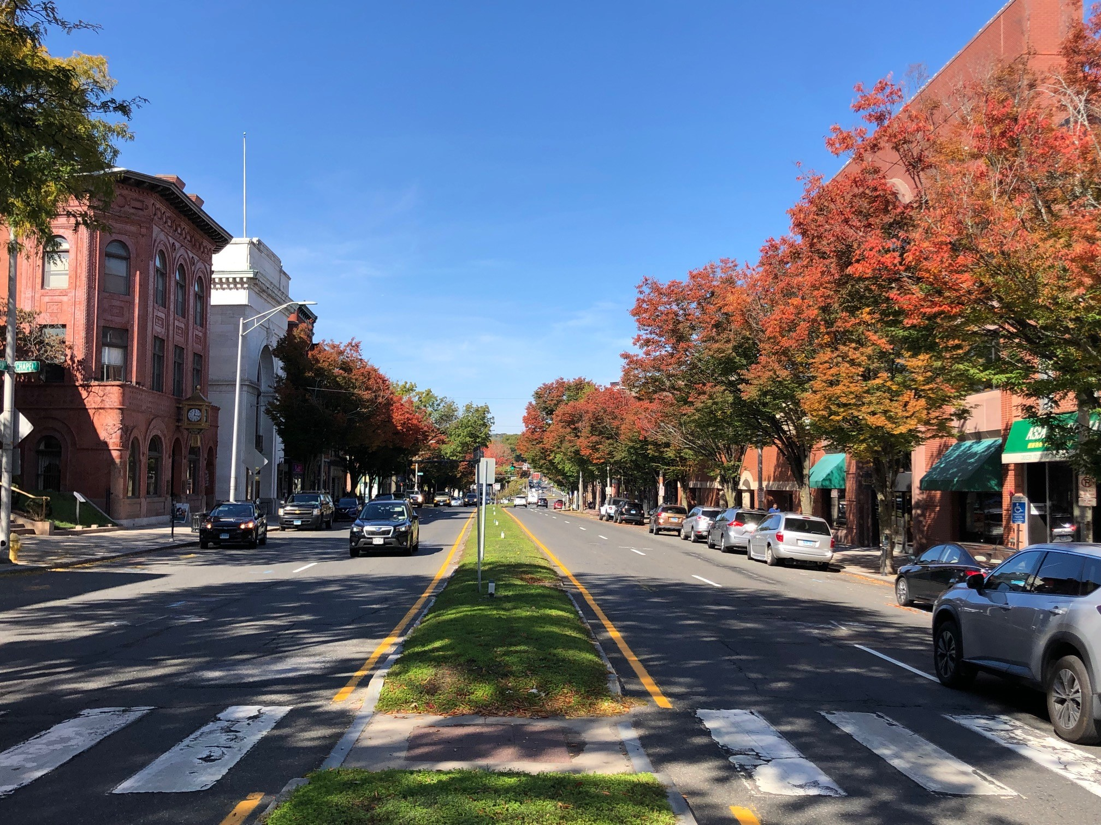

Village Districts
Notes:
A more recent special development zone is the village district. It offers design opportunities for New England’s villages without the restrictions imposed by historic district regulations. Let review their purpose and how they have been applied across Connecticut.

Slide 35

The Purpose of Village Districts
To protect distinctive character, landscape, and historic structures.
Five broad authorities granted by the Village District Act:
Alterations & Improvements
Design & Placement of Buildings
Maintenance of Public Views
Design & Placement of Public Roadways
Other Element
Notes:
Village districts are designed to protect and enhance the design and placement of buildings to unify the appearance of a portion of a community that has special landscape, building or design features.
Despite its name, village districts are used to protect landscapes, building clusters and streetscapes that are unique to a community. Some center on traditional town greens, some are associated with fashionable retail centers, some are connected to central business districts and others are used to maintain the character of development along specific culturally and historically significant roads.

Slide 36
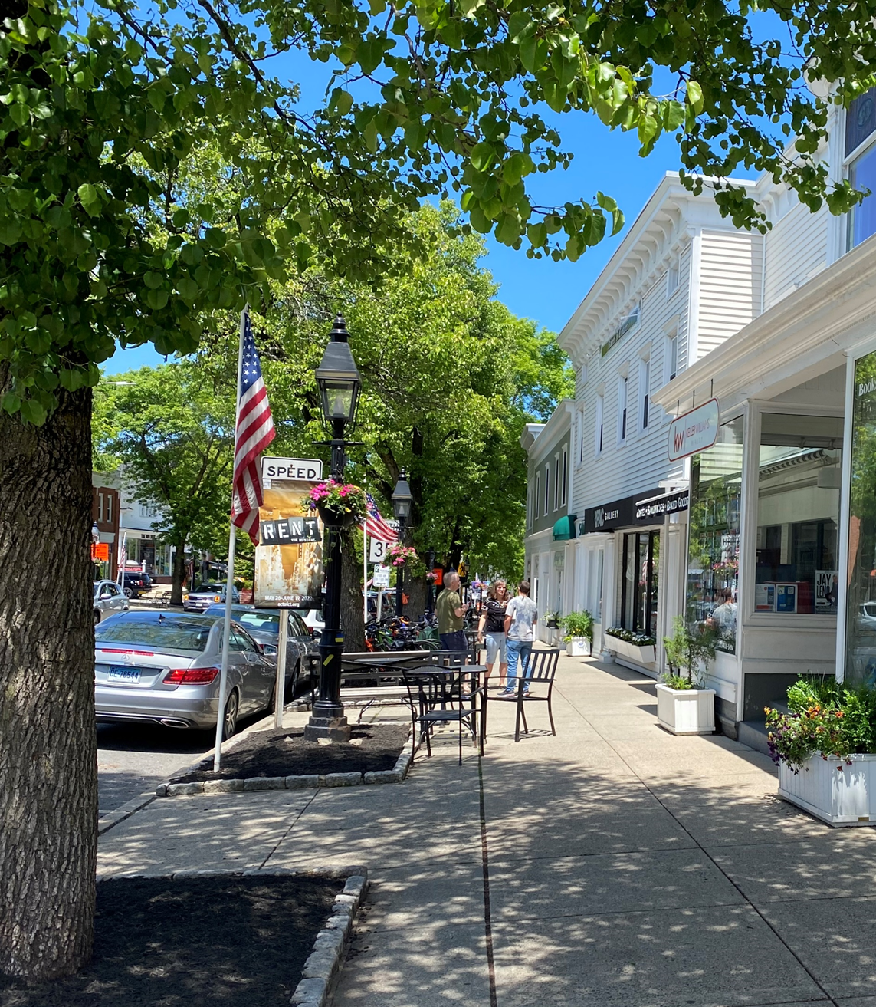
Activating Village Districts
Village district regulations are part of a town's zoning regulations
Activating the district follows procedural requirements of CGS Sec. 8-3.
A hearing must be conducted before adopting regulations
Approval requires a majority vote of zoning commission members
A two-thirds vote is required if 20% of affected property owners or all property owners within 500 feet of the affected properties file a protest by the time a hearing is held.
Notes:
Unlike historic districts, village district regulations are a part of municipal zoning regulations and must be created/modified like any other zone change procedure. Since village districts may impact numerous existing buildings selected to become a village under section 8-2J of the statutes, it is critical the activation process start by involving affected property owners. Without their support, a village district regulation is likely to fail.
(Note HB 5002)

Slide 37
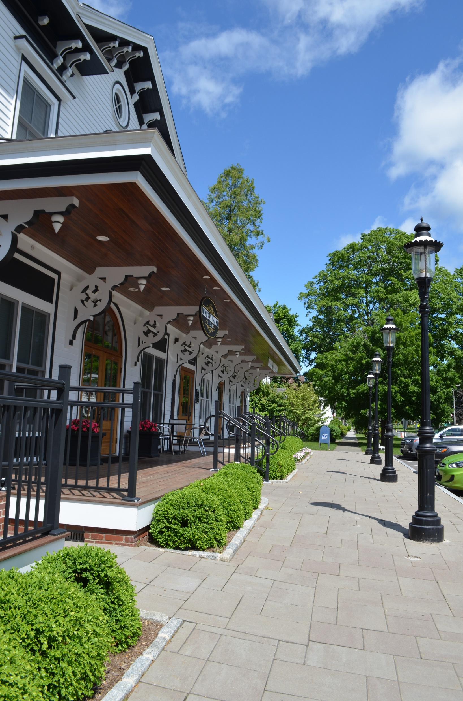
Village District Standards
Required Design Objectives
Building Layout & Orientation
Bldg. arrangement aligns with neighborhood
Neighborhood Road Network
Proposed streets tied to neighborhood road network
Open Space Patterns
Open space reinforces existing open space patterns
Locally Distinctive Vistas
Integrates distinctive vistas and bldgs. into site design
Compatible Landscape
Site landscape shall complement neighborhood landscape
Exterior Lighting & Sign Themes
Exterior lighting, signs, and accessory structures support uniform village theme
Scale, Proportion & Massing
Scale, proportion, massing consistent with neighborhood
Notes:
Unlike other special development zones in Connecticut, a village district created under Section 8-2J of the statutes must adopt seven design objectives shown on this slide. As you can see, building layout and orientation are important for any new development to ensure consistency with existing neighborhood patterns of development. Micro-scale issues are also important including lighting and signage as these can affect the quality of the village district appearance. Unlike Euclidean zoning where permits are granted to individuals to do as they see fit from a design perspective, under village district rules, individual design and placement decision are a team decision – relying on the expertise of the commission and the expert guidance provided by the advisory opinions of architects and/or American Institute of Certified Planners.

Slide 38
What is Village District “Distinctive Character”
8-2 J (a) “The zoning commission of each municipality may establish village districts as part of the zoning regulations adopted under section 8-2 or under any special act. Such districts shall be located in areas of distinctive character, landscape or historic value that are specifically identified in the plan of conservation and development of the municipality.”
8-2 J (b) “The regulations establishing village districts shall protect the distinctive character, landscape and historic structures within such districts…”
Notes:
These objectives together form the framework of a Distinctive Character as defined in the Village district statutes (Section 8-2J), which requires zoning commissions to establish regulations that protect this character.
The concept of distinctive character is associated with two concepts; the surrounding landscape and the historic structures within a designated village district. Yet the range of elements defining “distinctive character” must be interpreted within the seven key statutory authorities of section 8-2J.

Slide 39
Physical Site Characteristics Test
8-2(b) “Zoning regulations adopted pursuant to subsection (a) of this section shall:
(3) Be drafted with reasonable consideration as to the physical site characteristics of the district and its peculiar suitability for particular uses and with a view to encouraging the most appropriate use of land throughout a municipality;”
8-2 (d) “Zoning regulations adopted pursuant to subsection (a) of this section shall not:
(10) Be applied to deny any land use application, including for any site plan approval, special permit, special exception or other zoning approval, on the basis of (A) a district's character, unless such character is expressly articulated in such regulations by clear and explicit physical standards for site work and structures, or (B) the immutable characteristics, source of income or income level of any applicant or end user, other than age or disability whenever age-restricted or disability-restricted housing may be permitted.”
Notes:
Public Act 21-29 placed constraints on the use of the word “character” due to concerns the term was being used to exclude protected classes of people seeking affordable housing. The effect of this legislation effectively qualifies the use of the term “distinctive character” found under Section 8-2J to ensure consistency with the phrase “physical site characteristics” as seen in Section 8-2(b) of the Connecticut zoning enabling statutes.
To avoid misperceptions and maintain consistency with the zoning enabling legislation authorized by PA 21-29, physical site characteristics should be defined by the seven design principles authorized by Section 8-2J. However, in the case of developments that are not proposed in village districts, the term “physical site characteristics” should be explicitly defined in the glossary of the municipal zoning regulations and must address the terms “site work” and “structures.”

Slide 40

Model Definitions
Physical Site Characteristics: The height, number of stories and size of buildings and other structures; the percentage of the area of the lot that may be occupied; site work affecting the size of yards, courts and other open spaces; the density of population and the location and use of buildings, structures and land for trade, industry, residence or other purposes, including water-dependent uses.
Distinctive Characteristics: Building layout & orientation with respect to the neighborhood road network, open space patterns, locally distinctive vistas, capacity to support compatible landscape, and exterior lighting & sign themes including compatible scale, proportion & massing within the village district.
Notes:
Presented here is a model definition for the term “physical site characteristics” that can be used for any development. Except for the addition of the term “site work” this definition carries statutory authority since it represents the language establishing the authority of zoning commissions to regulate land uses in Connecticut under Section 8-2 (a) of the Connecticut General Statutes. The advantage of this definition is that it applies to all development coming before the commission.
However, it is not precise enough to work for development within a village district. In this case, the term physical site characteristics must be based on the seven design principles we previously reviewed.
Distinctive Characteristics: Building layout & orientation with respect to the neighborhood road network, open space patterns; locally distinctive vistas, and capacity to support compatible landscape and exterior lighting & sign themes including compatible scale, proportion & massing within the village district.

Slide 41
There are 71 municipalities with adopted village district regulations representing 106 different village districts. A total of 92% were adopted for various named town or village centers or comparable residential, commercial or historic zones.
Notes:
There are 71 municipalities that have adopted village district regulations and virtually all have applied them to village/town centers or other areas considered village districts not only in name but by tradition.
Despite the typical applications of 8-2J regulations there are a wide range of other innovative applications including enhancing scenic roadways, support economic development with a flair for design, and even to create a “gateway” zone at the entrance to a community.
There is no legal limitation on how a village district can be applied as long as it adheres to the seven design and planning principles set forth in the village district statutes. For example, strip commercial development areas could be governed by a village district if the area in question had distinctive characteristics.

Slide 42
Village District: Strengths v. Weaknesses
# | Strengths | Weaknesses
1 | Enables design flexibility | Multi-layered review process
2 | Has multiple land use applications | Boundary lines may not be same as base zone
3 | Tool to protect neighborhood character | Zoning enforcement relies on complaints
4 | Can be used as an overlay zone | Boundary lines may be poorly mapped
5 | Requires architect/AICP planner review | Limited reservoir of architects/AICP planners
6 | Access to professional planners | Rural municipalities lack professional planners
7 | Doesn’t violate the uniformity rule | Design principles are subjective
8 | Historic commission review NOT required | Doesn’t require consent of property owners
Notes:
Village districts appeal to many Connecticut towns that still have intact village centers. Despite the design benefits they offer, not all municipalities have the resources to manage the regulatory requirements or to acquire architects and certified planners to assist in the review process.
Overlay zones may also be used to implement village districts – an unusual synergistic advantage utilized by Trumbull, allowing for a more deliberative approach to convincing properties to join the village district at some point in the future.

Slide 43
Wide Range of Geographic Scope for Village Districts
Designated Streets, Parcel Sizes or Access Factors
Example: 8 Acre Design District
Base District Zone
Examples: Town Center, Village Center
Intra-District Overlay Zones
Example: Residential-Multi-Office Zone
Notes:
Like floating zones and overlay zones, village districts can be deployed at virtually any level including as base zones, intra-district overlay zones or for specific areas within one underlying zone.

Slide 44
Authority for Village Districts
Public Act 98-116, An Act Authorizing the Establishment of Village Districts
Authorized design standards including design & placement of buildings
Public Act 00-145, An Act Concerning Village District
Authorized link to POCD & expanded reviewer to landscape architects & certified planners
Connecticut Supreme Court Upheld Validity of Village Districts
111 S. Main St. LLC v. Newtown Planning & Zoning Commission (2016)
Notes:
Public Act 98-116 authorized Village Districts in 1998. This authority was modified in 2000 for greater flexibility in design guidelines. Village district regulations have been upheld by the CT Supreme Court in 2016 in a case involving a village district in Newtown, Connecticut.
More widespread use of village district regulations is limited by several factors including the more detailed review procedures required to address architectural design issues, the availability of architects and AICP planners and the level of community interest in protecting the character of Connecticut’s charming, and in some cases vanishing, village squares and village centers.

Slide 45
Village Districts are More than a Name
Village District Authority Based on Seven Design standards and
“…shall establish criteria from which a property owner and the commission may make a reasonable determination of what is permitted within such district.”
Commissions can’t cherry pick standards. Must be based on Section 8-2J of CGS:
Secretary of Interior’s Standards for Rehabilitation and Guidelines for Rehabilitating History Buildings OR
Distinctive characteristics of the district in the Municipal POCD
Notes:
Village districts have precise design guidelines that apply to any district created under Section 8-2J. The statutory revisions made in 2000 to the Village District statutes allows the zoning commission to use its Plan of Conservation of Development to guide design decisions in lieu of reliance on the Secretary of the Interior’s Rehabilitation Standards. This is a significant improvement that simplifies the use of the village district design options.
You should know that not all villages in Connecticut are protected by Village District regulations. To achieve greater use of the 8-2J statute, will require increased public participation in the formulation of village district regulations. As a zoning commission you can play an important role in educating your community and fellow commission members on its benefits – both aesthetic as well as economic.

Slide 46
Summary of Special Development Zones
Special Development Features | Floating Zones | Planned Development Zones | Overlay Zones | Village Districts
Typical Applications
Requires Design Considerations | No | No | Depends | Yes
Used for Industrial Development | Yes | Yes | No | No
Primarily Used for Environmental Protection | No | No | Yes | No
Used for Affordable Housing | Yes | Yes | Yes | No
Zoning Activation Procedures
Requires Zoning Text Change | Yes | Yes | Yes | Yes
Requires Zoning Map Change | Yes | Yes | Yes | Yes
Replaces Underlying Zone once mapped | Yes | Yes | Depends | Depends
Requires a 2 Step Approval Process | Yes | No | No | No
Planning Considerations
Requires Tethering Standards | Yes | No | No | No
Enables Long Range Planning | Yes | Yes | Yes | Yes
Benefits from Prior POCD Support | Yes | Yes | Yes | Yes
Benefits from Neighborhood Compatibility | Yes | Yes | Yes | Yes
Notes:
Here is a summary table of what we have discussed today. While the special development zones are similar in many respects there are also many differences. One major difference is that floating zones require a two-step legislative approval process and the Planned Development Districts generally require a one step approval process. In contrast, the other special development zones do not. Only floating zones require a tethering procedure.
While Floating zones and PDDs do not require design considerations, many of the municipalities that use these two special development zones include detailed design standards within the scope of their legislative authority – often in the form of incentives for design or urban design features.
In all cases, the Plan of Conservation and Development is an important planning tool to implement special development zones across Connecticut. Behind all these special development techniques is the need to customize the regulations to meet neighborhood compatibility.
We have learned that village districts are uniquely authorized to address architectural, landscaping and viewshed issues. We have also learned that floating zones have created standards that fall within their legislative authority to negotiate design conscious development outside of traditional zoning and special permit procedures.

Slide 47

Special Development Zone Observations
Zoning must adjust to changing development needs
Special development zones more flexible than Euclidean Zoning
Districts can be small: “spot zoning” rarely an issue if public interest based
CT Supreme Court has upheld public interest-based vest pocket districts
Courts interpret Uniformity Rule as an intra-district – not inter-district standard
Growing use of floating zones for innovative development
Overlay zones often used for sustainable development
Watershed & groundwater protection overlays are examples
Village districts are not limited by architecture or geography
Notes:
Special development zones are important tools to address developments that do easily fit into Euclidean zoning. Concerns with uniformity of zoning rules within a district have been replaced with concerns with inter-district compatibility including appropriate buffers, setbacks, traffic issues and infrastructure impacts.
Overlay zones are an important tool to protect natural resources and their widespread popularity is an indication that many zoning commissions now recognize their responsbility to address sustainable patterns of development.

Slide 48
Special Development Zone Observations
Special Development Zones Often Inter-Breed
An Overlay Zone can be a floating zone if it is located by rule and not mapped in advance. It can be applied when eligible properties are identified.
A Village District can be an overlay zone when affected properties are not mapped in advance. Mapping may occur when properties are later qualified by the established rule.
Notes:
Finally, let’s now forget the cross fertilization occurring between these four special development zones. An overlay zone can be deployed as a floating zone; a village district can be deployed as an overlay zone and a planned development district can be deployed through a special permit. These permutations of zoning techniques reflect the growing awareness that Euclidean zoning, while still an integral part of all zoning regulations, do not have the flexibility to solve more complex, large scale and mixed use development proposals.

Slide 49
Resources
Elizabeth Garvin, Making Use of Overlay Zones, Planning Commissioners Journal, Number 43, Summer 2001
Kevin E. McCarthy, Office of Legislative Research, Alternative Zoning Techniques, July 28, 2006
Kevin E. McCarthy, Office of Legislative Research, Village Districts v. Historic Districts, December 22, 2003
Terry J. Tondro, Connecticut Land Use Regulation, 2nd Edition, Atlantic Law Book Co., 1992
Dorothy Ariail, Flexible Zoning Techniques, American Planning Association Website, 2007
Catholic University Law Review, Zoning- Floating Zones: A Potential Instrument of Versatile Zoning, Catholic University Law Review, Vol. 16, Issue 1, 1967
Land Use Commissioner Trainings:
https://westcog.org/land-use-commissioner-trainings/
Notes:
You can learn more about special development zones from numerous short articles relevant to Connecticut’s zoning commissioners.
Thanks for attending and we hope this one-hour training session gave you a basic orientation to innovative approaches to managing land development in your municipality.
You can also accessed all of the land use training presentations available to planning and zoning commission and zoning board of appeals members at the following WestCOG website.
https://westcog.org/land-use-commissioner-trainings/

