Slide 1
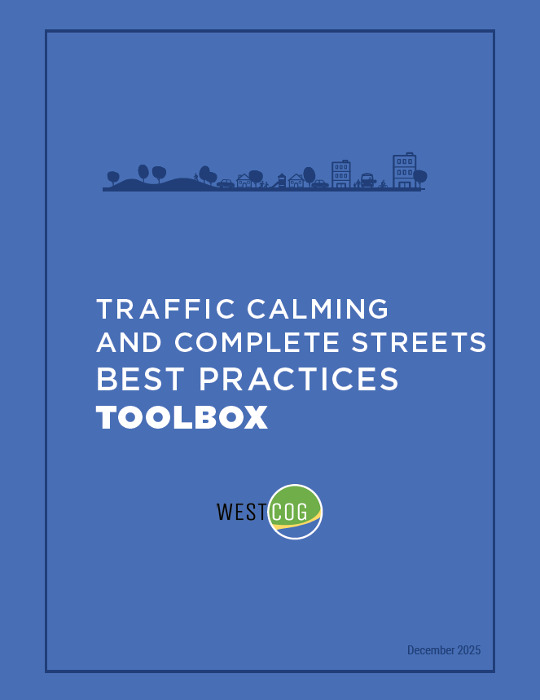


WESTERN CONNECTICUT COUNCIL OF GOVERNMENTS Traffic Calming and Complete Streets Best Practices Toolbox
WestCOG Board Meeting
February 19, 2026

Slide 2
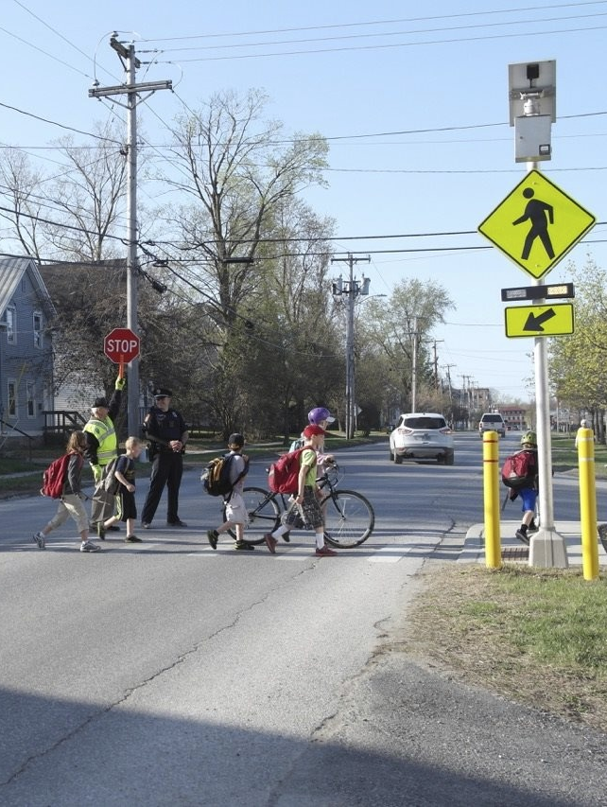
Agenda
Project Overview
How the Toolbox was Created
What’s in the Toolbox
Next Steps

Slide 3
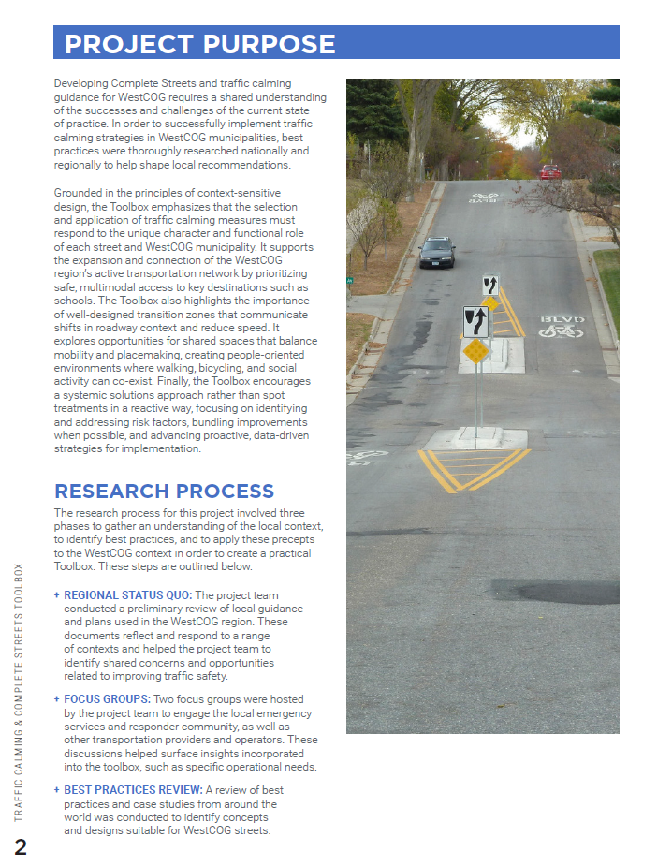
Project Overview
Provides planning precepts and design principles for local and residential roads
A practical “menu” of traffic calming tools to help municipalities plan, design, and implement safer streets

Slide 4
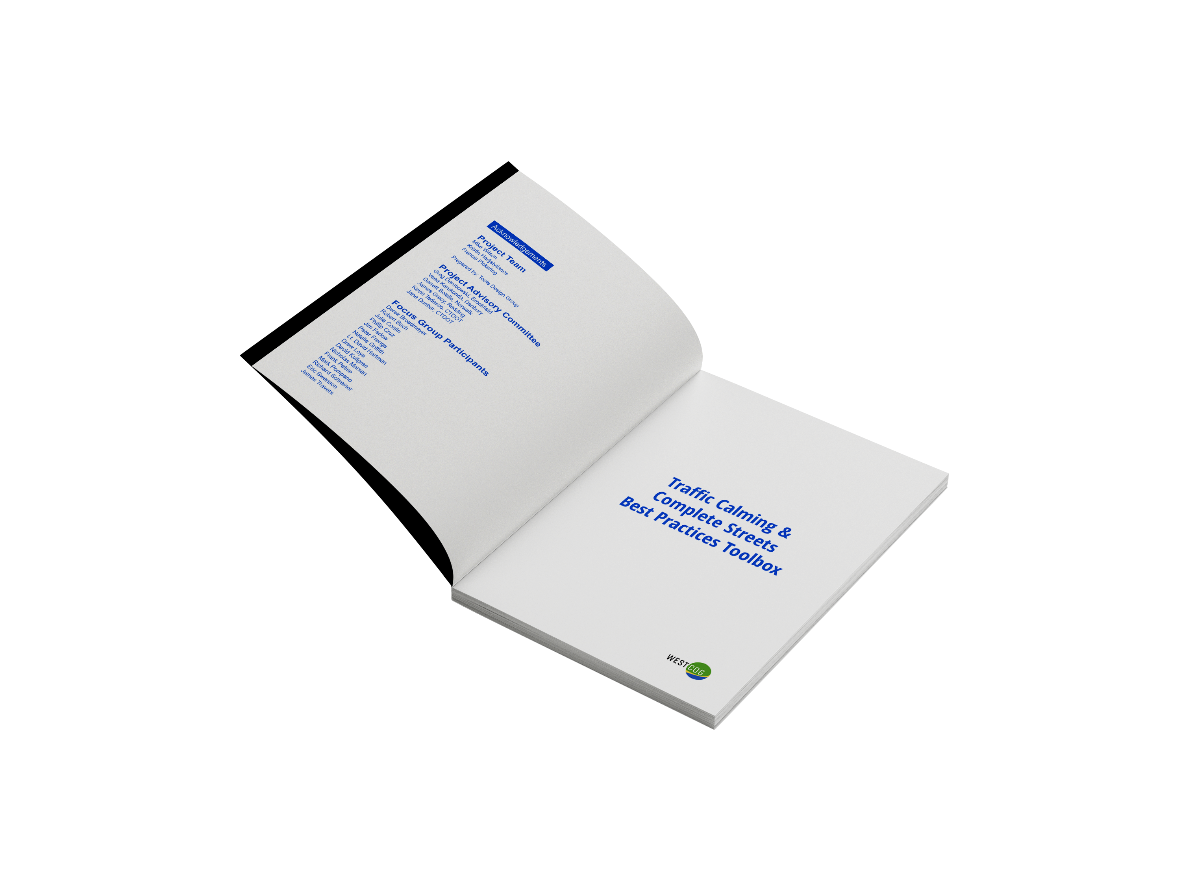

Project Overview: Steps To Date
Regional Status Quo March 2025
Focus Groups April 2025 - June 2025
Best Practices September 2025
Draft Toolbox December 2025
WE ARE HERE!
Traffic Calming and Complete Streets Best Practices Toolbox

Slide 5
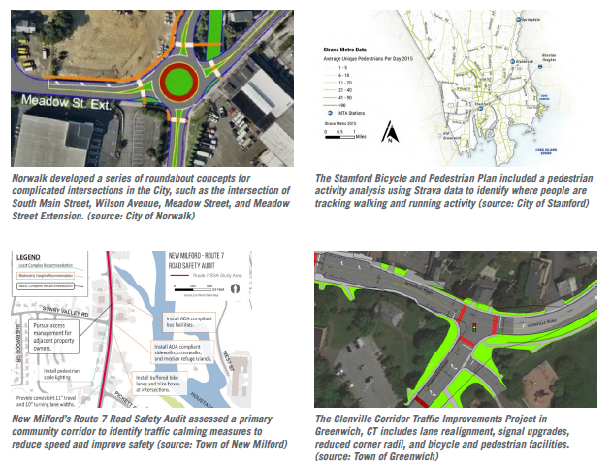
How the Toolbox was Created
Regional Status Quo
Researched and reviewed municipal guidance, manuals, and other resources
Key themes:
Advancing traffic calming and Complete Streets
Realigning intersections
Expanding bicycle and pedestrian infrastructure
Promoting access management
Improving parking management

Slide 6
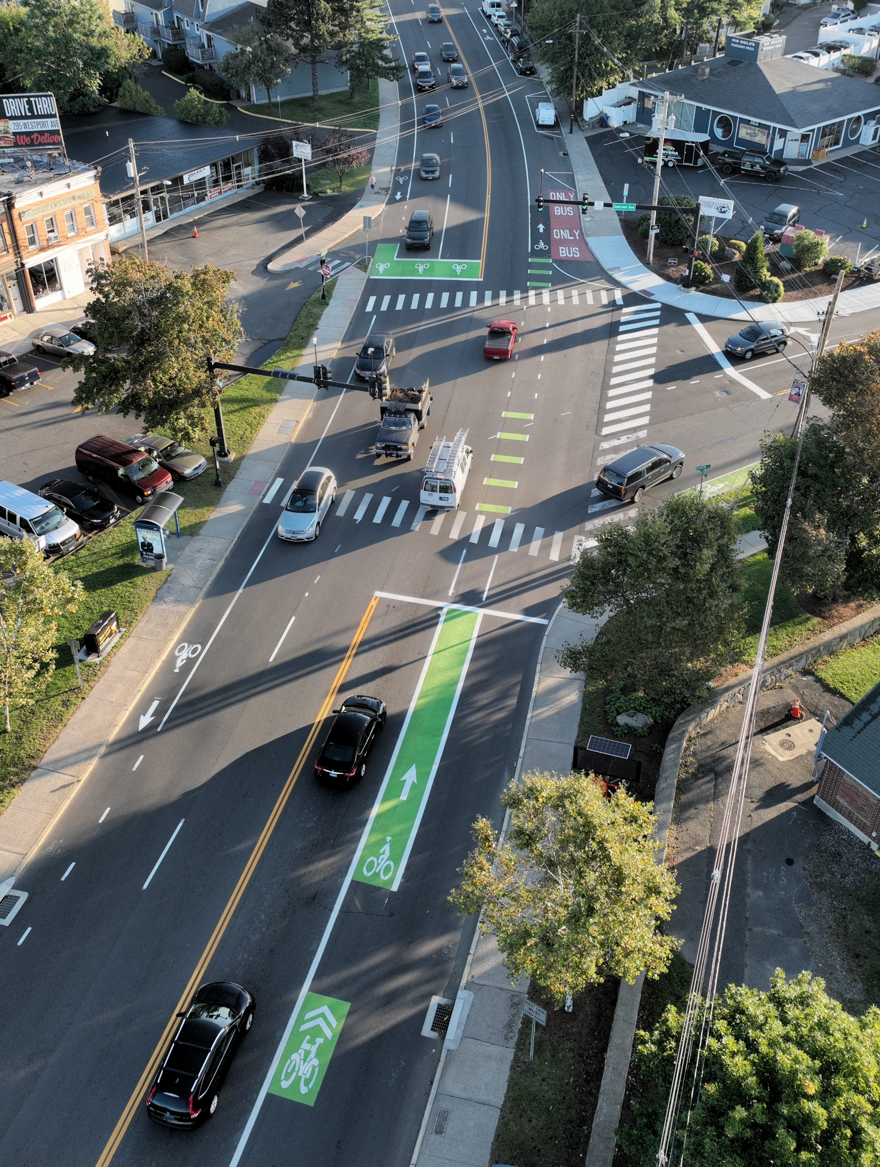
How the Toolbox was Created
Best Practices Review
Key takeaways:
Context-sensitive design is fundamental
Expand and connect the active transportation network
Transition zones are a safety and placemaking priority
Evaluate opportunities for shared spaces
Promote systemic solutions vs. spot treatments

Slide 7

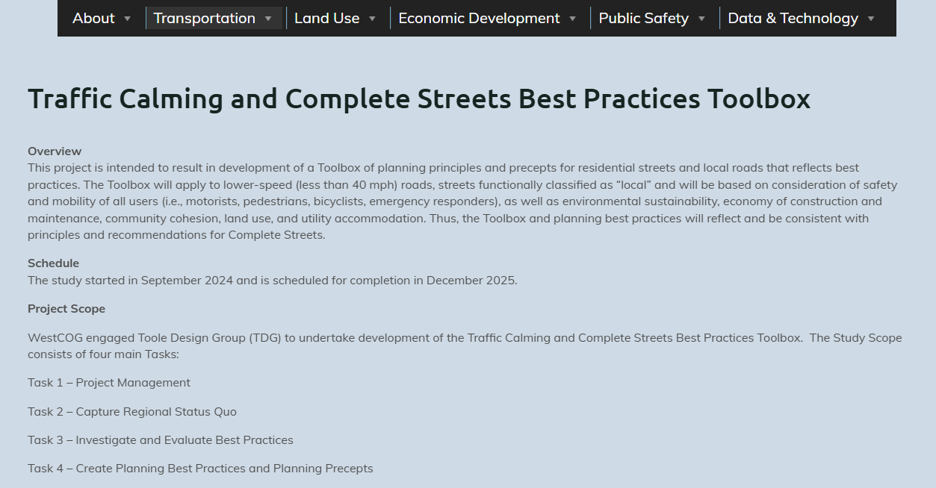
Engagement Throughout the Process
Project Advisory Committee
Focus Groups
Public Workshop
WestCOG Website
CTDOT
WestCOG Technical Advisory Group (TAG)

Slide 8
Project Advisory Committee (PAC)
PAC Engagement
December 2024: Kick-off meeting
Early 2025: Ongoing communication and material/referral requests
October 2025: Research update
December 2025: Draft Toolbox review
PAC Purpose
On-the-ground insight and expertise
Review and provide feedback
Be available for consultation
PAC Member Agencies
Connecticut Department of Transportation
WestCOG
Town of Brookfield
City of Danbury
Town of Redding
City of Norwalk

Slide 9
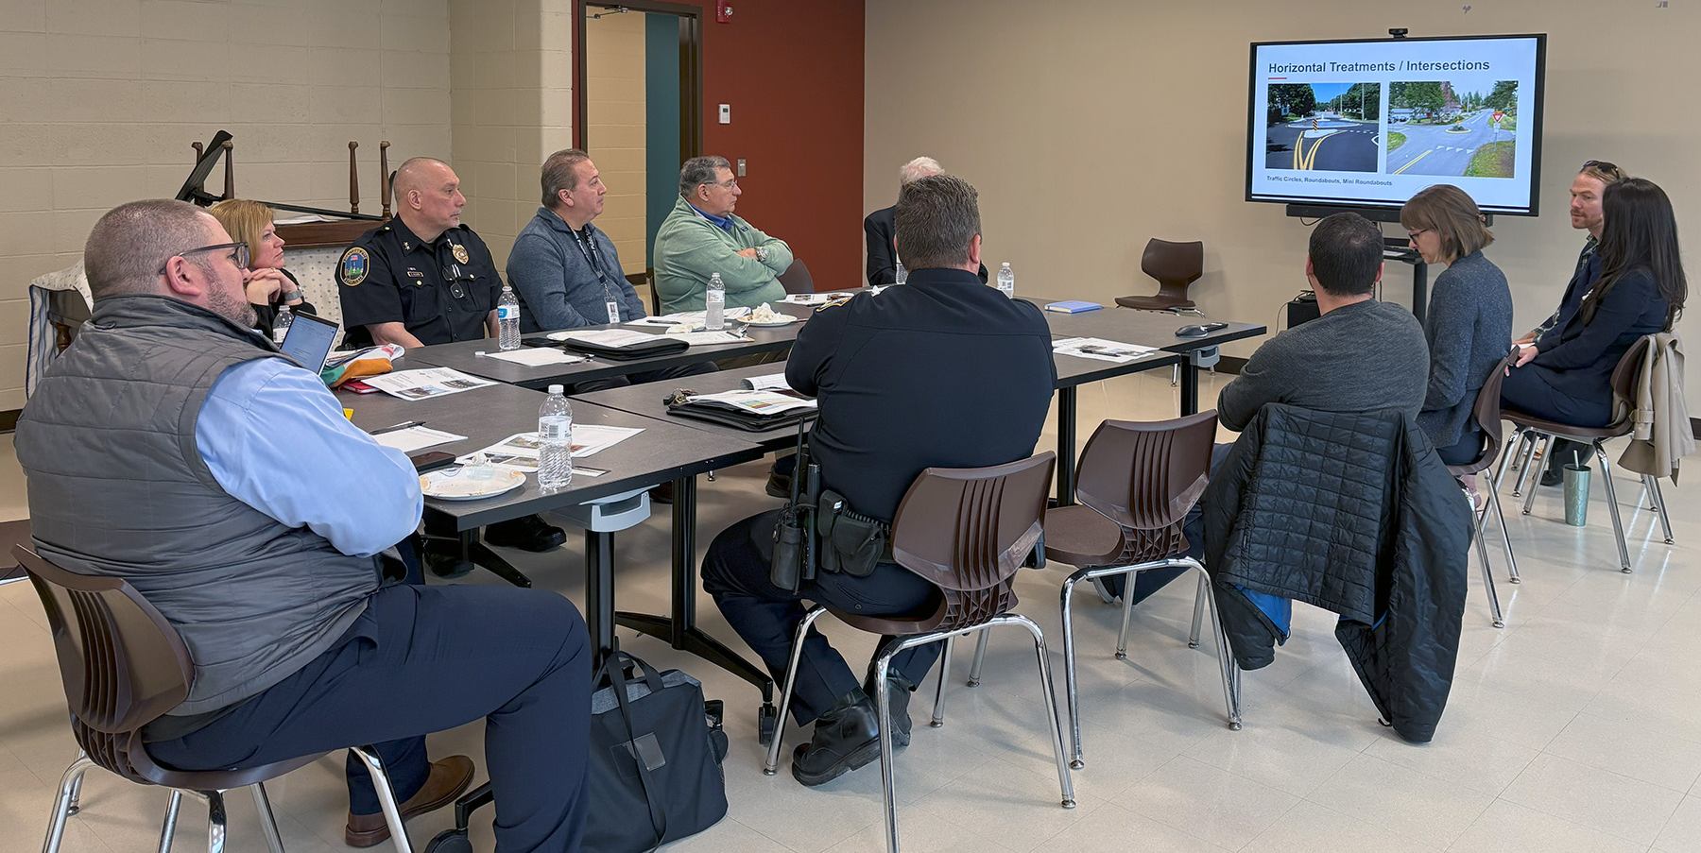
Focus Groups
Municipality | Representation
Bethel | Public Works
Brookfield | Fire Department
Darien | Fire Department
New Milford | Emergency Management
Newtown | Human Services, Police Department, Public Schools
Norwalk | Transit
Ridgefield | Fire Department
Stamford | Transportation Department
Wilton | Police Department
Meetings in April and June 2025

Slide 10
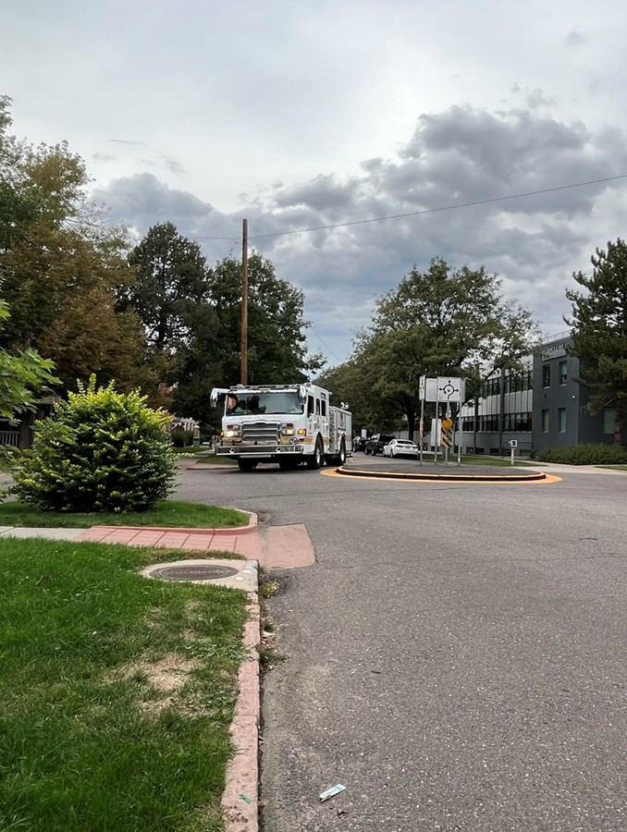
Focus Groups
Key insights:
Challenges with rerouting onto local roads
Constraints with legacy networks
Preference for raised crosswalks
Coordinating tools with development
Support education & enforcement tools

Slide 11
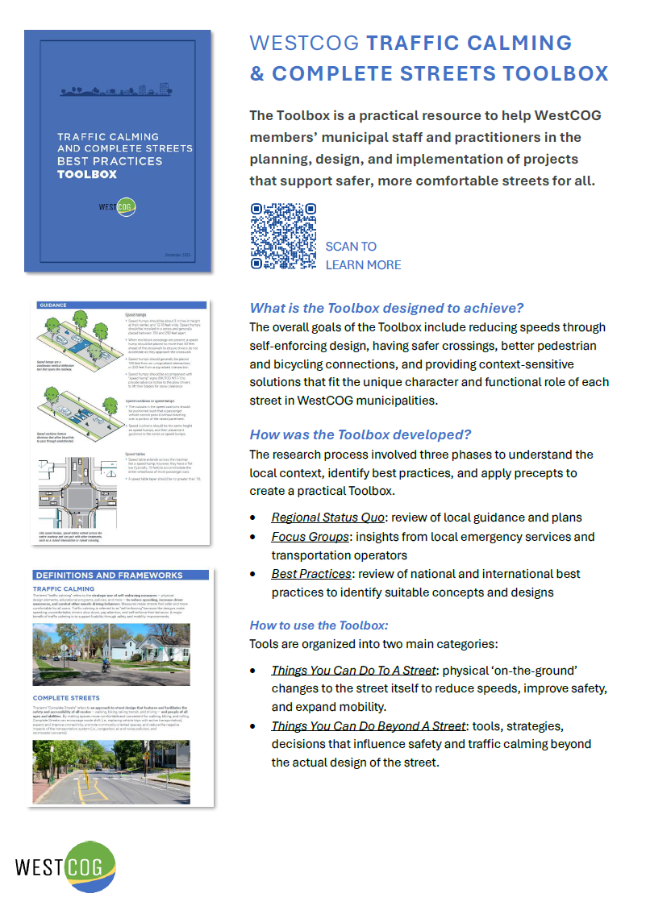
Public Workshop
December 9, 2025
Approximately 25 participants from various WestCOG municipalities
Feedback on draft toolbox (general), specific tools, and the elements referenced (e.g., suitability and resources)

Slide 12
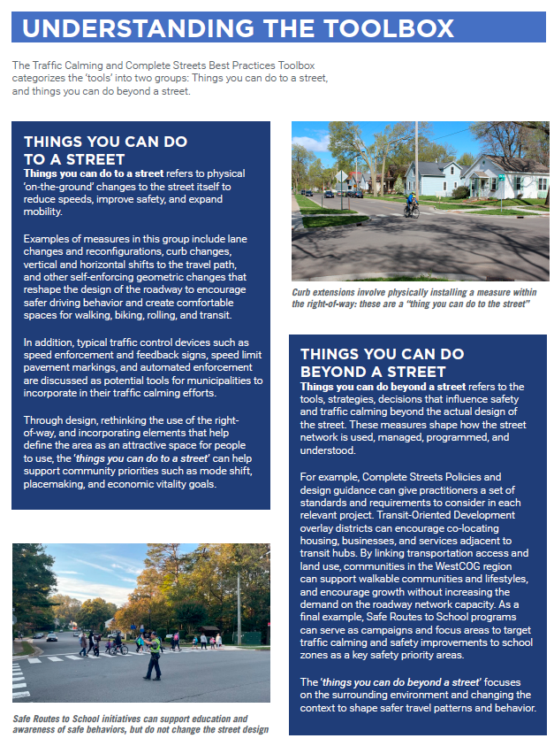
What’s in the Toolbox?
Things You Can Do To A Street
Physical changes to the right-of-way and traffic control devices such as lane reconfigurations, curb changes, automated enforcement, etc.
Things You Can Do Beyond A Street
Policies and programs such as zoning/guidelines, safety education, transit-oriented development, etc.

Slide 13
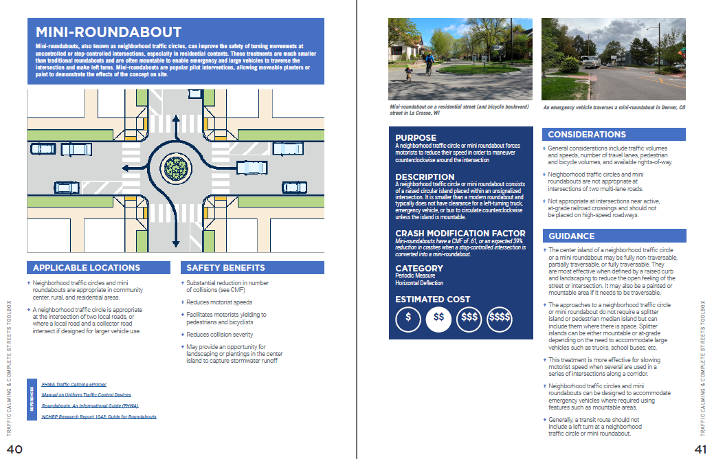
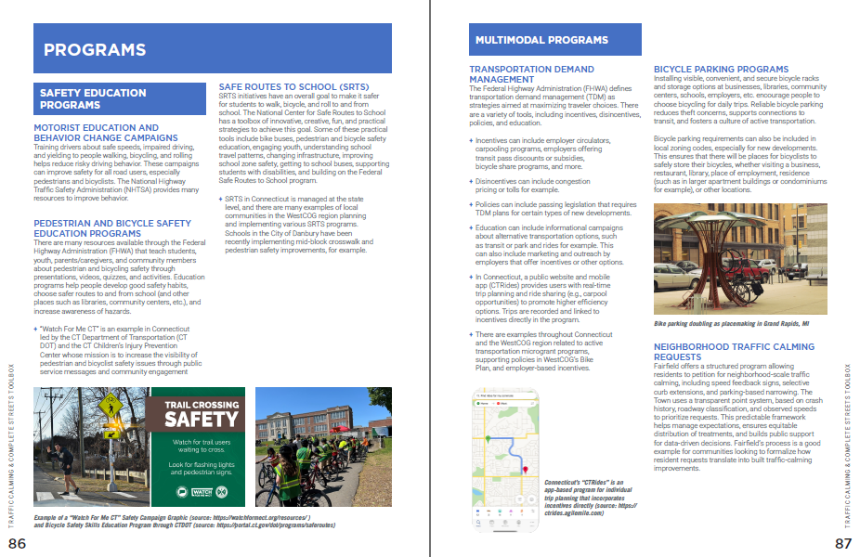
What’s in the Toolbox?
Special Street Types
Periodic Measures
Cross-section Changes
Traffic Control Devices
Softening the Street
Programs and Planning

Slide 14
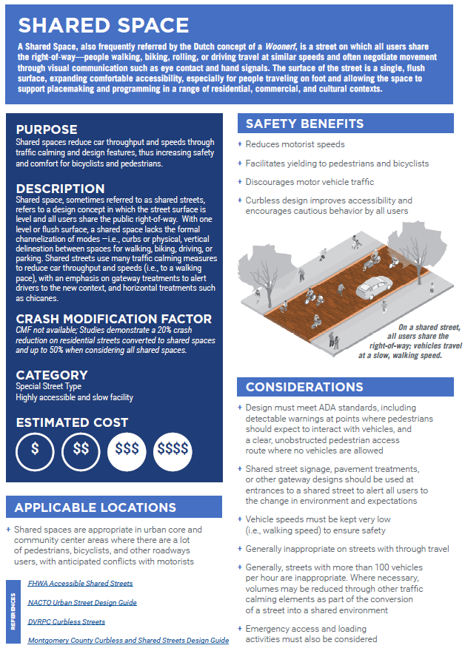
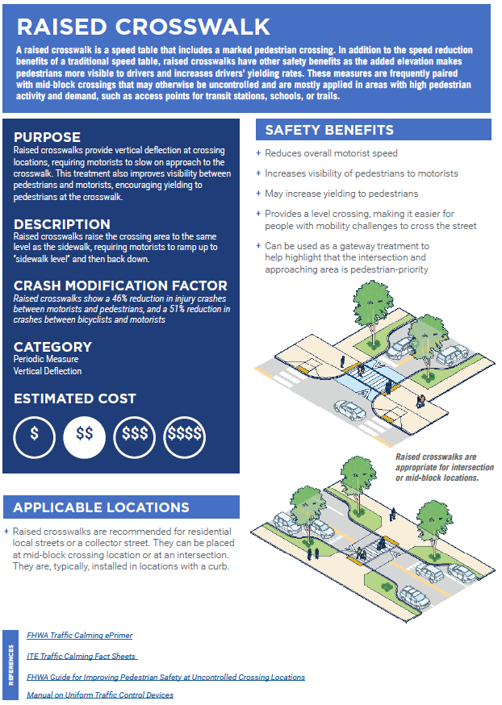
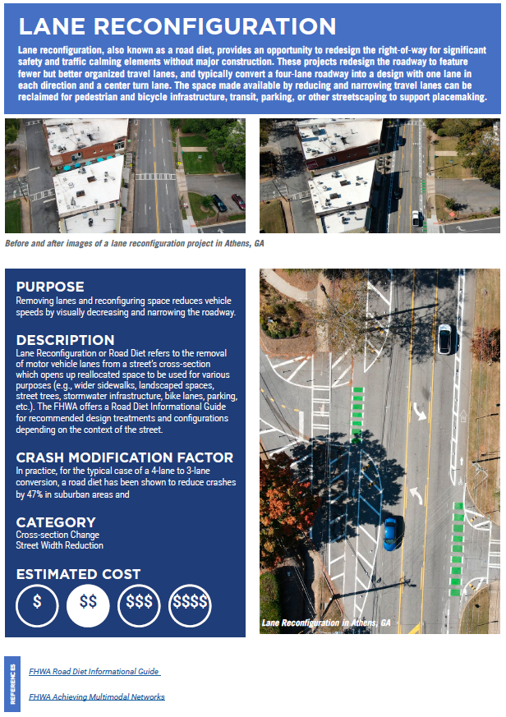
Snapshots from the Toolbox…

Slide 15
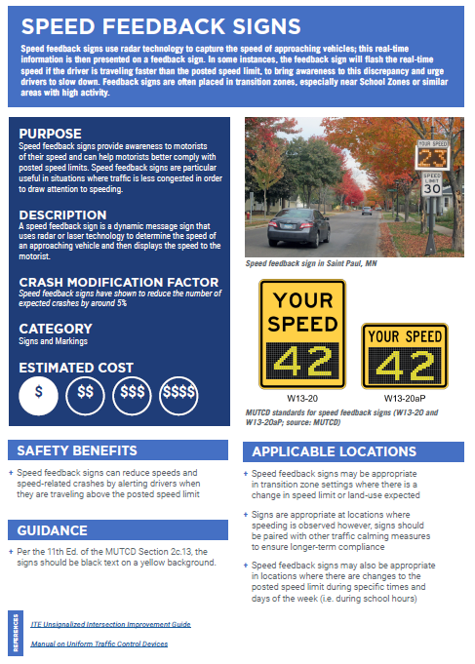
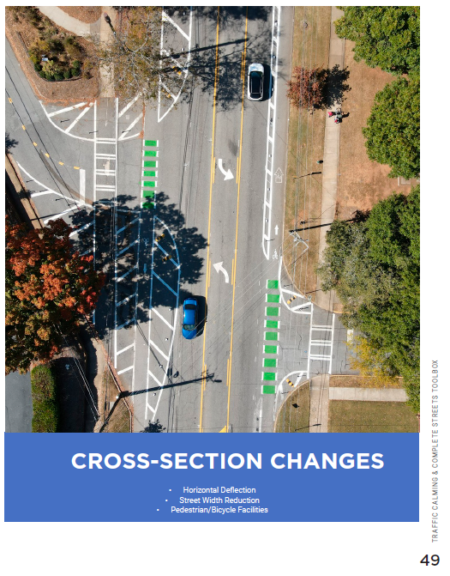
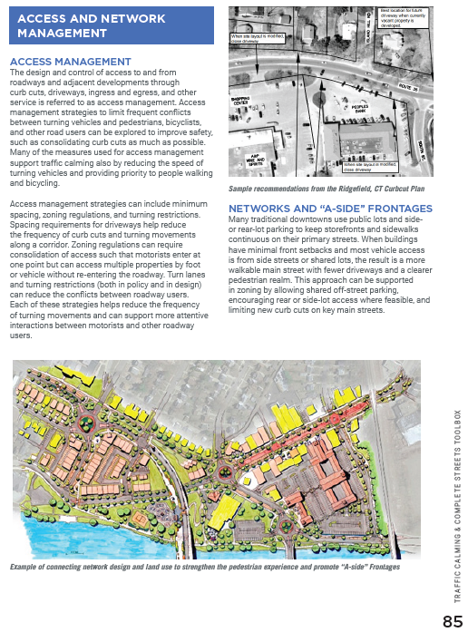
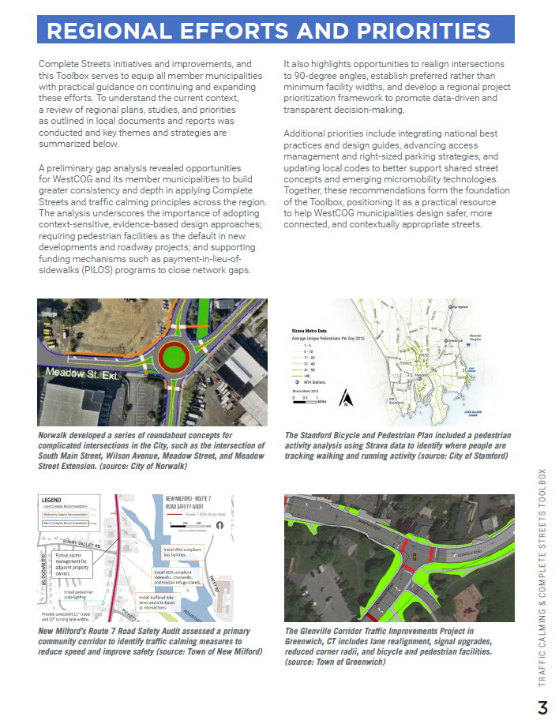
Thank You!
Learn More:
https://westcog.org/transportation/traffic-calming-and-complete-streets/

Slide 16
Questions? Contact:
Mike Wilson | mwilson@westcog.org
Carrie Long | clong@tooledesign.com

