Slide 1
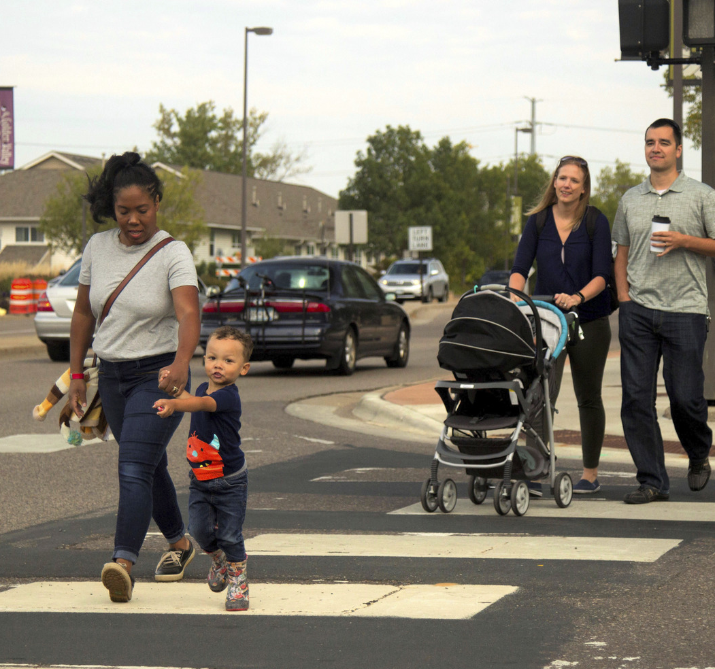


WESTERN CONNECTICUT COUNCIL OF GOVERNMENTS
Traffic Calming and Complete Streets Best Practices Toolbox
Project Advisory Committee Kick-off Meeting
December 10, 2024

Slide 2
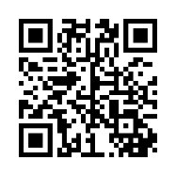
Agenda
Welcome and Introductions
Project Background, Goals, and Objectives
Project Tasks and Schedule
Role of the Project Advisory Committee (PAC)
Next Steps and Discussion

Slide 3
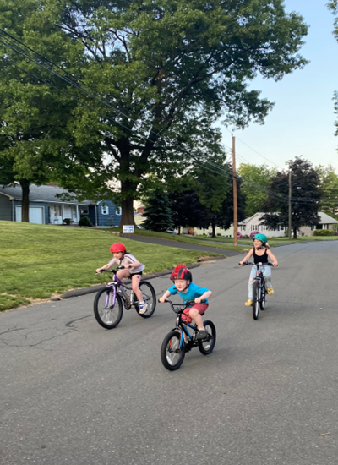
Introductions
Introductions and Ice Breaker:
  Name
  Role or Representing…
Thinking back to your younger days (i.e., middle school-aged), what is your favorite memory of getting around?

Slide 4
Project Background
Traffic Calming 101
Project Background

Slide 5
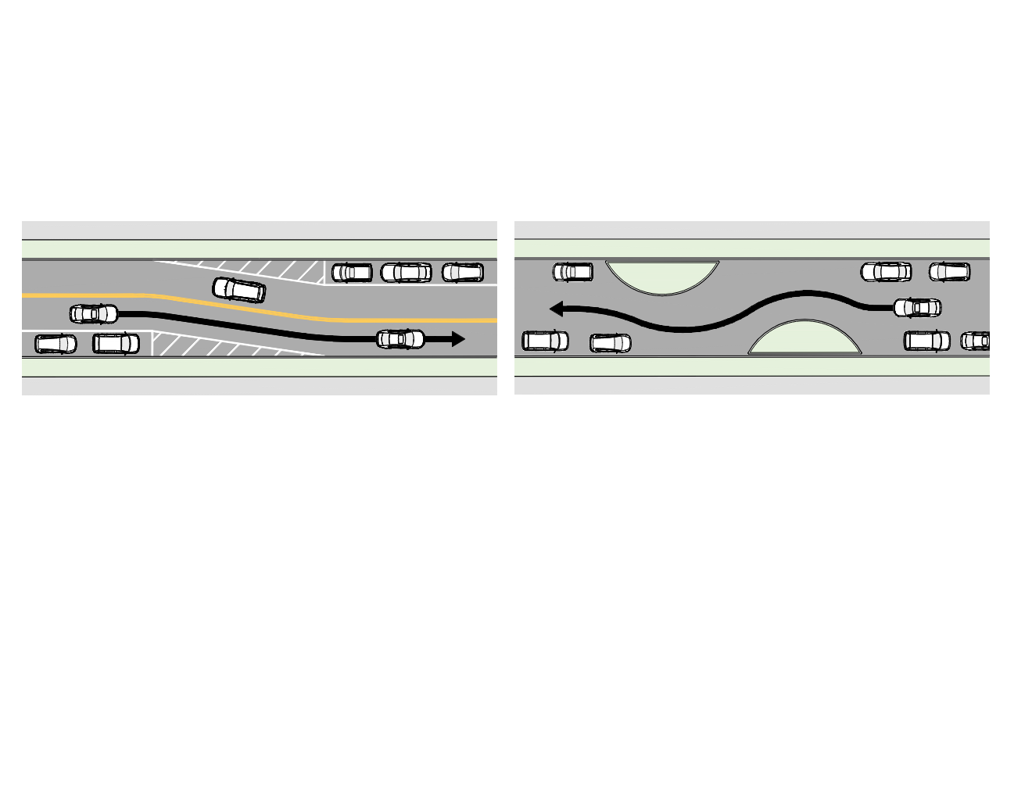
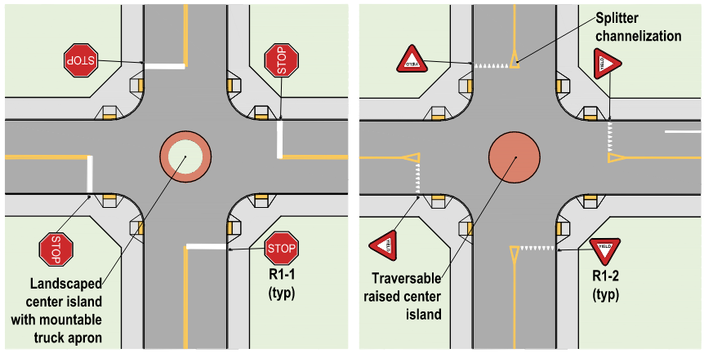
TRAFFIC CALMING 101
What is Traffic Calming?
A combination of mainly physical measures that:
reduce the negative effects of motor vehicle use;
alter motorist behavior;
improve conditions for non-motorized street users.
ITE Traffic Calming: State of the Practice (1999)

Slide 6
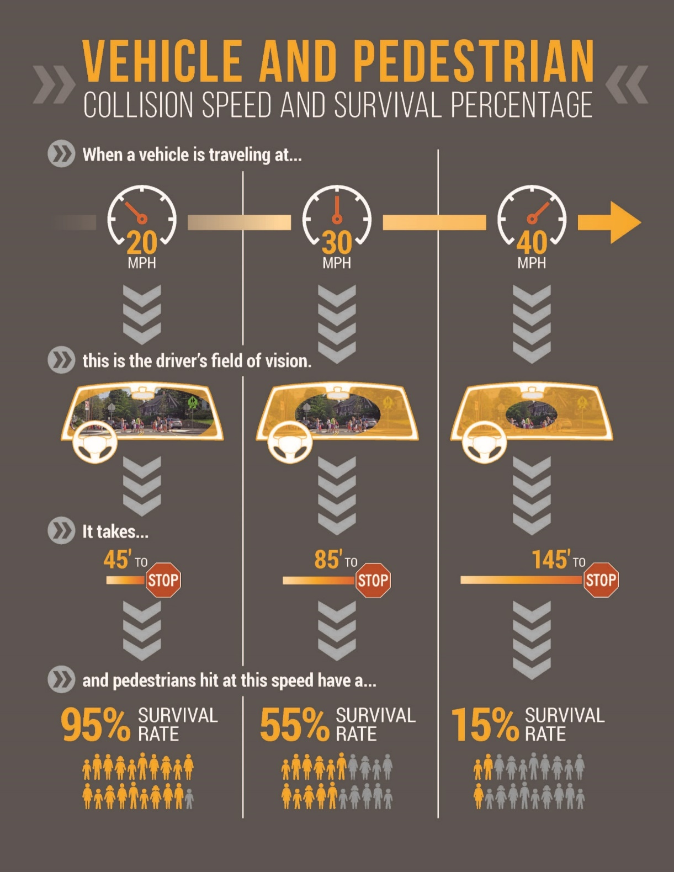
Speed and Safety
In Connecticut, excessive speed was a factor in more than 25% of fatalities, with 60% of speeding-related fatalities on roadways with posted speeds under 40MPH.
Source: 2021 Connecticut Highway Safety Office

Slide 7
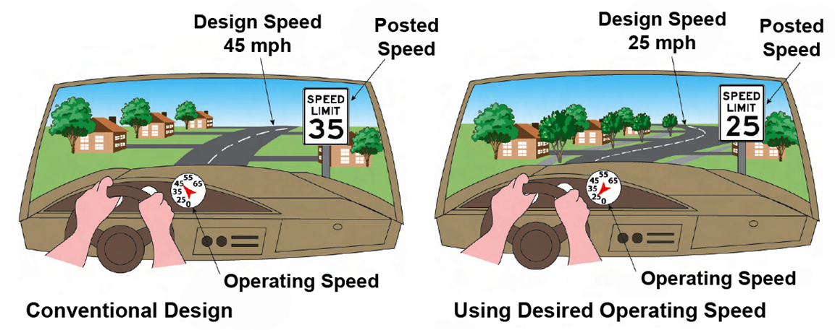
Design Speed & Operating Speed
CONVENTIONAL DESIGN
USING DESIRED OPERATING SPEED

Slide 8
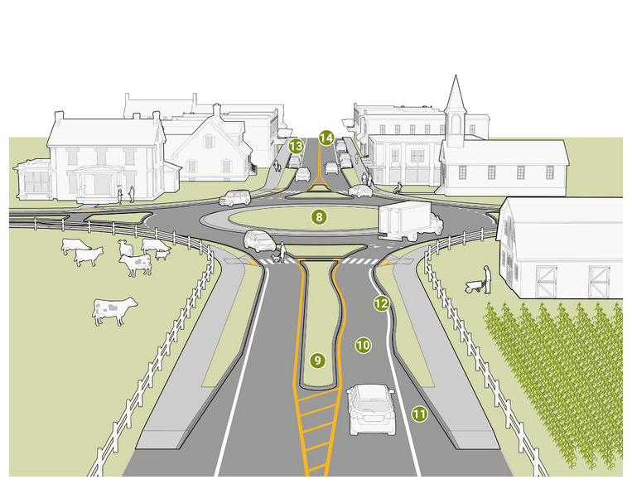
Transition Zones and Gateways
Alert drivers to change in the environment and character
Gradual reduction in speed
    Approach: Warning and psychological (signs, VMS, pavement color)
    Transition Zone: Physical countermeasures (medians, lane width)
    Gateways: Define new environment
8. Raised Medians
9. Reduced Lane Width
10. Shoulder Removal
11. Curbline
12.. Tall Vegetation, Street Tress, other Landscaping
Source: 2021 FHWA Achieving Multimodal Networks

Slide 9
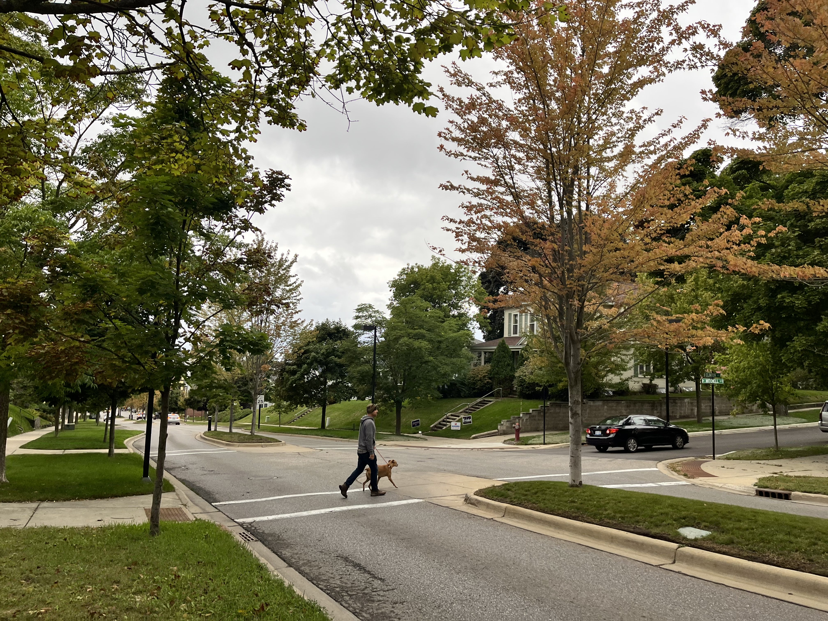
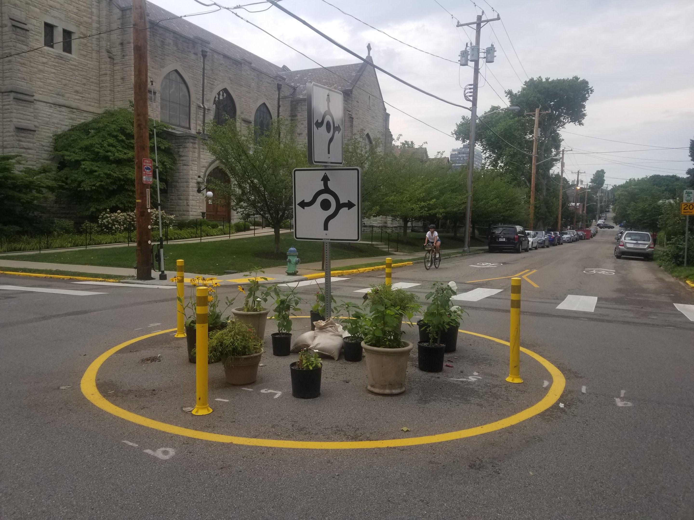
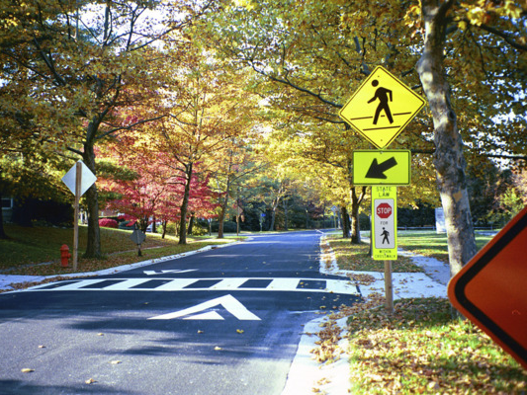
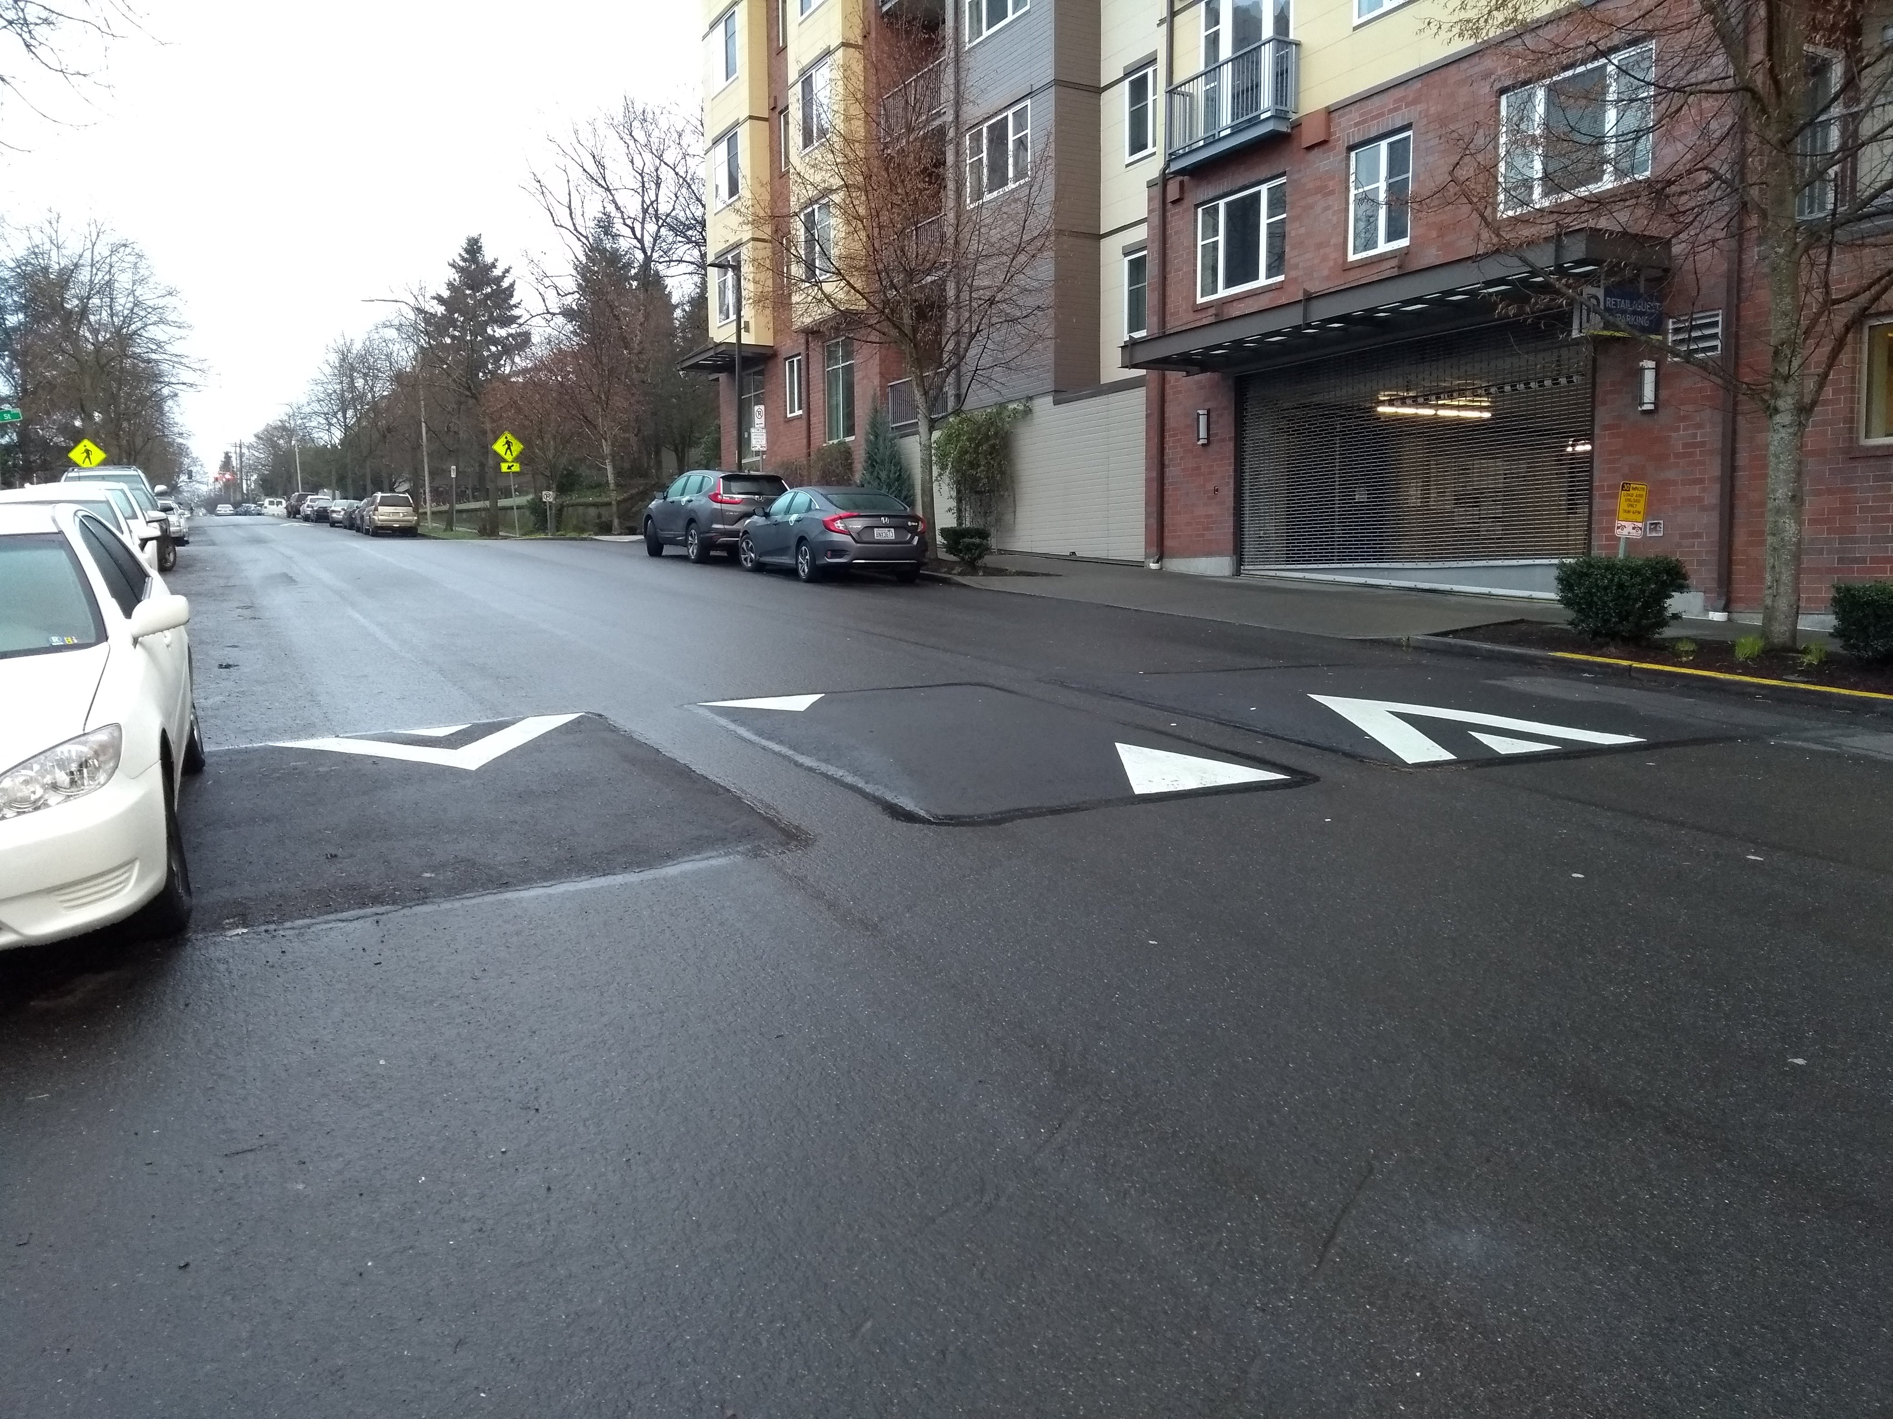
Elements of Traffic Calming
Horizontal Deflection
Lateral shifts
Gateways
Traffic circles
Vertical Deflection
Speed humps
Raised crosswalks
Raised intersections

Slide 10
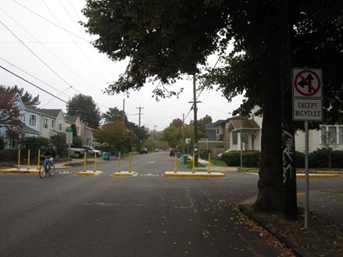
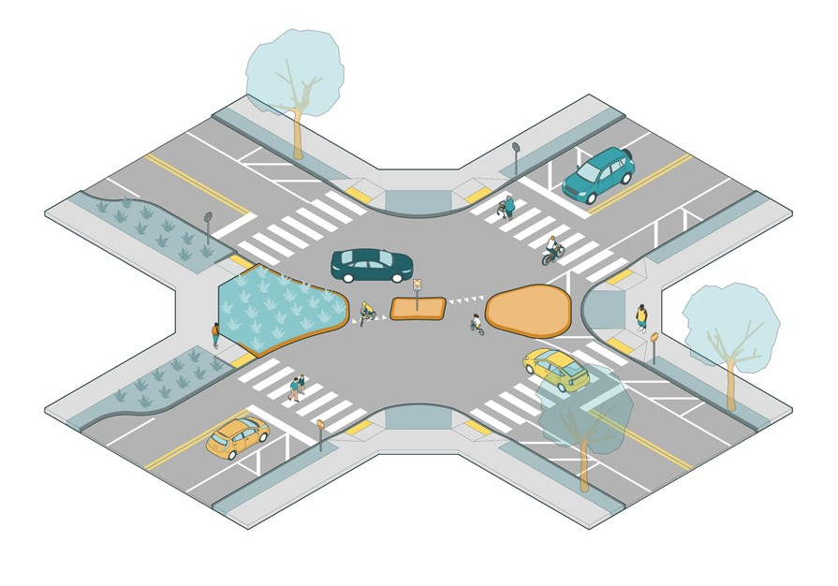
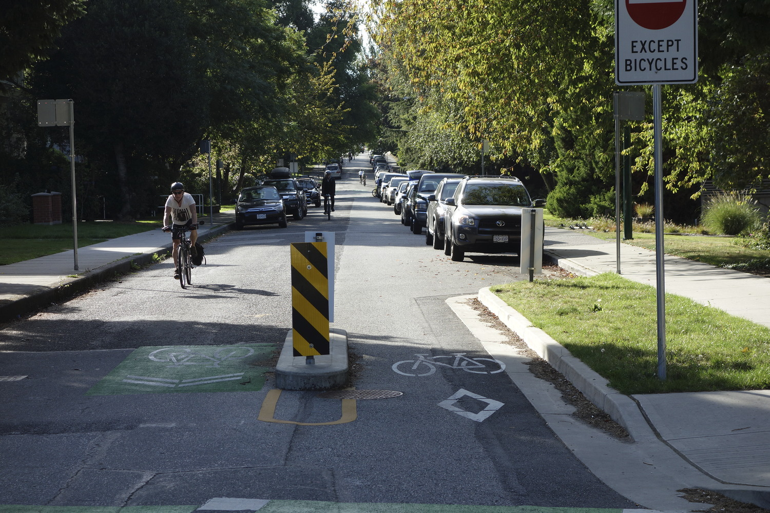
Elements of Traffic Calming
Physical Obstructions
Diverters
Street closures

Slide 11
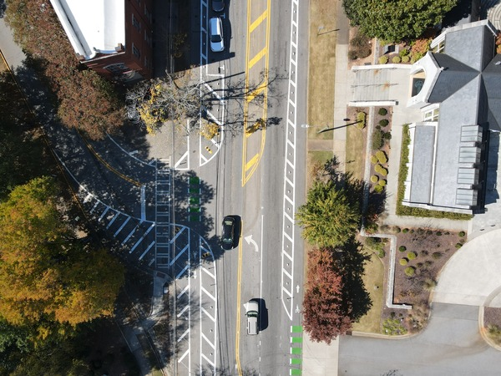
Elements of Traffic Calming
Lane Narrowing
Road diet
Adding on street parking
Introduction of bike lanes
Stormwater run-off mitigation
Notes:
A type of traffic calming that can be useful on higher volume streets that serve a larger purpose in the street network is road diets

Slide 12
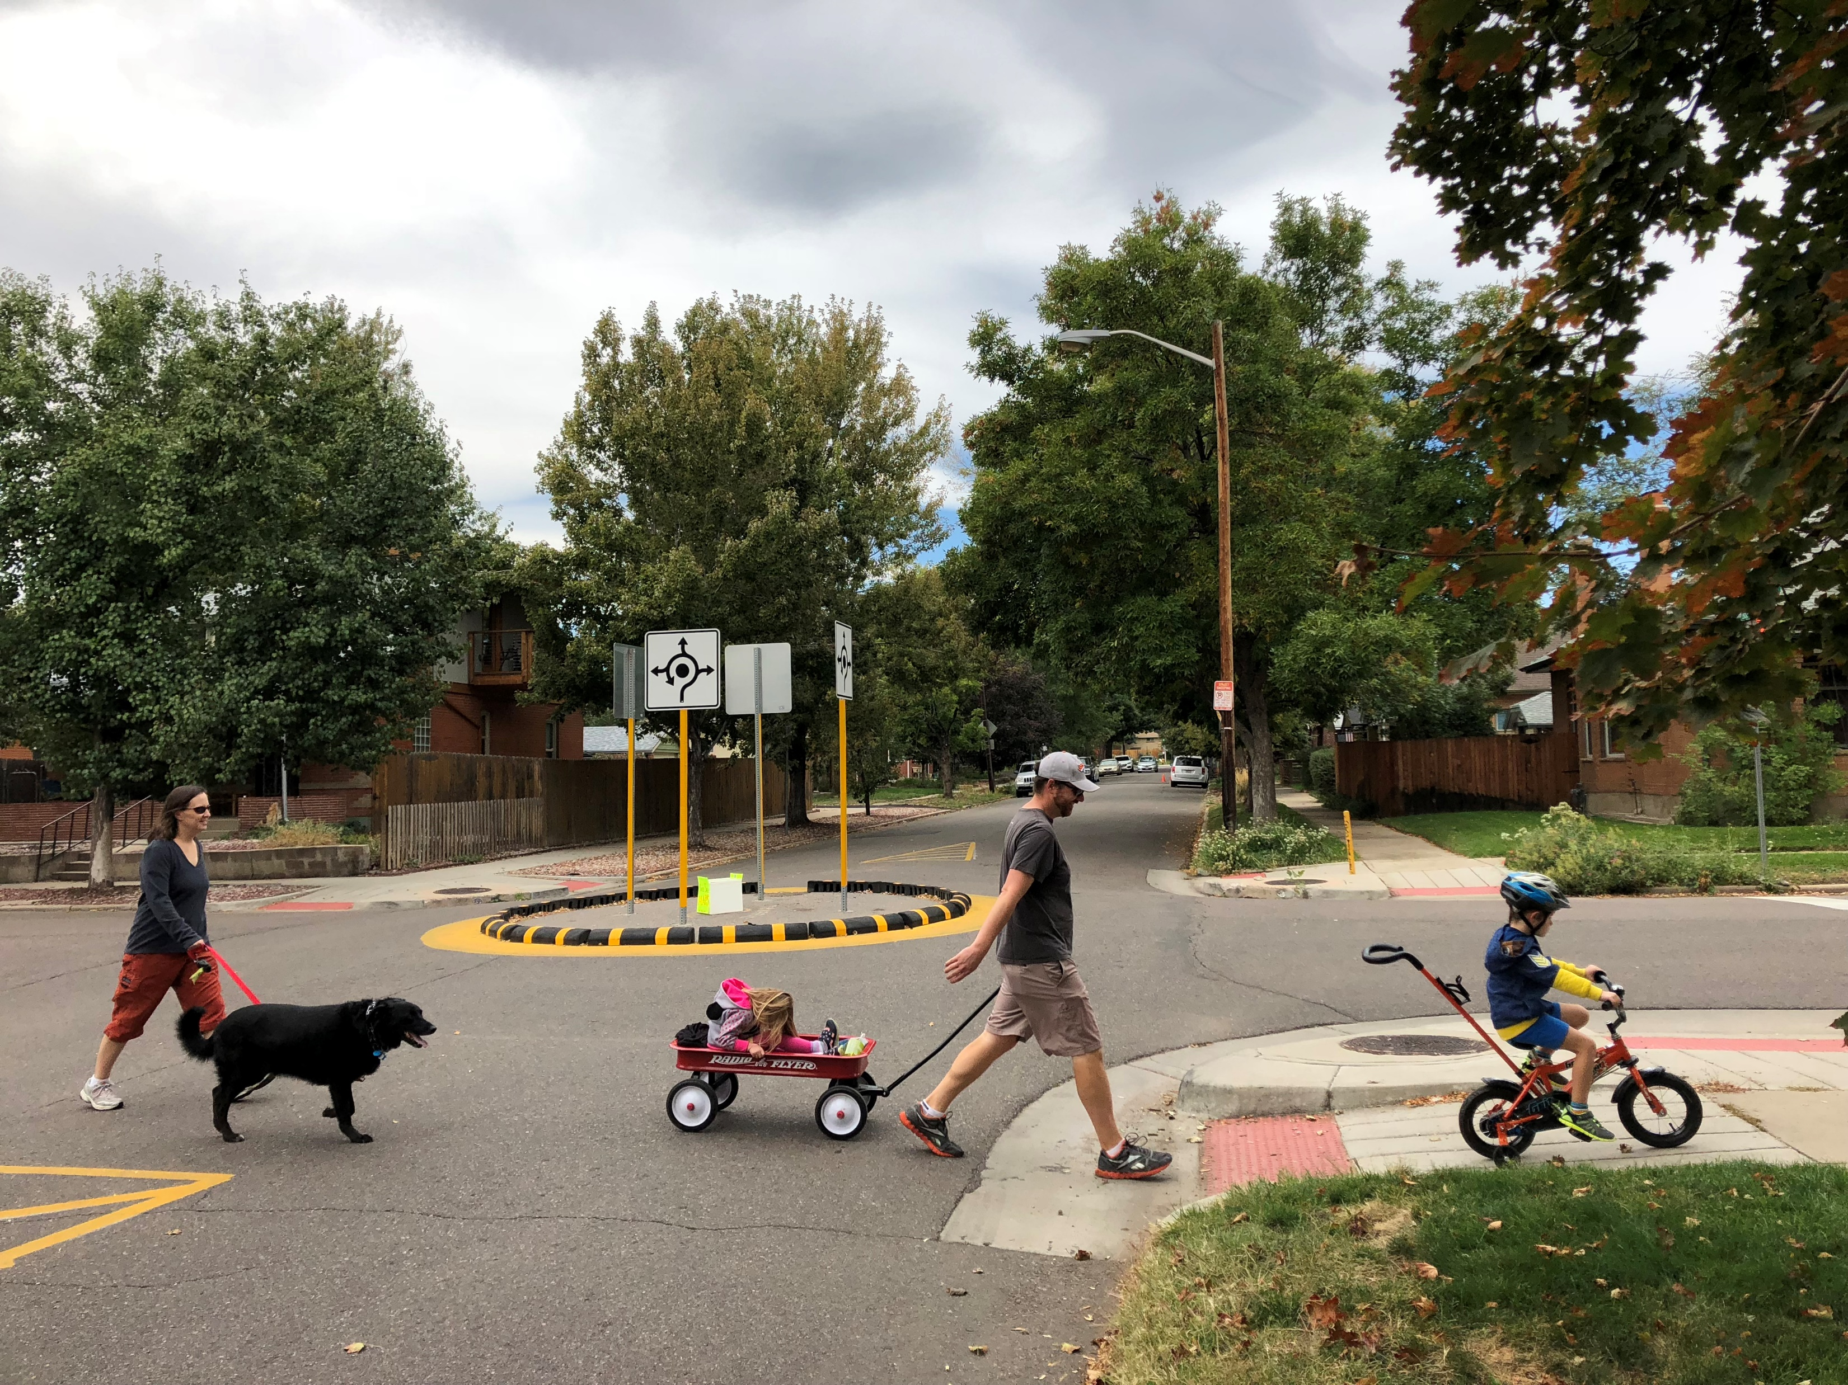
The Principles of Traffic Calming
Reduce motorist speed to the desired operating speed as consistently as possible through a corridor
Avoid unintentionally diverting motorists to parallel routes

Slide 13
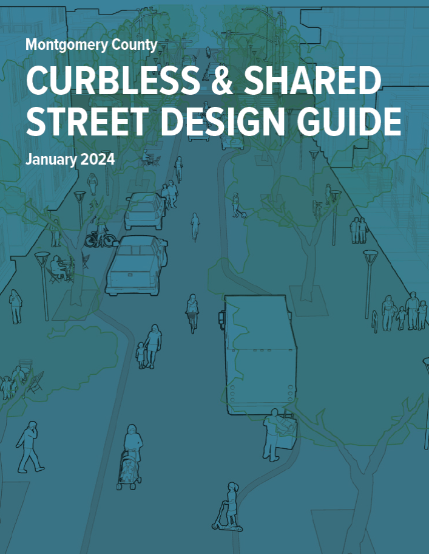
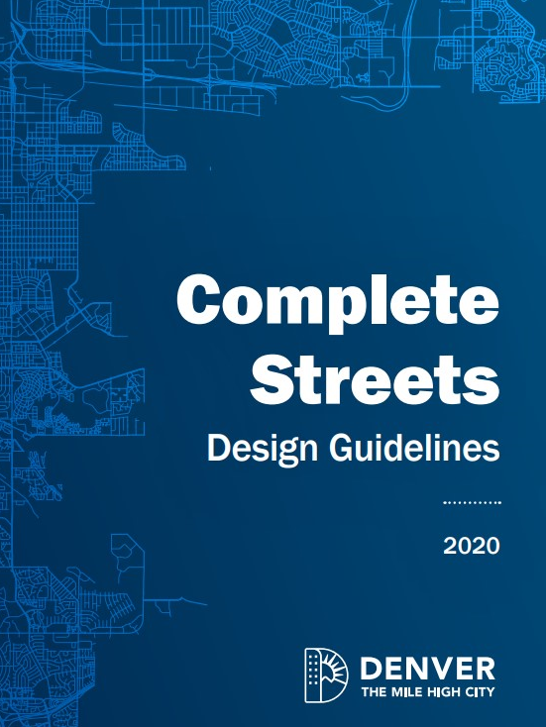
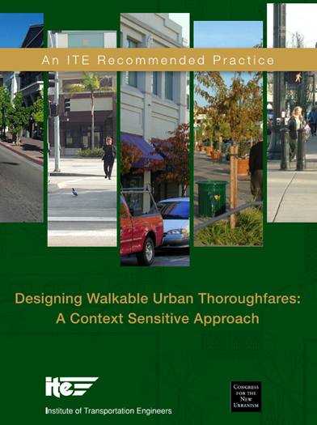
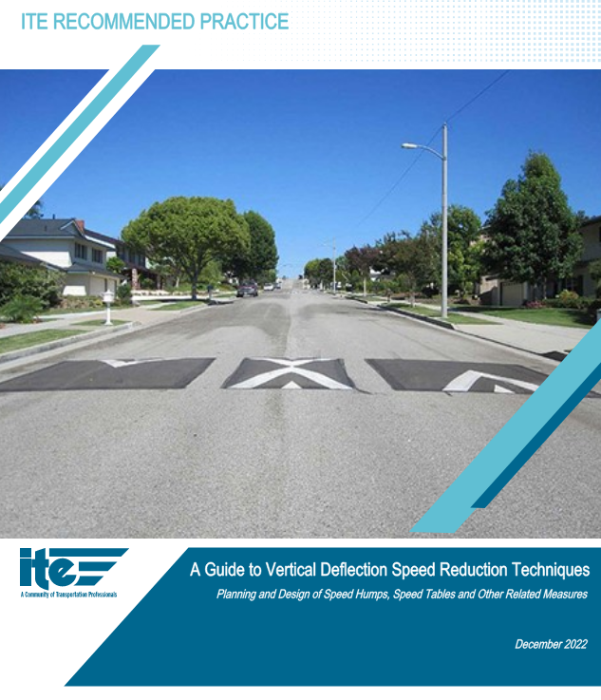
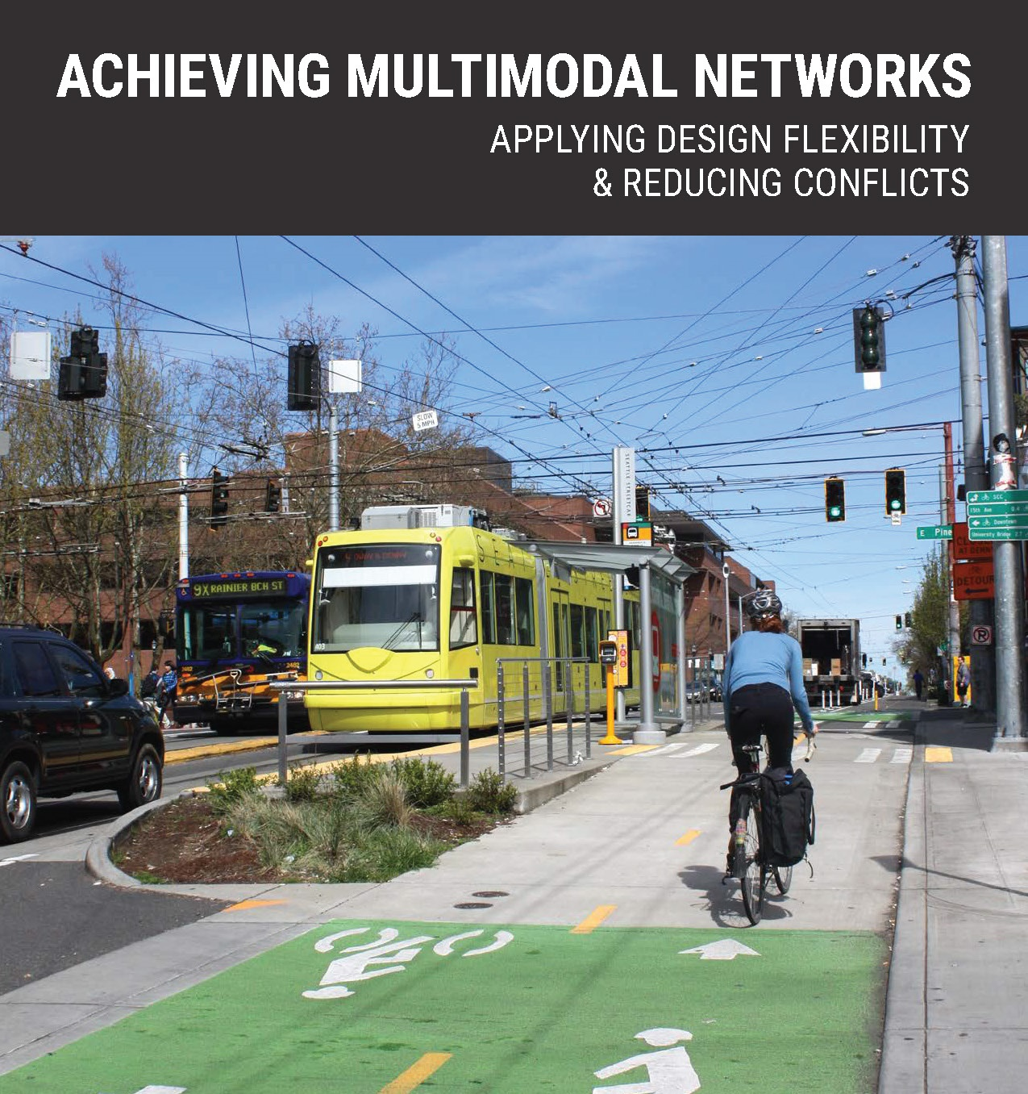
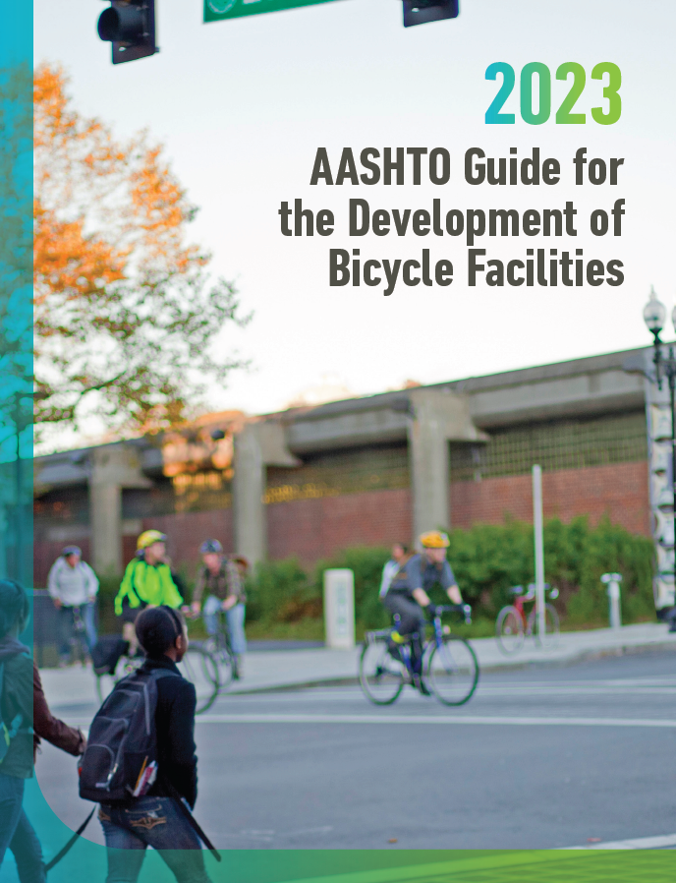
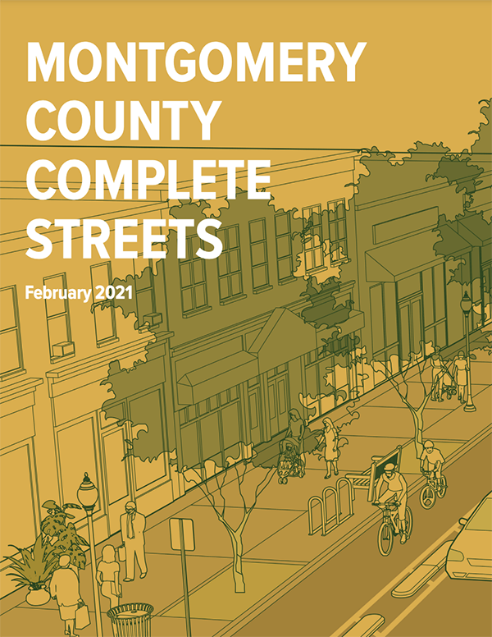
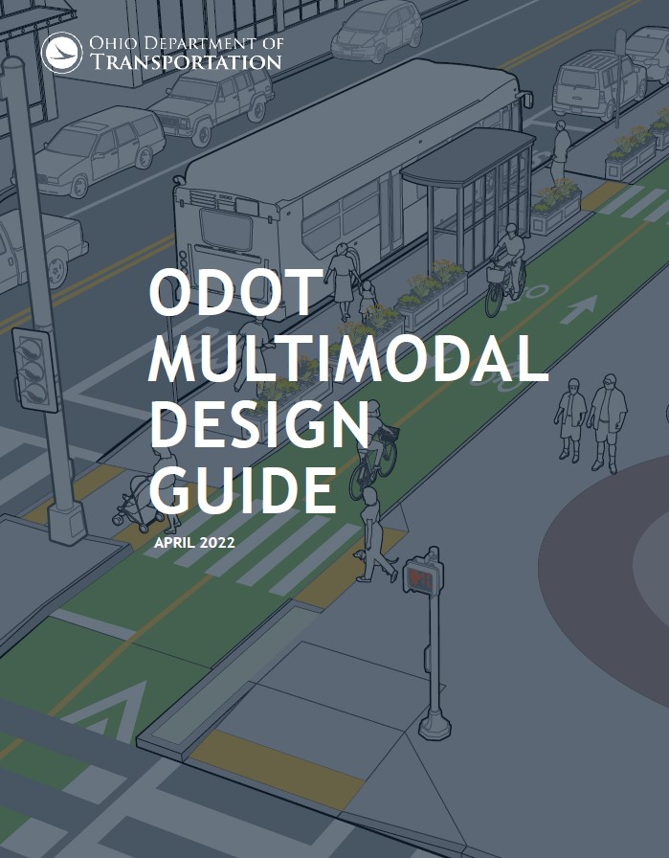


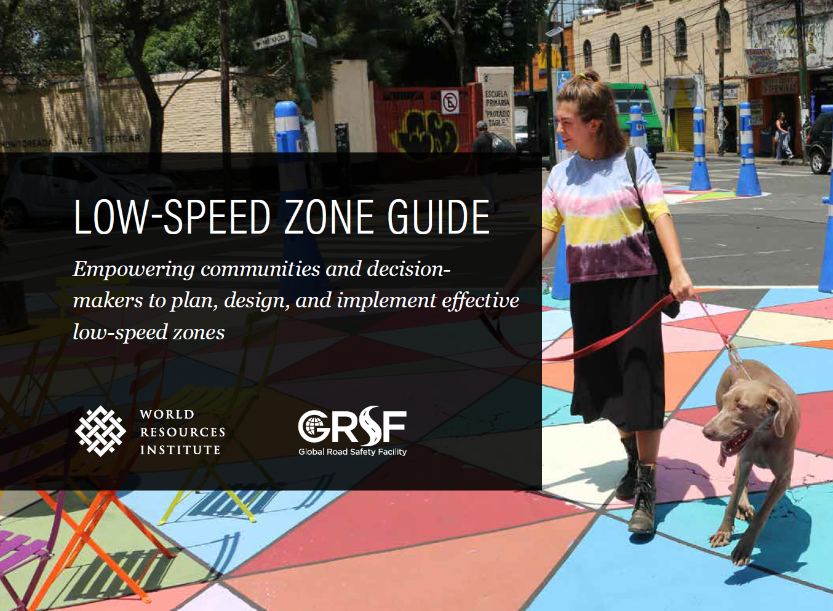
Traffic Calming Resources
Notes:
There are many resources out there that provide a traffic calming toolkit of sorts – a description on the different types of traffic calming treatments and the types of effects they may have on motorist speed and volume. Since treatments will be included in another training I’ll refrain from listing those here.
However from a higher planning level there are a few resources that I have found helpful:
ITE’s Design Walkable Urban Throughfares: A Context Sensitive Approach provides information on network and corridor planning that can be very useful when talking to community about potential impacts of diverting motorist traffic to other streets
ITE recently published A Guide to Vertical Deflection Speed Reduction Techniques that discusses key planning issues, public engagement process, and before-after study information for elements such as speed humps.
The Pennsylvania Department of Transportation released a traffic calming manual in 2012

Slide 14

How do we get there?

Slide 15
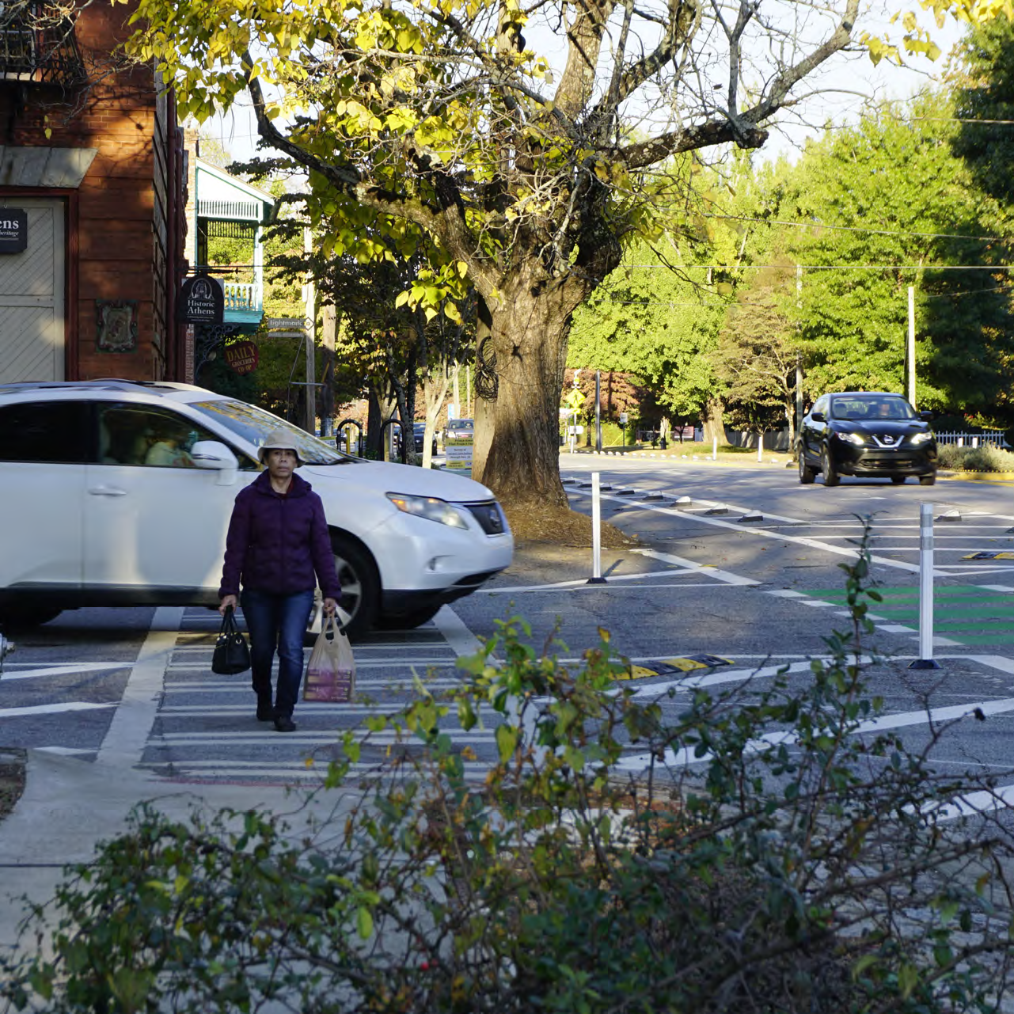
PROJECT BACKGROUND
Purpose of the Toolbox
The Traffic Calming and Complete Streets Best
Practices Toolbox will provide planning precepts
and design principles for local and residential roads.
This Toolbox will:
Reflect best practices and updated guidance
Provide traffic calming treatment and features
Be an alternative to the HDM

Slide 16
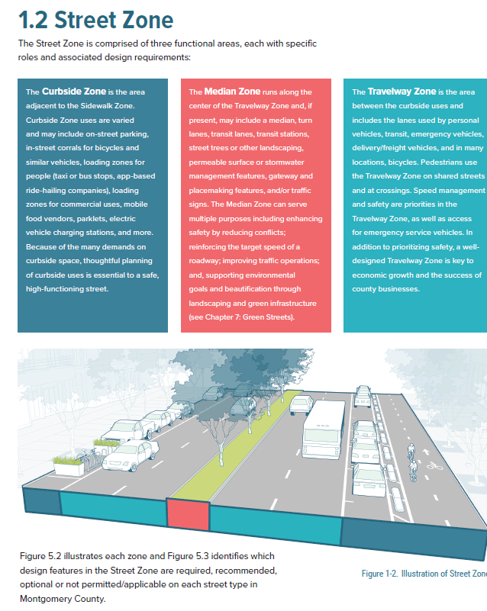
Purpose of the Toolbox
Advance a systemwide approach to decision making
Coordinate with Municipalities and with CTDOT
Reflective of WestCOG Context
Flexible, Educational, Integrated;
Intuitive and Comprehensive

Slide 17
Project Tasks
& Schedule

Slide 18
Project Tasks
Task 1: Project Management
Task 2: Regional Status Quo
Research and review of Municipal guidance, manuals, and other resources
Task 3: Best Practices
Task 4: Best Practices and Precepts Toolbox
Planning Precepts (Round 1 and Round 2)
Best Practices in Traffic Calming and Complete Streets
Ongoing Project Management, Reports, and Meetings
Technical Memo
Emergency Services Focus Groups & Considerations
Applicability to WestCOG Region
Draft and Final Toolbox

Slide 19
Project Schedule
Task | D | J | F | M | A | M | J | J | A
Task 1 Project Management | ♦
Task 2 Regional Status Quo |  |  | D
Task 3 Best Practices |  |  |  | D | F
Task 4 Planning Precepts and Toolbox |  |  |  |  |  |  | D |  | F
Project Advisory Committee | ☒ |  | ☒ |  |  |  | ☒ |  | ☒
♦ | Kickoff Meeting
☒ | PAC Meeting
SM | Stakeholder Meeting or Focus Group
D / F | Draft and Final Deliverable

Slide 20

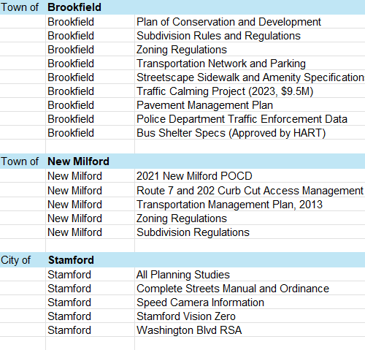
Regional Status Quo
Inventory municipalities’ standards and guidance used by municipalities for street design decision-making
  Identify considerations that inform street design and maintenance
  Technical Memo on existing standards
  Have documents to share? Send materials to Mike at mwilson@westcog.org
This Photo by Unknown Author is licensed under CC BY-NC

Slide 21
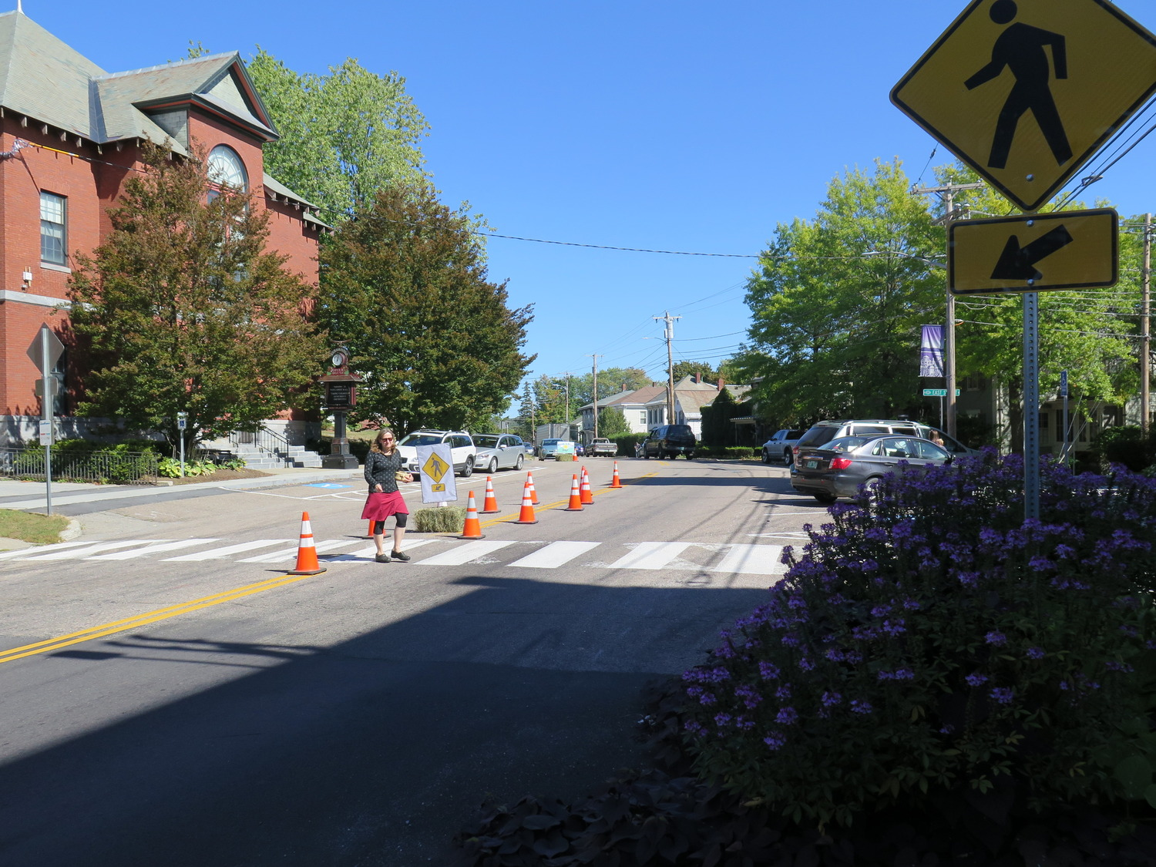
Compile Best Practices
Compiling planning standards and practices relevant to the WestCOG region
Consider relationship with land use and the built environment
Perform analysis on data and resources to shape precepts (i.e., impacts of interventions)

Slide 22
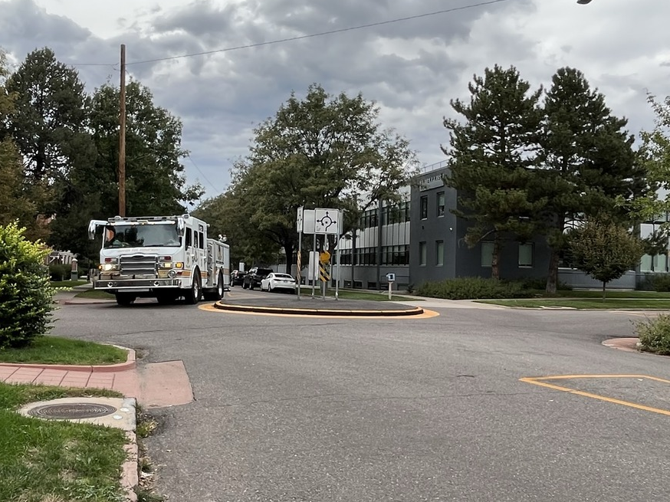
Focus Groups
Focus groups with First Responders and Emergency Service
Feedback, concerns, and perspectives will inform Toolbox
Have recommendations for agencies or individuals? Share via chat or email Mike at mwilson@westcog.org

Slide 23
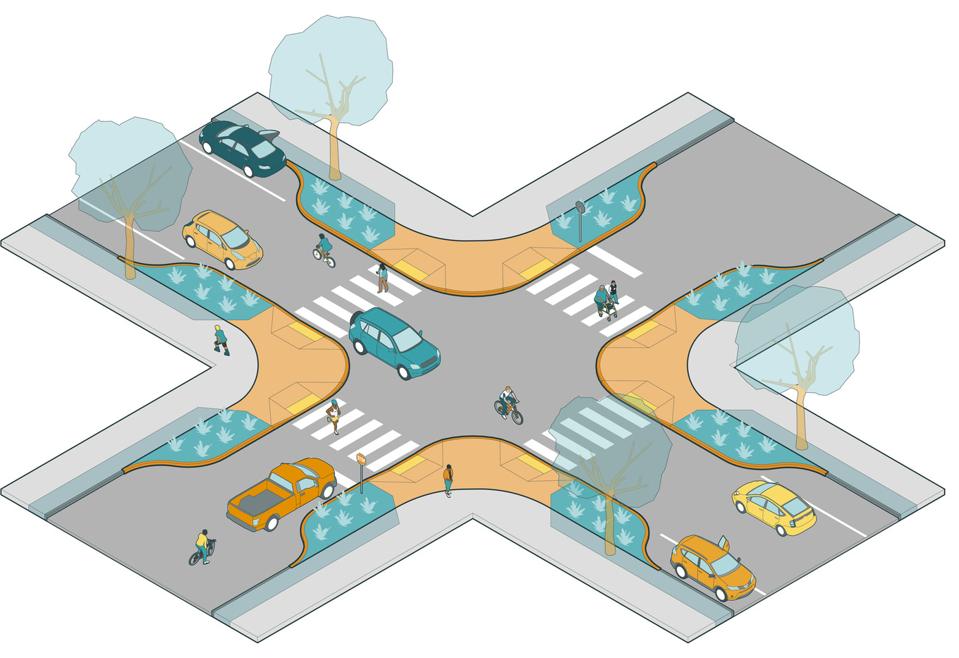
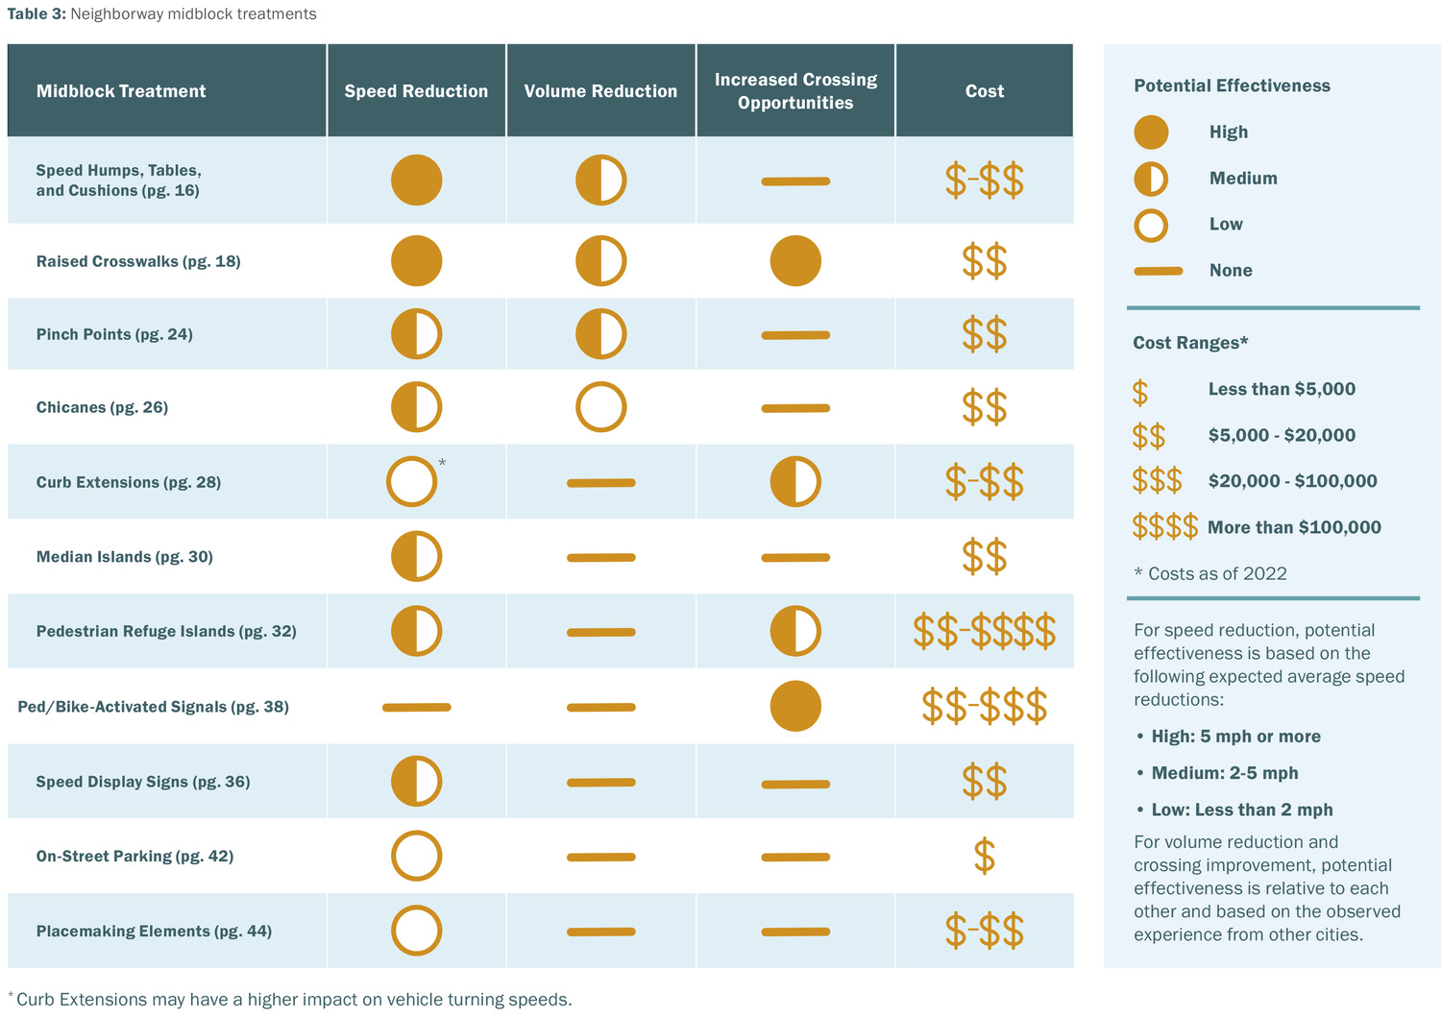
Planning Precepts and Toolbox
Review draft technical memos with the PAC and discuss planning precepts
Prepare preliminary concepts
Design draft best practices and planning precepts (shared publicly and with the PAC)
Best Practices → Final Toolbox

Slide 24
Role of the Project Advisory Committee

Slide 25
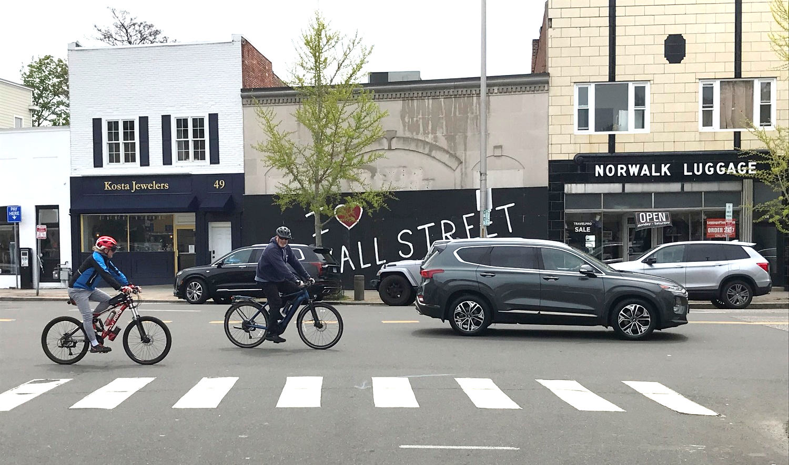
Role of the Project Advisory Committee
Meet up to 4 times over the course of the project
Provide on-the-ground insight and expertise
Review and provide feedback on draft materials
Be available for consultation with the project team

Slide 26
Discussion

Slide 27
Discussion
What is your main priority or objective with this Toolbox?
What does a successful Toolbox look like, or mean, for you?
Is there anything you’re particularly concerned about?
What other considerations should we be including?
Any recommendations for local materials, stakeholders, focus group participants, or relevant projects?

Slide 28
Next Steps

Slide 29
We Want to Hear From You!
Share your input and ideas with Mike at mwilson@westcog.org
Municipal materials or guidance documents
Recommendations for First Responder Focus Groups
Referrals for colleagues to participate on the PAC
Other opportunities or projects related to the Toolbox…

Slide 30
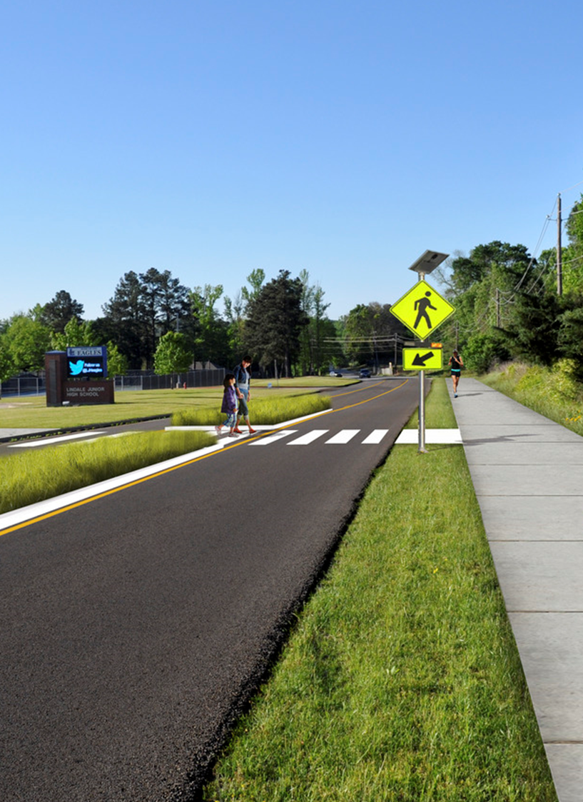
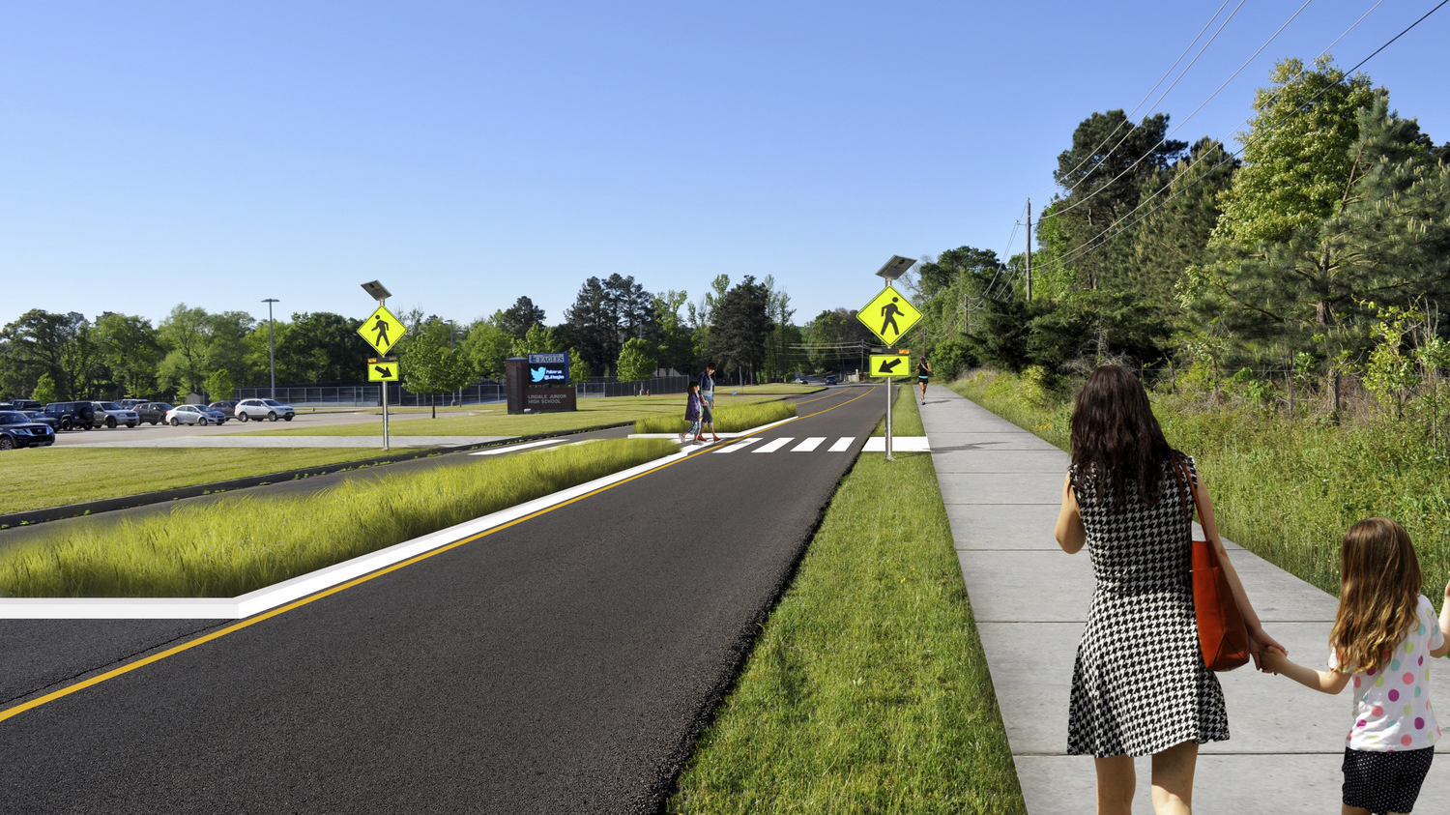
Next Steps
Convene a Project Advisory Committee
Next Meeting: late February/early March 2025
Review Municipal Guidance
Conduct a Best Practices Review
Coordinate Focus Groups
Develop Planning Precepts

Slide 31
Questions? Contact:
Mike Wilson | mwilson@westcog.org
Carrie Long | clong@tooledesign.com

