Slide 1
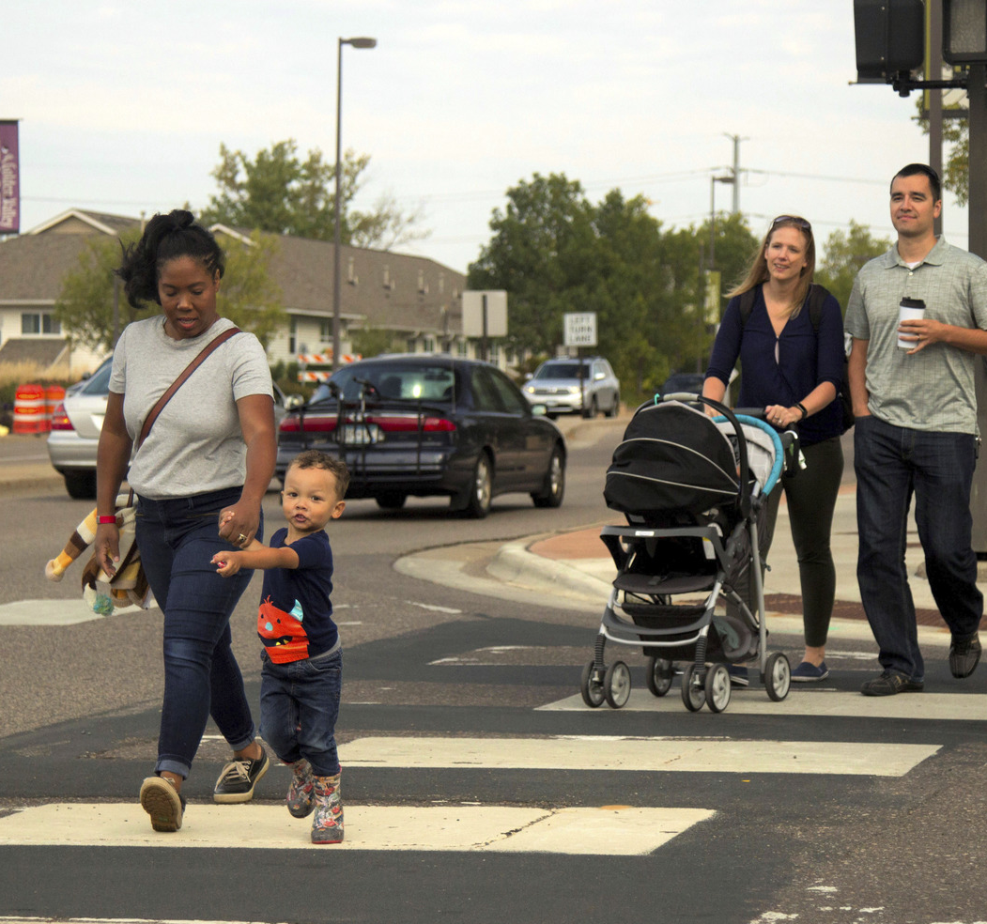



WESTERN CONNECTICUT COUNCIL OF GOVERNMENTS
Traffic Calming and Complete Streets Best Practices Toolbox
Project Advisory Committee Meeting
October 3, 2025

Slide 2

Agenda
Welcome and Introductions
Project Background, Goals, and Objectives
Regional Status Quo Memorandum
Best Practices Review
Next Steps and Discussion

Slide 3
Project Background
Traffic Calming 101
Project Background

Slide 4
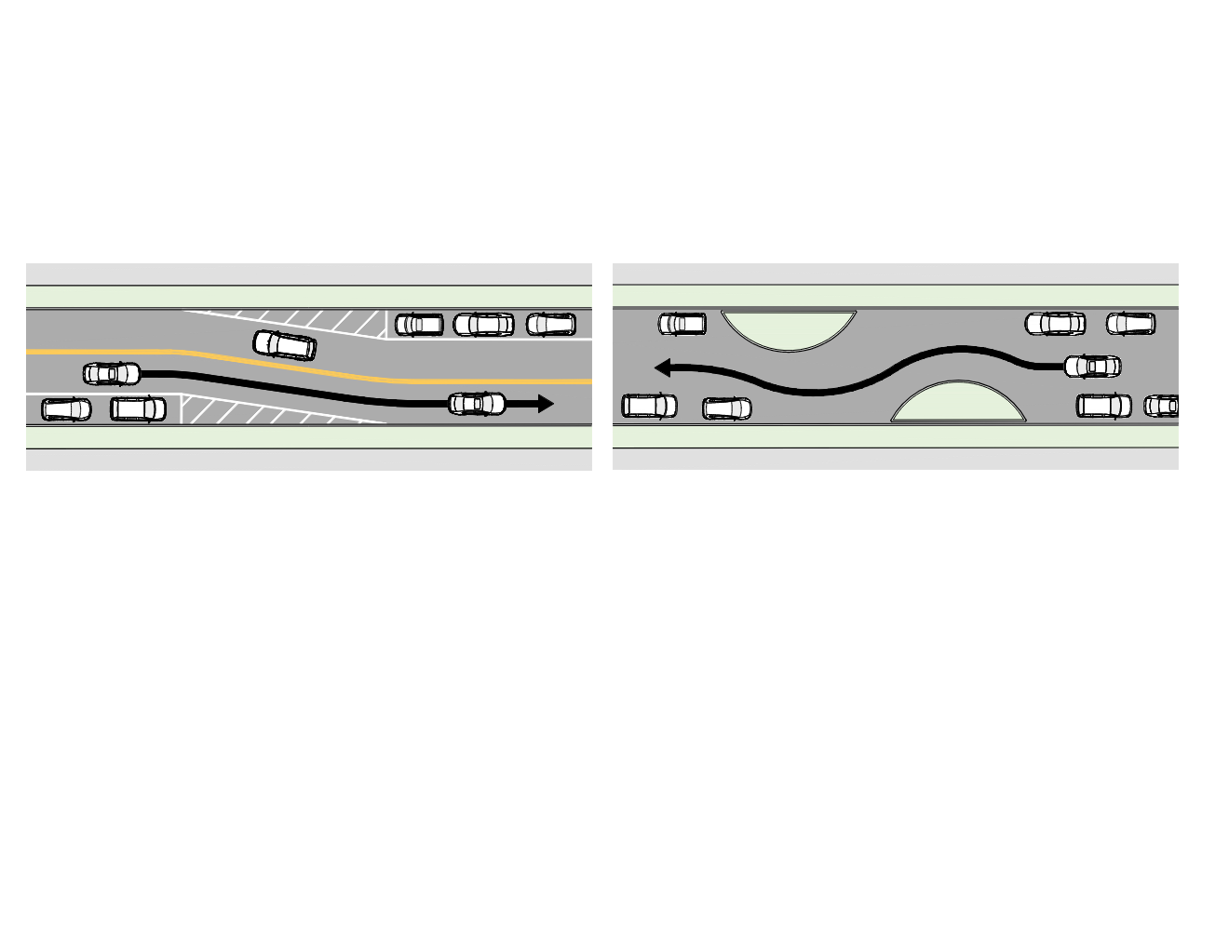
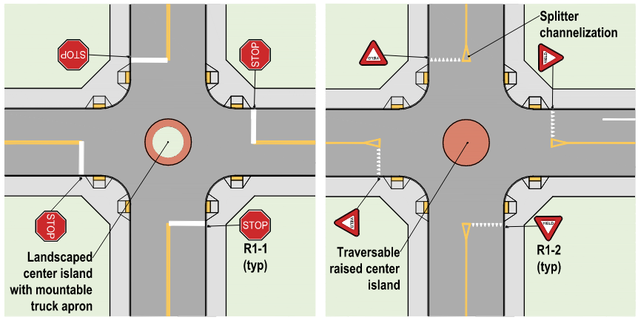
TRAFFIC CALMING 101
What is Traffic Calming?
A combination of mainly physical measures that:
reduce the negative effects of motor vehicle use;
alter motorist behavior;
improve conditions for non-motorized street users.
ITE Traffic Calming: State of the Practice (1999)

Slide 5
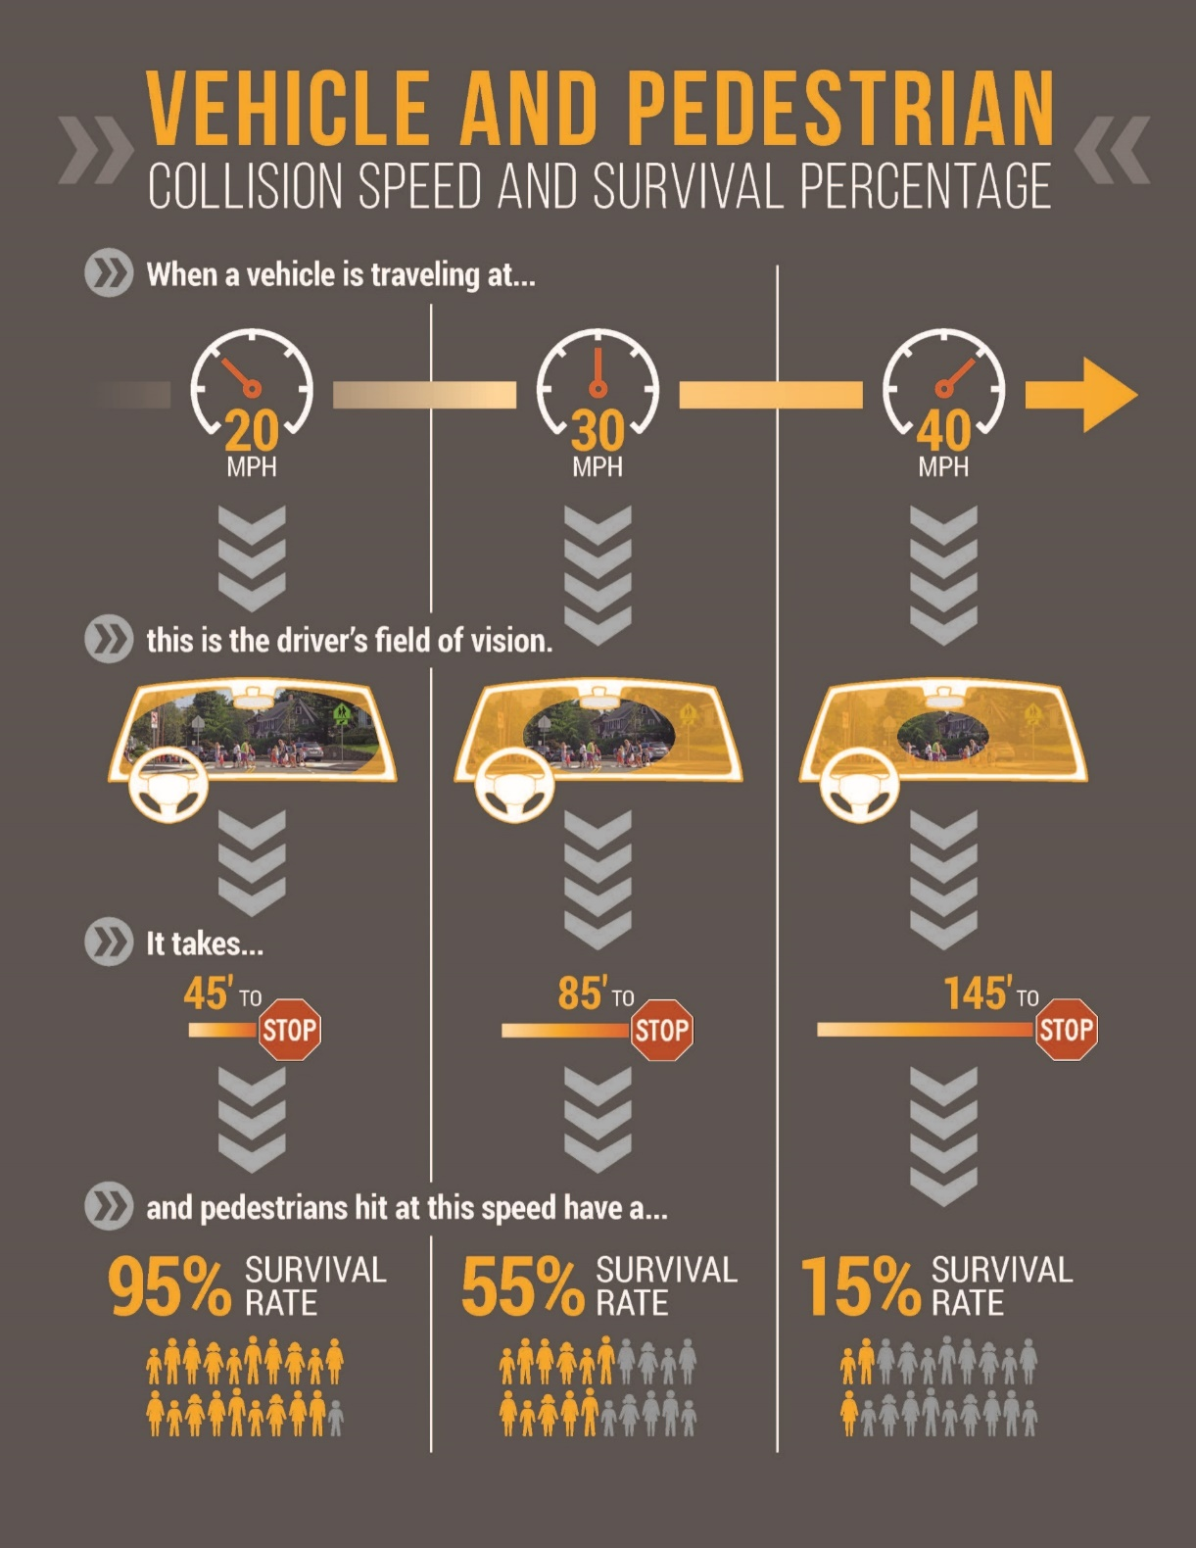
Speed and Safety
In Connecticut, excessive speed was a factor in more than 25% of fatalities, with 60% of speeding-related fatalities on roadways with posted speeds under 40MPH.
Source: 2021 Connecticut Highway Safety Office

Slide 6
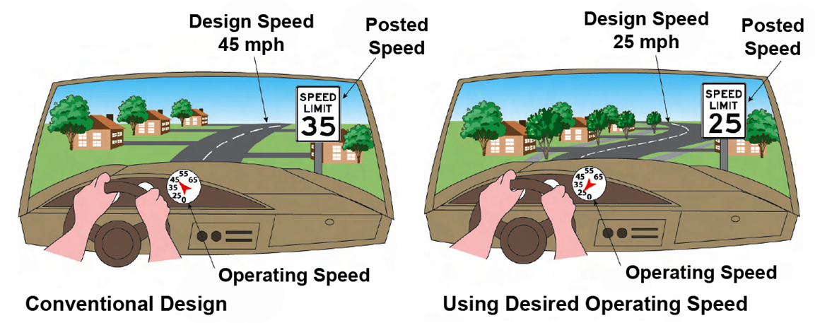
Design Speed & Operating Speed
CONVENTIONAL DESIGN
USING DESIRED OPERATING SPEED

Slide 7
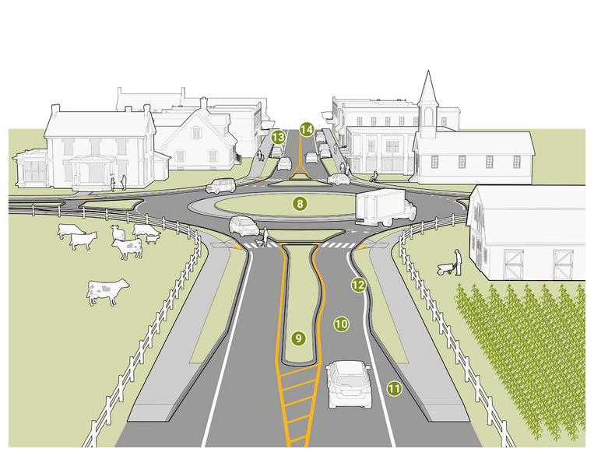
Transition Zones and Gateways
Alert drivers to change in the environment and character
Gradual reduction in speed
    Approach: Warning and psychological (signs, VMS, pavement color)
    Transition Zone: Physical countermeasures (medians, lane width)
    Gateways: Define new environment
8. Raised Medians
9. Reduced Lane Width
10. Shoulder Removal
11. Curbline
12.. Tall Vegetation, Street Tress, other Landscaping
Source: 2021 FHWA Achieving Multimodal Networks

Slide 8
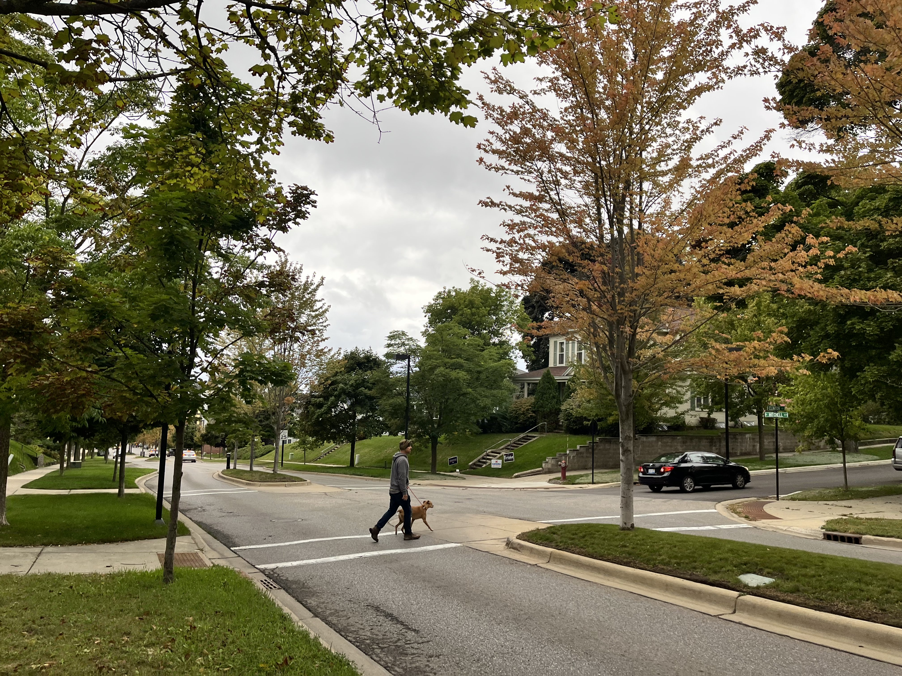
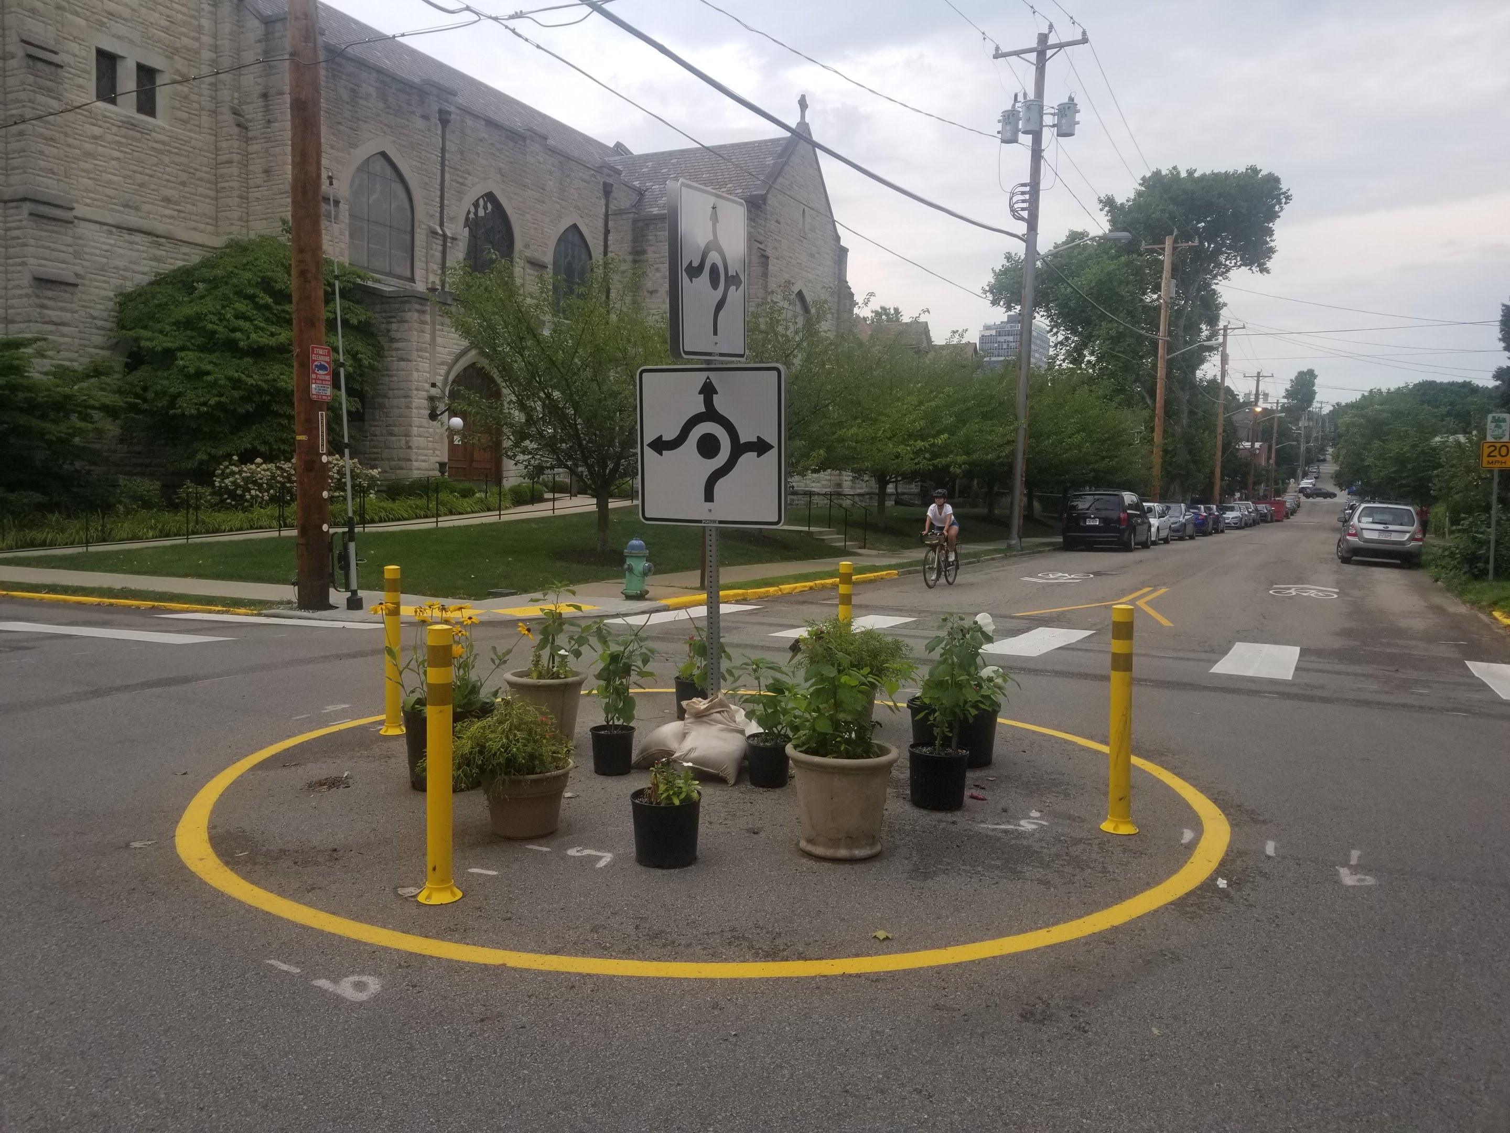
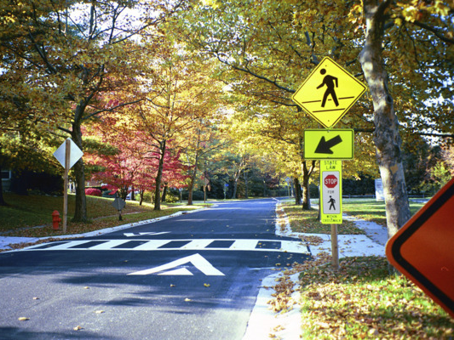
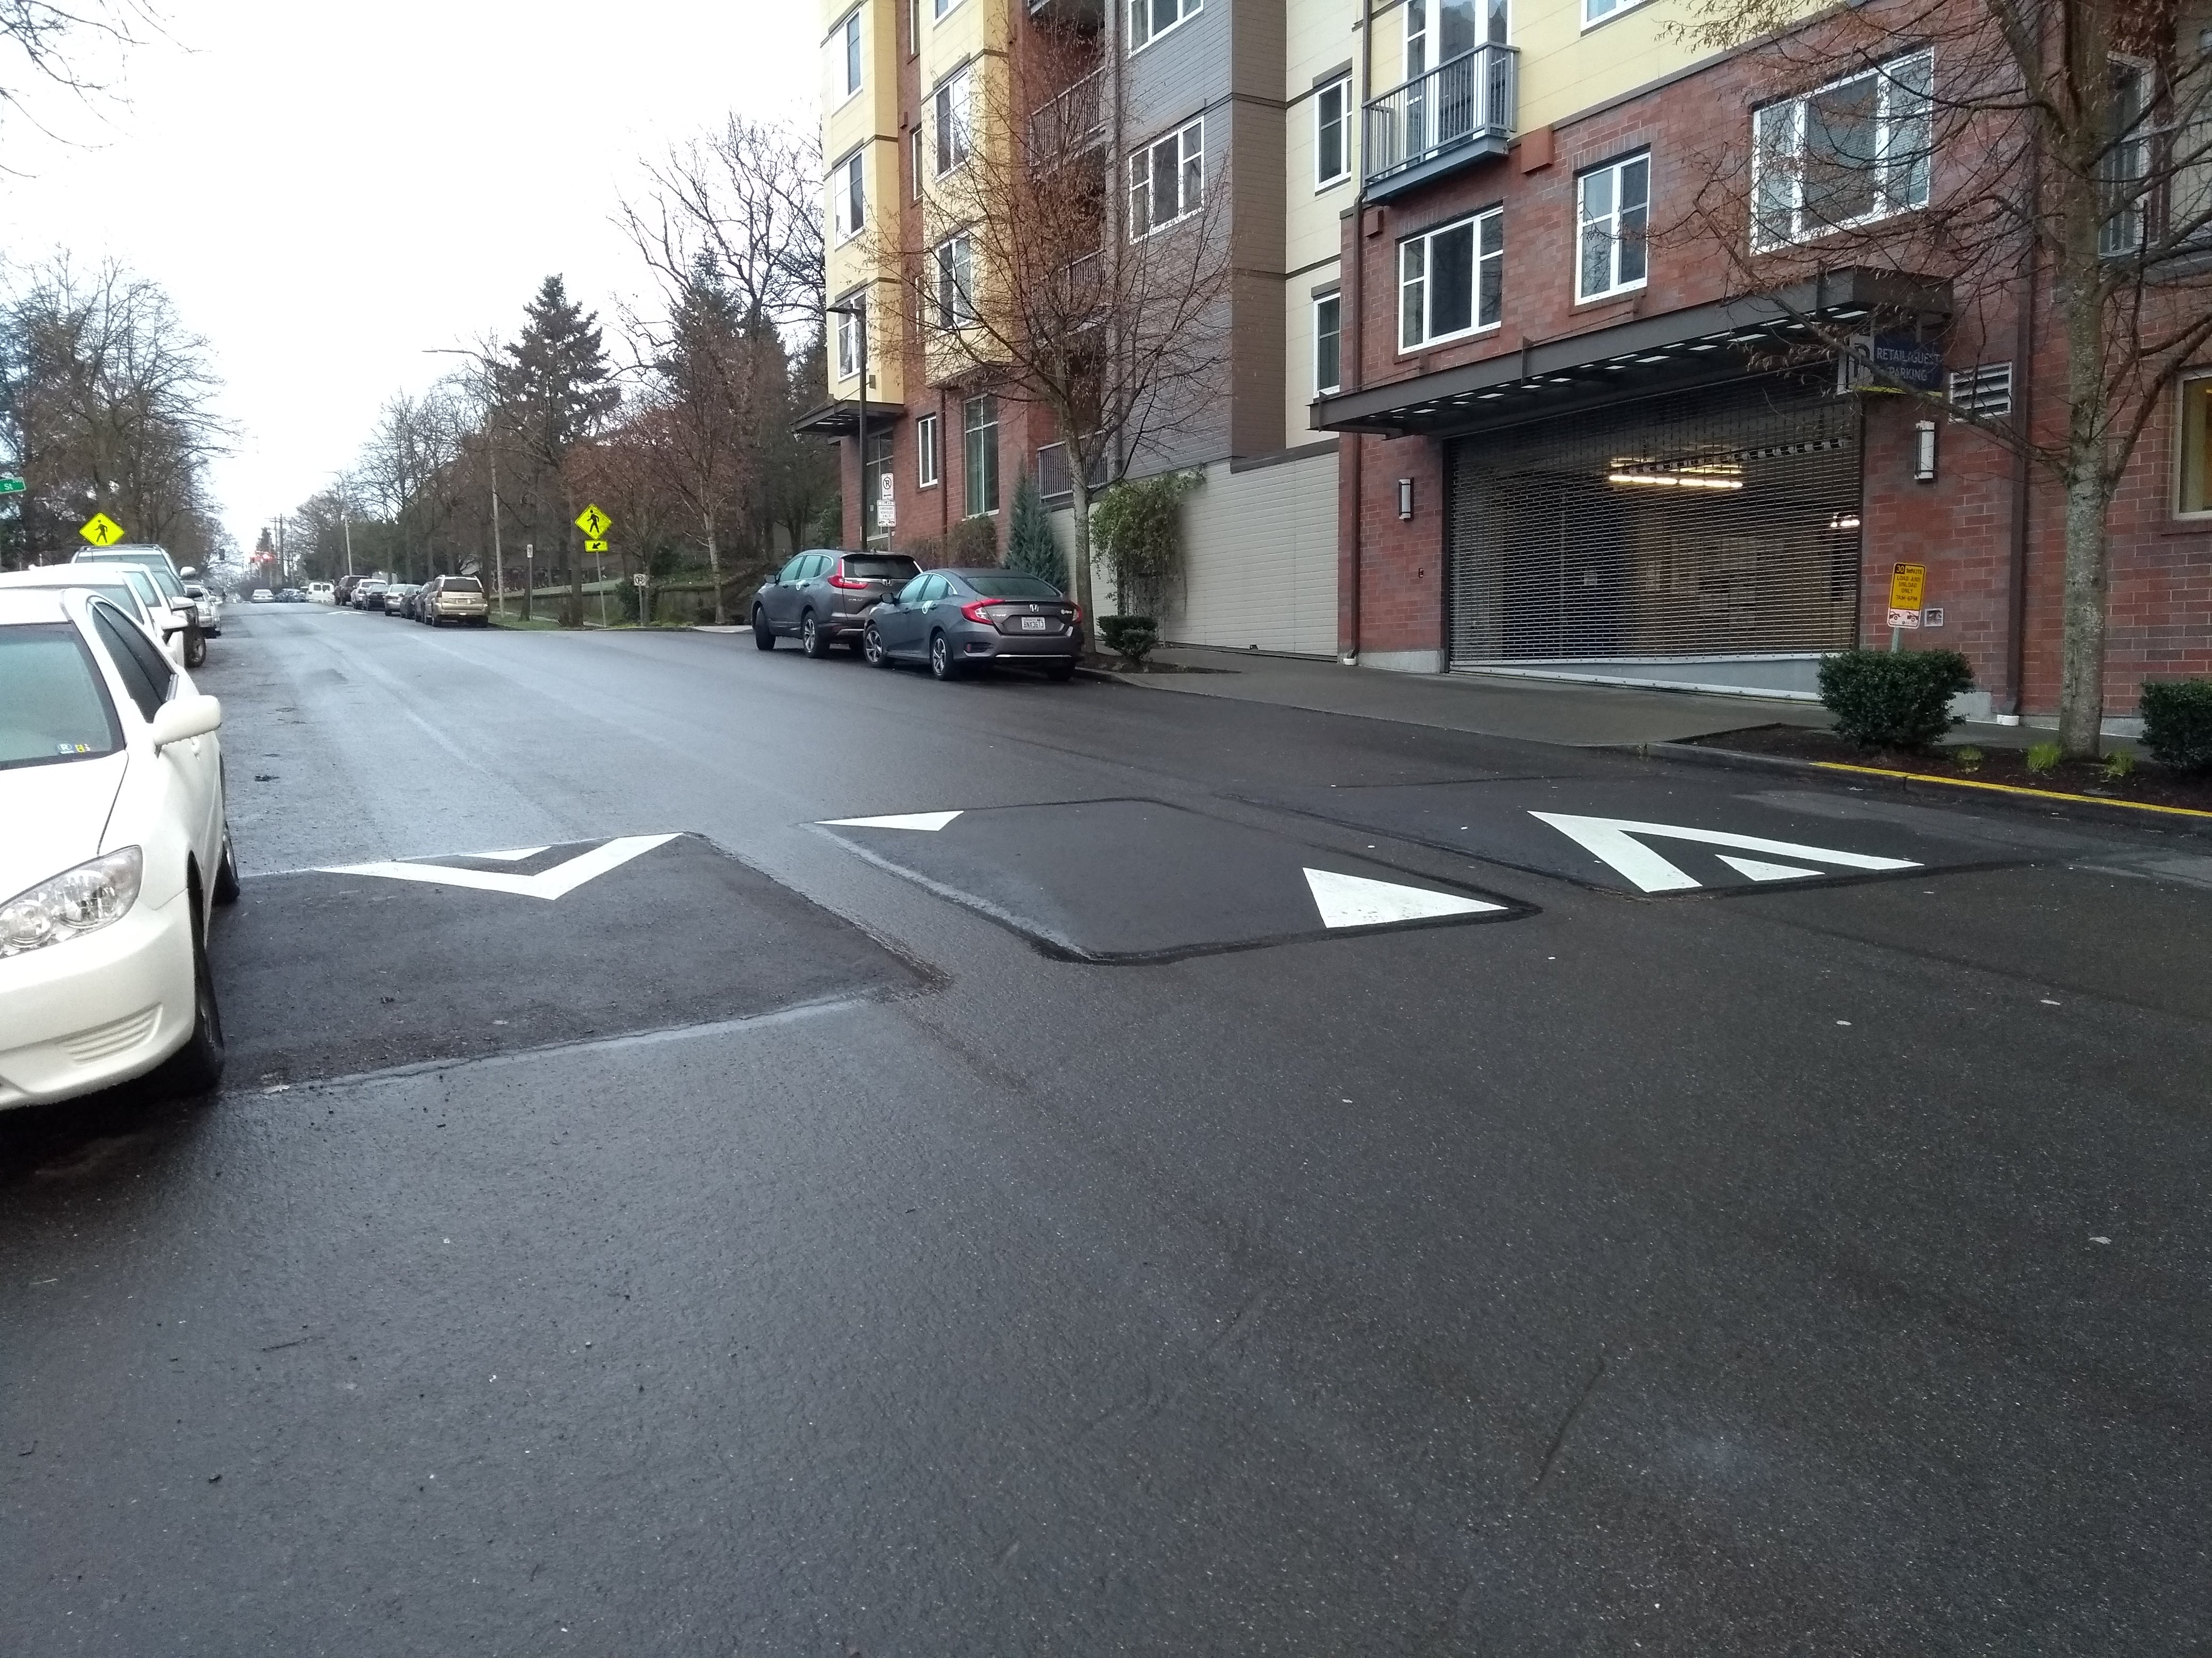
Elements of Traffic Calming
Horizontal Deflection
Lateral shifts
Gateways
Traffic circles
Vertical Deflection
Speed humps
Raised crosswalks
Raised intersections

Slide 9
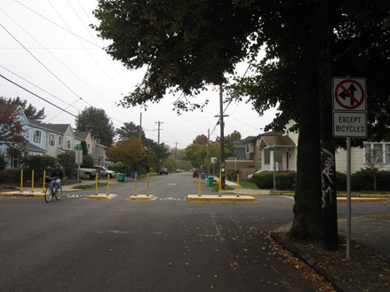
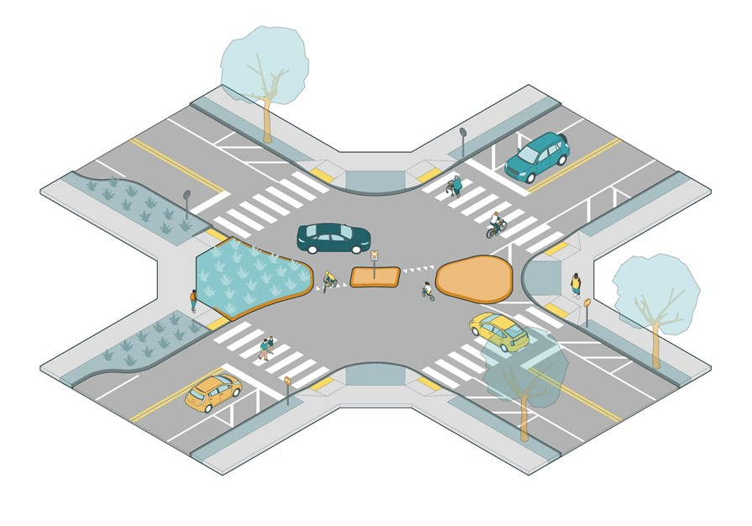
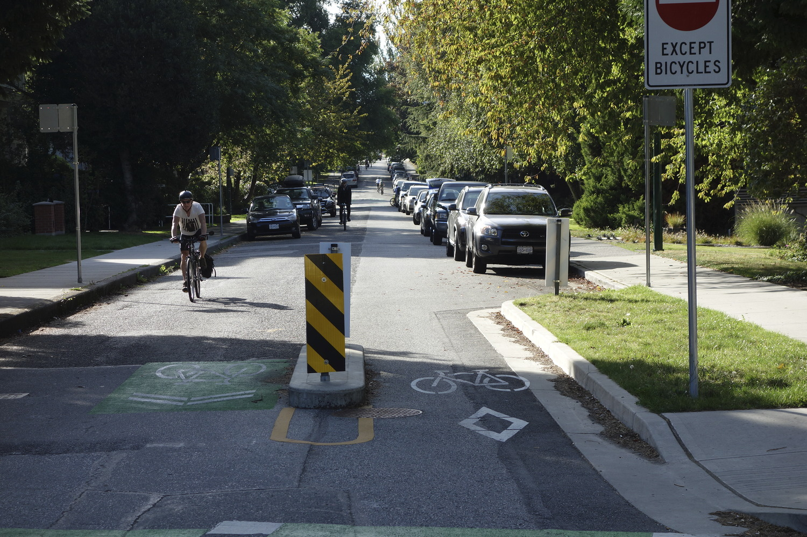
Elements of Traffic Calming
Physical Obstructions
Diverters
Street closures

Slide 10
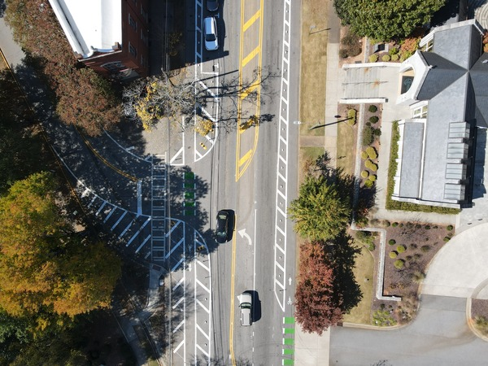
Elements of Traffic Calming
Lane Narrowing
Road diet
Adding on street parking
Introduction of bike lanes
Stormwater run-off mitigation

Slide 11
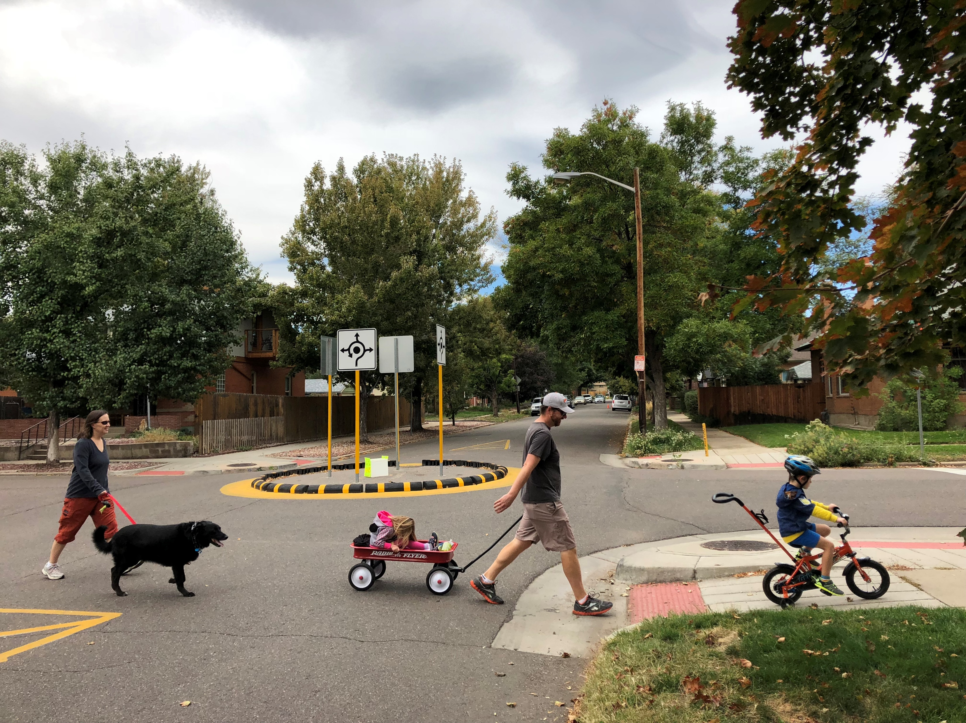
The Principles of Traffic Calming
Reduce motorist speed to the desired operating speed as consistently as possible through a corridor
Avoid unintentionally diverting motorists to parallel routes

Slide 12
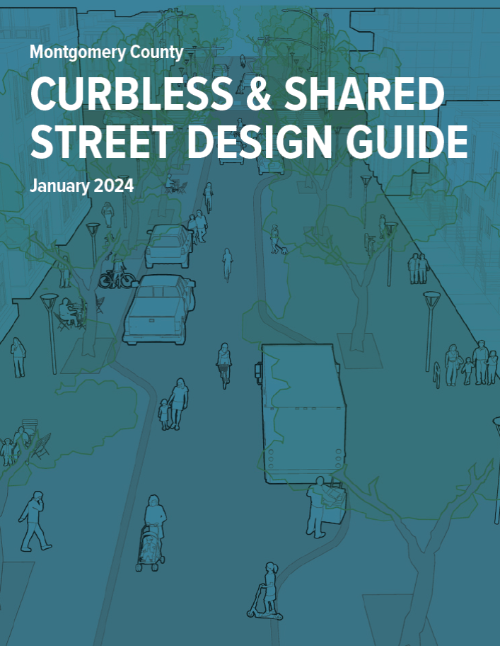
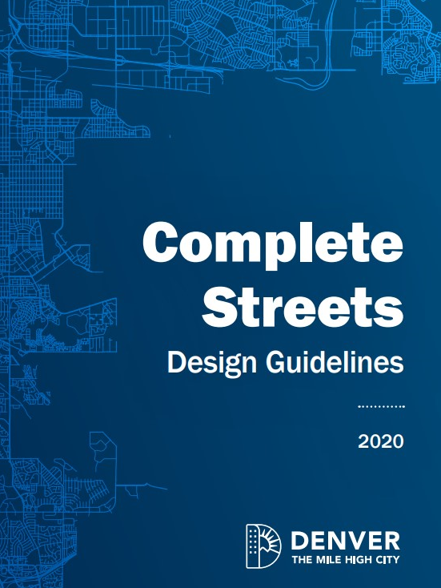
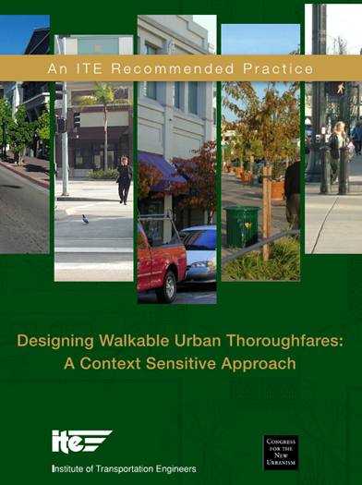
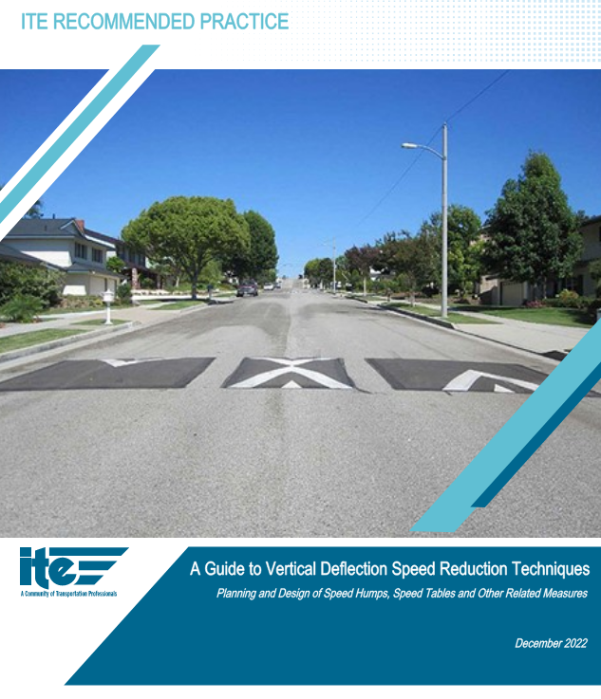
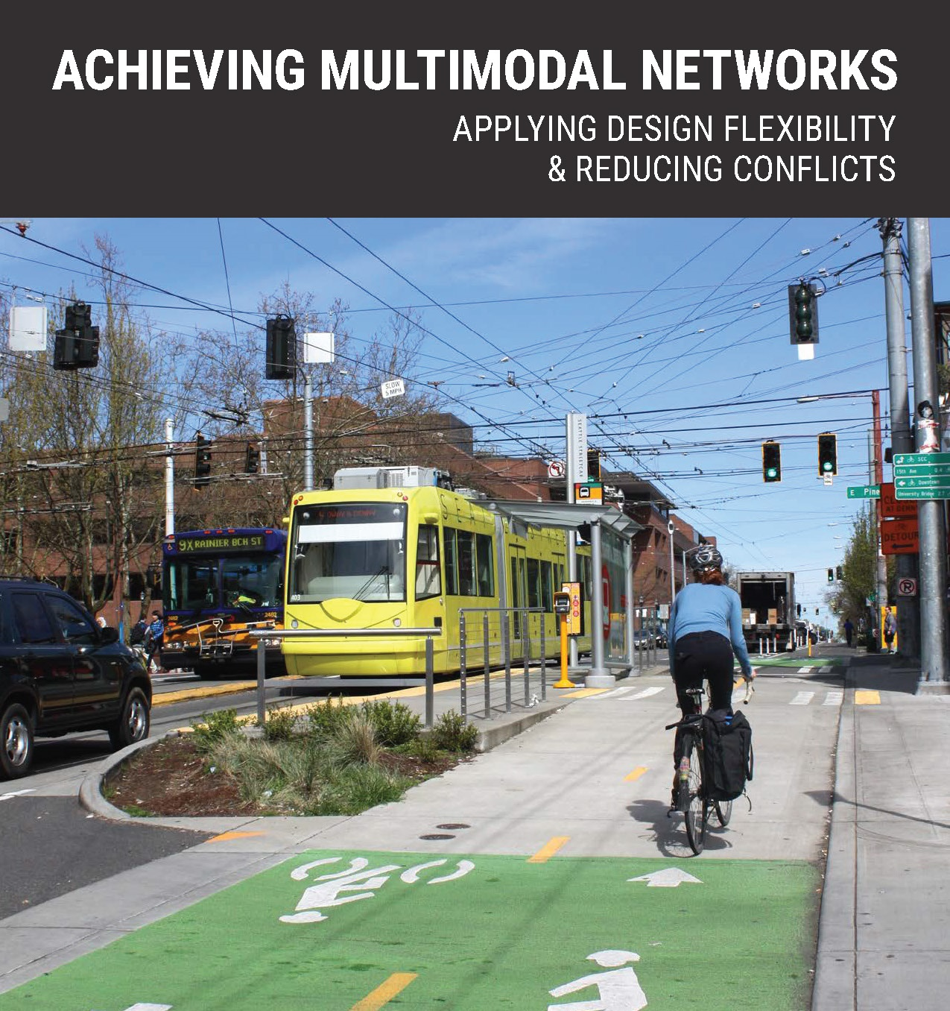
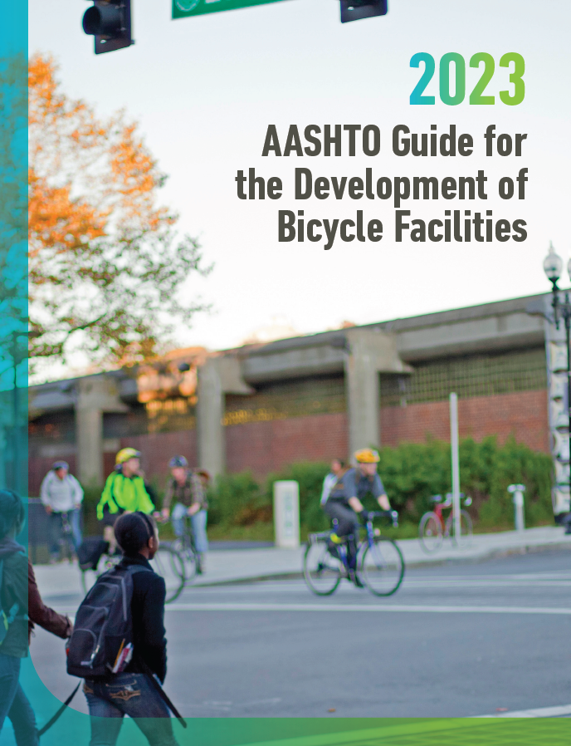
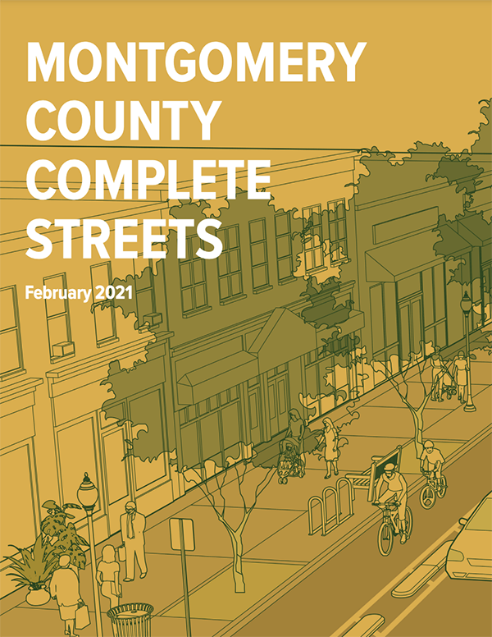
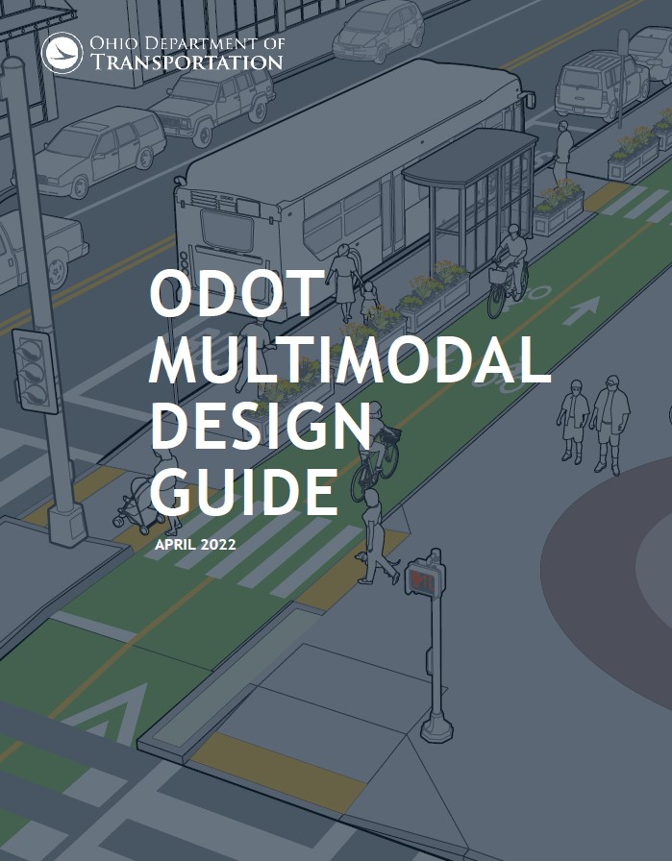

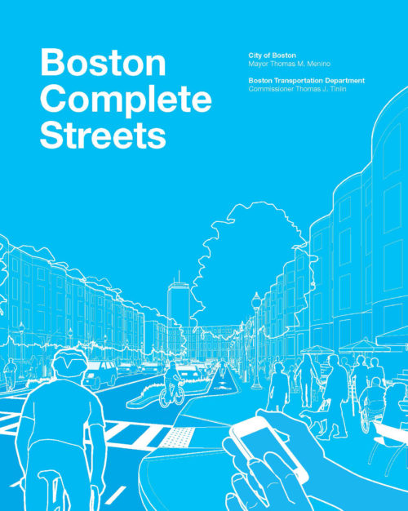
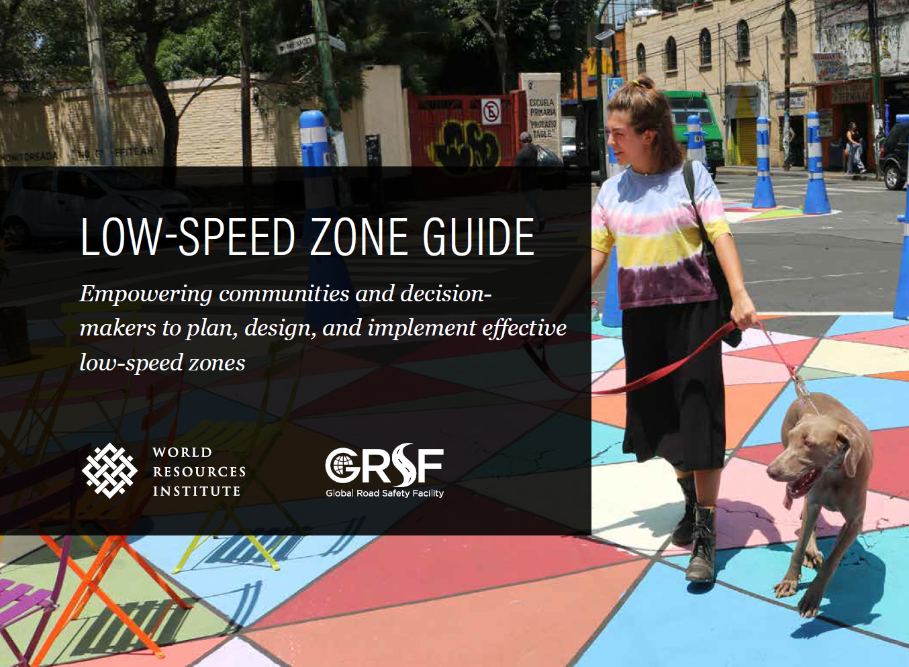
Traffic Calming Resources

Slide 13
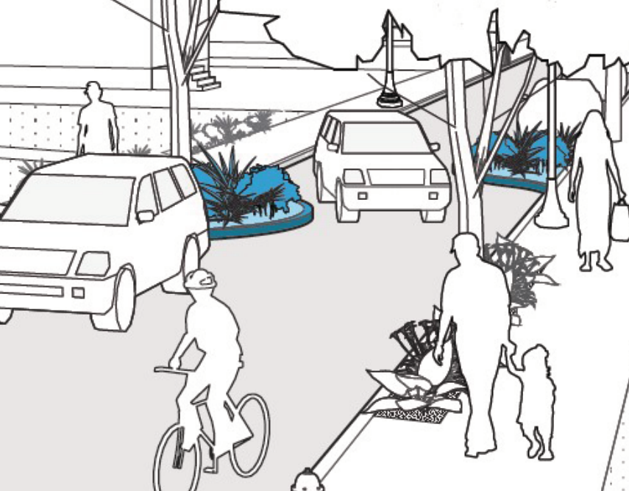
About the Toolbox
The Traffic Calming and Complete Streets Best
Practices Toolbox will provide planning precepts
and design principles for local and residential roads

Slide 14
Regional Status Quo

Slide 15

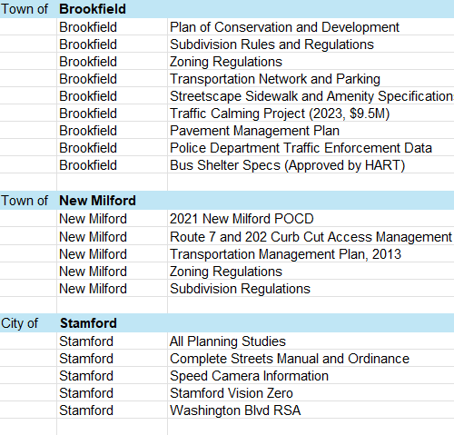
Regional Status Quo
Inventory municipalities’ standards and guidance used by municipalities for street design decision-making
  Identify considerations that inform street design and maintenance
  Technical Memo on existing standards
This Photo by Unknown Author is licensed under CC BY-NC

Slide 16
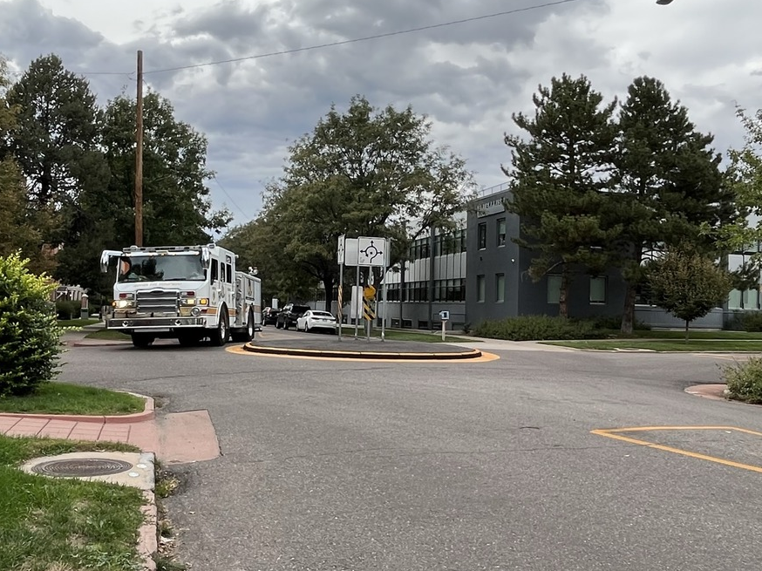
Focus Groups
Focus groups with First Responders and Emergency Service
Feedback, concerns, and perspectives will inform Toolbox

Slide 17
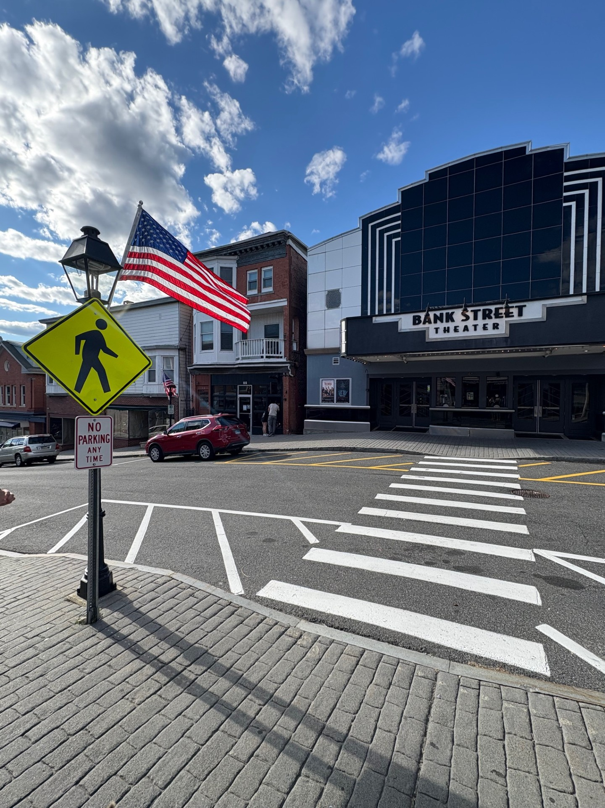
● Regional Status Quo
Research and review of municipal guidance, manuals, and other resources
Technical Memorandum

Slide 18
● Regional Status Quo – Key Takeaways
Advancing Traffic Calming and Complete Streets Initiatives
  Increase in local ordinances, toolkits, advisory committees, and campaigns
Realigning Intersections
  Reducing conflict with 90• turning movements, roundabouts, and daylighting
Expanding Pedestrian and Bicycle Infrastructure
  Addressing gaps in the sidewalk network and developing Bike/Ped Plans
Promoting Access Management
  Reviewing connectivity, circulation, driveway siting, and access to reduce curbcuts
Improving Parking Management
  Strategies to reduce parking: fee-in-lieu, incentives, and sharing arrangements

Slide 19
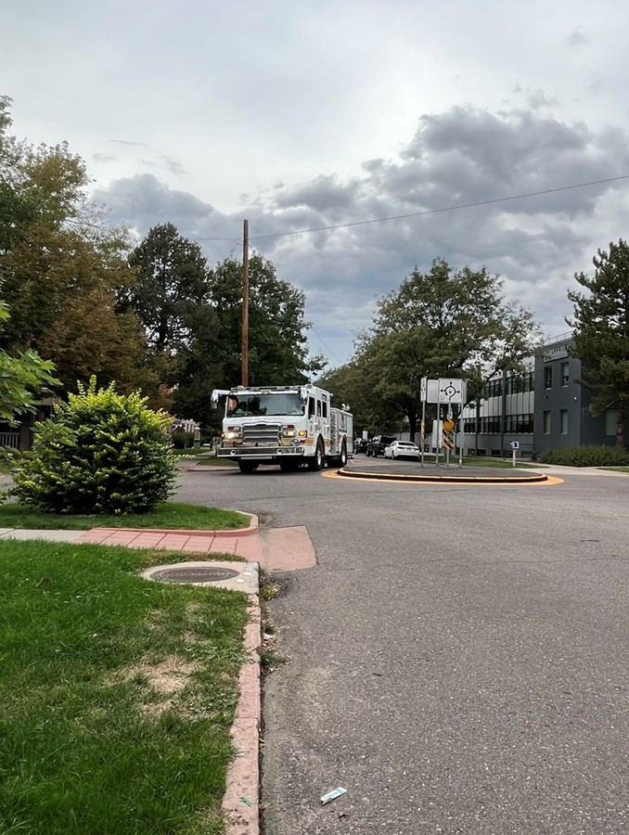
● Focus Groups
Conducted two focus groups for Emergency Service and Transportation Providers
  In-person Focus Group in Wilton, CT
  Virtual Focus Group
  15 participants representing ten WestCOG municipalities
Discussed operational needs and insights re: proposed traffic calming measures

Slide 20
● Focus Groups – Key Takeaways
Challenges with Rerouting onto Local Roadways (e.g., Waze)
  Increased traffic, speeding, and safety issues
Specific Constraints with Legacy Networks
  Historic streets and narrow rural roadways; informal or natural traffic calming exists today
Preference for Raised Crosswalks
  More cost-effective with less impact on emergency response than other vertical measures
Coordinating Tools/Measures with Development
  Disconnect with gridded/cul de sac networks, including traffic calming in development code
Support for Education and (Automated) Enforcement Tools
  School zone camera programs, public campaigns, and awareness efforts

Slide 21
Best Practices Review

Slide 22
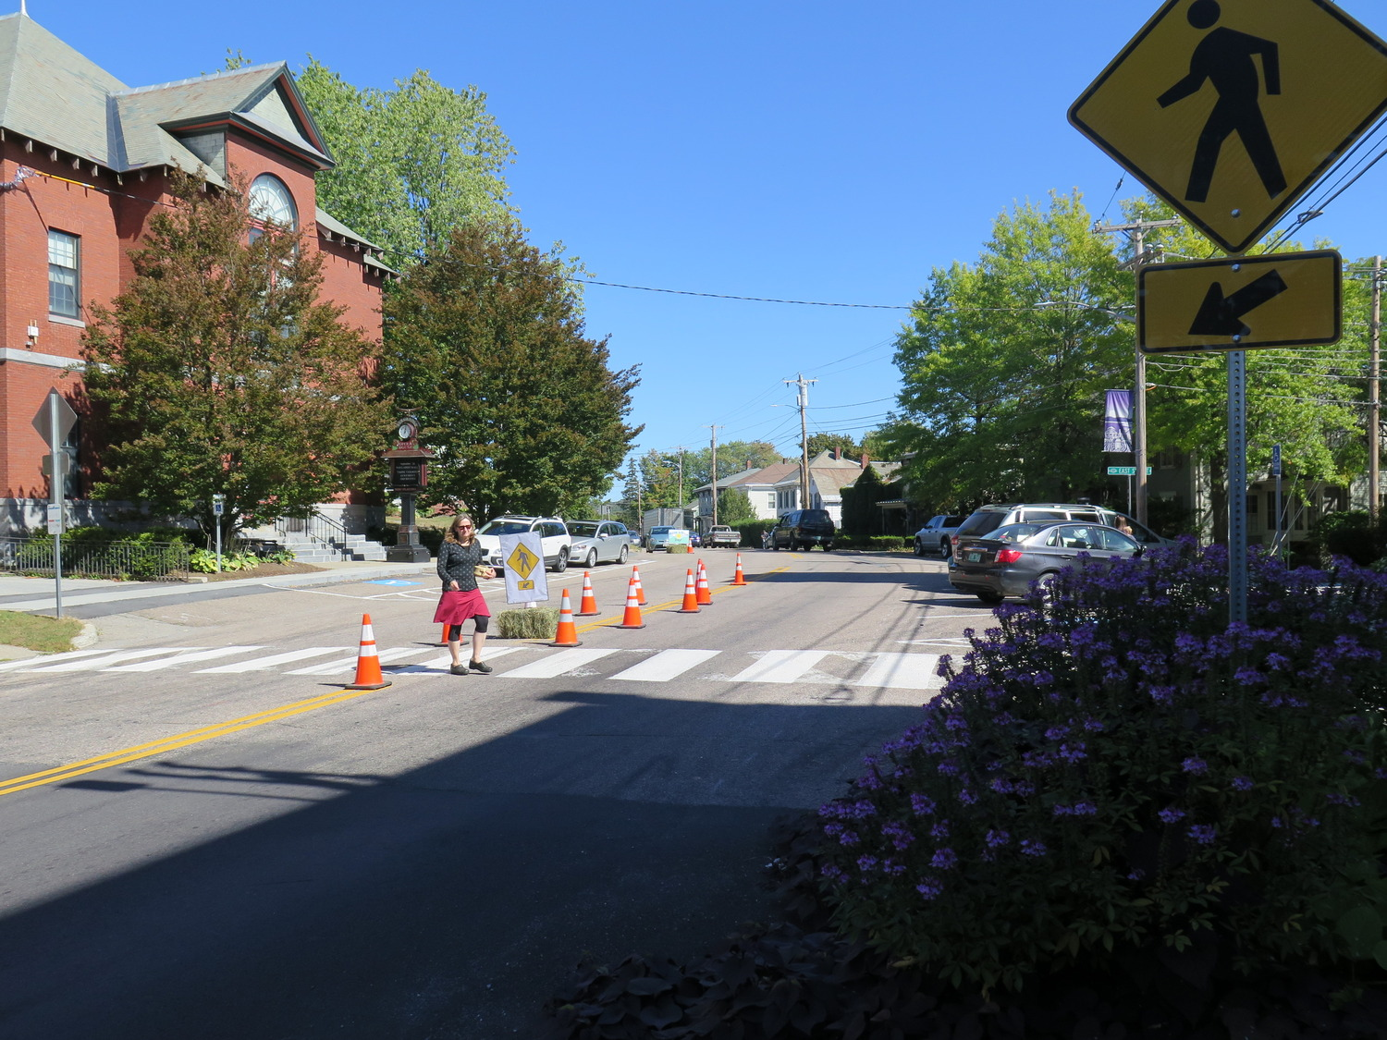
Compile Best Practices
Compiling planning standards and practices relevant to the WestCOG region
Consider relationship with land use and the built environment
Perform analysis on data and resources to shape precepts (i.e., impacts of interventions)

Slide 23
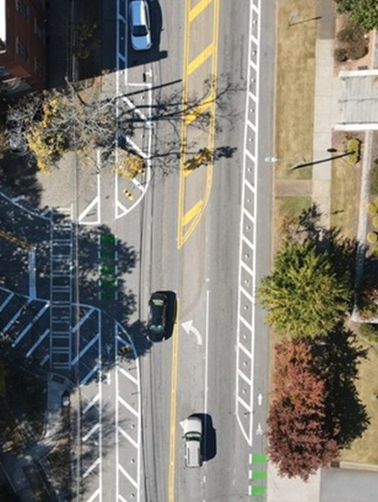
● Best Practices
Literature review of best practices in traffic calming and complete streets concepts
  Will informs the measures and specifications included in the Toolbox
Technical Memorandum

Slide 24
● Best Practices – Key Takeaways
Context-Sensitive Design is Fundamental
  Reflect the community’s natural and built environment and local priorities
Expand and Connect the Active Transportation Network
  Demand for safer connections and networks, especially to key destinations
Transition Zones are a Safety and Placemaking Priority
  Alert drivers to new contexts and expectations (e.g., rural roads as main streets)
Evaluate Opportunities for Shared Spaces
  All users share the right-of-way and the street can serve as a gathering space or paved yard
Promote Systemic Solutions vs. Spot Treatments
  Prioritization techniques and tools assess risk for higher-impact projects

Slide 25
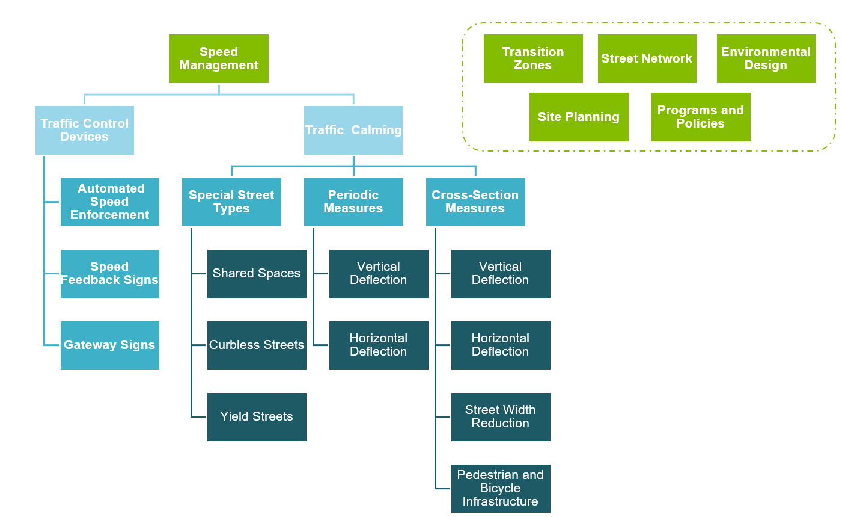
The Toolbox
Speed Management.
  Traffic Control Devices
  Traffic Calming
Transition Zones.
Street Network(s).
Site Planning/Design.
Programs and Policies.

Slide 26
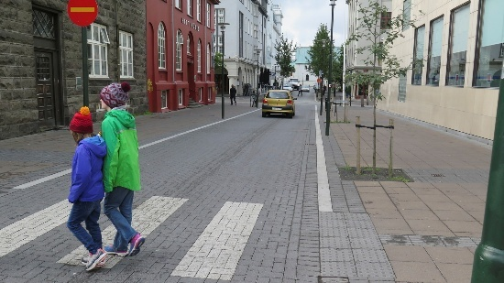
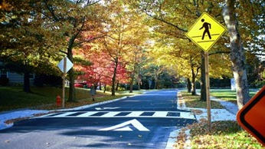
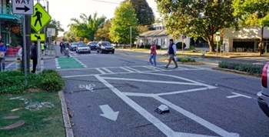
Traffic Calming Measures
Special Street Types
Periodic Measures
Cross-section Measures
Measures that alter the surface of the street such that it operates differently than other streets
Ex: Shared Spaces
Measures placed intermittently to reduce speed
Ex: Raised Crosswalks
Measures installed continuously — they are part of the cross-section
Ex: Lane Reconfiguration

Slide 27
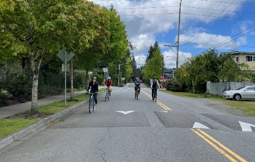
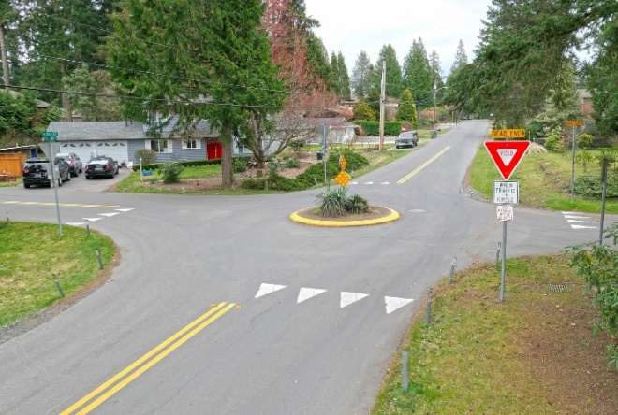
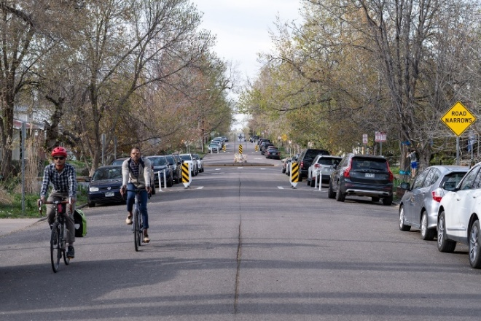
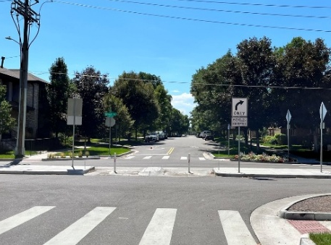
Traffic Calming Measures
Vertical Deflection
  Slow motorists by changing the height of the roadway
Horizontal Deflection
  Slow motorists by preventing them from driving in a straight path
Width Reduction
  Narrow the width of the roadway causing motorists to slow down
Routing Restriction
  Restricting movements at intersections to reduce speed/volume
1
2
3
4

Slide 28
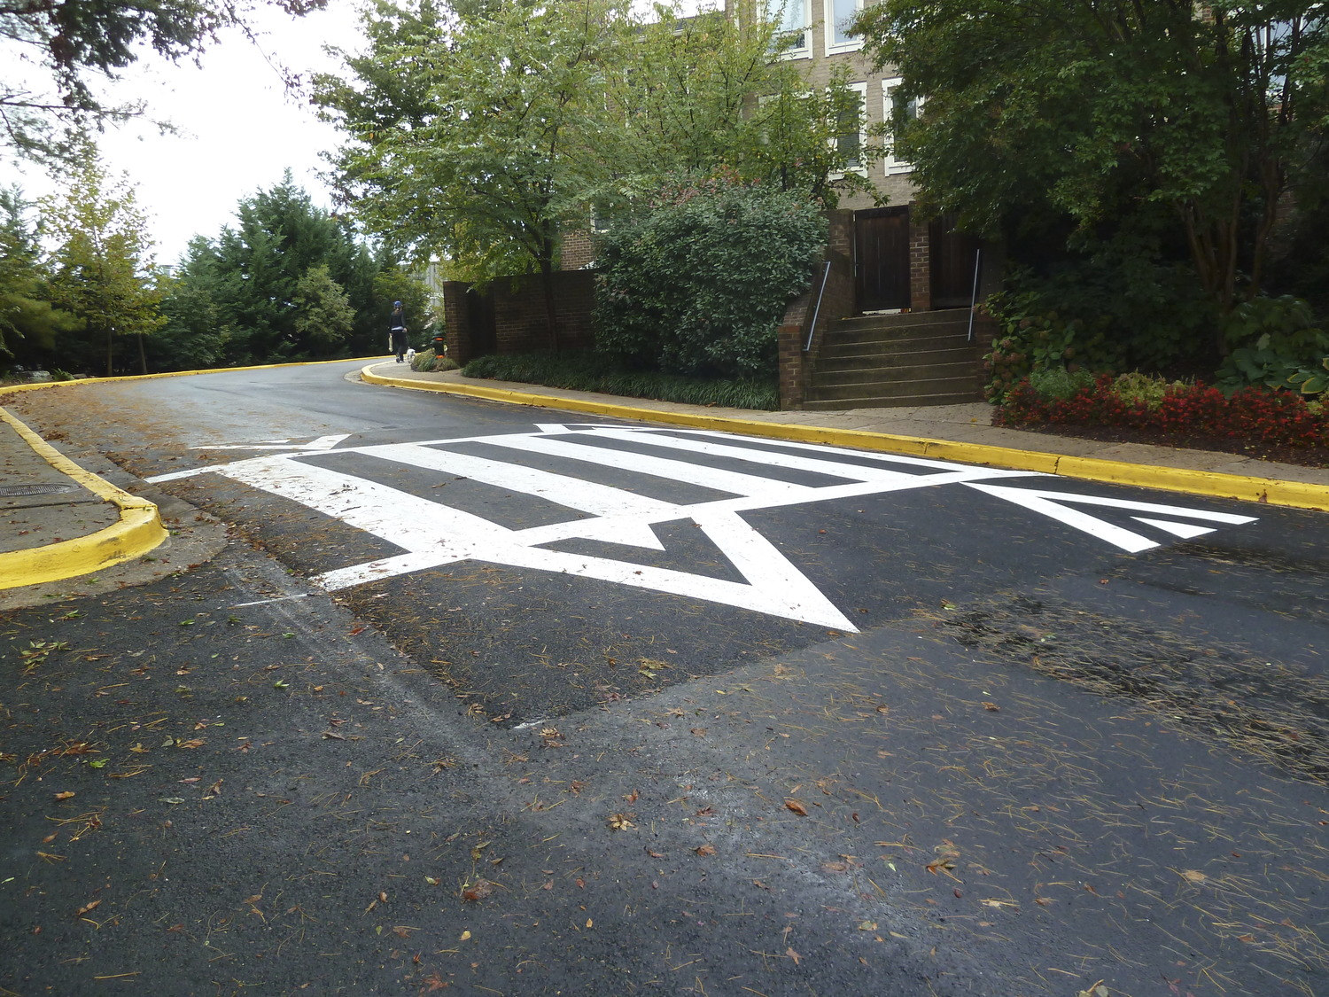
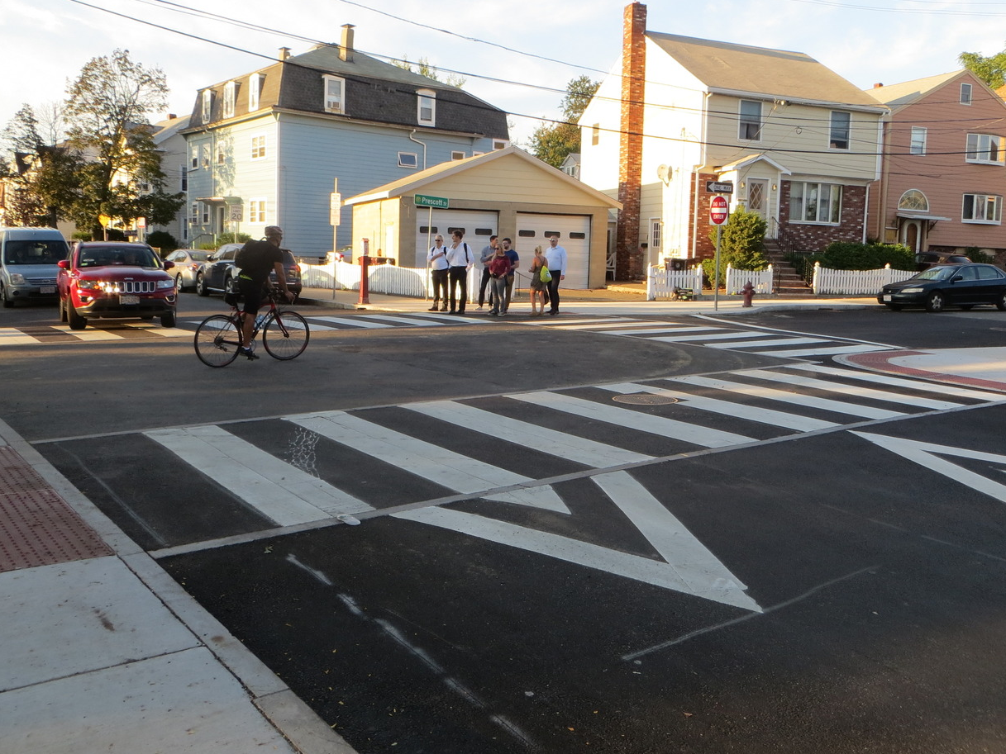
Raised Crossings and Intersections
Vertical Deflection, Periodic Measures

Slide 29
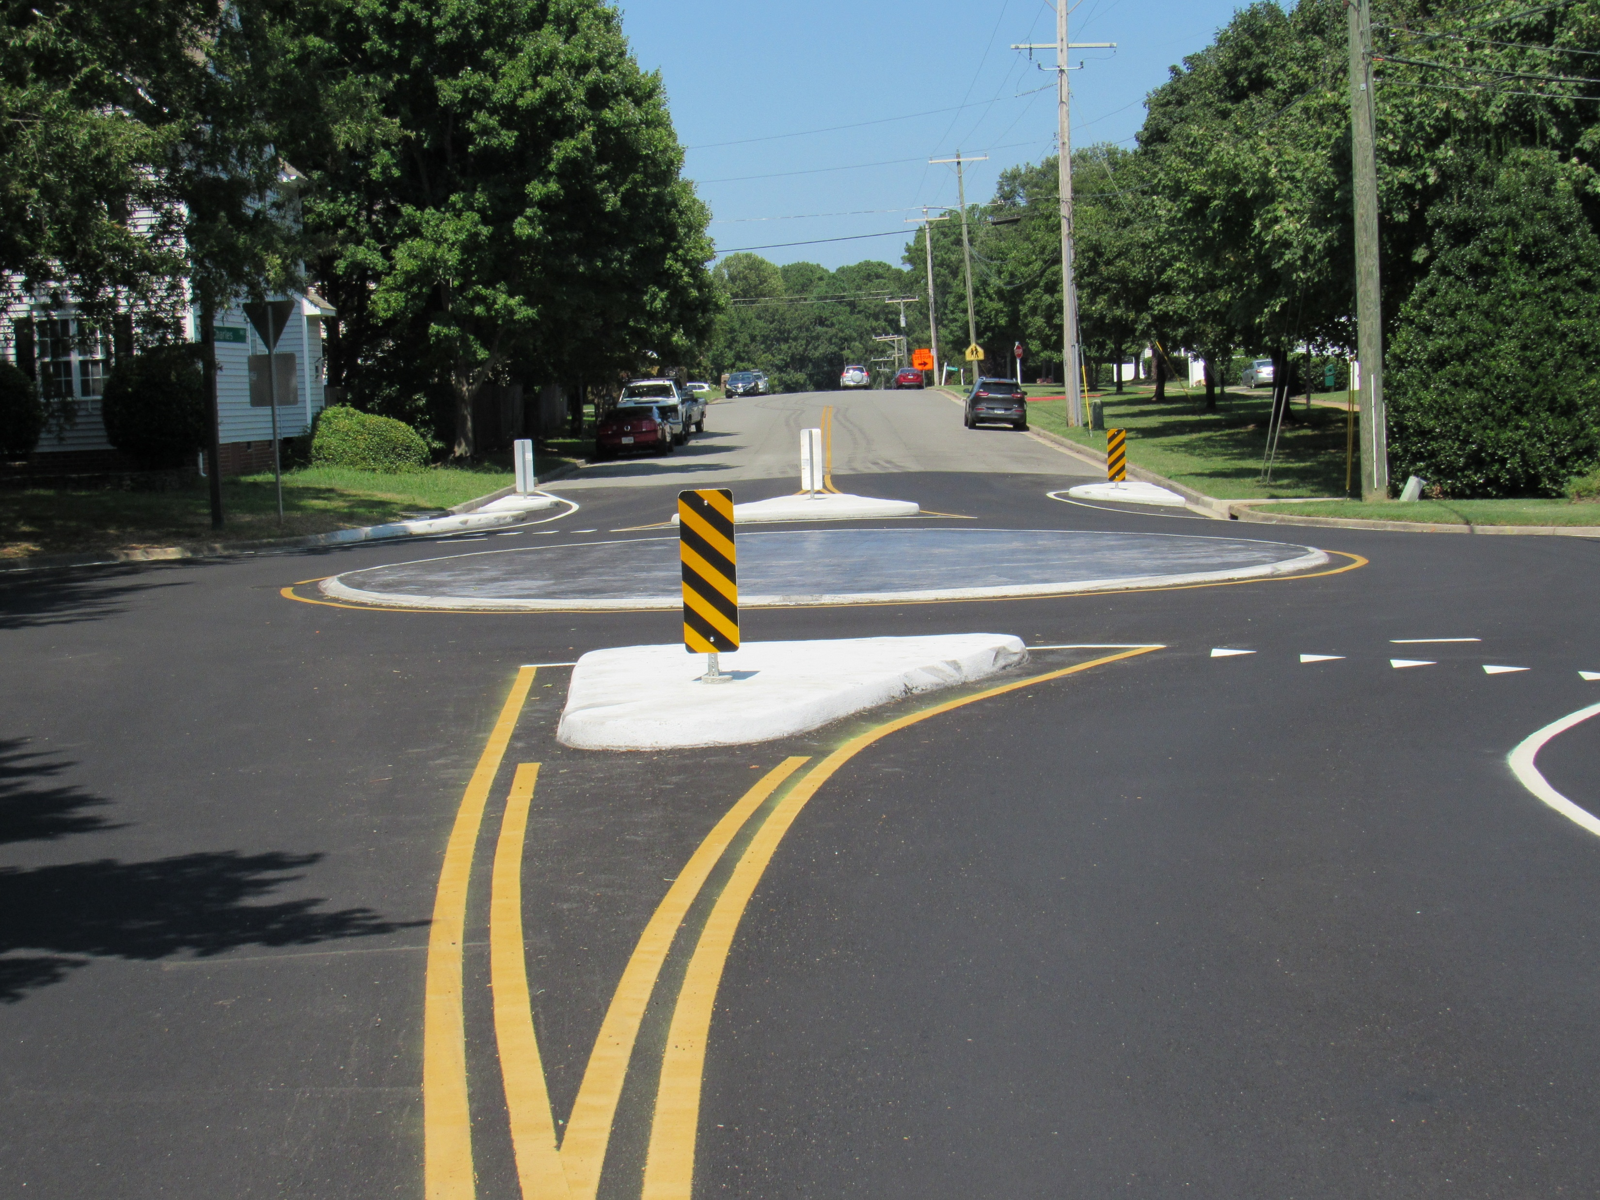
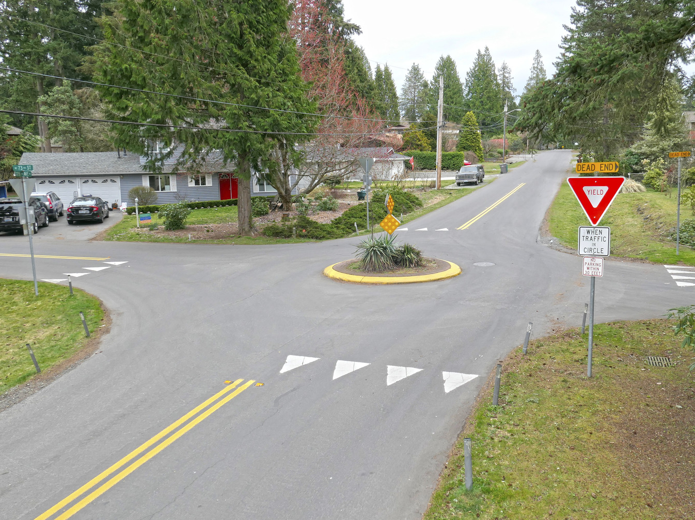
Mini-Roundabouts
Horizontal Deflection, Periodic Measures

Slide 30
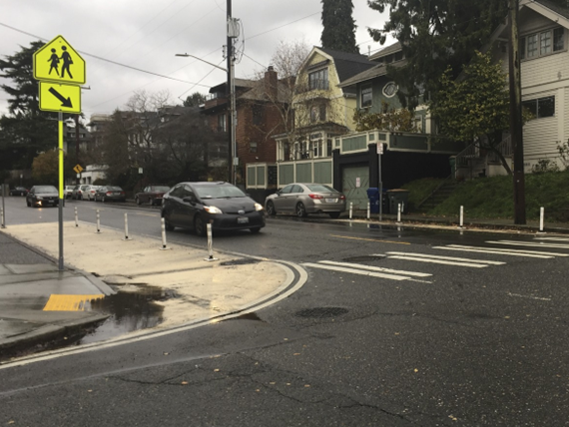
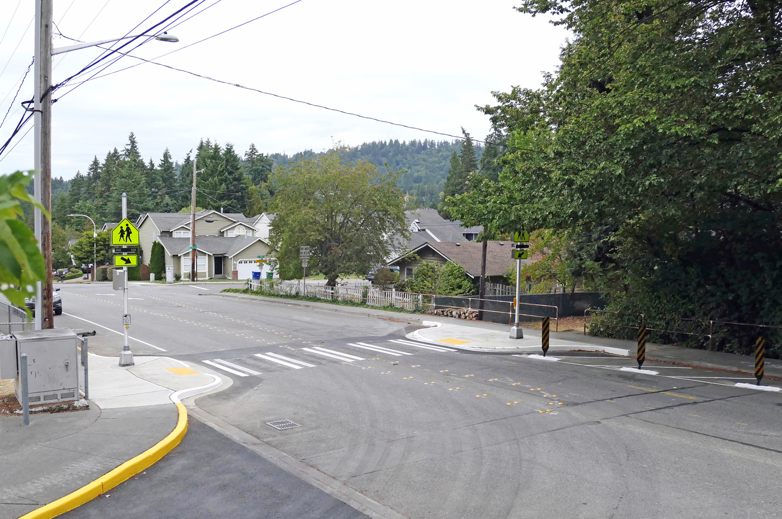
Curb Extensions
Street Width Reduction, Cross-section Measures

Slide 31
Programs, Policies, and Site Planning
Transit Oriented Development
Parking Reduction Strategies
Safe Routes to School
Streetscape Improvement Programs
Maintaining the Rhythm of Buildings
Green Stormwater Infrastructure
Street Trees and Landscaping

Slide 32
The Toolbox

Slide 33
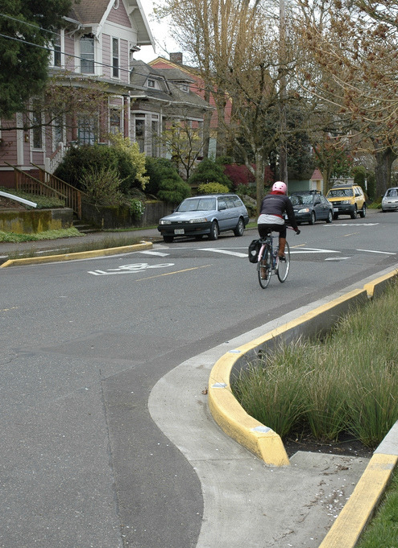
Developing the Toolbox
Purpose and Description
Cost and Timeline
Suitability and Context
Design Guidance
Special Considerations (Emergency Access, Transit, Stormwater)
Resources, Examples, Photos

Slide 34
Next Steps

Slide 35
Questions? Contact:
Mike Wilson | mwilson@westcog.org
Carrie Long | clong@tooledesign.com

