Slide 1
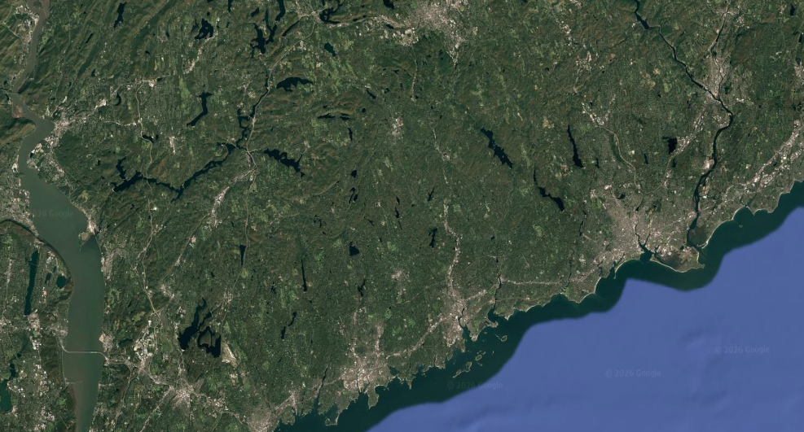
Re-examining Zoning in Connecticut: Commerce, Industry, and Services
Intentional Planning in a Changing Economy
Notes:
Go over the insights from latest WestCOG Report, which focuses on the economic role of land and how it has become detached from traditional zoning categories, particularly in regard to productive industry.
Presentation intended to meet continuing education requirements as an LU commissioner.

Slide 2
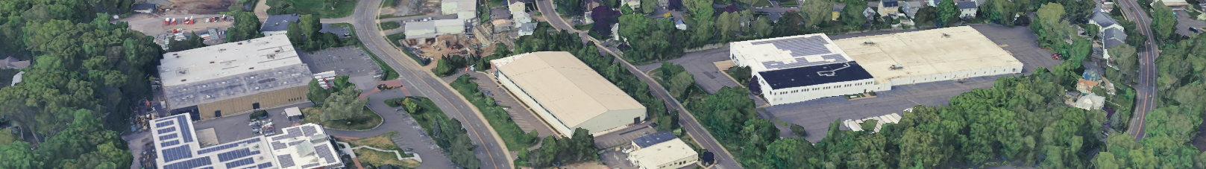
Background
Regulation of land use is one of the most impactful responsibilities of local government.
Modern zoning continues to rely on basic categorical distinctions.
Residential, Commercial, Industrial
Industry and commerce have fundamentally changed over time
Manufacturing has become cleaner, quieter, and smaller
Retail and service increasingly involves intensive logistics, processing, and vehicle traffic
Convergence has led to misclassification
Obscures economic role of land
Impacts all areas of planning
Need for intentional planning for industrial (and service-industrial) land uses
Notes:
As we all know, regulation of land use through zoning is one of the most impactful responsibilities of local government.
Though much has changed in the last century, the increasing complexity of zoning (for the most part) continues to rest on the same basic methods of categorization, dominated by three major categories:
In this report, we argue that industry and commerce have fundamentally changed over time, with industry becoming cleaner, quieter, and smaller while retail and service has become increasingly reliant on intensive logistics and vehicle traffic. This convergence has opened the door to misclassification of land use, which obscures the real economic role of land and impacts planning at all levels.
The purpose of this report is to call attention to the need for intentional planning for industrial and service-industrial land uses.

Slide 3
Overview
Convergence:
Change in industrial and commercial activity over time
Conflation:
How misclassification occurs
Why misclassification matters
Consideration:
Industrial land as economic infrastructure
Service-industrial zoning
Context:
Industrial planning in the statutory environment
Compatibility with residential development
Notes:
Over the course of this brief presentation, we will cover the change in industrial and commercial activity over time, and how misclassification occurs and why it matters. We will then discuss the value of industrial land, service-industrial zoning as a practical response, and the implications of the statutory environment in CT – particularly as it relates to recent legislation.

Slide 4
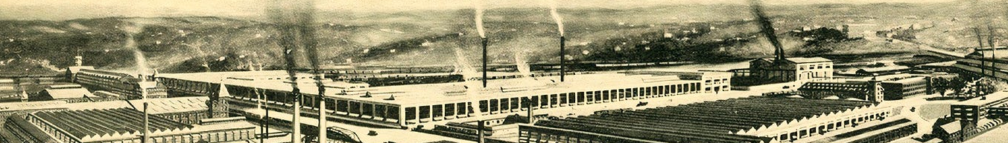
Convergence – Industrial Land Use
Industry in the 20th century - massive in scale
Large land footprint & infrastructure needs
Centralized production – all stages of production on site
Mass employment – need for transportation or central location
Significant impacts on environment & health (noise, air/water pollution)
Changed significantly over last ~75 years
Dramatic reduction in scale of industrial activity
Remaining industries often have smaller footprint
Precision fabrication, specialized assembly, etc.
Incompatibility with other land uses less of a constraint
Notes:
Zoning arrived to a Connecticut dominated by industry on a massive scale. Centralized production required large amounts of infrastructure and mass employment, and came with significant impacts on the environment and public health.
All of this has changed dramatically over the last 75 years. As global trade has allowed the most impactful industries to congregate in cheaper labor markets, what industry has remained has a much smaller footprint, and is less incompatible with other uses.

Slide 5
Convergence – Industrial Land Use
Specialization of manufacturing
Production no longer centralized
Parts manufactured at distant points, assembled after shipping
Shift towards supply chain logistics
Process of integrating parts and services
Reliance on warehousing
Notes:
This has been enabled through the specialization of manufacturing. Instead of a centralized model, now individual components are manufactured across the world and shipped to a single point for final assembly. This has necessitated a shift in focus towards logistics management – meaning factories dedicate greater staff time to administration than production and creating an increasing reliance on warehousing.

Slide 6
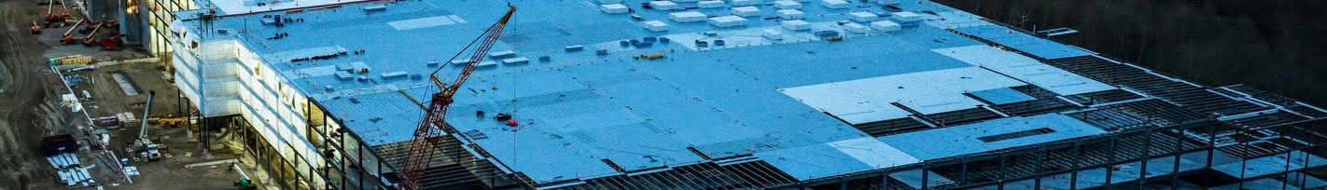
Convergence – Commercial Land Use
Conversely, commercial land uses have increased footprint
Increased vehicle traffic, large parking areas, overnight operation
Outwardly ‘commercial’ businesses can involve on-site warehousing, processing, fabrication, or assembly.
Small-scale manufacturers often sell goods directly to the public.
Categorical distinction between industry and commerce blurred
Notes:
At the same time, commercial land use has expanded in scale, becoming increasingly reliant on just-in-time delivery, ecommerce, and vertical integration. This has led to increased impacts on vehicle traffic and stormwater runoff from large impervious surfaces.
On a smaller scale, local manufacturers in brewing, woodworking, metal fabrication, etc often sell goods directly to public on-site. In this way the categorical distinctions become blurred and zoning officials are left to sort through different types of business. This has been addressed piecemeal with solutions like flexible business zones, mixed-use, planned developments, or special permits and variances.

Slide 7
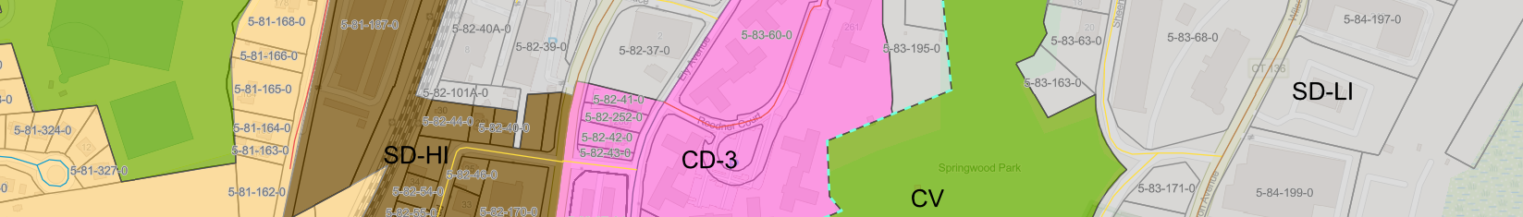
Conflation – How Misclassification Occurs
Emerged gradually from a combination of factors
Economic pressure, public perception, local politics
Negative connotations of ‘industry’, assumption of incompatibility
23 towns have no dedicated industrial zoning
‘Commercial’ zoning seen as cleaner, quieter (despite actual impacts)
Industry/service uses folded into commercial
Maintaining productive economic activity while avoiding political sensitivity
Commercial becomes catch-all
Viewed as flexible/transitional
Adaptation through reclassification rather than reevaluation
Notes:
Assumptions about dirty industry is one of several reasons that create the potential for misclassification of land use – but how does it occur? The previous era of smokestack industries has left negative connotations, and an assumption of incompatibility. Commercial zones are seen as cleaner and quieter despite coming with significant impacts of their own.
As a result, industry and service uses are folded into commercial zones as a catch-all, maintaining productive economic activity while avoiding the political sensitivity or community concern with industrial zoning.
This is adaptation through reclassification rather than reevaluation – and this is where the trouble starts.

Slide 8
Conflation – How Misclassification Occurs
Cumulative Zoning
Industrial (+ Commercial + Residential)
Problem is compounded by the broader structure of zoning
Cumulative zoning - lower-intensity uses allowed in higher-intensity zones
Most common
Commercial uses easily able to locate in industrial zones by-right
Non-cumulative zoning – discrete uses exclusively defined by district
Greater clarity if underlying classifications are accurate.
Lack of clear conceptual framework to communicate economic role of land
Commercial (+ Residential)
Residential
Notes:
The problem is compounded by different zoning structures. In towns that use cumulative zoning models, where (), commercial uses are able to easily locate in industrial zones – contributing to misclassification and the erosion of valuable industrial land. Non-cumulative zoning models, where districts are exclusive to one category, can provide greater clarity, but only if the underlying classifications are accurate. In both cases, the problem is not cumulative vs. non-cumulative zoning, it is the lack of a clear conceptual framework to communicate the economic role of land.

Slide 9
Cumulative or NOT: Neither are Popular
Conflation – How Misclassification Occurs
Only 59 industrial zones
In Connecticut allow both
Commercial and residential
Development or 20% of the
State’s industrial zones
Allow Retail or Commercial Use in Industrial Zones | Allow New Residential Development in Industrial Zones
 | No Industrial Zones | No | Yes | Grand Total
No Industrial Zones | 23 |  |  | 23
No |  | 46 | 8 | 54
Yes |  | 177 | 59 | 236
Grand Total | 23 | 223 | 67 | 313
Only 46 industrial zones
In Connecticut prohibit both
commercial and residential development 0r 16% of the state’s Industrial zones.
Notes:
WestCOG reviewed the state’s industrial zoning districts to determine trends in whether retail or residential uses are also allowed in industrial zones. What we found is that neither pure cumulative nor pure non-cumulative approaches exist in Connecticut. 59 industrial zones out of 290 that exist allow for cumulative zoning. 46 industrial zones have adopted a non-cumulative approach - as shown in the blue highlighted boxes on the table. The most popular approach is to prohibit residential development but allow commercial development in the state’s industrial zones. The implication is that most zoning commissions do not want residential uses in industrial zones.

Slide 10
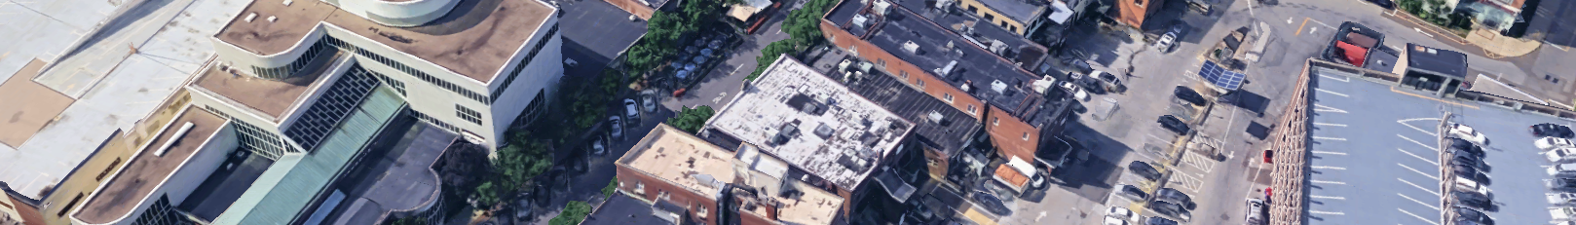
Conflation – Why Misclassification Matters
Industrial activity hidden on zoning maps
Commercial districts expanded in scope, becoming ‘catch-all’
Viewed as appropriate for conversion to other uses
Planning consequences
Distorted transportation planning
Reduced predictability for businesses
Incremental erosion of productive land
Weakened comprehensive planning
Not conscious hostility to industry – zoning systems haven’t adjusted to economic changes
Need for intentional alignment of uses, labels, and performance standards
Notes:
So what has this misclassification led to? Why does it matter?
Productive industrial and service-industrial activity has largely become hidden on zoning maps, with commercial zones becoming ‘catch-all’ areas for uses that didn’t fit neatly anywhere else. Industrial zones reserved for a few large-scale industries that don’t resemble anything else.
This all has several consequences for planning. Transportation planning is distorted as trip generation assumptions become misaligned with reality, productive industrial/service-industrial land is open to incremental erosion as commercial districts are viewed as more appropriate for conversion to other uses - as seen with recent housing legislation.
It’s important to note here that none of this is intentional – this is the result of zoning systems that haven’t caught up with a changing economic reality. The response shouldn’t be a return to older models of industrial zoning or privileging production over community needs like housing. Intentional alignment is needed.

Slide 11
Conflation – Why Misclassification Matters
Trip Generation Comparison
Commercial
Industrial
Land Use | Trip Gen. Rate*
Convenience Store | 762.3
Shopping Plaza | 94.5
Pharmacy | 90.8
Apparel Store | 66.4
Furniture Store | 6.3
Land Use | Trip Gen. Rate
Utility | 12.3
Manufacturing | 4.8
Parcel Hub Warehouse | 4.7
Industrial Park | 3.4
Data Center | 1
*Rounded weekday trips per 1,000 sq ft floor area, ITE Trip Generation Manual (11th ed, 2021)
Notes:
For context on relative traffic impacts, we can compare trip generation rates for some typical uses in different categories. Though there is a wide range across each category, Industrial uses tend to generate much fewer trips. We’ll return to these figures in a bit.
Now I turn it over to my colleague Tucker to cover the next section.

Slide 12
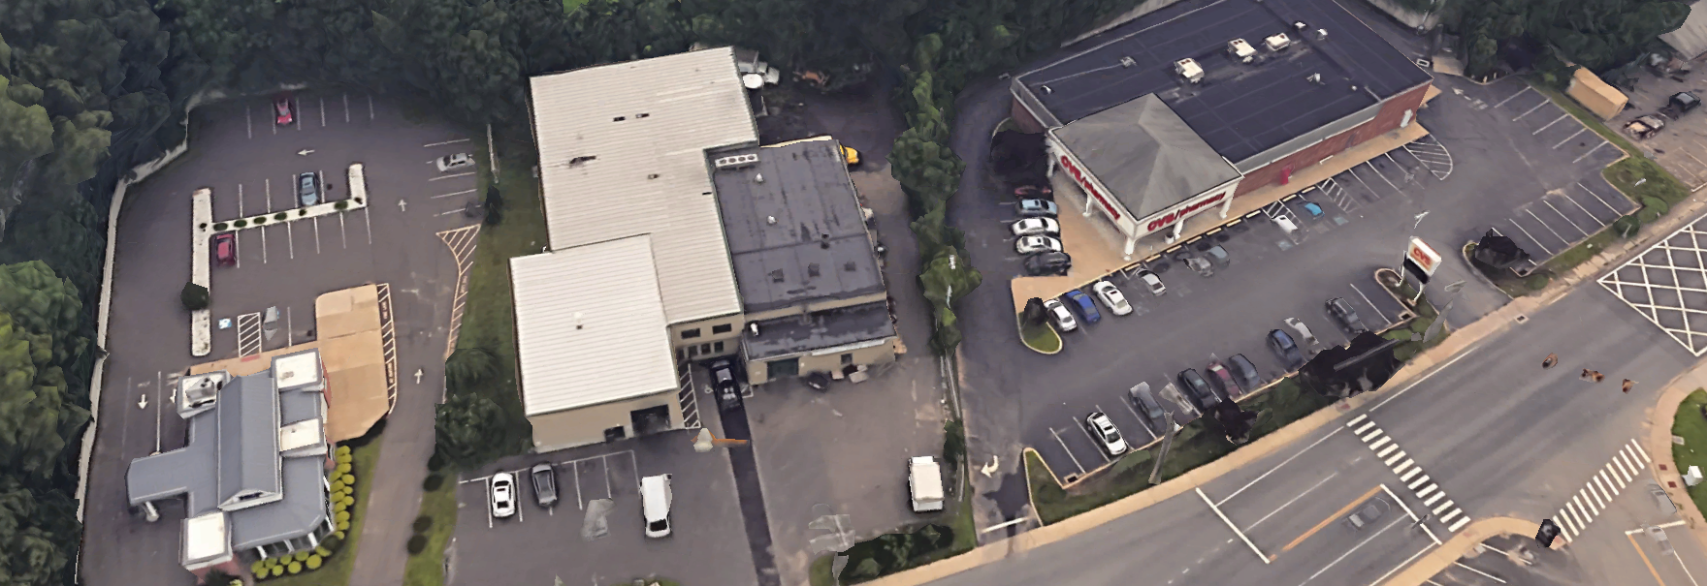
Consideration – Land as Economic Infrastructure
Industrial land performs a specific local/regional economic role
Supports production, skilled trades, maintenance, and repair
Stable middle-income employment base
Industrial uses linked to physical space, not interchangeable
Require access to specific infrastructure and resources
Large parcels
Benefit from clustering
Difficult to recover once lost
Notes:
Part of this alignment is recognizing the specific economic role of industrial land within a region. In many areas, industrially zoned land provides the backbone of production, maintenance, repair, and skilled trade services that support all other commercial and residential activity. It is also a solid employment base, maintaining a core body of well-paying, often unionized jobs. These uses are more closely linked to physical space than more interchangeable commercial uses - they can require things like access to transportation networks, power and water infrastructure, proximity to suppliers, or specific labor pools. They also often require large contiguous parcels.
Because of all this, they are very difficult to recover if the land is converted to other uses – and misclassification obscures where this may be occurring.

Slide 13
Consideration – Service-Industrial Zoning
Service-Industrial Uses:
Uses that fall between traditional industrial and commercial categories.
Vertically integrated in such a way that multiple stages of production occur within the same facility.
Limited on-site retail activity (accessory).
Small footprint, low environmental impact.
Examples:
Precision manufacturing (tools/instruments)
Furniture, cabinetry, & woodworking
Apparel & fashion
Electronics assembly
Artisan food production (coffee roasters, bakeries)
Copy/print/sign shops
Art studios
Notes:
One way to approach this is through dedicated service-industrial zoning. Service-Industrial encompasses a wide range of uses that fall between traditional industrial and commercial categories but share some key similarities.
They are vertically integrated – meaning that multiple stages of production or sale occur on-site. Where retail activity is involved, it is limited in scope and secondary to production. They also have small footprints, both in terms of physical space and environmental impact.
Some examples of service-industrial uses are:

Slide 14
Service Industrial Zone: Defined
“A service-industrial zone is designed to support employment-oriented uses that merge industrial activity with service business operations including light manufacturing, and specialized business services with retail components. These zones avoid the blight of traditional industrial districts that produce noise, dust, fumes or other offensive activities that adversely affect other properties. Service Industrial zones, are intended for those businesses that provide products and services to the public and generate employment.”
Notes:
While Middletown Connecticut is the first and only municipality to adopt the concept of a service industrial zone. It represents the merger of commercial and manufacturing sectors with a focus on businesses that provide services to the public and also generate employment. The concept of the service industrial zone is important in so far as it represents a modern approach to merging commercial and industrial uses in one zone with a focus on public access to services that are not normally associated with industrial land uses.

Slide 15
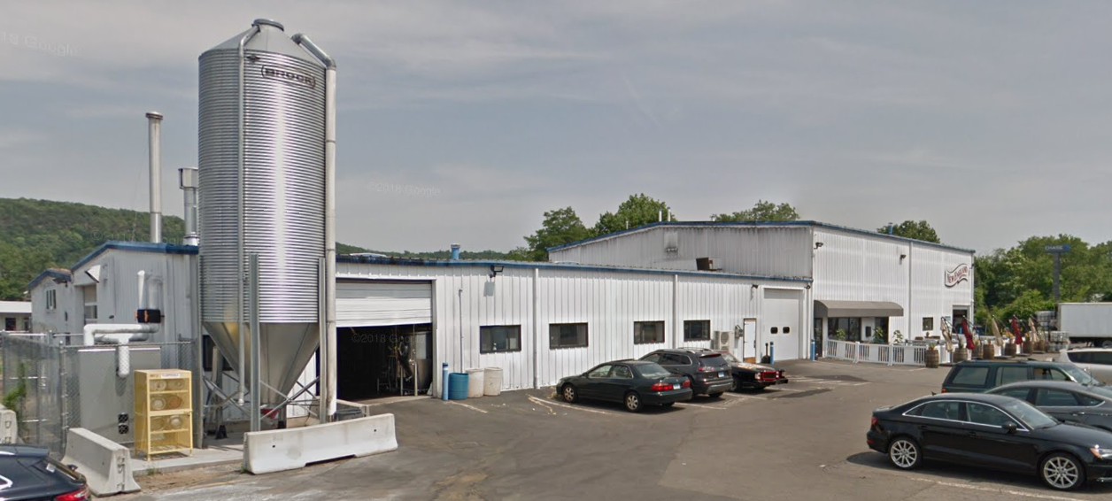
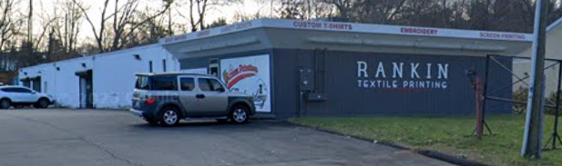
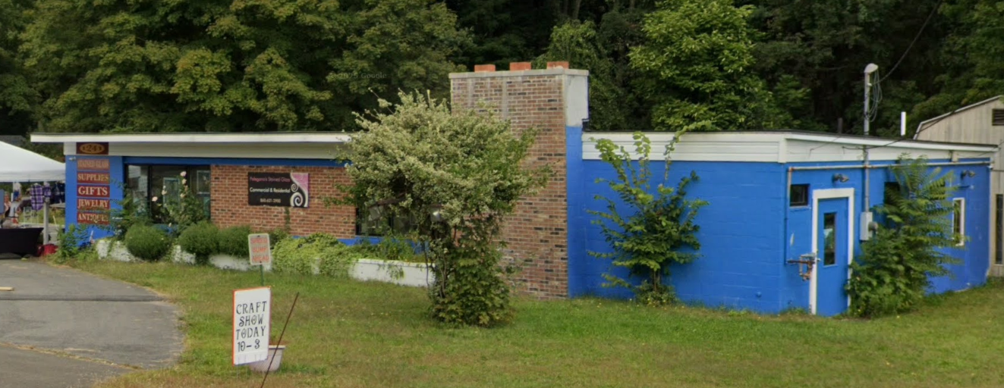
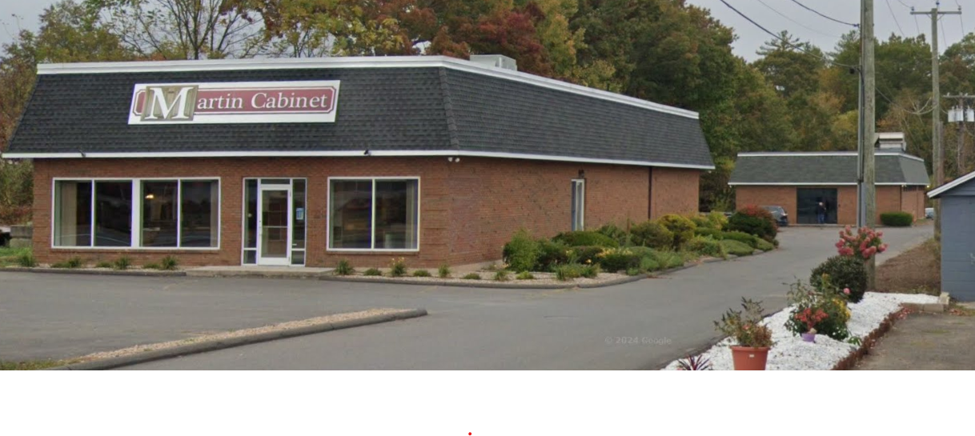
Consideration – Service-Industrial Zoning
Need for a distinct service-industrial category
Accommodates low-impact industrial & service activity
Distinct compatibilities and infrastructure needs
Maintains clarity of intent
Protects land needed for service and employment
May include:
Office space
Skilled trades contractors
Specialty services
Light industries
Notes:
Dedicated service-industrial zoning serves to separate out low-impact industrial and service activities in a distinct category, recognizing its distinct needs and compatibilities. The key benefit of this approach is that it maintains clarity of intent in zoning and protects critical employment land – preserving true industrial zoning for uses with greater land use needs.
Outside of strictly service-industrial uses, other low-impact uses on the fringes of other categories can be included in service-industrial zone, like offices, skilled trades contractors, specialty services, and light industries (examples above).

Slide 16
Consideration – Service-Industrial Zoning
Trip Generation Comparison
Commercial
Industrial
Service-Industrial
Land Use | Trip Gen. Rate*
Convenience Store | 762.3
Shopping Plaza | 94.5
Pharmacy | 90.8
Apparel Store | 66.4
Furniture Store | 6.3
Land Use | Trip Gen. Rate
Utility | 12.3
Manufacturing | 4.8
Parcel Hub Warehouse | 4.7
Industrial Park | 3.4
Data Center | 1
Land Use | Trip Gen. Rate
Brewery Tap Room | 61.7
Specialty Trade | 9.8
General Light Industry | 4.9
Copy/Print/Ship Store | 2.8
Hair Salon | 1.2
*Rounded weekday trips per 1,000 sq ft floor area, ITE Trip Generation Manual (11th ed, 2021)
Notes:
Returning to our trip generation comparison, we can add in relative traffic impacts of uses that would fit into a service-industrial zone and compare trip generation rates for some typical uses in different categories. While these can be higher than most industrial use rates, they tend to fall neatly in between the other two categories.

Slide 17
Consideration – US Examples
Service Based Industries in the United States
1. Apparel and Fashion
Companies often use light machinery, are noise-compliant, and operate in urban, high-density areas.
Custom Apparel & Cut-and-Sew: Companies like Cut and Sew USA (NYC) or Apparel Production Inc.
Small-Batch Fashion: Lefty Production Co. Specializes in low-minimum, small-batch production.
Boutique Knitwear & Print: Royal Apparel focuses on sustainable and customized apparel.
2. Artisan Food and Beverage
Artisan production is frequently permitted in light industrial/mixed-use zones due to low impact.
Craft Coffee Roasters: Small-scale roasting and packaging.
Microbreweries/Distilleries: Often include a retail tasting room (taproom) component.
Artisan Bakeries & Patisseries: Specialized production for local wholesale/retail.
3. Specialized Design and Manufacturing
These companies focus on high-value, small-batch, or customized goods.
Furniture & Woodworking: Custom furniture workshops and cabinet makers.
Jewelry & Watch Making: High-end, precise manufacturing with low environmental impact.
Ceramics/Pottery Studio: Boutique production of home goods.
Leather Goods Manufacturing: Small-batch, handmade leather items.
Notes:
Now we will address some exampless of service industrial land uses.
Over the last 50 years there has been a vertical integration of many industrial, commercial and service industries across the United States. Vertically integrated businesses are companies that own or control multiple stages of their supply chain—from production to distribution and retail—rather than relying on external suppliers. This strategy aims to increase efficiency, reduce costs, secure supply chains, and gain tighter control over quality and, in some cases, the market.
This phenomena has been accelerated by the increased use of computers, robotics and the development of small scale, lower cost technologies to create products and services. This slide shows some examples from the apparel and fashion industry, artisan foods and beverages and specialized design and manufacturing.

Slide 18
Consideration – US Examples (Cont.)
Service Based Industries in United States – Cont.
4. Technology and Specialized Assembly
These types of businesses are often the primary tenants in "Business and Research Parks".
3D Printing Workshops: Rapid prototyping and small-batch production.
Electronics Assembly: Small-scale assembly of consumer devices.
Medical/Dental Instrument Manufacturing: Precision, clean-room assembly.
5. Creative and Publishing
Graphic Design and Print Shops: Digital printing, bookbinding, and screen printing.
Signage Manufacturing: Custom, specialized sign fabrication.
Why These Fit Business Zones
Light Industrial/Mixed-Use Zoning: These zones allow for "clean" mfg. where production is largely indoors, and noise/emissions are minimal.
Low Environmental Impact: Unlike heavy industrial, they do not require massive freight traffic or generate excessive pollution.
Small Footprint: They can often fit into repurposed older buildings or modern business parks.
Notes:
Here are two more examples of service industry categories for technology and specialized assembly and creative publishing. Today, anyone can be an author using their own home computer. Furthermore, if they have the skills and software they can also perform digital printing, marketing and distribution on a small scale.
One of the challenges posed by creating a service industrial zone is that it may require a reassessment of what is called the principal use of the land. Most zoning regulations regulate the principal land use and limit other activities by labeling them subordinate uses. What happens in a vertically integrated business defies those definitions and calls for more flexibility consistent with the specific intent of the service industrial users. There may not be one principal use in a vertically integrated business over the life of that business.

Slide 19
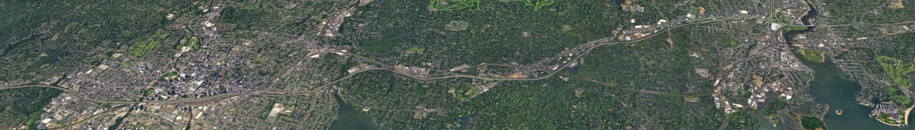
Context – The Statutory Environment
CGS 8-30g
Explicitly exempts industrially zoned land from appeals, not commercial
Reflects assumption that commercial land is suitable for conversion
Lack of clear planning intent
Allows for erosion of productive land without planning consideration
SSPA 25-1
Allows for summary review housing development in commercial zones
Redevelopment pressure without planning consideration
Notes:
We’ve been stressing so far the issue of planning intent – the stakes for misclassification rise when we look at the statutory environment in CT, where zoning labels (and their misapplications) carry substantive impact.
The two most significant pieces of land use planning legislation in recent memory, 8-30g and Special Session Public Act 25-1, both explicitly exempt industrially zoned land from their provisions, but facilitate the conversion of commercially zoned land. This reflects the assumption that commercial land is suitable for conversion (Public Act 25-1 exemption may be revised). But when commercial zones are frequently used as catch-all areas and the land use needs of service-industrial uses aren’t distinctly considered, this can lead to the erosion of ideal industrial/service land and gets in the way of effective prioritization of land for housing.

Slide 20
Context – Restrictions on Residential Development
 | Types & Number of Commercial & Industrial Uses
Type Of Housing Allowed | No Industrial Zones | Business & Industry Zones | Commercial Zones | Industrial Zones | Grand Total
Zones not Allowing Multi Family or Single Family | 23 | 7 | 49 | 201 | 280
Allow Multi Family but not Single Family |  |  | 4 | 5 | 9
Allow Single Family but not Multi Family |  | 2 | 7 | 9 | 18
Allow Single Family and Multi Family |  | 1 | 4 | 1 | 6
Grand Total | 23 | 10 | 64 | 216 | 313
Notes:
So let’s look at current zoning practices concerning residential development in commercial or industrial zones.
Most commercial and industrial zones in Connecticut do not allow residential development. 76% of the state’s commercial zones do not allow residential development and 93% of the state’s industrial zones do not allow residential development.
Residential development can be compatible with commercial development when planned properly. This is an important issue that is directly related to the mandates of Public Act 25-1.

Slide 21
Conclusion – Zoning with Intent
Intentional zoning for industry does not diminish the importance of residential or commercial uses.
Clear zoning intent
Accurate consideration of land use needs for each respective zone
Allows for more effective local and regional planning.
Service-industrial zoning offers a path forward.
Zoning should always accommodate change, but it must guide it intentionally so that it serves long-term community objectives.
Notes:
Ultimately, intentional zoning for industry does not mean diminishing the importance of residential or commercial uses. It means ensuring that zoning maps clearly communicate planning intent, and that the land use needs of both commercial, service-industrial, and industrial uses can be effectively considered. This allows for more effective planning across the board. This benefits residents, property and business owners, and developers as well, and allows state statutes to function as intended. Service-industrial zoning offers a practical path forward towards this goal.
This presentation was meant to serve as a brief overview of the ideas covered in the report – the full text is available on our website, it’s a short but dense read (24 pages). We hope it is informative, but we’re happy to address any questions right now as well.

Slide 22
Service Industrial References
Conclusion – References
WestCOG, Reexamining Industrial, Commercial, and Service Industrial Zoning in Connecticut, Preserving Economic Function, Compatibility, and Comprehensive Planning in a Changing Economy, March 2026
Charles Vidich, Senior Project Manager, WestCOG
Tucker Beckett, Senior Planner, WestCOG
Notes:
You can find the WestCOG report that addresses today’s training on our website.

