Slide 1
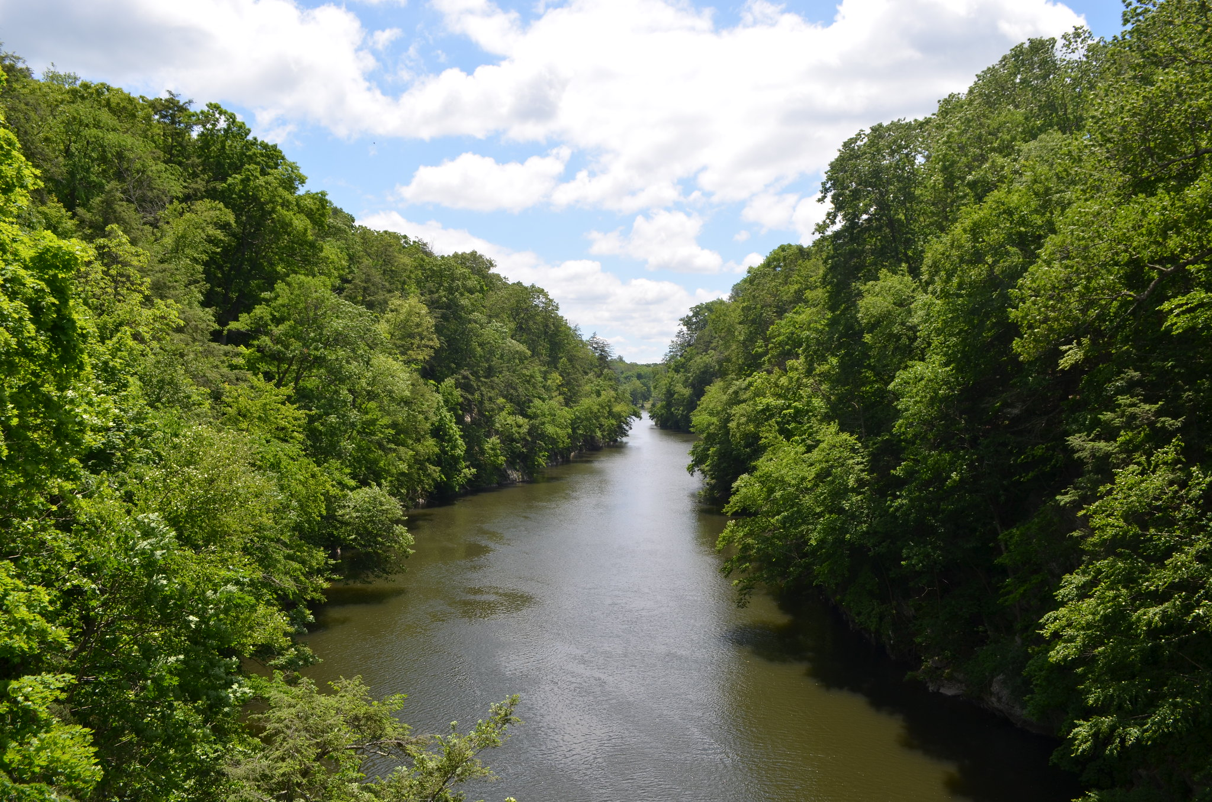
Land Use Controls to Safeguard Public Water Supply Watersheds
Recommended Zoning Practices for Zoning Commissions
Western Connecticut Council of Governments
May 11, 2026
Notes:
My name is Charles Vidich and I am joined by my colleague Tucker Beckett. . This training presentation addresses the need for improved land use controls in areas where public water supply watershed lands are owned by private landowners. WestCOG undertook a statewide analysis of municipal zoning practices specifically in areas where the groundwater classification is designated GAA or suitable for drinking water purposes.
This one-hour training session fulfills your requirement to receive at least one of the four hours of training relevant to your role as a planning and zoning commission or zoning board of appeals member every four years. If your term is longer than four years, then you must receive the required training during the term of your service on the commission.

Slide 2
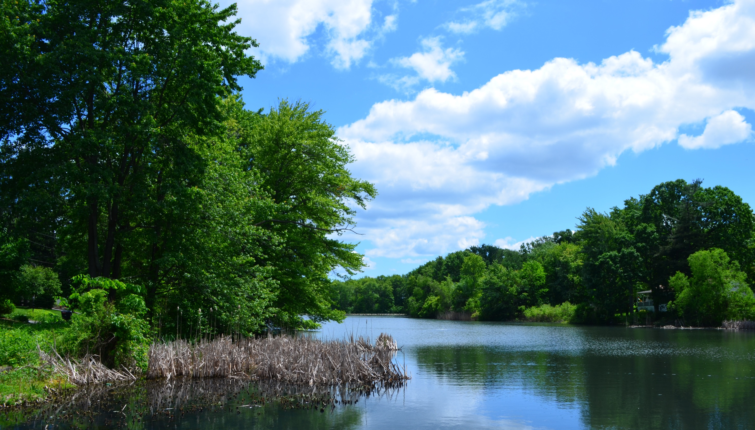
Overview of Land Use Controls
Connecticut Case Law
Who is Responsible for Safeguarding Water Supply Watersheds
Purpose of WestCOG Study & Study Methodology
Water Supply Watersheds v. GAA Classifications
Municipalities with Explicit Watershed Protections
Watershed Based Zoning: Best Practices & Top Zoning Tools
Prohibited & Permitted Uses: Current Practice
Relevant Zoning Strategies
Density of Stormwater Catch Basins
Status of Notification Procedures
Recommendations
Notes:
Our presentation will review the purpose and methodology for our study. We will then review the status of our watershed mapping work and related findings followed by our deep dive into watershed conscious zoning practices across the state.
It is important to understand that our focus is on public water supply lands and not on aquifer protection areas that have already been identified and delineated by DEEP.
One of the motivations for investigating zoning strategies for protecting public water supply watersheds reflects the legislative directive found in Public Act 85-279 that states planning and zoning regulations SHALL BE MADE WITH REASONABLE CONSIDERATION for the protection of existing and potential public surface and ground drinking water supplies.
This presentation reviews the key findings of our recently published report: Safeguarding Public Water Supply Watershed: Local Strategies to Prevent Chemical, Petroleum and Stormwater Contamination of Connecticut’s Drinking Water Resources.

Slide 3
Connecticut Case Law & Laws Bearing on Watershed Protection Through Zoning
1971
Public Trust for water, and natural resource Protection Public Act 96
Protection of existing & potential drinking water supplies, PA 85-279
State legislature approves the State’s First Water Plan
2021
Ten Zoning commissions use overlay zones to protect watersheds
2023
NPDES permit for MS4 program requires low impact development
2024
WestCOG finds only 63 of 129 towns have water supply watershed protections
Erosion & Sediment control regulations required for zoning PA 83-388
2019
2025
WestCOG releases “Safeguards for Public Water Supply Watersheds”
2001
EPA approves Nitrogen TMDL for Long Island Sound
Fertilizer limited within 20 feet of water bodies, PA 12-155
1998
Authorizes zoning agent to determine adverse affects on watershed PA 98 115
2017
Phosphorus reduction strategy released by Legislative committee
2021
Municipality discharging to Long Island Sound must reduce hypoxia, PA 21-29
2025
Legislature establishes a working group to develop riparian buffer protections, PA 25-12
1983
1985
2012
WestCOG releases “The Case for Riparian Corridor Protections”
2022
Notes:
The Connecticut legislature authorized the use of zoning in 1925. In 1959 when Euclidean zoning was modified to allow for special permit uses within any given zoning district. The zoning enabling act of 1925 did not provide for any incompatible uses but it soon became apparent that some uses might be compatible if they were managed under special permit standards. Soon other innovations emerged with the National Flood Insurance Program in 1968 creating floodplain zones. In 1969 the CT Supreme Court upheld the use of floating zones in Stamford and then in 1985 the legislature enabled the use of overlay zones to expand its use beyond that limited to the coastal zone management program. ​
In 1998 the legislature added village districts as a new zoning tool to expand architectural protections from the exclusive domain of historic districts to be a tool for innovative village and urban design. Nine years later incentive housing overlay zones were added to the list of special development techniques. In 2013 the CT Supreme Court put guard rails on some special development practices in the Mackenzie case to ensure the principles of uniformity – otherwise known as the equal protection act – were complied with.

Slide 4
Who is Responsible for Safeguarding Water Supply Watersheds

Slide 5
Key Agencies Influencing Water Quality in Connecticut’s Public Water Supply Watersheds
Open Space Acquisition
DEEP
MS4
General
Permit
DPH
Source
Water
Protection
Water Quality monitoring
Hazwaste Regulations
Septic System Setbacks
UST/AST Controls
Water Utility Oversight
TMDL Standards
Pesticide Mgt.
IWA
Upland
Review
Area
PZC
Watershed
Based
Zoning
DOT
Catch
Basin
Mgt.
Stormwater Mgt.
Salt & Deicing
Erosion Controls
Detention Basins
Permitted & Prohibited Uses
Water Quality Monitoring
Reservoir Guard Rails
Riparian Buffers for Tributaries
Low Impact Development
Notes:
Safeguarding our public drinking water supplies requires multiple municipal and even state agencies to achieve our goals. This slide shows five key organizations that affect drinking water. Of course there are other that must be mentioned as well including conservation commissions, Boards of Selectmen, watershed associations and the list goes on.

Slide 6
Who is in Charge of Watershed Protections?
Rule 1: When there is no single accountable authority then the rule is “No one is in charge”
Rule 2: When no one is responsible then gaps in responsibility arise
Rule 3: Lack of accountability calls for coordination and delegations of authority under clear governance structures

Slide 7
Purpose of the WestCOG Study
And the Study Methodology

Slide 8
What is the Purpose of the WestCOG Study?
Identify Existing Zoning Techniques for Protecting Public Water Supply Watersheds
Identify Gaps in Protection of Existing & Potential Water Supplies
Develop Best Zoning Practices Applicable to Developed and Developable Land in the 169 Municipalities
Recommend Relevant Training and Educational Materials for Planning and Zoning Commissions, Town Planners, Inland Wetland Agencies & Conservation Commissions.
Assist the Connecticut Water Planning Council with Source Water Protection through Zoning.
Notes:
Our goal was to determine gaps in land use controls that may adversely affect water quality and then to identify and if necessary, develop best practices including relevant training.

Slide 9
Water Supply Watersheds v. GAA Classifications
Notes:
Next we will explore the spatial extent of water supply watersheds and GAA classified aquifers.

Slide 10
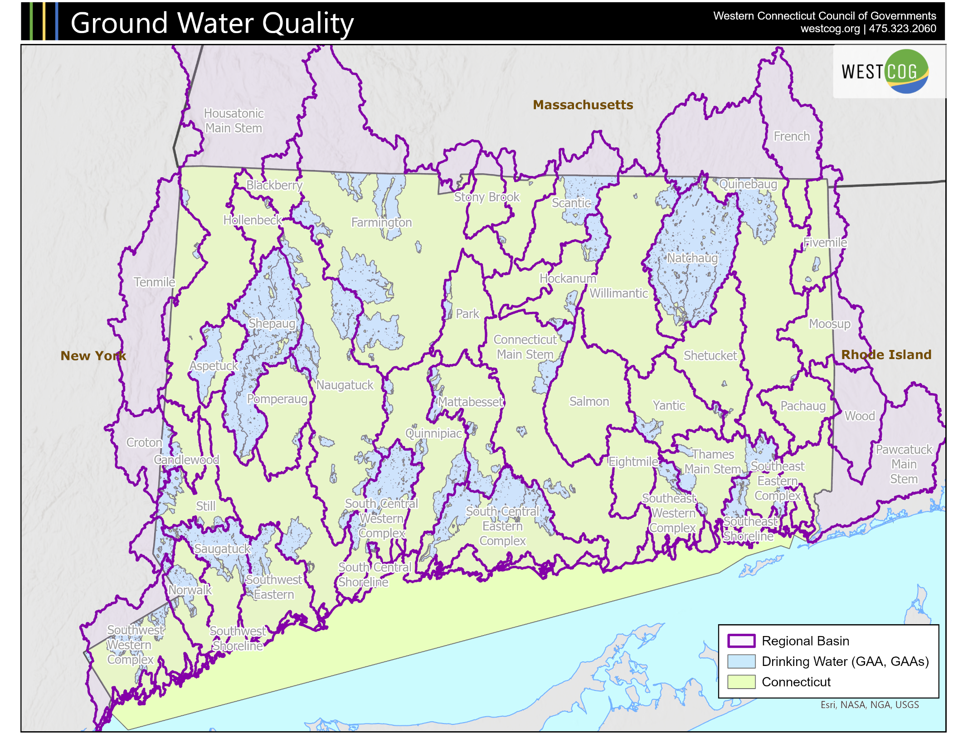
Notes:
This is a map showing the regional basins (outlined in purple) and the class GAA ground water in blue, derived from CT DEEP data. Both the surface water and ground water classification data were originally compiled in 1980 from information collected for each major drainage basin and is updated on a rotating schedule. As we can see, Western CT is home to a significant amount of the state’s public water supply – almost all of the less-developed area of the region holds GAA groundwater.

Slide 11
Only five Regional basins have 40%+ of the Watershed Designated GAA
3 of the 4 Most Pristine Watersheds are in Western Connecticut
Regional Basin | GAA as % of Regional Basin
Shepaug | 94.8%
Natchaug | 90.1%
Saugatuck | 55.2%
Aspetuck | 48.7%
South Central Western Complex | 47.0%
South Central Eastern Complex | 37.6%
Southeast Eastern Complex | 30.2%
Hockanum | 27.3%
Scantic | 26.6%
Thames Main Stem | 24.8%
Norwalk | 22.7%
Southwest Eastern | 21.3%
Naugatuck | 21.0%
Mattabesset | 21.0%
Still | 20.6%
Croton | 20.6%
Quinnipiac | 16.8%
Southwest Western Complex | 16.7%
Farmington | 16.3%
Candlewood | 13.0%
Regional Basin | GAA as % of Regional Basin
Southeast Western Complex | 12.6%
Quinebaug | 9.9%
Yantic | 9.2%
Park | 5.5%
Connecticut Main Stem | 5.1%
Pomperaug | 4.9%
Willimantic | 3.1%
Fivemile | 2.8%
South Central Shoreline | 1.8%
Housatonic Main Stem | 1.8%
Hollenbeck | 1.8%
Eightmile | 0.7%
Tenmile | 0.6%
Shetucket | 0.6%
Blackberry | 0.0%
Southeast Shoreline | 0.0%
Salmon | 0.0%
Pawcatuck Main Stem | 0.0%
Pachaug | 0.0%
Southwest Shoreline | 0.0%
Notes:
This table breaks down the numbers behind the map we just looked at - a list of the regional basin names and the percent of GAA ground water within them. It is surprising to note that only three regional basins in Connecticut have more than half of their watersheds classified as GAA. Three of these are within the WestCOG region, the Shepaug, Saugatuck, and Aspetuck.

Slide 12
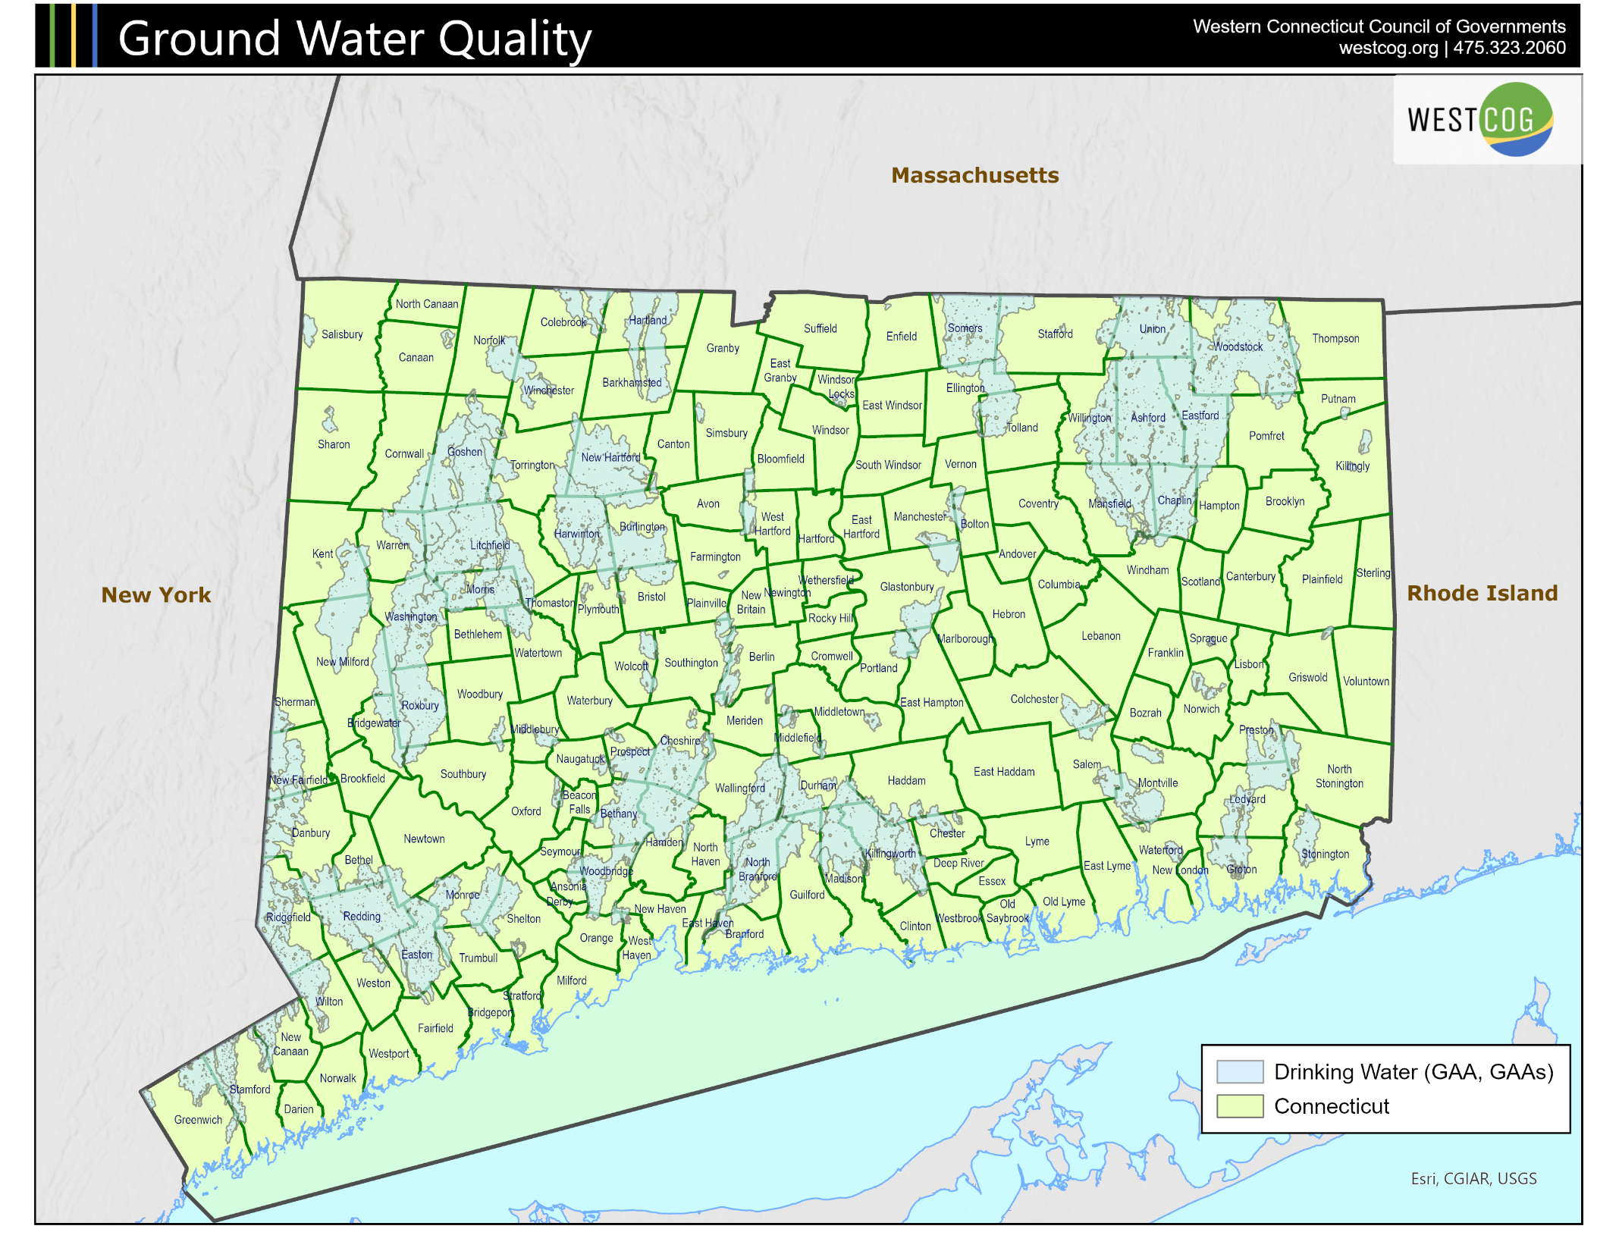
A Municipal Perspective on GAA Classified Land
Notes:
This map shows GAA classified land as an overlay to the state’s 169 municipal boundaries, which we can use to show ground water percentage by municipal area. We can see some towns have much higher responsibility than others when it comes to protecting the state’s groundwater. Ashford and New Hartford have values well over 90%. For another example, Easton has 78% of its land area in GAA.

Slide 13
Municipalities with Explicit Watershed Protections
Notes:
Next we’ll look at some municipalities that have developed explicit watershed protections.

Slide 14
63 of the 129 Municipalities with Public Water Supply Watershed Lands have Explicit Zoning Protections
169 Municipalities
80% of PWSW
Is privately owned
In Connecticut
129 with GAA Area
649,449 Acres (100% of GAA Land
63 with PWSW
Zoning Regs.
421,790 Acres (64.9% of GAA Land)
93% of PWSW
Is privately owned
In Western Connecticut
24 with 4+
Protection
Criteria
39,488 Acres (6.1% of GAA Land)
Note: For Purposes of this analysis Public Water Supply Watershed (PWSW) Lands are those Classified as GAA. There are
128 municipalities with PWSW lands serving Connecticut drinking water needs. One municipality has PWSW land
that exclusively serves New York City (Sherman). The result is 129 municipalities have watershed protection responsibilities.
Notes:
As mentioned earlier, Public Act 85-279 requires planning and zoning commissions to develop regulations that make reasonable consideration for protection existing and potential surface and ground drinking water supplies.
Only 129 municipalities have land with a GAA classification. Of that number only 63 have developed some type of zoning regulation aimed to protect surface or groundwater drinking supplies. A further deep dive into current zoning practice shows that only 24 of the 129 municipalities had ‘watershed conscious zoning regulations’ - measured by having adopted 4 or more land use controls that are protective of surface or groundwater in their municipality.

Slide 15
24 Municipalities with Public Water Supply Watershed Protections
Table focuses on municipalities with 4 or more land use Controls
Municipality | Name of Watershed Protection Zone
Barkhamsted | Farmington River Protection Overlay Dist.
Bethany | Public Drinking Water Watershed Overlay
Bethel | Water Supply Protection Overlay Zone
Danbury | Public Water Supply Watershed
Easton | Residence Districts
Glastonbury | Groundwater Protection Permit
Greenwich | Green Area Regulations
Groton* | Water Resource Protection Dist.
Guilford | Water Supply District
Killingly | Five Mile River Protection Overlay Dist.
Litchfield | Environmental Impact Review
Middletown | Protection of Water Sources
New Hartford | Public Water Watershed Overlay Dist.
North Branford | Water Supply Dist.
North Stonington* | Water Supply Protection Overlay Dist.
Plymouth | Aquifer/Water Protection Areas
Preston* | Special Resource Protection Dist.
Redding | Townwide Standards.
Salem | Riparian Corridor Overlay Zone
Somers | Groundwater Protection
Sprague | Natural Resource Protection Zone
Stonington | Groundwater Protection Overlay Dist.
Trumbull | Special Requirements for Aquarion Watershed Land
Municipality relies on
Watershed Overlay Zone
*Municipalities that participated
In the Drinking Water Quality Mgt.
Plan in Southeast Connecticut.
21 of 24 of these municipalities
also have Town Planners.
Note: This table excludes Killingworth even though it has 4 watershed protection criteria.
Notes:
As mentioned earlier, there are 24 municipalities that we have identified as having the most robust watershed protection standards in their zoning regulations. This table shows that 10 of the 24 municipalities use overlay zoning techniques to protect public water supply watershed lands. It is also worth noting that 21 of 24 municipalities with the best watershed protective standards are also served by professional town planning staff – a factor that can be less common in the more rural towns that hold much of the state’s GAA groundwater.

Slide 16
Watershed Based Zoning: Best Practices & Top Zoning Tools

Slide 17
Best Practices: Use of Overlay Zoning Regulations to Protect Public Water Supply Watersheds: Ten Municipalities with Explicit Controls
Overlay Zones have 3 Benefits:
Simplifies Land Use reviews with multiple zones in PWSW.
One Stop Shopping. All requirements in one place.
3) Enables Consistency of Approach across
Municipality, COG Regions and the State.
Municipality | Name of Watershed Protection Zone
Barkhamsted | Farmington River Protection Overlay Dist.
Bethany | Public Drinking Water Watershed Overlay
Bethel | Water Supply Protection Overlay Zone
Killingly | Five Mile River Protection Overlay Dist.
Middletown | Protection of Water Sources
New Hartford | Public Water Watershed Overlay Dist.
North Stonington | Water Supply Protection Overlay Dist.
Salem | Riparian Corridor Overlay Zone
Sharon | Watershed Overlay Dist.
Stonington | Groundwater Protection Overlay Dist.
Overlay Zones have 3 Limitations:
Less Useful for Small PWSW within an
existing Zone.
May be Poorly Depicted on municipal zoning maps.
3) Often Lack Detailed Statement of Purpose.
Notes:
In this table we take a closer look at the 10 zoning regulations that represent the best practices for watershed conscious zoning. Overlay zones have benefit and limitation as are noted in this table. When the benefits and limitations are weighed the overall weight of evidence points to overlay zones as offering more benefits than disadvantages. It is instructive to note that the overlay zoning approach was also the approach adopted by the 81 municipalities with aquifer protection areas in Connecticut.

Slide 18
Prohibited & Permitted Uses: Current Practice

Slide 19
Prohibited Land Uses in Public Water Supply Watersheds: An Analysis of 20 of 129 Municipalities with Watershed Conscious Zoning Regulations
Common concerns: septic effluent, chemical discharges from tanks, vehicle service facilities, medical labs, road salt, and manufacture and storage of hazmat.
Description of Prohibited Land Uses | Code | Municipalities with PWSW Regulations
Manufacture or Storage of Hazmat | HAZ | 13
Chemical Storage Facilities including Salt | STORC | 13
Sanitary Landfills | SLAN | 10
Septage Lagoons and Wastewater discharges | SEP | 8
Junk yards | JUN | 7
Gasoline and Fuel Dispensing | GAS | 7
Truck Terminals | TRT | 7
Engine Repair and Maintenance | ENR | 6
Facilities that use Solvents | SOL | 6
Underground Storage Tanks | UST | 6
Uses Otherwise Prohibited in the Underlying zone | PROH | 4
Cemeteries | CEM | 3
Excavation & Filling | EXC | 2
Medical Laboratories, Clinics and Offices | MEDO | 2
Storage of Vehicles | STORV | 2
Tree Cutting | TREE | 2
Airport and Heliport Landing Fields | AIR | 1
Impoundments & Dams | DAM | 1
Golf Courses | GOL | 1
Pestcide Applications within 500 ft. of public water Supply | PEST | 1
Public Sewers | PSEW | 1
Library, Day Care, Post Office, Non-Profit Music Venues, Commercial Recreation, Recycling Ops, Telecom Facilities | MiSC. | 7
 |  | 110
Note 1: Only 20 of 129 municipalities
with PWSW lands have regulations for permitted and prohibited land uses in
the public water supply GAA zone.
Note 2: 63 municipalities have 297 distinct permitted land uses: variations exist in nomenclature and permitting procedures.
Notes:
This table is a deeper dive on the types of prohibited land uses found to be incompatible with public water supply watersheds. Only 20 municipalities have adopted this zoning tool even though 100% of them should be doing so. This table underscores the importance of improved training and education for planning and zoning commissions, town planners and other municipal officials influencing land development decisions.

Slide 20
Relevant Zoning Strategies

Slide 21
Type and Number of Zones Governing Public Water Supply Lands
by Minimum Lot Size: 2024 (Square Feet)
Analysis of 129 Municipalities with Public Water Supply Watersheds | Number and Percent of Zones | 130K and Greater | 80K to Less than 130k | 60K to less than 80K | 40K to less than 60K | 20K to less than 40K | 5K to less than 20K | 1k to less than 5K | Lot Size Not Specified | Total
Residential Single Family | # of Zones | 35 | 90 | 23 | 60 | 28 | 31 | 0 | 7 | 274
 | % of Zones | 13% | 33% | 8% | 22% | 10% | 11% | 0% | 3% | 100%
Industrial | # of Zones | 6 | 11 | 1 | 14 | 1 | 0 | 0 | 7 | 40
 | % of ones | 15% | 28% | 3% | 35% | 3% | 0% | 0% | 18% | 100%
Commercial | # of Zones | 3 | 10 | 5 | 22 | 13 | 8 | 0 | 10 | 71
 | % of Zones | 4% | 14% | 7% | 31% | 18% | 11% | 0% | 14% | 100%
Multi Family | # of Zones | 0 | 2 | 0 | 3 | 1 | 6 | 3 | 1 | 16
 | % of Zones | 0% | 13% | 0% | 19% | 6% | 38% | 19% | 6% | 100%
Govt & Park | # of Zones | 0 | 0 | 0 | 0 | 0 | 0 | 0 | 8 | 8
 | % of Zones | 0% | 0% | 0% | 0% | 0% | 0% | 0% | 100% | 100%
Overlay Zones | # of Zones | 0 | 0 | 0 | 0 | 0 | 0 | 0 | 10 | 10
 | % of Zones | 0% | 0% | 0% | 0% | 0% | 0% | 0% | 100% | 100%
Total Zones | # of Zones | 44 | 113 | 29 | 99 | 43 | 45 | 3 | 43 | 419
 | % of Zones | 11% | 27% | 7% | 24% | 10% | 11% | 1% | 10% | 100%
Notes:
We reviewed the zoning that applies to all GAA classified land in Connecticut to the type of zone and the minimum lot size required by each zone. There are 419 zones in Connecticut that govern public water supply watershed lands. We will review the details of this analysis on the next two slides.

Slide 22
Single Family Residential Zones Represent 65% of the 419 Zones Applied to GAA Groundwater Lands in Connecticut
Commercial & industrial zoned land represents a threat when “watershed conscious” zoning protections do not exist.
Notes:
As you can see, 65% or about two thirds of all zoning in Connecticut that regulates land in the GAA zones is residential single family. However, 111 zones, or 26%, are commercial or industrial. They pose a greater threat to drinking water supplies.

Slide 23
Municipalities with “Watershed Conscious” Zoning Have 60% of the 419 Zones Applied to GAA Groundwater Lands in Connecticut
A Watershed Overlay Zone is
an indicator of municipal
concern for source water protection.
Notes:
This chart distinguishes the number of zones of each class of zoning based on whether they have or do not have watershed conscious zoning. It is worthy to note that there are nearly twice as many commercial and industrial zones in the 63 municipalities with watershed conscious zoning than those without any such regulations. Could the reason for this distinction reflect greater concern and therefore more robust regulations due to past commercial or industrial releases of chemicals or spills?

Slide 24
Land use Tools to Protect Public Water Supply Watersheds
Pervious Land Cover
Wetland
Buffers
Public Water Supply
Watersheds
Riparian Buffers
Low Impact Development
Pre-Development Storm water Hydrology
Land Use
Restrictions
Buildable
Lot Standards
Notes:
Thee are six basic land use tools that support low impact development as shown in this side. They are especially important for use in watershed areas that are used for public water supply.

Slide 25
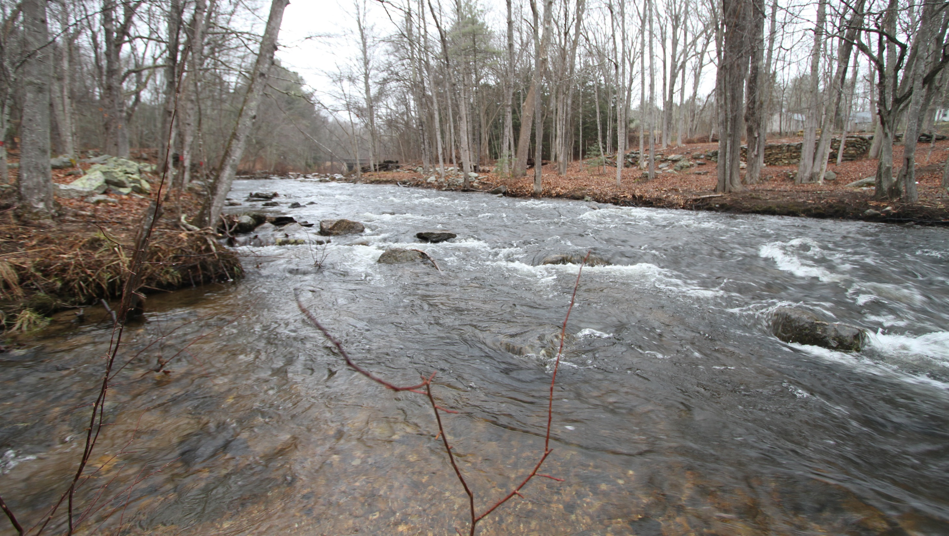
Relevant Zoning Strategies: Land Based; Activity Based & Review Based
Land Based Strategies
Rely on Permitted and Prohibited Uses
Riparian Buffers, Low Impact Development
Activity Based Strategies
Hazardous Materials Storage and Use
Spill Response Plans, Inspection & Maintenance Plans
Review Based Strategies
Special Permit Approvals, Site Plans Reviews
Environmental Impact Analysis
Lot Size and Lot Coverage
Pesticide and Fertilizer Storage and Use
Watershed Management Plan, Stormwater Plans
Notes:
Zoning strategies are founded on three basic concepts: land based, activity based and reviewed based regulations. Land based strategies are the traditional and most useful zoning approach to protecting watersheds. However, the other strategies are useful when zoning commissions have sufficient time, staff and expertise to manage public water supply watersheds. In reality, it is a tall order that few municipalities have the resources to comfortably command.

Slide 26
Zoning, Inland Wetlands & Dept. of Pubic Health Setback Strategies: Land Based; Activity Based & Review Based
Land Based Setback Strategies
Municipal Riparian Buffer Setbacks
DPH Water Reservoir Setbacks
Activity Based Strategies
Municipal Manure Pile Setbacks from watercourses
Review Based Setback Strategies
Upland Review Area setbacks for Watercourse and Wetlands
DPH Septic System Leaching Field Setbacks from watercourses
Upland Review Area setbacks for Designated Rivers and Streams
Municipal Hazmat Storage Setbacks from watercourses
Municipal Timber Cutting Setbacks from watercourses
Notes:
These same three strategies are also applicable to the use of setback controls and are some of the most important watershed protection tools that exist today.

Slide 27
Watershed Conscious Zoning Checklist
Step 1 | Assessment Phase: Identify Vulnerable ground and surface waters | Check Completed Items (√ )
1 | Identify existing Land Uses in Areas classified as GAA
2 | Identify those portion of the GAA Classified Land that is privately owned
3 | Identify Total Maximum Daily Load status for rivers/streams in Public Water Supply Watershed
Step 2 | Identify Activity Based Threats to Watershed Protection
1 | Identify agricultural activities too close to tributaries to reservoirs
2 | Identify businesses and industries in watershed that store hazardous or petroleum chemicals
3 | Identify activities of concern in Watershed Management Plan for your Municipality - if one exists
4 | Identify businesses & industries in watershed subject to the Community Right to Know Act
5 | Identify businesses industries that are small or large quantity generators of hazardous waste
Step 3 | Identify Land Use Based Threats to Watershed Protection
1 | Identify the types of commercial and industrial land uses located in GAA classified land
2 | Identify the current zoning for all GAA classified land
3 | Determine existing commercial or industrial enterprises considered a threat to drinking water
4 | Identify locations of underground and aboveground storage tanks in GAA classified land
Notes:
WestCOG developed this watershed conscious zoning checklist to assist with the process of improving the protections governing public water supply watersheds. Surprising at it may seem, WestCOG is one of the few organizations that has developed detailed zoning strategies to protect Connecticut’s water supplies. The first three steps are to assess and identify vulnerable ground and surface waters; then to identify activity based threats and land use based threats to watershed protection as listed here.

Slide 28
Watershed Conscious Zoning Checklist (Cont.)
Step 4 | Identify Review Based Threats to Watershed Protection | Check Completed Items (√ )
1 | Determine special permit or site plan controls for uses in GAA classified land
2 | Identify zoning standards for commercial/industrial uses in a water supply watershed
Step 5 | Develop Zoning Toolbox Options
1 | Adopt Impervious Cover Standards within 100 feet of tributaries
2 | Require Stormwater Management Plans for development disturbing over 1/2 acre
3 | Ensure Low Impact Development is first step in stormwater management
4 | Establish a Riparian Buffer Zone along tributaries to water supply reservoirs
5 | Locate Septic System Leach Fields at least 100 feet from tributaries to reservoirs
6 | Identify Permitted and Prohibited Uses in GAA Classified land
7 | Consider Larger Lot Sizes and Setbacks near tributaries to water supply reservoirs
8 | Use Verifiable Inspection/Maintenance of catch basins, detention/retention basins
9 | Consider Greater Riparian Buffers for Headwater Streams and Steep Slopes
10 | Limit Pesticides Use in public water supply watersheds
11 | Restrict underground storage tanks in public water supply watersheds
12 | Use UCONN CLEAR Parcel Prioritization Software to identify & protect high value land
Step 6 | Coordinate with adjacent Municipalities sharing same Watershed
1 | Meet with abutting municipalities to Protecting Public Water Supply Watershed
2 | Get technical assistance from CLEAR Staff, CT Dept. of Health, CT DEEP and COGs
3 | Work with watershed management associations on land use related strategies
Notes:
The next step after identifying activity and land use threats is to identify review based threats – this means threats that can best be addressed through the special permit and site plan review process as we have discussed earlier.
Step 5 is the key part of this checklist. It focuses on the zoning tools that support watershed conscious zoning. Let’s review a few of the key zoning tools.

Slide 29
Density of Stormwater Catch Basins
Notes:
Here we’ll dig a little more into stormwater runoff, looking at the density of stormwater catch basins across the region.

Slide 30
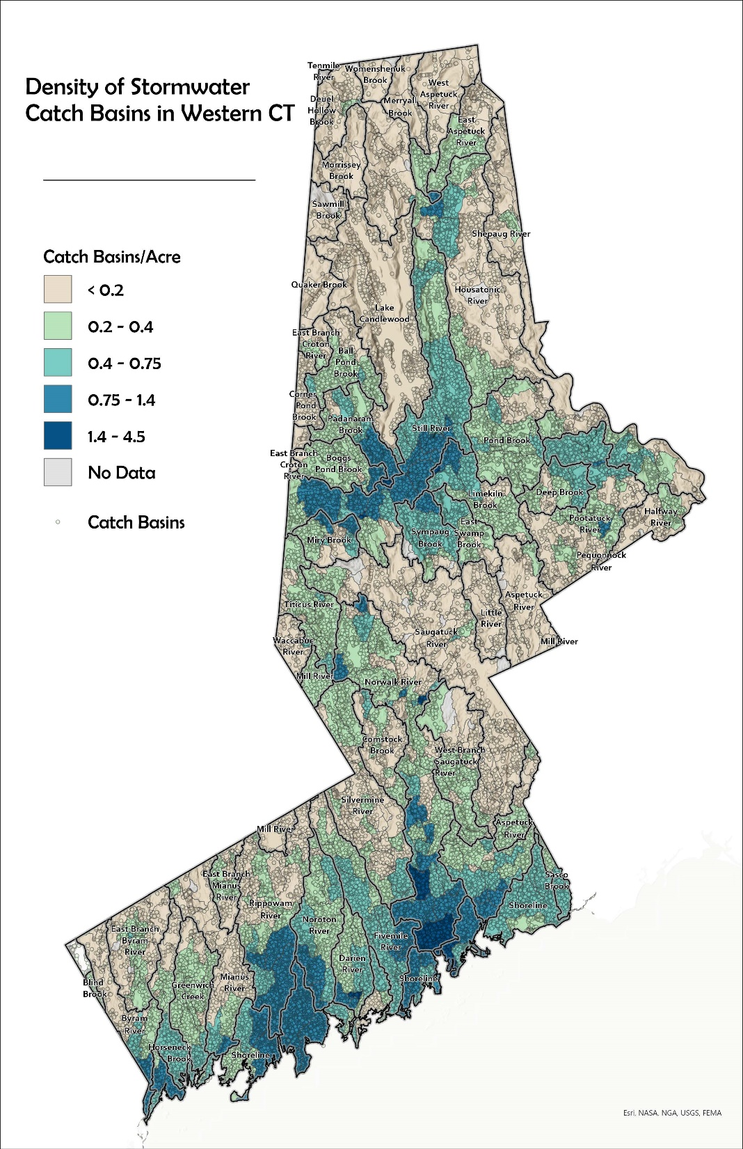
Density of Stormwater Catch Basins in Western Connecticut: 2024
Stormwater Directly Connected to Catch Basins pollutes drinking water.
Limit Catch Basins in Public Water Supply Watersheds
Rippowan and Noroton Rivers are not Pristine
  Have as many as 4.5 catch basins per acre
Shepaug and Aspetuck most Pristine Basins in CT
  Have Less than 1 catch basin per 5 acres.
Notes:
One of the greatest water quality concerns we face is the excessive number of catch basins discharging into public water supply watersheds. This is an opportunity for municipalities and the Connecticut Department of Transportation to focus efforts on reducing the number of locations with directly connected impervious areas discharging to streams and rivers within public water supply watersheds. Catch basins and DCIA, as it is called, create perfect pathways for spilled petroleum, PFAs, brake and tire residue, and other toxic substances off our highways and into water systems. Towns should work to disconnect these pathways wherever possible.

Slide 31
Status of Notification Procedures

Slide 32
Notifications to Public Water Utilities
Section 8-3i requires planning and zoning commissions to notify water utilities when development occurs within a watershed of a water company.
  In theory 129 municipalities with drinking watersheds are subject to this requirement
  A review of statewide zoning regulations found only 38 reference section 8-3i or similar language; 10 of which have no public water supply watersheds.
    Only 6 Municipalities with public water supply “watershed conscious” zoning require 8-3i notifications.
Conclusion: Section 8-3i is conspicuous by its absence in municipalities with public water supply watersheds.
Notes:
Despite the hopes of the state legislature, the water utility notification procedure (codified as Section 8-3i of the zoning enabling statutes) is not holding up to expectations. Though 129 municipalities are meant to be subject to this requirement, in practice only about 20% of the covered zoning commissions use the notification procedure.

Slide 33
Only 30 Municipalities Share Watershed Conscious Zoning with Aquifer Protection Area Zoning Regulations
63 Watershed
Conscious Zoning Regulations
66 Non-Watershed
Conscious Zoning Regulations
81 APA Regulations
30
35
40 Lacking Public Water Supply Watersheds
16
Notes:
This graph shows the intersection between municipalities with watershed conscious zoning and municipalities that have adopted aquifer protection area regulations. It’s worth noting that aquifer protection areas exist in 16 municipalities that fall outside of the GAA groundwater classification system developed by DEEP.

Slide 34
Recommendations

Slide 35
Key Recommendations
Adopt Watershed Management Best Practices (Focus on examples in Connecticut and New England)
Adopt Riparian Buffer Strategies (focus on Source Water Protection)
Develop Engineering Controls for Catch Basins (focus on those in Public Water Supply Watersheds).
Adopt Watershed Wide Impervious Cover Standards (Focus is for Public Water Supply Watersheds)
Continue Technical Assistance to Municipal Stakeholders (Municipal Planning and Zoning Commissions, watershed management associations, Conservation Commissions and Inland Wetland Agencies)
Notes:
We still have a great deal of work to complete but we would appreciate any feedback or suggestions you might have about what we have presented. Our recommendations will only work when there is public understanding of the threats posed to our drinking water.

Slide 36
Relevant WestCOG Studies
The Case for Riparian Corridor Protections: Zoning Strategies to Reduce Pollution of Inland Waters and Resultant Hypoxia of Long Island Sound, August 2021
Safeguarding Public Waer Supply Watersheds, Local Strategies to Prevent Chemical, Petroleum and Stormwater Contamination of Connecticut’s Drinking Water Resources, December 23, 2024
Charles Vidich, Senior Project Manager, cvidich@westcog.org
Tucker Beckett, Senior Planner, tbeckett@westcog.org
Notes:
These are two of the most relevant documents for those interested in learning more about protecting drinking watersheds through zoning.

