Slide 1
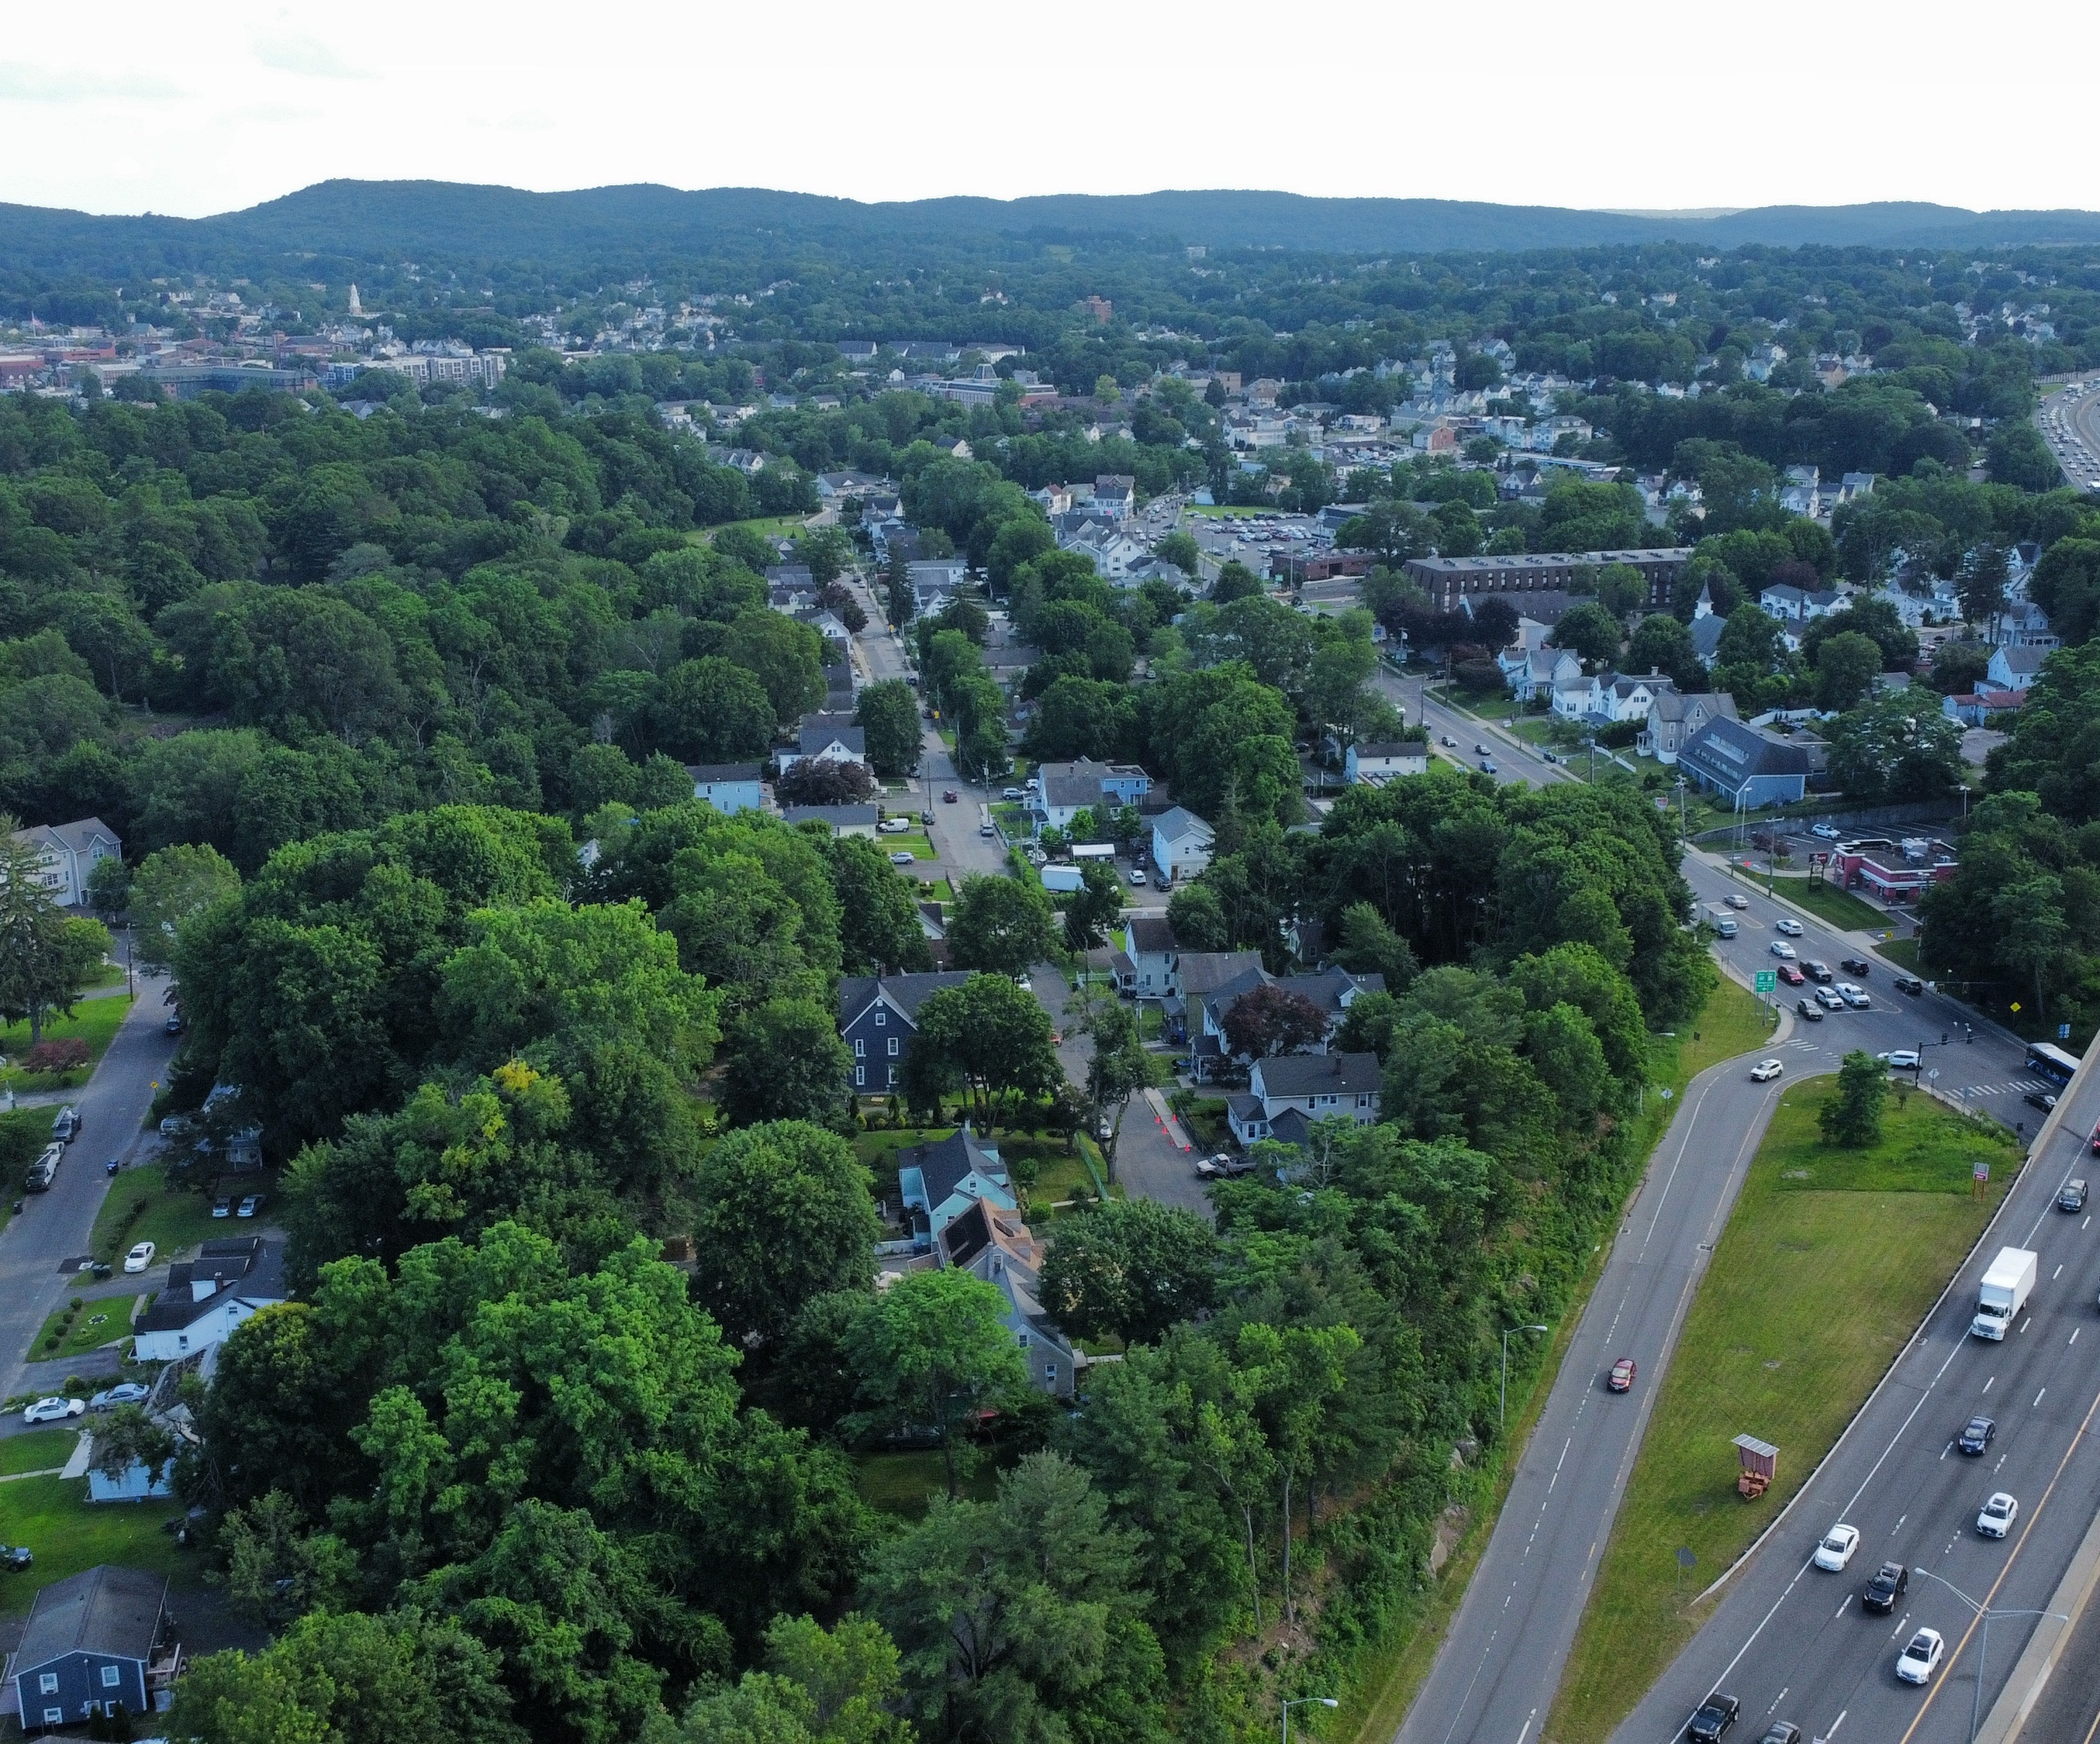
POCD Resilience Update
Public Act 25-33
[Date]

Slide 2
Agenda
Review:
  New resilience planning requirements for POCDs
  Resources from WestCOG to support resilience updates
Discuss and confirm:
  Hazard assessment results
  Resilience planning considerations
  Resilience vision
  Resilience strategies and actions
2

Slide 3
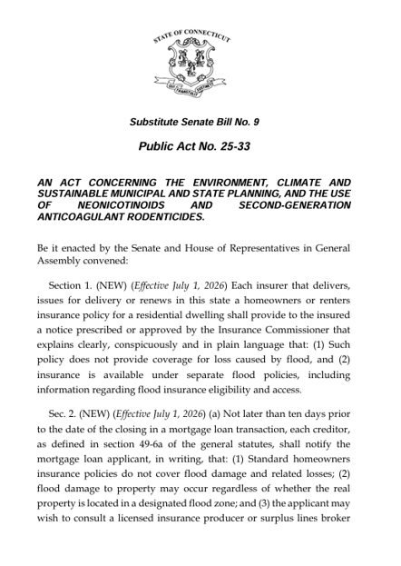
Public Act 25-33:
New Resilience Requirements
New content required in all POCDs adopted on or after October 1, 2027
POCDs must:
  Include a Vulnerability Assessment
  Identify:
    Resilience Goals
    Policies
    Projects
    Design Standards

Slide 4
New & Expanded POCD Requirements
Prior to October 1, 2027 | On or after October 1, 2027
Consider the most recent sea level change scenario for Connecticut | Consider the most recent hazard and climate projections
Recommend and map the most desirable use of land | Incorporate a climate change vulnerability assessment
 | Identify resilience goals, policies, and techniques
 | Document planning consistencies and inconsistencies
Recommend most desirable population density | Map vulnerability-informed land use
Note inconsistencies in management principles | Consider reductions in vehicle mileage
 | Identify infrastructure for evacuation and sustaining quality of life during a disaster
 | Identify risk reduction strategies and design standards
 | Include geospatial data

Slide 5
Optional POCD Resilience Strategies
Identify priority area(s) or asset(s) for implementation funding
Transfer of development rights program to increase resilience
Identify a Resiliency Improvement District

Slide 6
Why Integrate Resilience into POCDs
Advance resilience in development and natural resources management
Decrease disaster damage, stabilize tax base, increase financial sustainability
Data-backed
planning & policies
Demonstrate consistency in decision-making
6

Slide 7
Why Integrate Resilience into POCDs
Fulfill new State requirements (PA 25-33)
Position to align
with Housing Plans
Maintain eligibility for discretionary state funding
Straightforward compliance process
with new resources
7

Slide 8
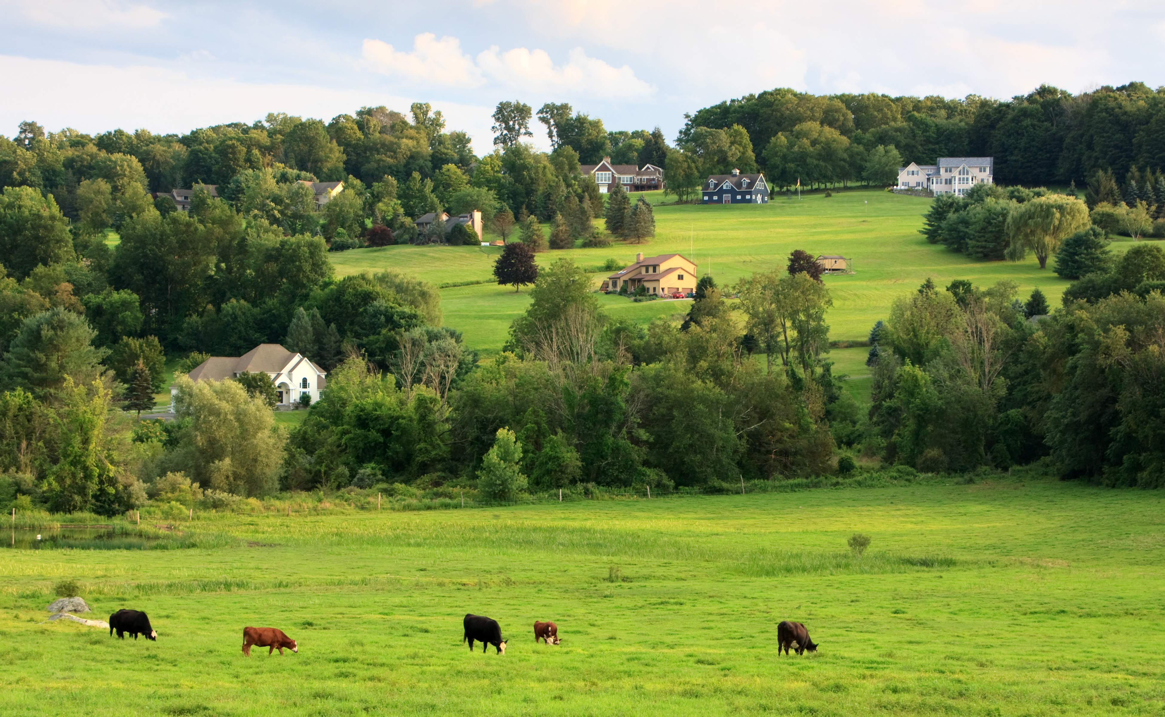
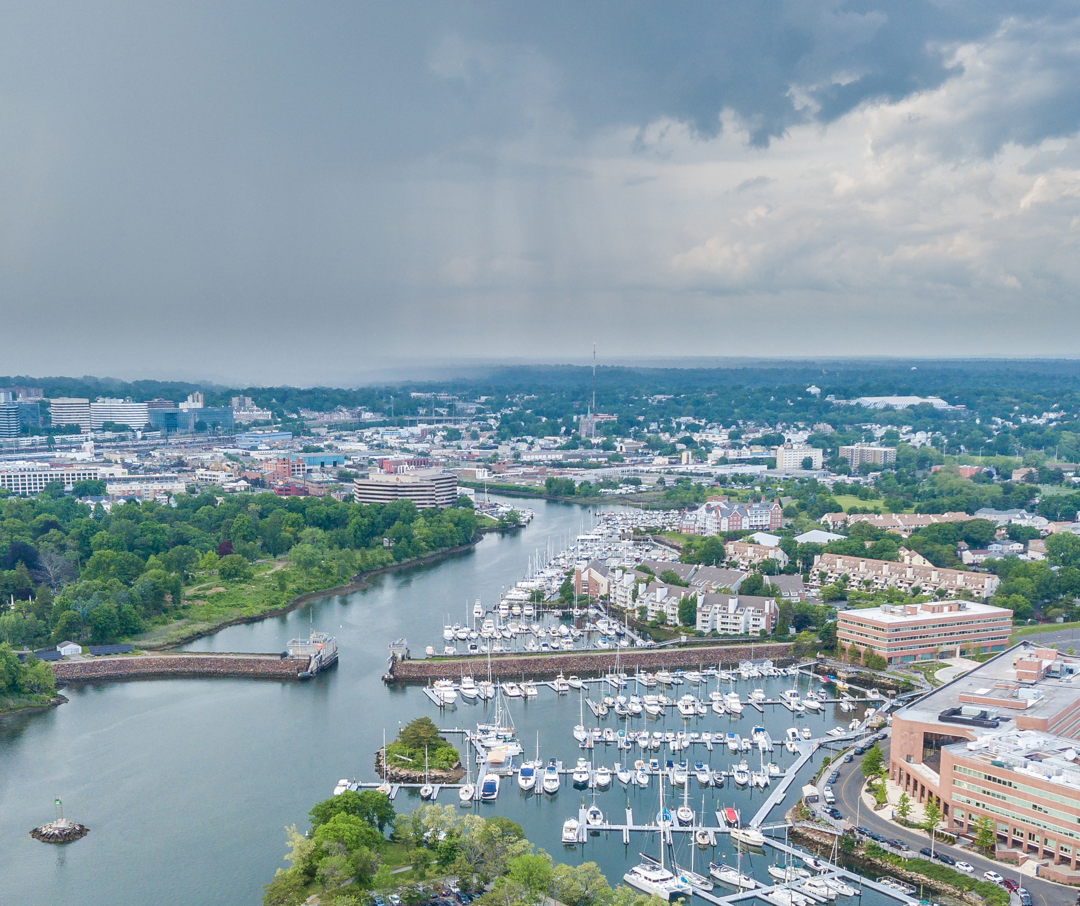
New Resources
POCD updates leverage the best available hazard data and planning resources from WestCOG
Model Resilience Chapter
  Example POCD chapter aligned with necessary updates
Municipal Hazard Maps and Data
  Datasets for 17 hazards
  Maps for floodplains, wildfire, and heat vulnerability
Implementation Guidance
  Instructions for using data resources and the Model Resilience Chapter
Summary Presentation Template
How to access?
Available from WestCOG: https://westcog.org/pocd-climate-provisions/
8

Slide 9
Hazard Assessment
Area Profile: [Coastal-Moderate]
Coastal Flooding
Extreme Heat
Extreme Storms
Drought
Rainfall-Driven Flooding
Riverine Flooding
Wildfire

Slide 10
Natural Hazard Risks
Hazards
Extreme Storm Events | Rainfall Flood | Riverine Flood | Coastal Flood | Extreme Heat | Drought | Wildfire
[Risk Level] | [Risk Level] | [Risk Level] | [Risk Level] | [Risk Level] | [Risk Level] | [Risk Level]

Slide 11
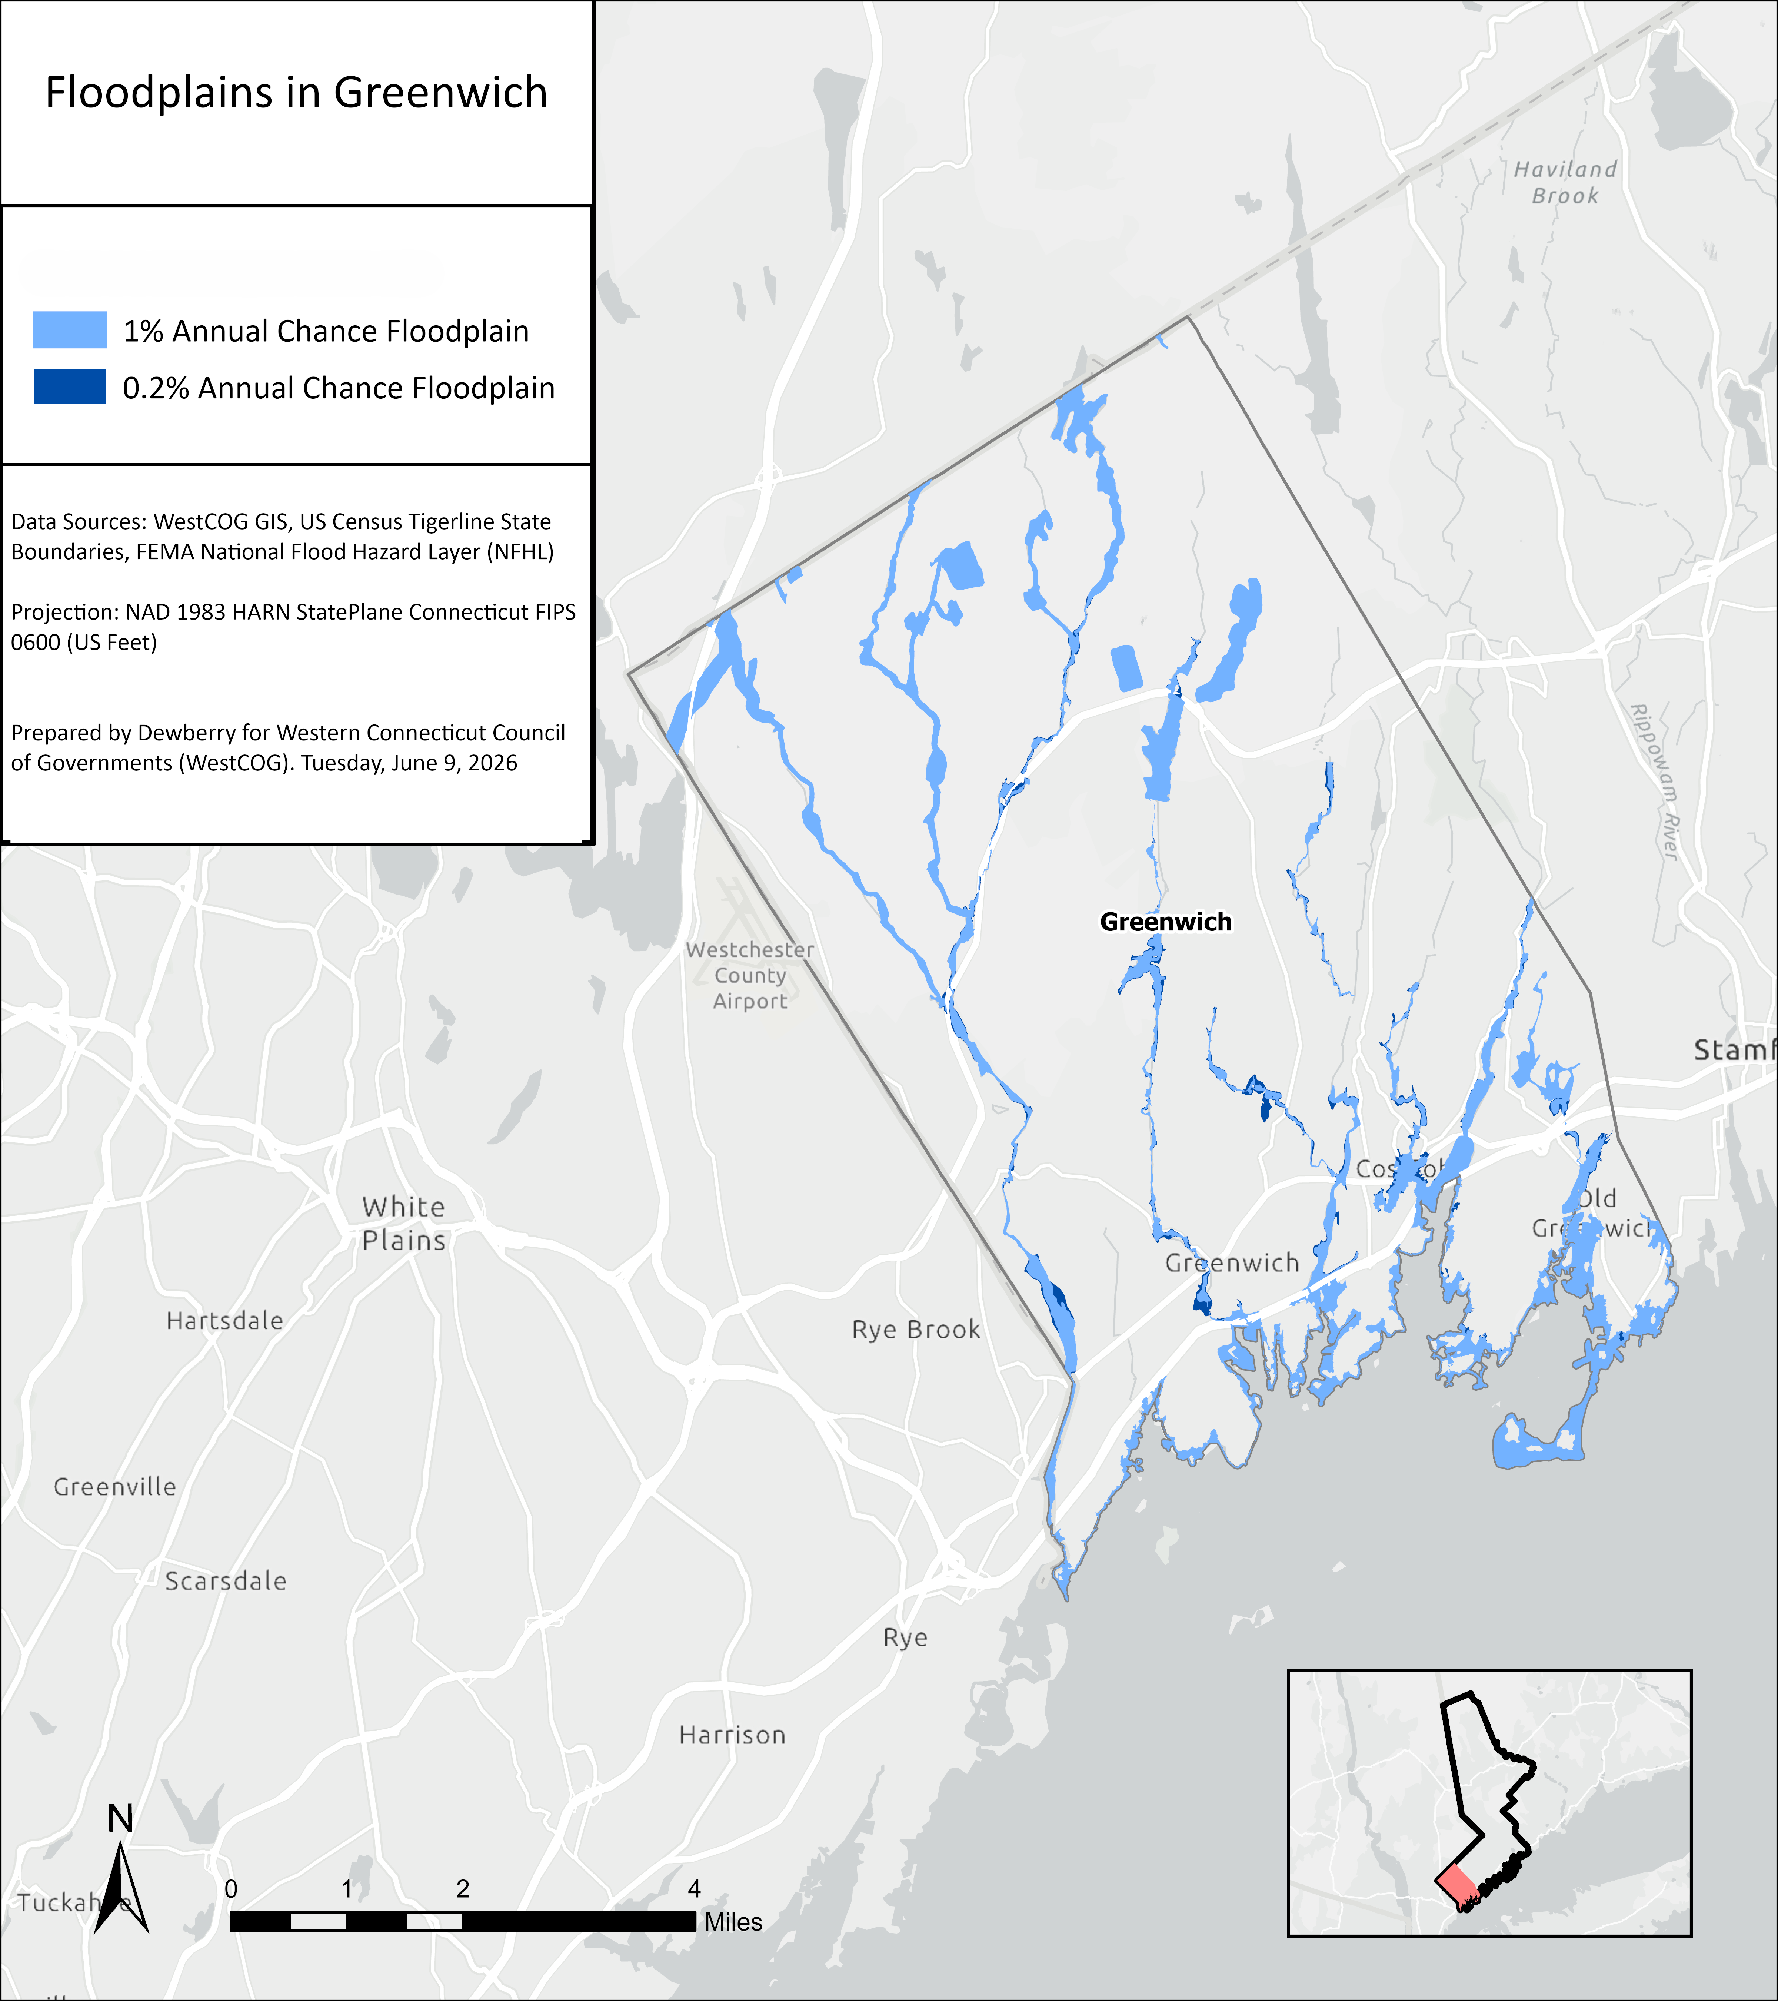
Flood
Maps
How should land use change based on hazard exposure?
[Example from Greenwich]

Slide 12
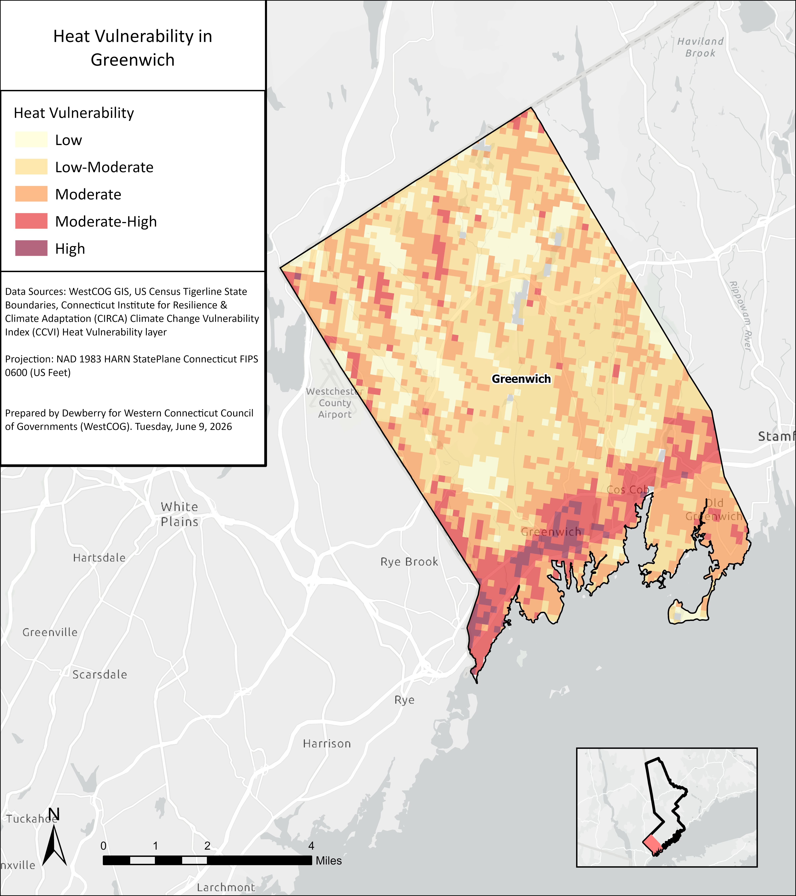
Heat
Maps
How should land use change based on hazard exposure?
[Example from Greenwich]

Slide 13
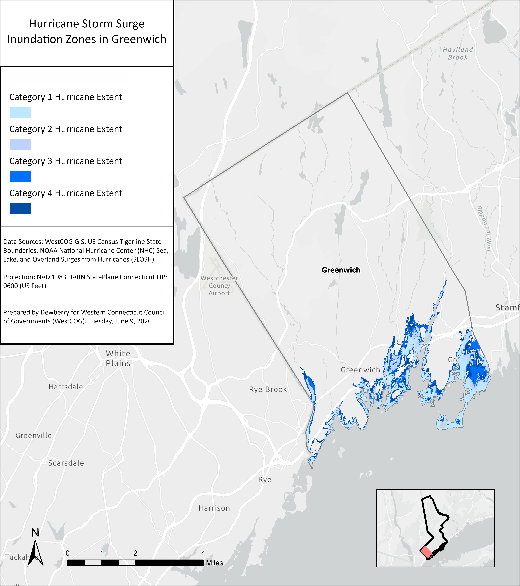
Hurricane
Maps
How should land use change based on hazard exposure?
[Example from Greenwich]

Slide 14
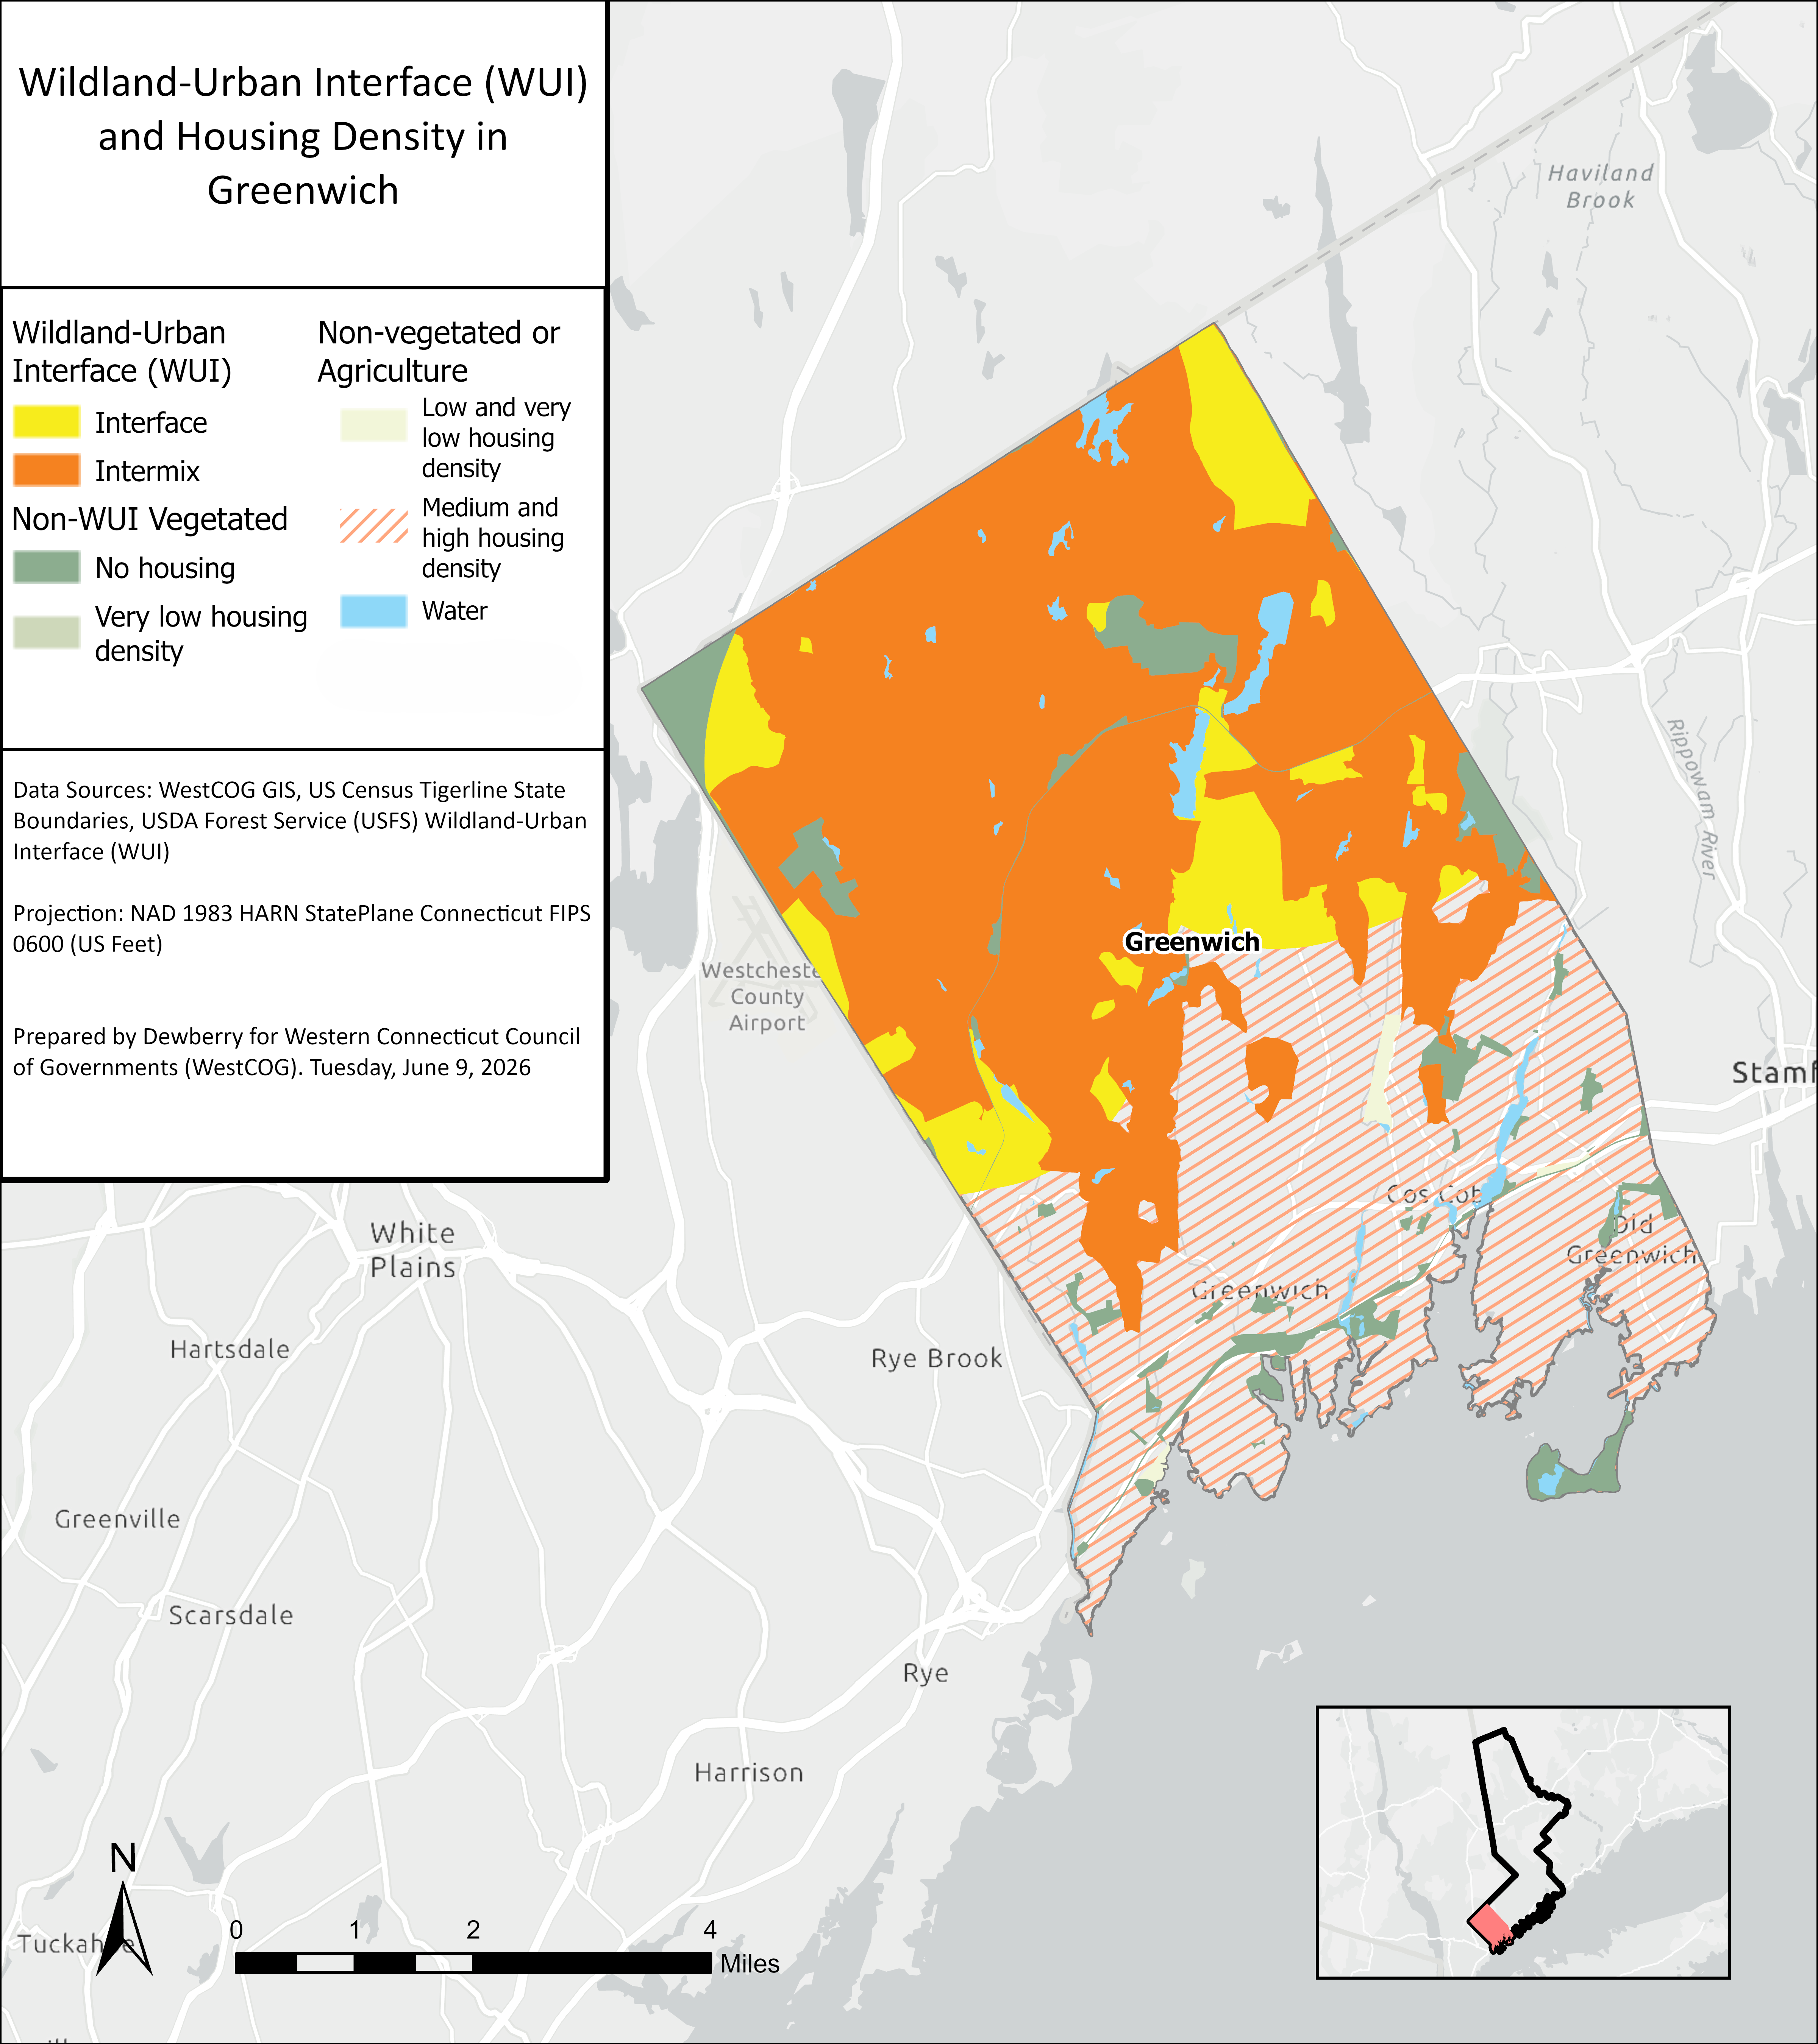
WUI
Maps
How should land use change based on hazard exposure?
[Example from Greenwich]

Slide 15
Vulnerability and Planning Considerations
Decreased access to commercial spaces during “sunny day flooding”
Public and community infrastructure:
Public safety,
health, and welfare
Reduced access or damage to emergency and evacuation routes
Economic development
and businesses
Impacts to water treatment facilities in high-hazard zones
Increased stress from experiencing repeated significant storm events
Increased amounts of storm debris
Agricultural losses from damaged fisheries/aquaculture
Additional costs of emergency response and recovery
Land loss
Road washouts and closures
Additional protection and repairs to historic sites
[Examples from a Coastal-Moderate Risk community]

Slide 16
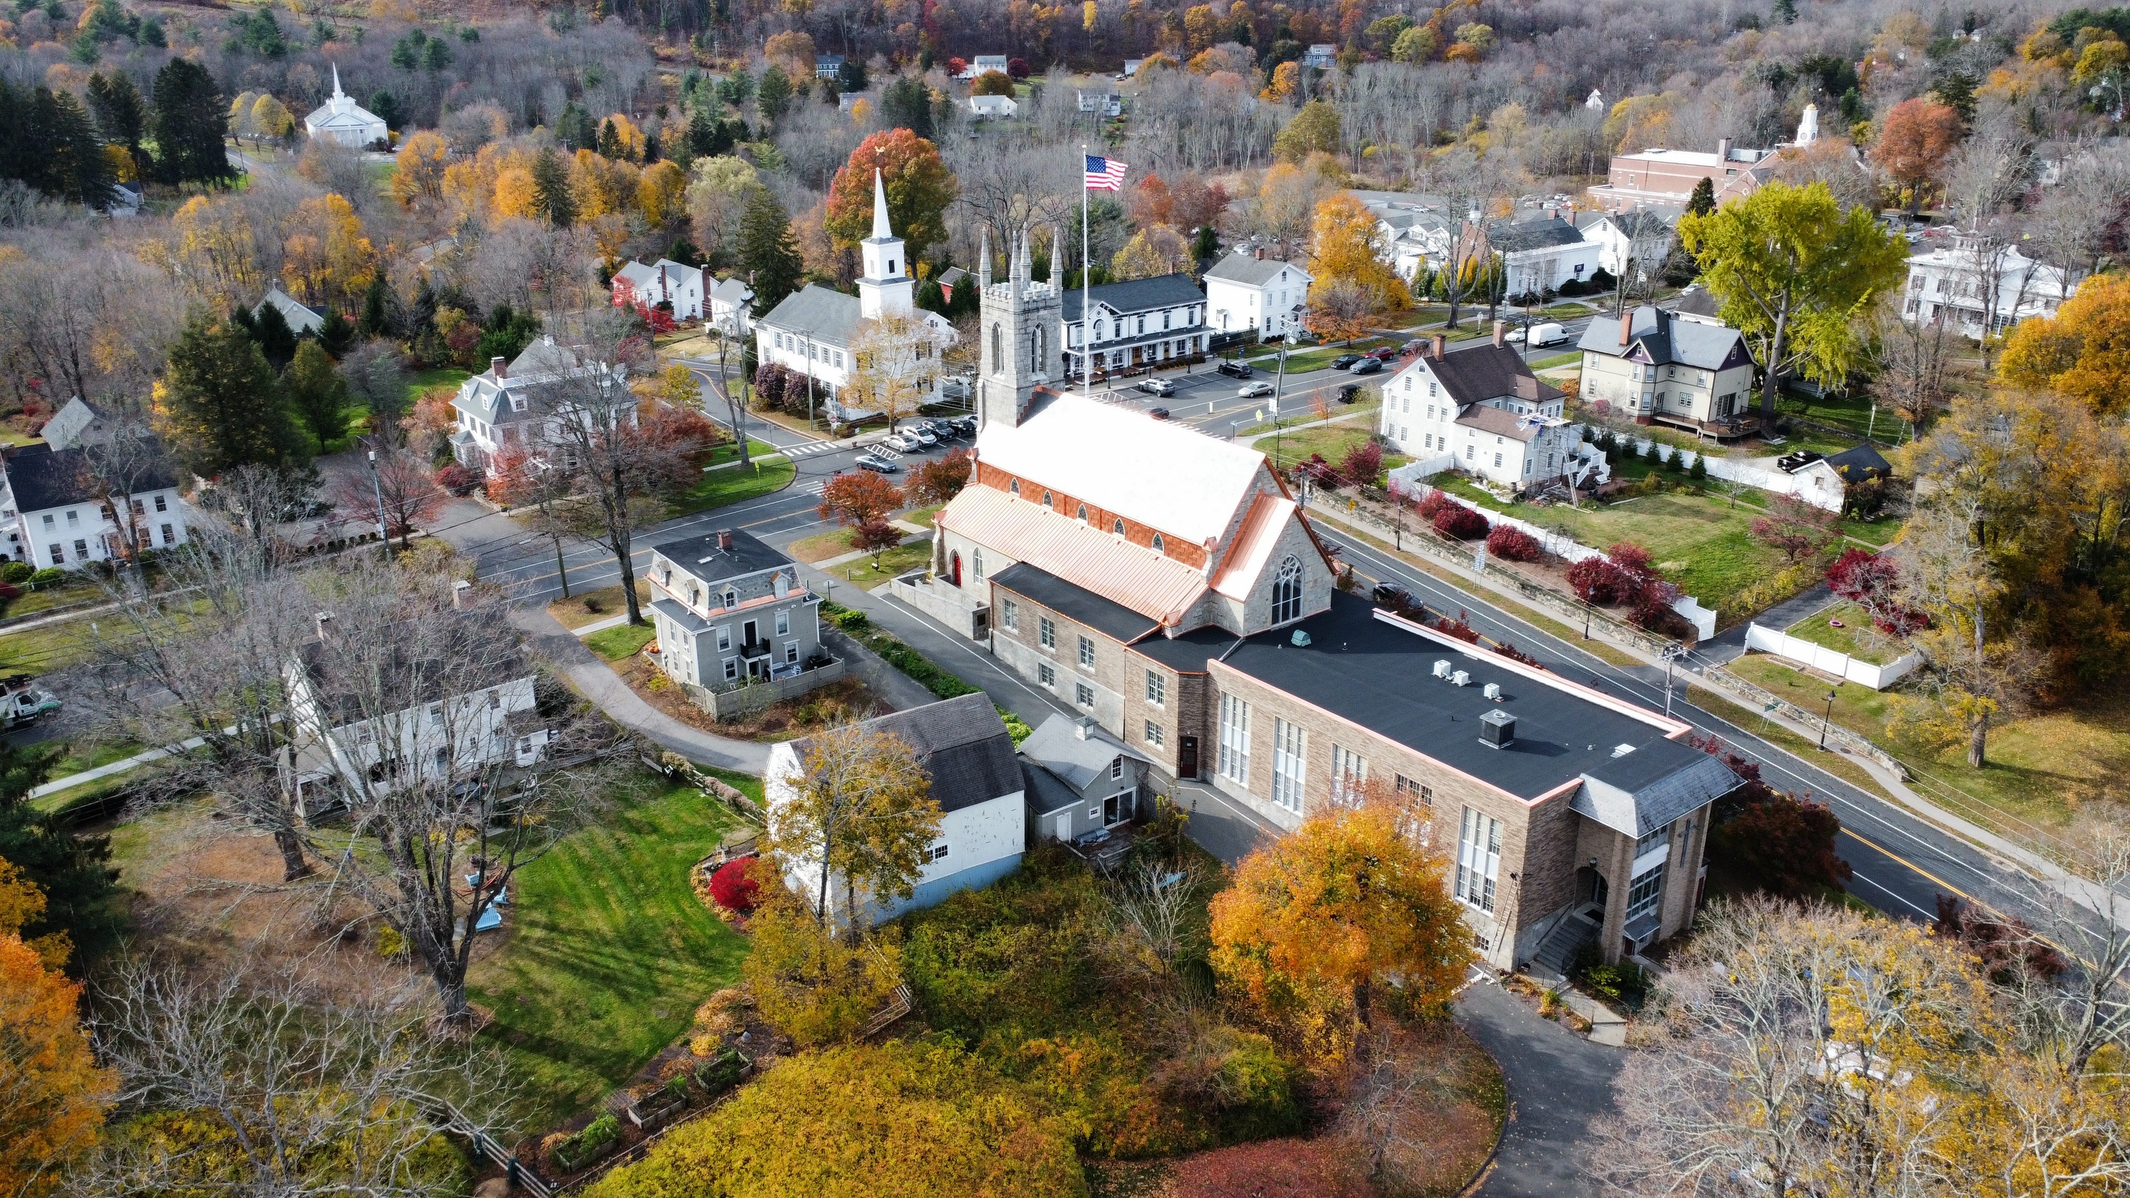
Resilience Vision
Vision Statement:
[Add your municipalities’ comprehensive vision statement and/or relevant guiding principles. Where possible, climate adaptation and resilience should be incorporated.]

Slide 17
Resilience Goals
[List the Municipality’s Resilience Goals. Review the list below and add/update as needed.
Protect Life Safety and Community Welfare
Reduce Flood Risk to People, Property, and Infrastructure
Protect and Restore Natural Systems
Foster a Climate-Adapted Built Environment
Strengthen Emergency Preparedness and Response
Improve Access to Resilience Solutions
Support Fiscal Resilience
Notes:
These are the main new requirements for POCDs.
Read through the slide, noting:
Data includes historical/current data as well as future-looking
The vulnerability assessment must be multi-hazard and consider the impacts of increased temperatures, drought, flooding, wildfire, storm damage, sea level rise, and saltwater intrusion (which is saline water moving into freshwater aquifers)
POCDs must include maps, including one that shows the municipality’s proposed land uses and vulnerability assessment results
Resilience strategies. This can, but doesn’t have to include, funding priorities top investment areas or assets
(Planning alignment/inconsistencies) with growth management principles of:
Maintaining public safety and evacuation routes
Revitalizing commercial corridors
Expanding housing opportunity and choice
Supporting transit-oriented development
Conserving natural, historical, and farmland resources
Aligning across all levels of government

Slide 18
Resilience Strategy and Actions
[Describe your community’s approach to managing natural hazard risks. Review the list below and add/edit as needed.]
Prioritizing stormwater infrastructure upgrades in the highest-risk and most socially vulnerable neighborhoods, focusing on increasing pipe capacity, modernizing inlets, and addressing outfall vulnerability.
Protecting and restoring riparian buffers and wetland systems through conservation acquisition, zoning overlays, and land use regulations that limit encroachment.
Implementing or expanding existing coastal buffer and setback zones that protect tidal wetlands from encroachment and reduce direct coastal flood exposure for new development.
[Add your community’s map of vulnerability-informed land use.]

Slide 19
Thank you!
Contact Information
Name | Organization | Email

